Slide 1
Writing and presenting Research
Lecture 29th

Slide 2
RECAP

Slide 3
Getting started with writing
Practical hints
Create time for your writing
Write when your mind is fresh
Find a regular writing place
Set goals and achieve them
Use word processing
Generate a plan for the report
Finish each writing session on a high point
Get friends to read and comment on your work

Slide 4
Structuring your research report
Suggested structure
Abstract
Introduction
Literature review
Method
Results
Discussion
Conclusions
References
Appendices

Slide 5
Writing for different audiences
Key differences between an ‘Academic’ report
and a ‘Consultancy’ or ‘Management’ report
The academic report:
Tends to be longer
Will be marked and graded
Will contain contextual descriptions
The consultancy report:
Has less focus on the development of theory
Contains recommendations relating to the organisation’s business

Slide 6
Research dissertation/report structure
The abstract
Four short paragraphs that answer the questions:
What were my research questions and why were they important? (Focus on the issue of research work)
How did I go about answering the research questions? (Methodology, study design and data)
What did I find out in response to these questions?
(Main results or findings of the study)
4. What conclusions can be drawn? (must be sharp conclusion)
Adapted from Saunders et al. (2009)

Slide 7
Report structure
2. Introduction
The research questions(s) and a clear statement of research objectives
Brief background and a guide to the storyline
3. Literature review - purpose
To set your study in the wider context
To show how your study supplements existing work

Slide 8
Report structure
4. Methodology
Participants
How many?
How were they selected?
What were their characteristics?
How were refusals/non-returns handled?
Materials
What tests/scales/interview or observation
schedules/questionnaires were used?
How were purpose-made instruments developed?
How were the resulting data analyzed?

Slide 9
Report structure
Methodology
Procedures
What were the characteristics of the interviewers and observers, and how were they trained?
How valid and reliable do you think the procedures were?
What instructions were given to participants?
How many interviews/observations/questionnaires were there; how long did they last; where did they take place?
When was the research carried out?

Slide 10
Report structure
5. Results chapter(s) - purpose
To report the facts your research discovered
To support the facts with quotes from participants/previous research findings
6. Discussion chapter- purpose
To interpret results and relate the findings to the original research goals and objectives
To indicate implications of the research

Slide 11
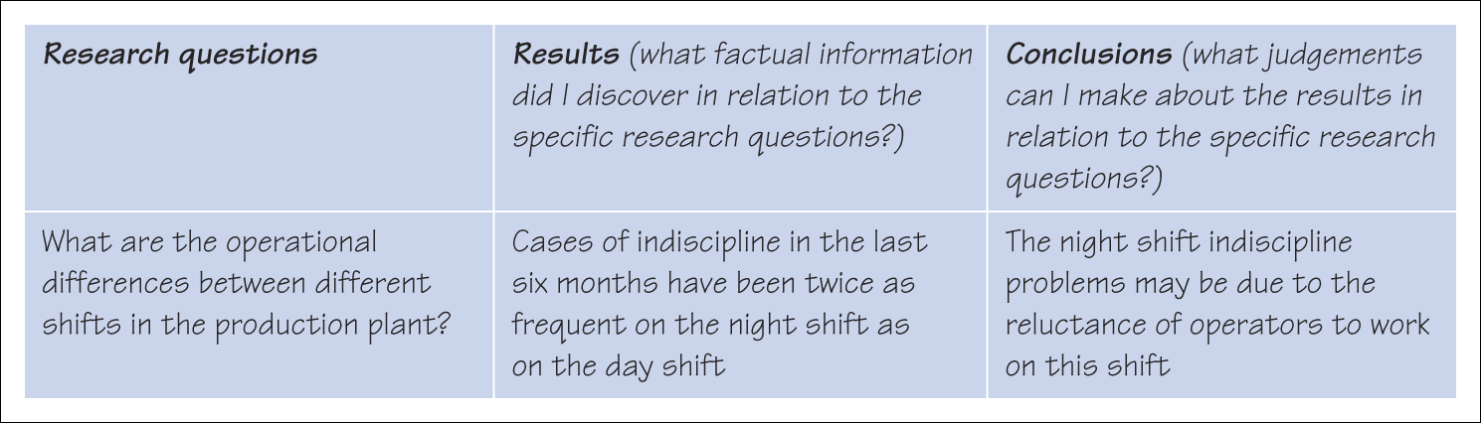
Report structure
Using a matrix in the planning of the content for the results and conclusions chapters
Saunders et al. (2009)
Figure 14.1 Using a matrix in the planning of the content for the results and conclusions chapters

Slide 12
Report structure
7. Conclusion chapter – purpose
To answer the research question(s)
To meet the research objectives
To consider the findings
To present any contributions to the topic displayed in the literature
To reflect on any implications for future research

Slide 13
Report structure
8. References
Use a convention that is accepted by your university (e.g. Harvard, APA, MLA, Chicago)
Cite all sources referred to in the text
Check all citations to prevent plagiarism
9. Appendices
Include only essential supporting material
Include copies of interview schedules
Keep appendices to a minimum

Slide 14
Organising the report content
Main points to consider
Choosing the title
Telling a clear story
Helping the reader by-
Dividing your work
Previewing and summarising chapters
Using suitable tables and graphics
Writing in a suitable style

Slide 15
Writing style
Key points:
Clarity and simplicity – avoid jargon
Checking grammar and spelling
Preserving anonymity
Regularly revising each draft

Slide 16
Summary
Writing is a creative process and a powerful way to clarifying your thinking
A project report needs a clear structure that helps to develop the storyline
All the information should be readily accessible to the reader

Slide 17
Summary
Use a clear writing style free and check for spelling and grammatical errors
Be prepared to rewrite the first draft several times
Remember to check the assessment criteria

