Slide 1
Qualitative Data Analysis
Lecture 27th

Slide 2
Recap

Slide 3
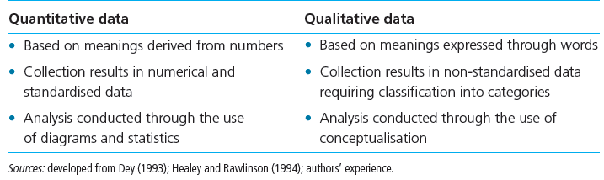
Difference

Slide 4
WHAT IS THE INTERPRETIVE WAY OF THINKING?
Multiple Realities
Data versus Information
Subjects versus Research Participants
Values

Slide 5
Multiple Realities
Many ways of “knowing”
  The researcher’s reality
  The research participant’s reality
  The mutual reality created when researcher and research participant interact
These multiple realities are dynamic (constantly changing)

Slide 6
Data Versus Information
Data
Units of evidence (such as facts, numbers, pictures) that are collected for the purposes of answering a research question
Information
Derived from data; it is the meaning or interpretation given to data

Slide 7
Subjects Versus Research Participants
Qualitative research places high value on the link between the individuals being studied and the data that they provide.
Data are considered in the context of the research participant’s reality.

Slide 8
Values
Value Awareness –
The ability to put aside your own values when you are conducting research studies or when you are evaluating the research results of others (sometimes called disinterestedness)
Qualitative research involves an immersion in values so that their inevitable effect can be better understood

Slide 9
Analyzing and Interpreting the Data
Qualitative data are typically in text form.
In the analysis, the aim is to:
  Reveal the true expressions of research participants
  Explanations should be in accordance with the beliefs and experiences of the research participants.
  “walk the walk” and “talk the talk” of the research participants.

Slide 10
Presentation and Dissemination of Findings
Qualitative research reports are typically lengthy.
Data are typically presented in the form of quotes or summary notes

Slide 11
Comparing Quantitative and Qualitative Approaches
Philosophical Differences
 | QUANT | QUAL
Reality | Objective | Subjective
Ways of “Knowing” | Deductive | Inductive
Value Base | Researcher Detached | Researcher Engaged
Application | Generalization | In-depth understanding

Slide 12
Perceptions of Reality
Quantitative
  People share common experiences that can be described objectively.
Qualitative
  People have unique experiences that can only be described subjectively by individuals

Slide 13
Ways of “Knowing”
Quantitative
  Knowledge is gained by closely examining specific parts of the experiences of many cases
Qualitative
  Knowledge is gained by closely examining whole experiences of just a few cases

Slide 14
Value Bases
Quantitative
  Researcher “suspends” all values and offers no personal meaning to the research participants or the data collected; Researcher and “subject” are separate
Qualitative
  The researcher attends to his or her personal values and their influence on the research process; Researcher and “research participant” are interconnected

Slide 15
Applications
Quantitative
  Research results are generalized to representative populations; “average” experiences for large groups of people are reported
Qualitative
  Research results give in-depth understanding of a few; detailed description is presented

Slide 16
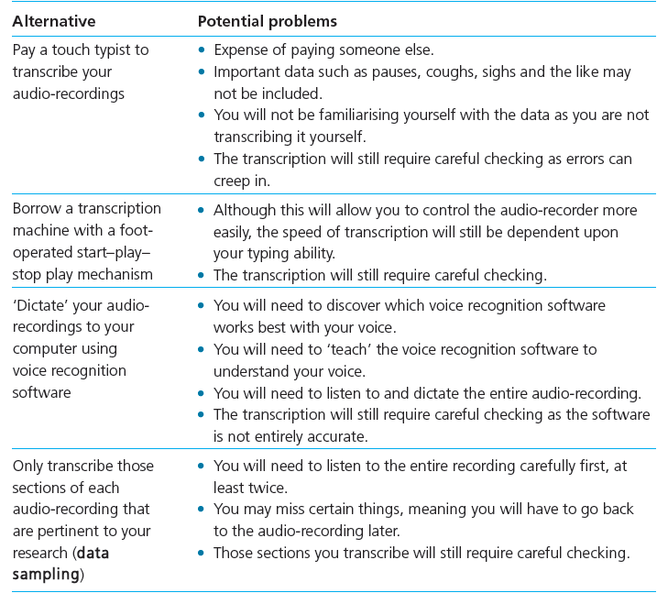
Transcribing Data

Slide 17
SUMMARY
Qualitative research is a respected approach to knowledge building.
Qualitative and quantitative research are complementary but are based on divergent principles.

