Slide 1
Data Exploration
Lecture 26th

Slide 2
Recap

Slide 3
Measures of Central Tendency
Mean
Median
Mode
Notes:
Central tendency is a measure of location. The common measures of central tendency include the mean, median, and mode.
The mean is the arithmetic average of a data distribution.
The median is the midpoint of a data distribution.
The mode is the most frequently occurring value in a distribution. There may be more than one mode in a distribution. When there is more than one score that has the highest yet equal frequency, the distribution is bimodal or multimodal.

Slide 4
Measure of Central Tendency
Central tendency is a measure of location.
The common measures of central tendency include the mean, median, and mode.
The mean is the arithmetic average of a data distribution.
The median is the midpoint of a data distribution.
The mode is the most frequently occurring value in a distribution. There may be more than one mode in a distribution.
When there is more than one score that has the highest yet equal frequency, the distribution is bimodal or multimodal.

Slide 5
Measures of Variability
Variance
Quartile
deviation
Standard
deviation
Dispersion
Interquartile
range
Range
Notes:
This slide lists the common measures of variability, also referred to as dispersion or spread.
The variance is a measure of score dispersion about the mean. If all the scores are identical, the variance is 0. The greater the dispersion of scores, the greater the variance. Variance is used with interval and ratio data. It is computed by summing the squared distance from the mean for all cases and dividing the sum by the total number of cases minus 1.
The standard deviation summarizes how far away from the average the data values typically are. It is the most frequently used measure of spread because it improves interpretability by removing the variance’s square and expressing deviations in their original units. It reveals the amount of variability within the data set. The standard deviation is calculated by taking the square root of the variance.
The range is the difference between the largest and smallest scores in the distribution.
The interquartile range (IQR) is the difference between the first and third quartiles of the distribution. It is also called the midspread.
The quartile deviation is always used with the median for ordinal data. It is helpful for interval or ratio data when the distribution is stretched by extreme values.

Slide 6
Measures of Variability
  The variance is a measure of score dispersion about the mean.
  If all the scores are identical, the variance is 0.
  The greater the dispersion of scores, the greater the variance.
  Variance is used with interval and ratio data.
  It is computed by summing the squared distance from the mean for all cases and dividing the sum by the total number of cases minus 1.

Slide 7
Measures of Variability
  The standard deviation summarizes how far away from the average the data values typically are.
  It is the most frequently used measure of spread because it improves interpretability by removing the variance’s square and expressing deviations in their original units.
  It reveals the amount of variability within the data set.
  The standard deviation is calculated by taking the square root of the variance.

Slide 8
Measures of Variability
  The range is the difference between the largest and smallest scores in the distribution.
  The inter-quartile range (IQR) is the difference between the first and third quartiles of the distribution.
  It is also called the mid spread.
  The quartile deviation is always used with the median for ordinal data.
  It is helpful for interval or ratio data when the distribution is stretched by extreme values.

Slide 9
Data Analysis
Exploratory
Confirmatory
In exploratory data analysis, the researcher has the flexibility to respond to the patterns revealed in the preliminary analysis of the data. Patterns in the collected data guide the data analysis or suggest revisions to the preliminary data analysis plan. This flexibility is an important attribute of this approach.
When the researcher is attempting to show causation, confirmatory data analysis is required. Confirmatory data analysis is an analytical process guided by classical statistical inference in its use of significance and confidence.

Slide 11
Data Exploration and Analysis
Data visualization is an integral element in the data analysis process and a necessary step prior to hypothesis testing.

Slide 12
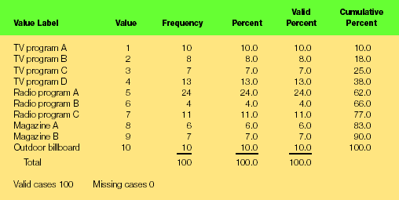
Frequency and Percentage: Example
Notes:
A frequency table is a simple device for arraying data. It arrays category codes from lowest value to highest value, with columns for count (frequency), percent, valid percent (percent when missing data is extracted), and cumulative percent.
Ad recall, a nominal variable, describes the ads research participants remembered seeing or hearing without being prompted by the researcher or the measurement instrument. Although there are 100 observations, the small number of media placements makes the variable easily tabled.
The same data are presented using a pie chart on the next slides.

Slide 13
Data Exploration
A frequency table is a simple device for arraying data.
It arrays category codes from lowest value to highest value, with columns for count (frequency), percent, valid percent (percent when missing data is extracted), and cumulative percent.
The ads research participants remembered seeing or hearing without being prompted by the researcher or the measurement instrument.
Although there are 100 observations, the small number of media placements makes the variable easily tabled.
The same data are presented using a pie chart on the next slides.

Slide 14
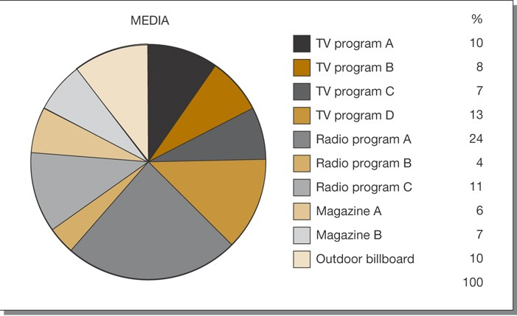
Pie Chart
Data may be more readily understood when presented graphically.

Slide 15
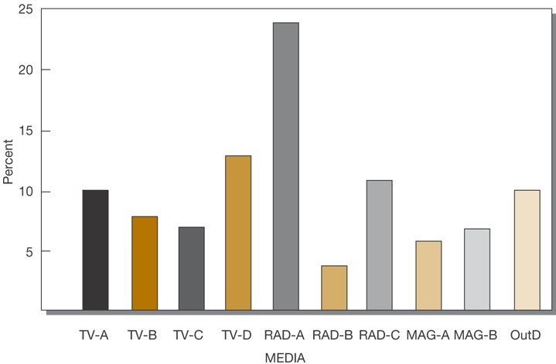
Bar Chart

Slide 16
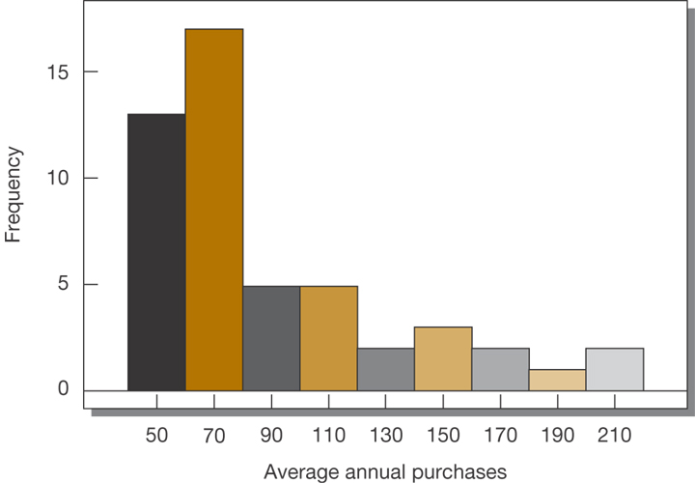
Histogram
A histogram is a graphical bar chart that groups continuous data values into equal intervals, with one bar for each interval.
Notes:
The histogram is the conventional solution for the display of interval-ratio data. Histograms are used when it is possible to group the variable’s values into intervals. A histogram is a graphical bar chart that groups continuous data values into equal intervals, with one bar for each interval.
Data analysts find histograms useful for 1) displaying all intervals in a distribution, even those without observed values, and 2) examining the shape of the distribution for skewness, kurtosis, and the modal pattern.
The values for the average annual purchases variable presented in the figure were measured on a ratio scale and are easily grouped. Histograms are not useful for nominal variables like ad recall that has no order to its categories.

Slide 17
Histogram
The histogram is the conventional solution for the display of interval-ratio data.
Histograms are used when it is possible to group the variable’s values into intervals.
A histogram is a graphical bar chart that groups continuous data values into equal intervals, with one bar for each interval.

Slide 18
Histogram
Data analysts find histograms useful for
displaying all intervals in a distribution, even those without observed values, and
examining the shape of the distribution for skewness, kurtosis, and the modal pattern.
The values for the average annual purchases variable presented in the figure were measured on a ratio scale and are easily grouped.
Histograms are not useful for nominal variables that has no order to its categories.

Slide 19
Summary

