Slide 1
Data Preparation and Description
Lecture 25th

Slide 2
RECAP

Slide 3
Data Preparation and Description

Slide 4
Codebook
Coding involves assigning numbers or other symbols to answers so that the responses can be grouped into a limited number of categories.
In coding, categories are the partitions of a data set of a given variable. For instance, if the variable is gender, the categories are male and female.
Categorization is the process of using rules to partition a body of data. Both closed and open questions must be coded.

Slide 5
Codebook
Numeric coding simplifies the researcher’s task in converting a nominal variable like gender to a “dummy variable.”
A codebook contains each variable in the study and specifies the application of coding rules to the variable.
It is used by the researcher or research staff to promote more accurate and more efficient data entry.
It is the definitive source for locating the positions of variables in the data file during analysis.

Slide 6
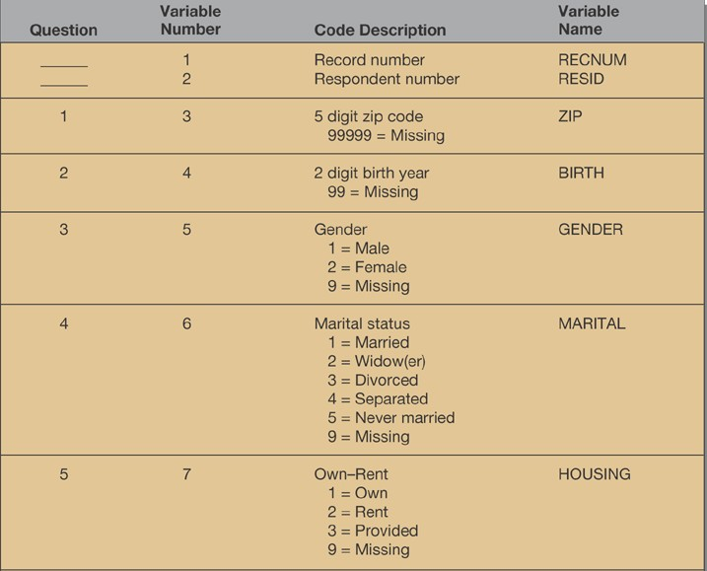
Sample Codebook

Slide 7
Precoding
Precoding means assigning codebook codes to variables in a study and recording them on the questionnaire.
With a precoded instrument, the codes for variable categories are accessible directly from the questionnaire.

Slide 8
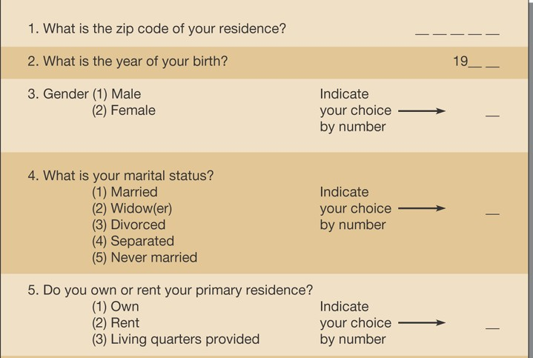
Sample Precoded Instrument

Slide 9
Coding Open-Ended Questions
One of the primary reasons for using open-ended questions is that insufficient information or lack of a hypothesis may prohibit preparing response categories in advance.
Researchers are forced to categorize responses after the data are collected.
In the Figure on the next slide, question 6 illustrates the use of an open-ended question.
After preliminary evaluation, response categories were created for that item.
They can be seen in the codebook.

Slide 10
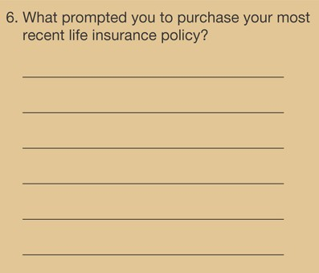
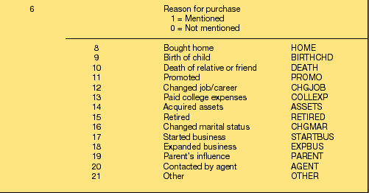
Coding Open-Ended Questions

Slide 11
Coding Rules
Exhaustive
Appropriate to the
research problem
Categories
should be
e.g. other
every option in the category set is defined in terms of one concept or construct
Mutually exclusive
Derived from one
classification principle
Notes:
Appropriateness is determined at two levels: 1) the best partitioning of the data for testing hypotheses and showing relationships and 2) the availability of comparison data.
Researchers often add an “other” option to a measurement question because they know they cannot anticipate all possible answers.
The need for a category set to follow a single classification principle means that every option in the category set is defined in terms of one concept or construct.

Slide 12
Content Analysis
Content analysis measures the semantic content or the what aspect of a message.
It is used for open-ended questions.

Slide 13
Types of Content Analysis
Syntactical
can be words, phrases, sentences, or paragraphs.
Referential
Are described by words, phrases, and sentences and may be objects, events, persons, etc.
e.g., Three miles island
Propositional
are assertions about an object, event, or person.
e.g., Magazine saves Rs. 3000 per month
Thematic
topics contained within and across texts.
Reflecting a temporal theme, e.g., I used to purchase product A , I really like the new packaging of Product B.

Slide 14
Handling “Don’t Know” Responses
When the number of “don’t know” (DK) responses is low, it is not a problem.
However, if there are several given, it may mean that the question was poorly designed, too sensitive, or too challenging for the respondent.
The best way to deal with undesired DK answers is to design better questions at the beginning.
If DK response is legitimate, it should be kept as a separate reply category.

Slide 15
Frequencies
Unit Sales Increase (%) | Frequency | Percentage | Cumulative Percentage
5 6 7 8 9 Total | 1 2 3 2 1 9 | 11.1 22.2 33.3 22.2 11.1 100.0 | 11.1 33.3 66.7 88.9 100
Notes:
A frequency table arrays category codes from lowest value to highest value, with columns for count, percent, percent adjusted for missing values, and cumulative percent. A frequency distribution is an ordered array of all values for a variable.
The table arrays data by assigned numerical value, in this case the actual percentage unit sales increase recorded. To discover how many manufacturers were in each unit sales increase category, read the frequency column. The cumulative percentage reveals the number of manufacturers that provided a response and any others that preceded it in the table. This column is helpful when the data have an underlying order. The proportion is the percentage of elements in the distribution that a criterion. In the example, the criterion is the origin of manufacture.

Slide 16
Frequencies
A frequency table arrays category codes from lowest value to highest value, with columns for count, percent, percent adjusted for missing values, and cumulative percent.
A frequency distribution is an ordered array of all values for a variable.
The table arrays data by assigned numerical value, in this case the actual percentage unit sales increase recorded.

Slide 17
Frequencies
To discover how many manufacturers were in each unit sales increase category, read the frequency column.
The cumulative percentage reveals the number of manufacturers that provided a response and any others that preceded it in the table.
This column is helpful when the data have an underlying order. The proportion is the percentage of elements in the distribution that a criterion.
In the example, the criterion is the origin of manufacture.

Slide 18
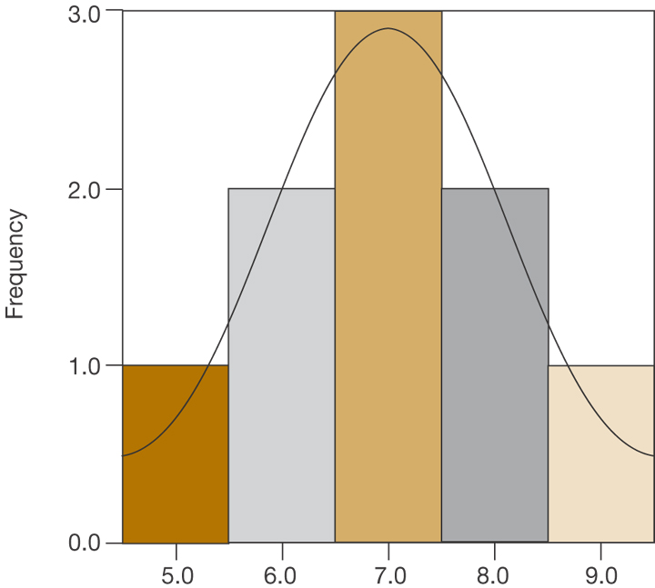
Distributions
Notes:
Many variables of interest that researchers will measure will have distributions that approximate a standard normal distribution. A standard normal distribution is a special case of the normal distribution in which all values are given standard scores. The distribution has a mean of 0 and a standard deviation of 1. A standard score (z score) conveys how many standard deviation units a case is above or below the mean. The Z score, being standardized, allows the comparison of the results of different normal distributions.

Slide 19
Distributions
Many variables of interest that researchers will measure will have distributions that approximate a standard normal distribution.
A standard normal distribution is a special case of the normal distribution in which all values are given standard scores.
The distribution has a mean of 0 and a standard deviation of 1.
A standard score (z score) conveys how many standard deviation units a case is above or below the mean.
The Z score, being standardized, allows the comparison of the results of different normal distributions.

Slide 20
Measures of Central Tendency
Mean
Median
Mode
Notes:
Central tendency is a measure of location. The common measures of central tendency include the mean, median, and mode.
The mean is the arithmetic average of a data distribution.
The median is the midpoint of a data distribution.
The mode is the most frequently occurring value in a distribution. There may be more than one mode in a distribution. When there is more than one score that has the highest yet equal frequency, the distribution is bimodal or multimodal.

Slide 21
Measure of Central Tendency
Central tendency is a measure of location.
The common measures of central tendency include the mean, median, and mode.
The mean is the arithmetic average of a data distribution.
The median is the midpoint of a data distribution.
The mode is the most frequently occurring value in a distribution. There may be more than one mode in a distribution.
When there is more than one score that has the highest yet equal frequency, the distribution is bimodal or multimodal.

