Slide 1
Quantitative Data Analysis
Lecture 23rd

Slide 2
RECAP

Slide 3
Example of Figure

Slide 4
Example of Figure: Comparison

Slide 5
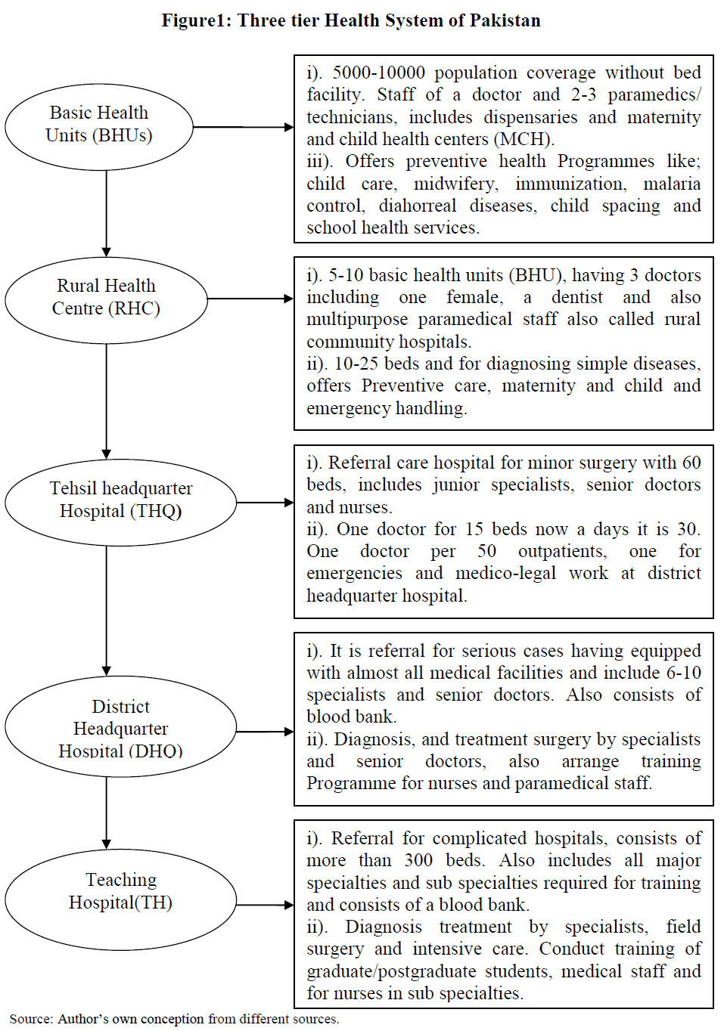
Health System of Pakistan
Primary
1st Tier
2nd Tier
Secondary
Tertiary
3rd Tier

Slide 6
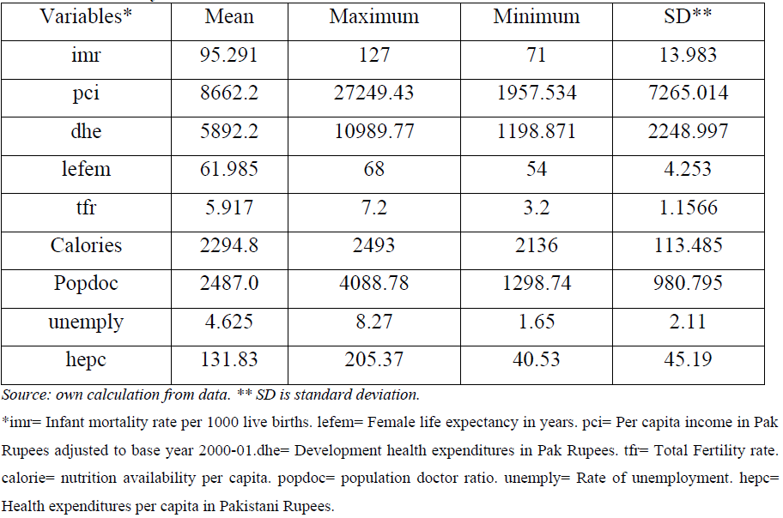
Example of Table: Summary Statistics

Slide 7
Designing Diagrams and Tables
For diagrams
Does it have clear axis labels?
Are bars and their components in the same logical sequence?
Is more dense shading used for smaller areas?
Have you avoided misrepresenting or distorting the data Is a key or legend included (where necessary)?

Slide 8
Designing Diagrams and Tables
For tables
Does it have clear column and row headings?
Are columns and rows in a logical sequence?

Slide 9
Designing Diagrams and Tables
It best to begin exploratory analysis by looking at individual variables and their components.
The key aspects you may need to consider will be guided by your research question(s) and objectives, and are likely to include (Sparrow 1989):
specific values; highest and lowest values; trends over time; proportions; distributions.

Slide 10
Designing Diagrams and Tables
Once you have explored these, you can then begin to compare and look for relationships between variables, considering in addition (Sparrow 1989):
conjunctions (the point where values for two or more variables intersect);
totals;
interdependence and relationships.

Slide 11
Summary
• Data for quantitative analysis can be collected and subsequently coded at different scales of measurement.
The data type (precision of measurement) will constrain the data presentation, summary and analysis techniques you can use.
• Data are entered for computer analysis as a data matrix in which each column usually represents a variable and each row a case.
Your first variable should be a unique identifier to facilitate error checking.

Slide 12
Summary
Your data matrix must be checked for errors.
Your initial analysis should explore data using both tables and diagrams.
Your choice of table or diagram will be influenced by your research question(s) and objectives, the aspects of the data you wish to emphasize, and the scale of measurement at which the data were recorded.
This may involve using:
– tables to show specific values;
– bar charts, multiple bar charts, histograms and,
- occasionally pictograms to show highest and the lowest values

Slide 13
Summary
– line graphs to show trends;
– pie charts and percentage component bar charts to show proportions;
– box plots to show distributions;
– scatter graphs to show relationships between variables

Slide 14
Summary
All data should, with few exceptions, be recorded using numerical codes to facilitate analyses.
• Where possible, you should use existing coding schemes to enable comparisons.
• For primary data you should include pre-set codes on the data collection form to minimize coding after collection.
For variables where responses are not known, you will
need to develop a codebook after data have been collected
for the first 50 to 100 cases.

