Slide 1
Analyzing Quantitative Data
Lecture 21st

Slide 2
Recap
Questionnaires are often used to collect descriptive and explanatory data
Five main types of questionnaire are Internet- or intra-net mediated, postal, delivery and collection, telephone and interview schedule
Precise data that meet the research objectives can be produced by using a data requirements table

Slide 3
Recap
Data validity and reliability and response rate depend on design, structure and rigorous pilot testing
Wording and order of questions and question types are important considerations
Closed questions should be pre-coded to facilitate data input and analysis

Slide 4
Recap
Important design features are a clear layout, a logical order and flow of questions and easily completed responses
Questionnaires should be carefully introduced and pilot tested prior to administration
Administration needs to be appropriate to the type of questionnaire

Slide 5
Analyzing Quantitative Data
Lecture 21st

Slide 6
Preparing, inputting and checking data
If you intend to undertake quantitative analysis consider the following:
type of data (scale of measurement);
format in which your data will be input to the analysis software; SPSS, EVIEWS, STATA, NVIVO.
impact of data coding on subsequent analyses (for different data types);
methods you intend to use to check data for errors.

Slide 7
Quantitative Data
Quantitative data can be divided into two distinct groups: categorical and numerical.
Categorical data refer to data whose values cannot be measured numerically but can be either classified into sets (categories) according to the characteristics that identify or describe the variable or placed in rank order (Berman Brown and Saunders 2008).

Slide 8
Quantitative Data
They can be further sub-divided into descriptive and ranked.
A car manufacturer might categorise the types of cars it produces as hatchback, saloon and estate. These are known as descriptive data or nominal data as it is impossible to define the category numerically or to rank it.
Rather these data simply count the number of occurrences in each category of a variable.
For virtually all analyses the categories should be unambiguous and discrete; in other words, having one particular feature, such as a car being a hatchback, excludes all other features for that variable. This prevents questions arising as to which category an individual case belongs.

Slide 9
Quantitative Data
Although, these data are purely descriptive, you can count them to establish which category has the most and whether cases are spread evenly between categories (Morris 2003).
Some statisticians (and statistics) also separate descriptive data where there are only two categories. These are known as dichotomous data, as the variable is divided into two categories, such as the variable gender being divided into female and male.
Ranked (or ordinal) data are a more precise form of categorical data.

Slide 10
Quantitative Data
Numerical data, which are sometimes termed quantifiable’, are those whose values are measured or counted numerically as quantities (Berman Brown and Saunders 2008).
This means that numerical data are more precise than categorical as you can assign each data value a position on a numerical scale. It also means that you can analyse these data using a far wider range of statistics.
There are two possible ways of sub-dividing numerical data: into interval or ratio data and, alternatively, into continuous or discrete data.

Slide 11
Quantitative Data
If you have interval data you can state the difference or ‘interval’ between any two data values for a particular variable, but you cannot state the relative difference.
This means that values on an interval scale can meaningfully be added and subtracted, but not multiplied and divided.
The Celsius temperature scale is a good example of an interval scale.
Although the difference between, say, 20°C and 30°C is 10°C it does not mean that 30°C is one and a half times as warm.

Slide 12
Quantitative Data
In contrast, for ratio data, you can also calculate the relative difference or ratio between any two data values for a variable.
Consequently, if a multinational company makes a profit of $300 000 000 in one year and $600 000 000 the following year, we can say that profits have doubled.

Slide 13
Quantitative Data
Continuous data are those whose values can theoretically take any value (sometimes within a restricted range) provided that you can measure them accurately enough (Dancey and Reidy 2008).
Data such as furnace temperature, delivery distance and length of service are therefore continuous data.
Discrete data can, by contrast, be measured precisely.
Each case takes one of a finite number of values from a scale that measures changes in discrete units.

Slide 14
Quantitative Data
Understanding differences between types of data is extremely important when analysing your data quantitatively, for two reasons.
Firstly, it is extremely easy with analysis software to generate statistics from your data that are inappropriate for the data type and are consequently of little value.
Secondly, the more precise the scale of measurement, the greater the range of analytical techniques available to you.

Slide 15
Quantitative Data
Data that have been collected and coded using a precise numerical scale of measurement can also be regrouped to a less precise level where they can also be analyzed.
For example, a student’s score in a test could be recorded as the actual mark (discrete data) or as the position in their class (ranked data).

Slide 17
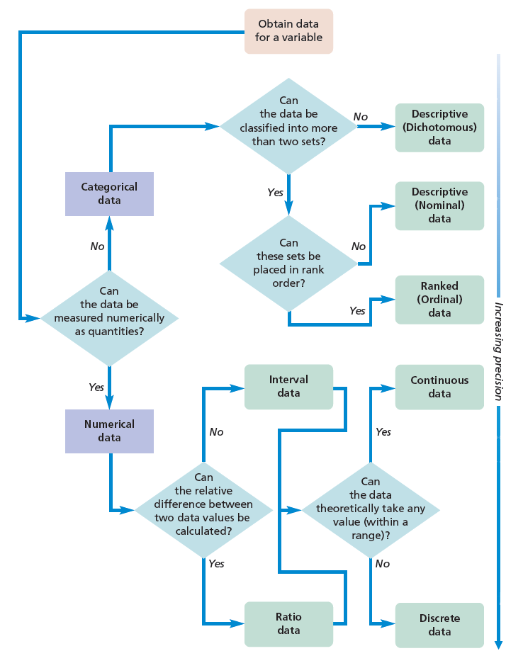
Quantitative Data

