Slide 1
Collecting primary data: use of questionnaires
Lecture 20th

Slide 2
Recap
When to use questionnaires?
For explanatory or descriptive research.
Linked with other methods in a multiple-methods research design.
To collect responses from a large sample prior to quantitative analysis.

Slide 3
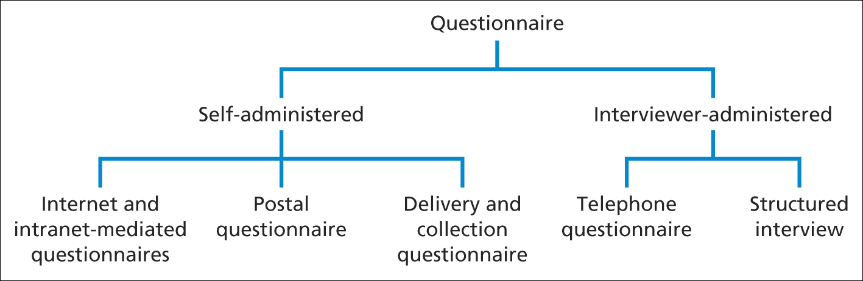
Recap
Type of Questionnaire

Slide 4
Designing individual questions
Some of the important considerations are as follows;
Adopting or adapting existing questions – remember to check copyright
Question wording
Translating questions into other languages
Question coding

Slide 5
Designing individual questions
Does your question collect data at the right level of detail to answer your investigative question as specified in your data requirements table?
Will respondents have the necessary knowledge to answer your question? A question on the implications of a piece of European Union legislation would yield meaningless answers from those who were unaware of that legislation.
Does your question talk down to respondents? It should not!
Are the words used in your question familiar, and will all respondents understand them in the same way? In particular, you should use simple words and avoid jargon, abbreviations and colloquialisms.
Are there any words that sound similar and might be confused with those used in your question? This is a particular problem with interviewer administered
questionnaires.

Slide 6
Designing individual questions
Are there any words that look similar and might be confused if your question is read quickly? This is particularly important for self-administered questionnaires.
Are there any words in your question that might cause offence? These might result in biased responses or a lower response rate.
Can your question be shortened? Long questions are often difficult to understand, especially in interviewer-administered questionnaires, as the respondent needs to remember the whole question. Consequently, they often result in no response at all.

Slide 7
Designing individual questions
Are you asking more than one question at the same time? The question ‘How often do you visit your mother and father?’ contains two separate questions, one about each parent, so responses would probably be impossible to interpret.
Does your question include a negative or double negative? Questions that include the word ‘not’ are sometimes difficult to understand. The question ‘Would you rather not use a non-medicated shampoo?’ is far easier to understand when rephrased as: ‘Would you rather use a medicated shampoo?’
Is your question unambiguous? This can arise from poor sentence structure, using words with several different meanings or having an unclear investigative question. If you ask ‘When did you leave school?’ some respondents might state the year, others might give their age, while those still in education might give the time of day!

Slide 8
Translating Questionnaire
When translating the source questionnaire attention should be paid to:
• lexical meaning – the precise meaning of individual words (e.g. the French word chaud can be translated into two concepts in English and German, ‘warm’ and ‘hot’);
• idiomatic meaning – the meanings of a group of words that are natural to a native speaker and not deducible from those of the individual words (e.g. the English expression for informal communication, ‘grapevine’, has a similar idiomatic meaning as the

Slide 9
Translating Questionnaire
French expression téléphone arabe, meaning literally ‘arab telephone’ and the German expression Mundpropaganda, meaning literally ‘mouth propaganda’);
• Experiential meaning – the equivalence of meanings of words and sentences for people in their everyday experiences (e.g. terms that are familiar in the source questionnaire’s context such as ‘dual career household’ may be unfamiliar in the target questionnaire’s context);
• grammar and syntax – the correct use of language, including the ordering of words and phrases to create well-formed sentences (e.g. in Japanese the ordering is quite different from English or Dutch, as verbs are at the end of sentences).

Slide 10
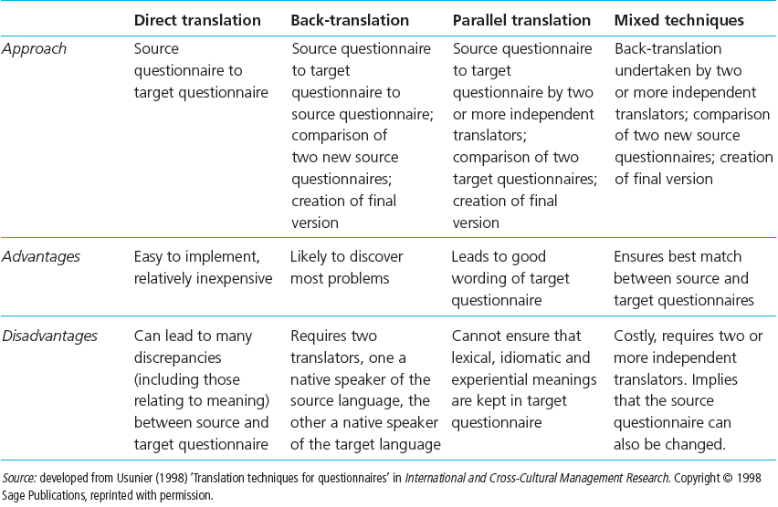
Translating Questionnaire

Slide 11
Constructing the questionnaire
Main considerations
Order and flow of questions
Questionnaire layout

Slide 12
Order of Questions
Are questions at the beginning of your questionnaire more straightforward and ones the respondent will enjoy answering? Questions about attributes and behaviors are usually more straightforward to answer than those collecting data on opinions.
Are questions at the beginning of your questionnaire obviously relevant to the stated purpose of your questionnaire? For example, questions requesting contextual information may appear irrelevant.
Are questions and topics that are more complex placed towards the middle of your questionnaire? By this stage most respondents should be completing the survey with confidence but should not yet be bored or tired.

Slide 13
Order of Questions
Are filter questions and routing instructions easy to follow so that there is a clear route through the questionnaire? (For interviewer-administered questionnaires) Are instructions to the interviewer easy to follow?
Are questions grouped into obvious sections that will make sense to the respondent?
Have you re-examined the wording of each question and ensured it is consistent with its position in the questionnaire as well as with the data you require?

Slide 14
Explaining the purpose and testing
Key points
The covering letter
Introducing and closing the questionnaire
Pilot testing and assessing validity

Slide 15
Administering the questionnaire
Points to consider
Internet and intranet-mediated responses
Postal questionnaires
Delivery and Collection
Telephone questionnaires
Structured interviews

Slide 16
Summary
Questionnaires are often used to collect descriptive and explanatory data
Five main types of questionnaire are Internet- or intra-net mediated, postal, delivery and collection, telephone and interview schedule
Precise data that meet the research objectives can be produced by using a data requirements table

Slide 17
Summary
Data validity and reliability and response rate depend on design, structure and rigorous pilot testing
Wording and order of questions and question types are important considerations
Closed questions should be pre-coded to facilitate data input and analysis

Slide 18
Summary
Important design features are a clear layout, a logical order and flow of questions and easily completed responses
Questionnaires should be carefully introduced and pilot tested prior to administration
Administration needs to be appropriate to the type of questionnaire

