Slide 1
Collecting primary data: use of questionnaires

Slide 2
Recap
Use of non-standard (qualitative) interviews should generate rich and detailed data
Different types of interview are useful for different research purposes
Qualitative interviews are generally categorised as in-depth (structured) and semi-structured
Research design may incorporate more than one type of interview

Slide 3
Recap
Using qualitative interviews is related to the research strategy and data collection questions
Establishing personal contact with subjects and the length of time required are significant factors
Data quality issues, interviewer competence and resource management are important considerations
Face-to-face (individual, group and focus group) and electronic interviews can all be advantageous

Slide 4
What is questionnaire?
Techniques of data collection in which each person is asked to respond to the same set of questions in a predetermined order
Adapted from deVaus (2002)

Slide 5
Use of questionnaires
When to use questionnaires
For explanatory or descriptive research.
Linked with other methods in a multiple-methods research design.
To collect responses from a large sample prior to quantitative analysis.

Slide 6
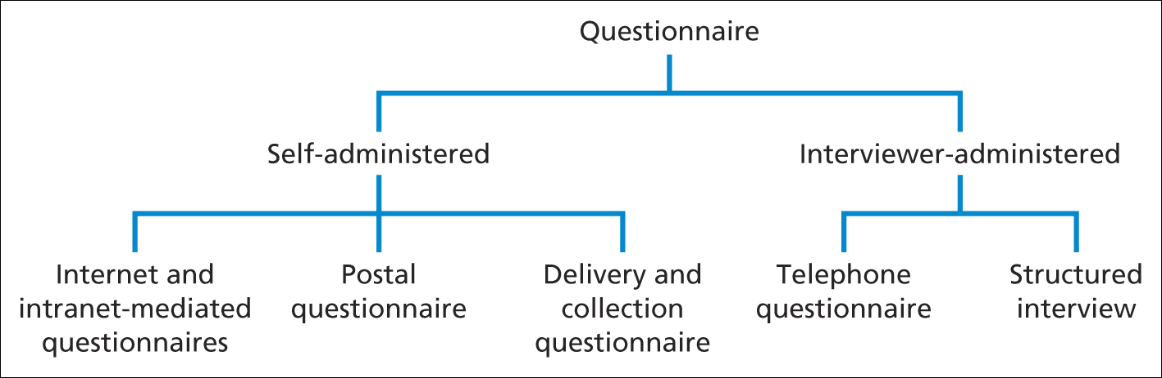
Types of Questionnaire
These are the types of questionnaire given in tabular form below;
Saunders et al. (2009)
Figure 11.1 Types of questionnaire

Slide 7
Types of questionnaire
The design of a questionnaire differs according to how it is administered and in particular, the amount of contact you have with respondents.
Self-administered questionnaires are usually completed by respondents.
Such questionnaires are administered electronically using the internet [Internet-mediated questionnaires] or
intranet [intranet-mediated questionnaires],
posted to respondents who return them by post after completion [postal or mail questionnaire], or
delivered by hand to each respondent and collected later [delivery and collection questionnaire].

Slide 8
Response Rate, Validity and Reliability
Response rates, validity and reliability can be maximized by:
careful design of individual questions;
clear and pleasing layout of the questionnaire;
logical explanation of the purpose of the questionnaire;
pilot testing;
carefully planned and executed administration.

Slide 9
Types of questionnaire
Responses to interviewer-administered questionnaires are recorded by the interviewer on the basis of each respondent’s answers.
Questionnaires administered using the telephone are known as telephone questionnaires.
The final category, structured interviews [sometimes known as interview schedules], refers to those questionnaires where interviewers physically meet respondents and ask the question face to face.
These differ from semi-structured and unstructured [in-depth] interviews, as there is a defined schedule of questions, from which interviewers should not deviate.

Slide 10
Choice of questionnaire
The choice of questionnaire depends on the following related factors
Characteristics of the respondents and access
Respondents answers not being contaminated or distorted
Size of sample required for analysis
Type and number of questions required
Available resources including use of computer software

Slide 11
Data collection
Following are the key factors involved in data collection using questionnaire
Precisely defined questions
Representative and accurate sampling
An understanding of the organisational context
Relationships between variables – dependent, independent .
Types of variable

Slide 12
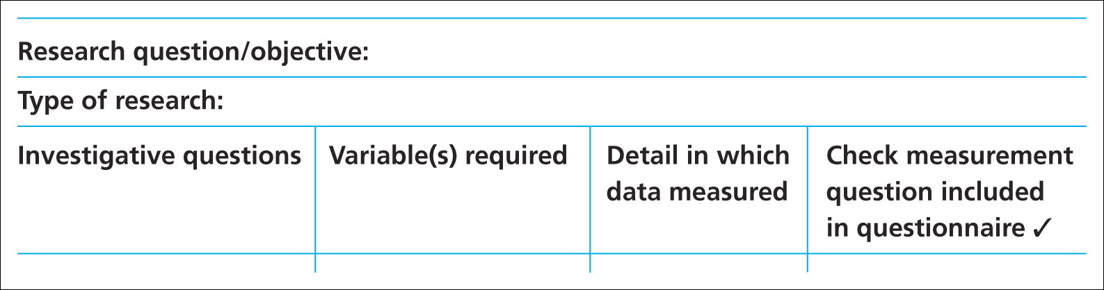
Ensuring essential data are collected
Data requirements table
Saunders et al. (2009)
Table 11.2 Data requirements table

Slide 13
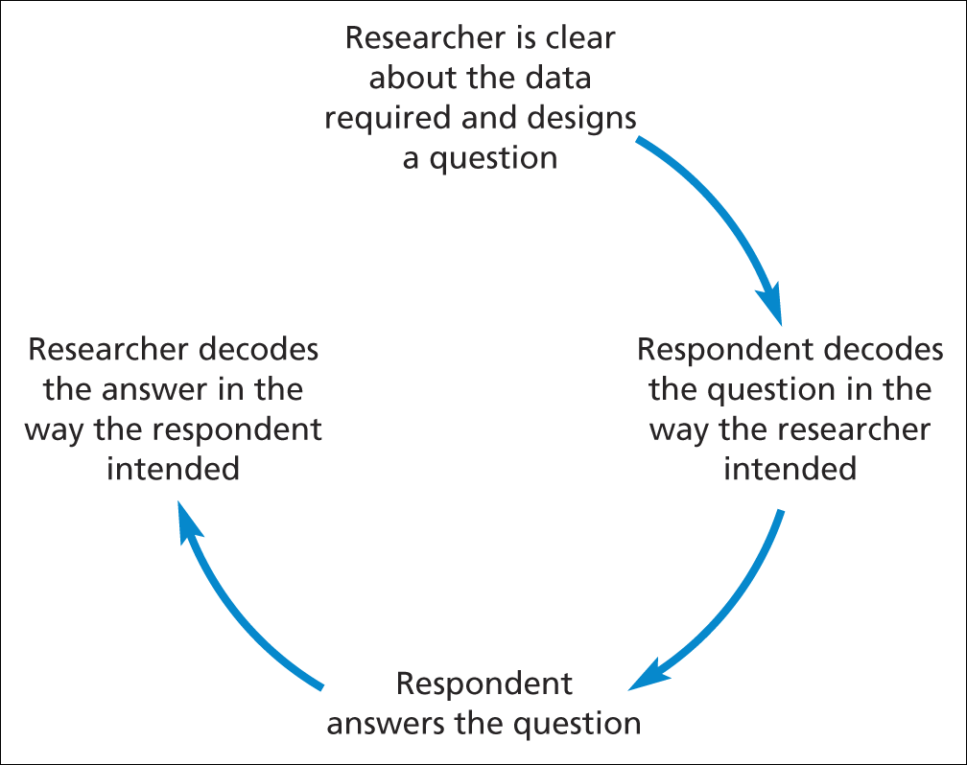
Designing the questionnaire
Stages that must occur if a question is to be valid and reliable
Source: developed from Foddy (1994)

Slide 14
Designing the questionnaire
Assessing validity
Internal
Content
Criterion – related (predictive)
Construct

Slide 15
Designing the questionnaire (3)
Testing for reliability- the 3 stage process
Test re-test
Internal consistency
Alternative form
Mitchell (1996)

Slide 16
Examples of question types
Open questions
Please list up to three things you like about the job you are doing
1…………………………………………
2…………………………………………
3…………………………………………
Saunders et al. (2009)

Slide 17
Examples of question types
List questions
What is your religion?
Please tick ✓ the appropriate box
Buddhist  None 
Christian  Other 
Hindu 
Muslim 
Saunders et al. (2009)

Slide 18
Examples of question types (3)
Category questions
8 How often do you visit the shopping centre?
Interviewer: listen to the respondent’s answer and tick ✓ as appropriate
 First visit
 Once a week
 Less than fortnightly to once a month
 2 or more times a week
Less than once a week to fortnightly
Less often
Saunders et al. (2009)

Slide 19
Examples of question types
Ranking questions
Please number each of the factors listed below in order of importance to you in choosing a new car. Number the most important 1, the next 2 and so on. If a factor has no importance at all, please leave blank.
Factor Importance
Carbon dioxide emissions [ ]
Boot size [ ]
Depreciation [ ]
Price [ ]
Adapted from Saunders et al. (2009)

Slide 20
Examples of question types
Rating questions
10 For the following statement please tick the box that matches your view most closely
Agree Tend to agree Tend to disagree Disagree
I feel employees’    
views have
influenced the
decisions taken
by management
Saunders et al. (2009)

Slide 21
Examples of question types
Quantity questions
What is your year of birth?
(For example, for 1988 write: )
Saunders et al. (2009)
1
9
1
9
8
8

Slide 22
Summary
When to use questionnaires?
For explanatory or descriptive research.
Linked with other methods in a multiple-methods research design.
To collect responses from a large sample prior to quantitative analysis.

Slide 23
Summary
Type of Questionnaire

