Slide 1
Primary data Collection: Using semi-structured, in-depth and group interviews
Lecture 18th

Slide 2
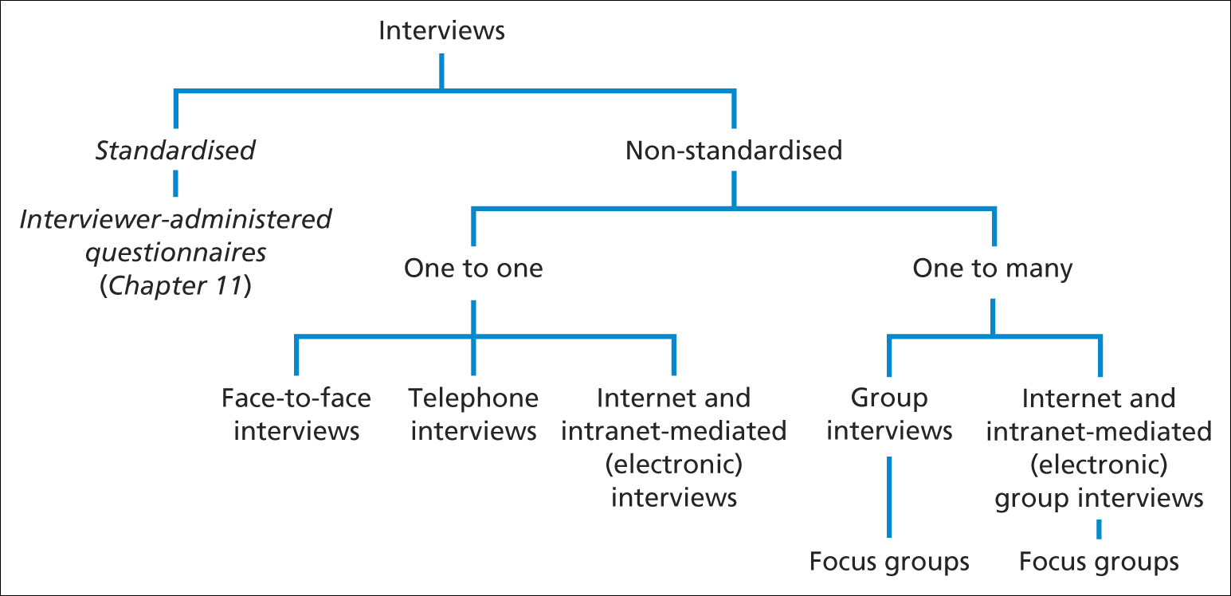
Recap
Form of Interviews

Slide 3
Recap
Types of interview used in research are;
1). Semi-structured
2). Structured
3). In-depth
4). Group

Slide 4
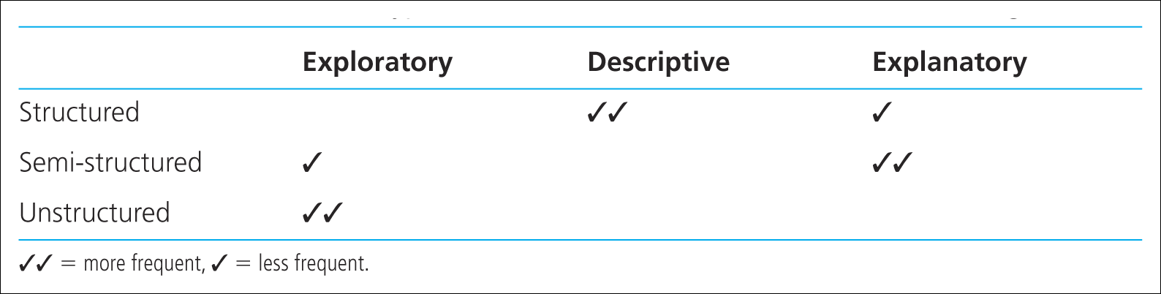
Uses of different types of interview in each of the main research categories
Recap

Slide 5
Recap
Data quality
The importance of preparation –
the 5 Ps
‘prior planning prevents poor performance’

Slide 6
Interviewing competence
There are several areas where you need to develop and demonstrate competence in relation to conduct of semi structured and in-depth research interview .
These areas are:
Opening the interview;
Using appropriate language;
Questioning;

Slide 7
Interviewing competence
Listening;
Testing and summarizing understanding;
Recording and dealing with difficult participants;
Recording data.

Slide 8
Interviewing competence
Approaches to questioning
Open questions Probing questions
Specific and closed questions

Slide 9
Open questions
The use of open question will allow participants to define and describe the situation or event.
An open is designed to encourage the interviewee to provide an extensive and developmental answer and may be used to reveal attitudes or obtain facts.
It encourage s the interviewee to reply as they wish.
An open question is likely to start with or include, one of the following words: ‘what’, or ‘how’, or ‘why’,.

Slide 10
Probing questions
Can be used to explore responses that are of significance to the research topic.
They may be worded like open questions but request a particular focus or direction.

Slide 11
Specific and closed questions
These types of questions are simpler to those used in structured interviews.
They can be used to obtain specific information or to confirm a fact or opinion.

Slide 12
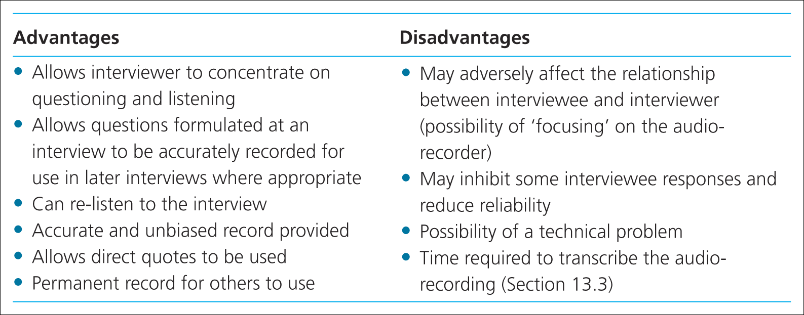
Interviewing competence
Advantages and disadvantages of audio-recording interviews
Saunders et al. (2009)
Table 10.3 Advantages and disadvantages of audio-recording the interview

Slide 13
Interviewing competence
Some other issues to consider
Dealing with difficult participants –Table given in the next slide
Managing resources – logistics and time
Obtaining participants’ permission for interview records (written and taped)

Slide 14
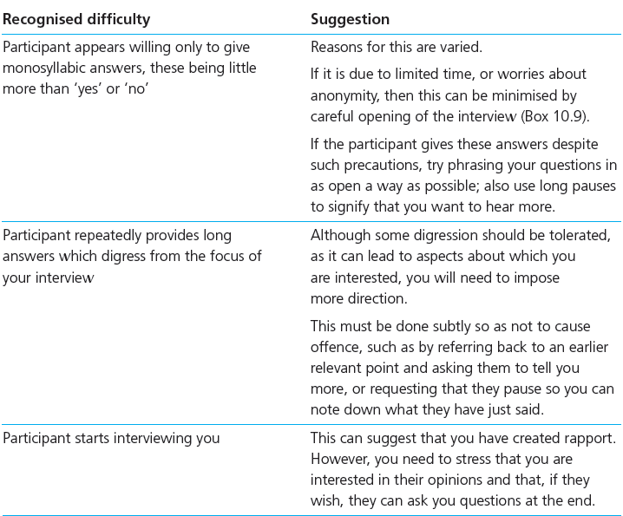
Difficult participant and how to address them?

Slide 15
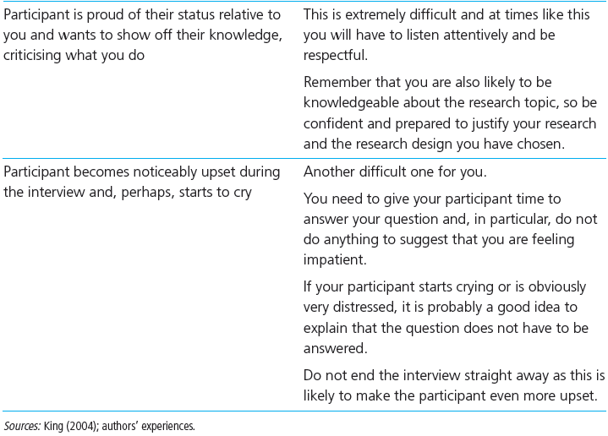
Difficult participant and how to address them?

Slide 16
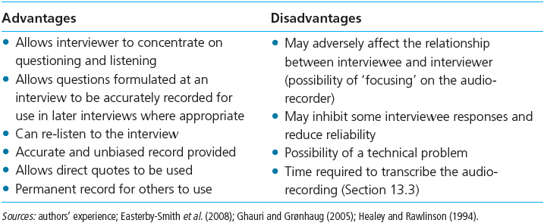
Interview Recording: Audio Recording

Slide 17
Interviewing competence
Additional forms of interviews:
Group interviews
Focus groups
Telephone interviews
Internet and intra-net mediated interviews

Slide 18
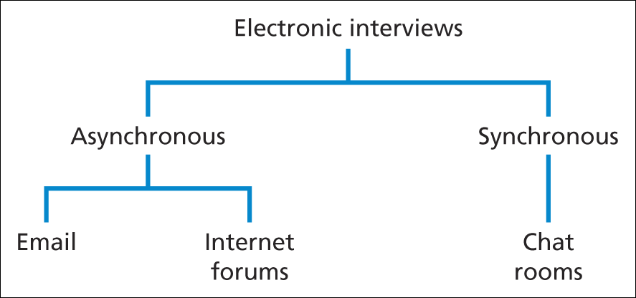
Interviewing competence
Forms of electronic interviews
Saunders et al. (2009)
Figure 10.2 Forms of electronic interviews

Slide 19
Summary
Use of non-standard (qualitative) interviews should generate rich and detailed data
Different types of interview are useful for different research purposes
Qualitative interviews are generally categorised as in-depth (structured) and semi-structured
Research design may incorporate more than one type of interview

Slide 20
Summary
Using qualitative interviews is related to the research strategy and data collection questions
Establishing personal contact with subjects and the length of time required are significant factors
Data quality issues, interviewer competence and resource management are important considerations
Face-to-face (individual, group and focus group) and electronic interviews can all be advantageous

