Slide 1
Primary data Collection: Using semi-structured, in-depth and group interviews
Lecture 17th

Slide 2
Summary: Types of observation
There are two main types of observations;
1). Participant observation –
Emphasises the discovery of meaning attached to actions (qualitative)
2). Structured observation –
It is concerned with frequency of actions (quantitative)

Slide 3
Summary
Participant observation is used in a wide range of social settings.
Participant observation means adopting a number of potential roles.
Roles are differentiated according to the degree of concealed identity and participation in events adopted by the researcher.

Slide 4
Summary
The aim of participant observation is to develop theory and avoid mere story telling
Structured observation is concerned with the frequency of events.
It is characterised by high levels of predetermined structure and quantitative analysis
The main threats to reliability and validity are subject error, time error and observer effects

Slide 5
Research Interviews
‘An interview is a purposeful discussion between two or more people’
Kahn and Cannell (1957)
Types of interview used in research are;
1). Semi-structured
2). Structured
3). In-depth
4). Group
Saunders et al. (2009)

Slide 6
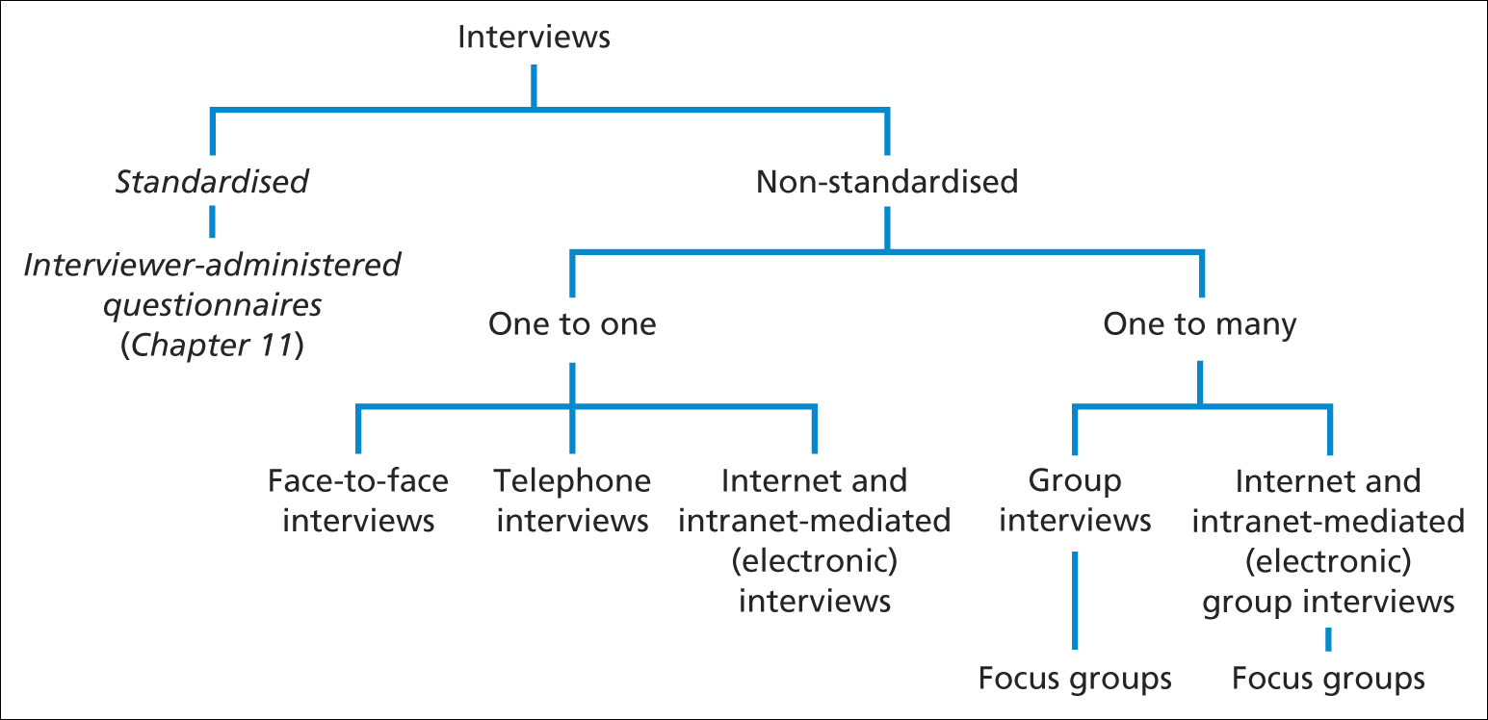
Research purpose and strategy
Forms of interview
Saunders et al. (2009)
Figure 10.1 Forms of interview

Slide 7
Types of interview
Structured interviews:
use questionnaire based on a predetermined and ‘standardized’ or identical set of questions and we refer to them as interviewer administered questionnaires.
Semi-structure interviews:
the researcher will have a list of themes and questions to be covered, although these may vary from interview to interview.
This means that you may omit some questions in particular interviews, given a specific organizational context that is encountered in relation to the research topic.
The order of questions also be varied depending on the flow of conversation.
On the other hand, additional questions may be required to explore your research question and objectives given the nature of events within particular organizations.

Slide 8
Types of interview
Unstructured interviews:
Unstructured interviews are informal.
You would use these to explore in-depth a general area in which you are interested .
We therefore, refer to these as in-depth interviews.
There is no predetermined list of questions to work through in this situation, although you need to have a clear idea about the aspect or aspects that you want to explore.
The interviewee is given the opportunity to talk freely about events behavior and beliefs in relation to topic area.

Slide 9
Types of interview
So that this type of interaction is sometimes called ‘nondirective’.
It has been labeled as informant interview since it is the interviewees perceptions that guide the conduct of the interview.
In comparison, a participant (or respondent) interview is one where the interviewer directs the interview and the interviewee responds to the questions of the researcher.

Slide 10
Types of interview
We can also differentiate between types of interview related to the nature of interaction between the researcher and those who participate in this process.
Interview may be conducted one to one basis, between you and single participant(face to face)(telephone)(internet) (intranet)

Slide 11
Types of interview
There may be other situation where you conduct a number of participants to explore an aspect of your research through a group of discussion that you facilitate.

Slide 12
Interview and type of research
In an exploratory research study, in-depth interviews can be very helpful to find out what is happening and to seek new insights.
Semi stretchered interviews may be used in relation to an exploratory study.
In descriptive studies structured interviews can be used as a means to identify general patterns.

Slide 13
Interview and type of research
In an explanatory study, semi structured interviews can be used in order to understand the relationships between variables, such as those revealed from a descriptive study.
Structured interview may also be used in relation to an explanatory study, in statistical sense.

Slide 14
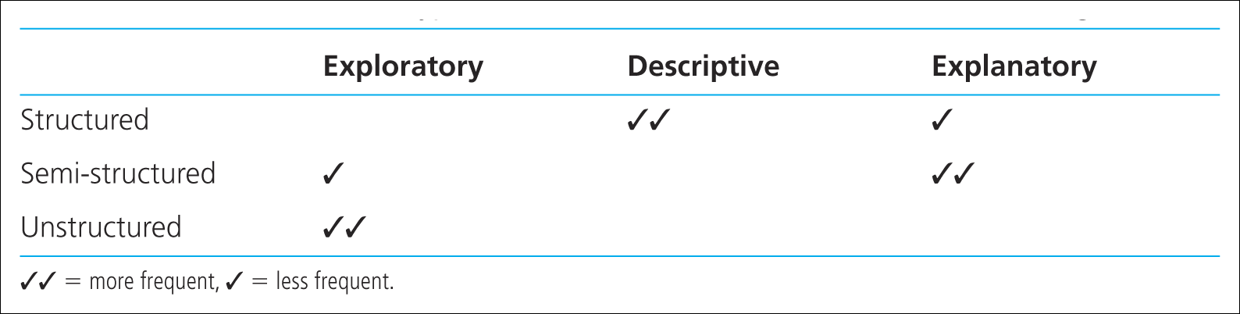
Research purpose and strategy
Uses of different types of interview in each of the main research categories
Saunders et al. (2009)

Slide 15
Non-standardised (qualitative) interviews
Four key aspects
Purpose of the research
Significance of establishing personal contact
Nature of the data collection questions
Time required and completeness of process

Slide 16
Data quality
Issues to consider
Reliability
Forms of bias
Validity and Generalisability

Slide 17
Data quality
The importance of preparation –
the 5 Ps
‘prior planning prevents poor performance’
Saunders et al. (2009)

Slide 18
Interview preparation
Associated issues
Interviewer’s level of knowledge
Level of information supplied to interviewees
Creating an interview guide
Appropriateness of location

Slide 19
Interview preparation
Associated issues
Researcher’s appearance – dress code
Shaping the interview - opening comments
Approach to questioning – clarity and reducing bias
Use of critical incident technique

Slide 20
Interview preparation
Associated issues
Appropriate interviewer behaviour- verbal and non-verbal
Attentive listening skills and testing understanding
Approaches to data recording - notes and tape-recording
Cultural differences and bias

Slide 21
Recap

