Slide 1
Collecting Primary Data
Lecture 16th

Slide 2
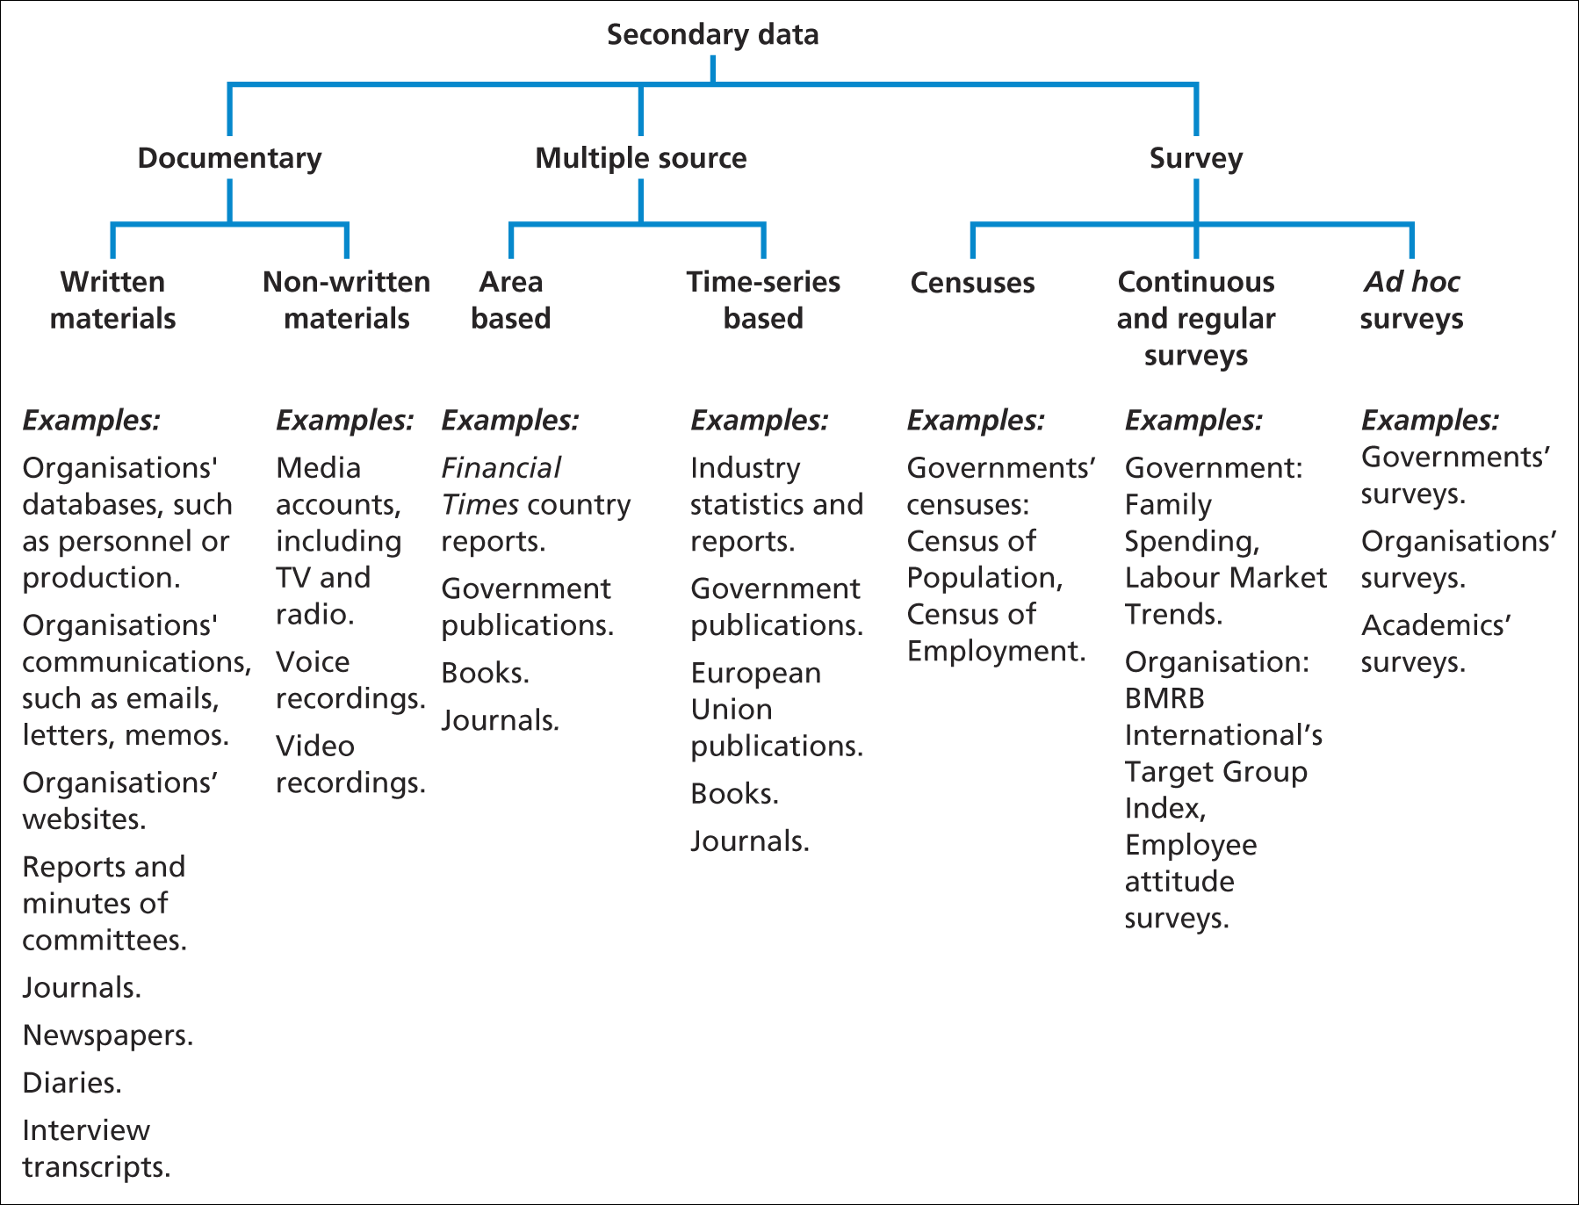
Recap of Secondary Data
Source: Saunders et al. (2006)

Slide 3
Recap of Secondary Data
Secondary data consists of three main types - documentary, survey and multiple sources
The data can be used in a variety of ways
Secondary data may be less current and collected for a purpose that does not match your research question(s)
Secondary data needs to be located and its availability established
Data sources should be assessed for suitability, measurement validity and coverage

Slide 4
Recap of Secondary Data
Evaluation of secondary data should include reliability and any measurement bias
Costs and benefits of using secondary data should be evaluated and compared with alternative sources
Although secondary data may contain some bias, it can help to answer your research question
Remember to check the research project assessment regulations regarding the use of secondary data

Slide 5
Observation: A data collection method
‘Observation involves the systematic observation, recording, description analysis and interpretation of people’s behaviour’.
Saunders et al. (2009)

Slide 6
Types of observation
There are two main types of observations;
1). Participant observation –
Emphasises the discovery of meaning attached to actions (qualitative)
2). Structured observation –
It is concerned with frequency of actions (quantitative)

Slide 7
Participant observation
‘Where the researcher attempts to participate fully in the lives and actions of subjects, enabling them to not merely observe what is happening but also feeling it’.
Adapted from Gill and Johnson (2002)

Slide 8
Choice of participant observer role
The Determining factors are as follows;
Purpose of the research and time available
Degree of suitability felt by the researcher
Organisational access
Ethical considerations

Slide 9
Data collection and analysis
These are few important Points to consider
Threats to validity
The perspective of the subject - not the researcher
Saunders et al. (2009)

Slide 10
Advantages
It is good at explaining “what is going on” in particular social situation.
It heightens the researcher’s awareness of significant social process.
It is particularly useful for researchers working within their own organization.

Slide 11
Advantages
Some participant observation affords the opportunity for the researcher to the experience ‘for real’ the emotions of those who are being researched.
Virtually all data collected are useful.

Slide 12
Disadvantages
It can be very time consuming.
It can pose difficult ethical dilemmas for the researchers.
They can be high levels of role conflict for the researcher.
The closeness of the researcher to the situation being observed can lead to significant observer bias .

Slide 13
Disadvantages
The participant observer role is a very demanding one, to which not all researchers will be suited.
Access to organizations may be difficult.
Data recording is often very difficult for the researcher.

Slide 14
Structured observation
Some point to ponder during structure observations are as follows;
Structured observation is systematic and aims to establish straightforward facts
Proliferation of the Internet potentially widens the scope of participant observation

Slide 15
Structured Observations: Advantages
It can be used by anyone after suitable training in the use of the measuring instrument. Therefore, you could delegate this extremely time-consuming task.
In addition, structured observation may be carried out simultaneously in different locations. This would present the opportunity of comparison between locations.
It should yield highly reliable results by virtue of its replicability.

Slide 16
Structured Observations: Advantages
The easier the observation instrument to use and understand, the more reliable the results will be.
Structured observation is capable of more than simply observing the frequency of events.
It is also possible to record the relationship between events.
For example, is the visit to the retail chemist’s counter to present a prescription preceded by an examination of merchandise unrelated to the prescription transaction?

Slide 17
Structured Observations: Advantages
The method allows the collection of data at the time they occur in their natural setting.
Therefore, there is no need to depend on ‘second-hand’ accounts of phenomena from respondents who put their own interpretation on events.
Structured observation secures information that most participants would ignore because to them it was too mundane or irrelevant.

Slide 18
Structured Observations: Disadvantages
The observer must be in the research setting when the phenomena under study are taking place.
Research results are limited to overt action or surface indicators from which the observer must make inferences.
Data are slow and expensive to collect.

Slide 19
Structured observation
Data collection and analysis
Choosing an ‘off the shelf’ coding schedule
Designing your own coding schedule
Combining both types of schedule
Use of simple (manual) or complex (computer) methods of analysis

Slide 20
Structured observation
There can be following threats to validity and reliability
Subject error
Time error
Observer effects and strategies to overcome this –
habituation and minimal interaction.

Slide 21
Summary
Participant observation is used in a wide range of social settings.
Participant observation means adopting a number of potential roles.
Roles are differentiated according to the degree of concealed identity and participation in events adopted by the researcher.

Slide 22
Summary
The aim of participant observation is to develop theory and avoid mere story telling
Structured observation is concerned with the frequency of events.
It is characterised by high levels of predetermined structure and quantitative analysis
The main threats to reliability and validity are subject error, time error and observer effects

