Slide 1
Using secondary data
Lecture 15th

Slide 2
RECAP: ETHICAL ISSUES IN RESEARCH

Slide 3
Secondary data and primary data
Secondary data is data that have already been collected for some other purposes. Examples of secondary data are; data from Economic Survey of Pakistan, World Development Indicators etc.
While primary data is data which can be collected specifically for the purpose of answering a research question(s) and to meet research objectives.
Which we have discussed in our sampling technique lectures and it is the first hand information.

Slide 4
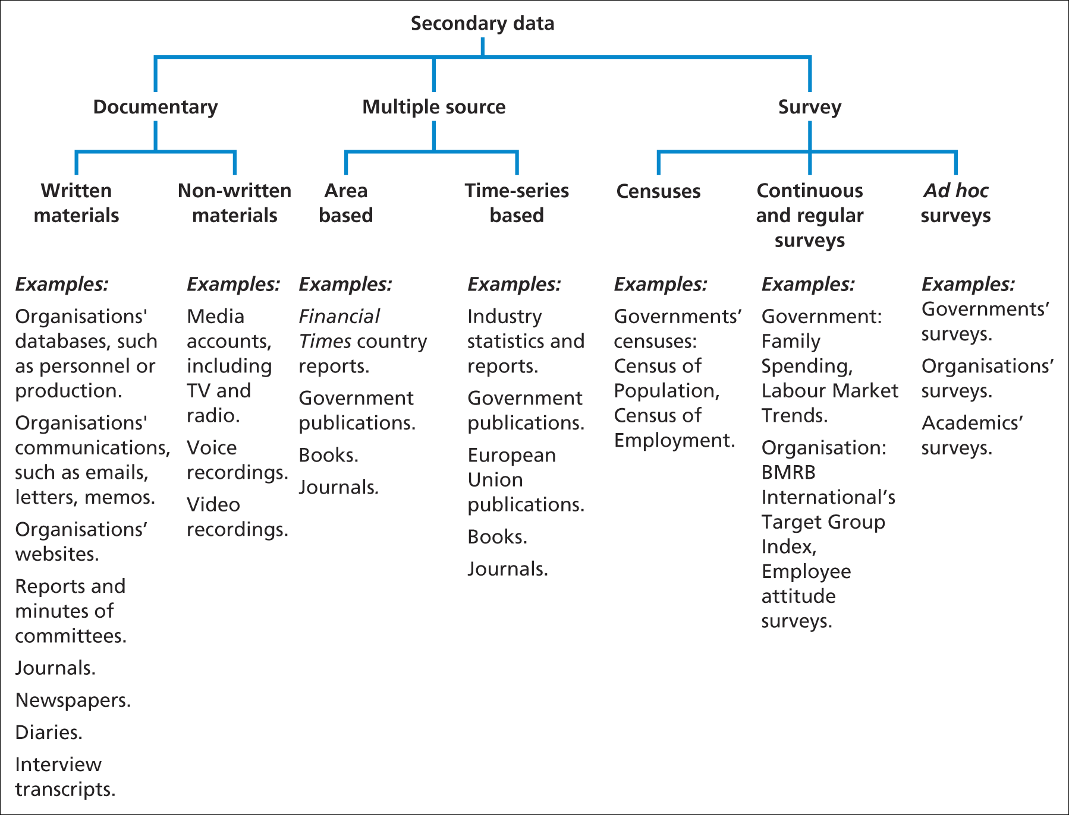
Types of secondary data
Source: Saunders et al. (2006)

Slide 5
Types of secondary data
Documentary
often used in research projects that also use primary data collection methods. However, you can also use them on their own or with other sources of secondary data.
Surveys
Refers to data collected using a survey strategy, usually by questionnaires, that have been already analysed for their original purpose.

Slide 6
Multiple – source secondary data
Multiple-source secondary data can be based entirely on documentary or on survey secondary or can be amalgam of the two.
The key factors is that different data sets have been combined to form another data set prior to your accessing the data.

Slide 7
Multiple – source secondary data
Times series for longitudinal studies: one method of compilation is to extract and combine selected comparable variables from a number of surveys or from the same survey that has been repeated a number of times to provide a time series of data to undertake a longitudinal study.
Cohort studies: Data also can be compiled for the same population over time using a series of ‘snap shots’ to form cohort studies.

Slide 8
Multiple – source secondary data
Area-based data sets: Multi- source secondary data also can be combined , if they have the same geographical basis, to form area based data sets.

Slide 9
Locating secondary data
Finding the data is a two stage process;
Establishing that the required secondary data is available.
Locating the precise data required.

Slide 10
Availability of secondary data: Sources
References in publications (books, journal articles)
Within organisations (unpublished sources)
Tertiary literature –
( indexes and catalogues in archives or online)

Slide 11
Availability of secondary data: Finding Secondary Data
References in published guides
Data held by organisations
Data on the Internet

Slide 12
Evaluating secondary data: Advantages
Fewer resource requirements
Unobtrusive
Longitudinal studies may be feasible
Provision of comparative and contextual data
Unforeseen discoveries may occur
Generally permanent and available

Slide 13
Evaluating secondary data: Disadvantages
Purpose of data collection may not match the research needs
Access may be difficult or costly
Aggregations and definitions may be unsuitable
No real control over data quality
Initial purpose may affect data presentation

Slide 14
Evaluating secondary data
Ensure that data sources are;
Enable the research question(s) to be answered
Enable research objectives to be met
Have greater benefits than their associated costs
Allow access for research

Slide 15
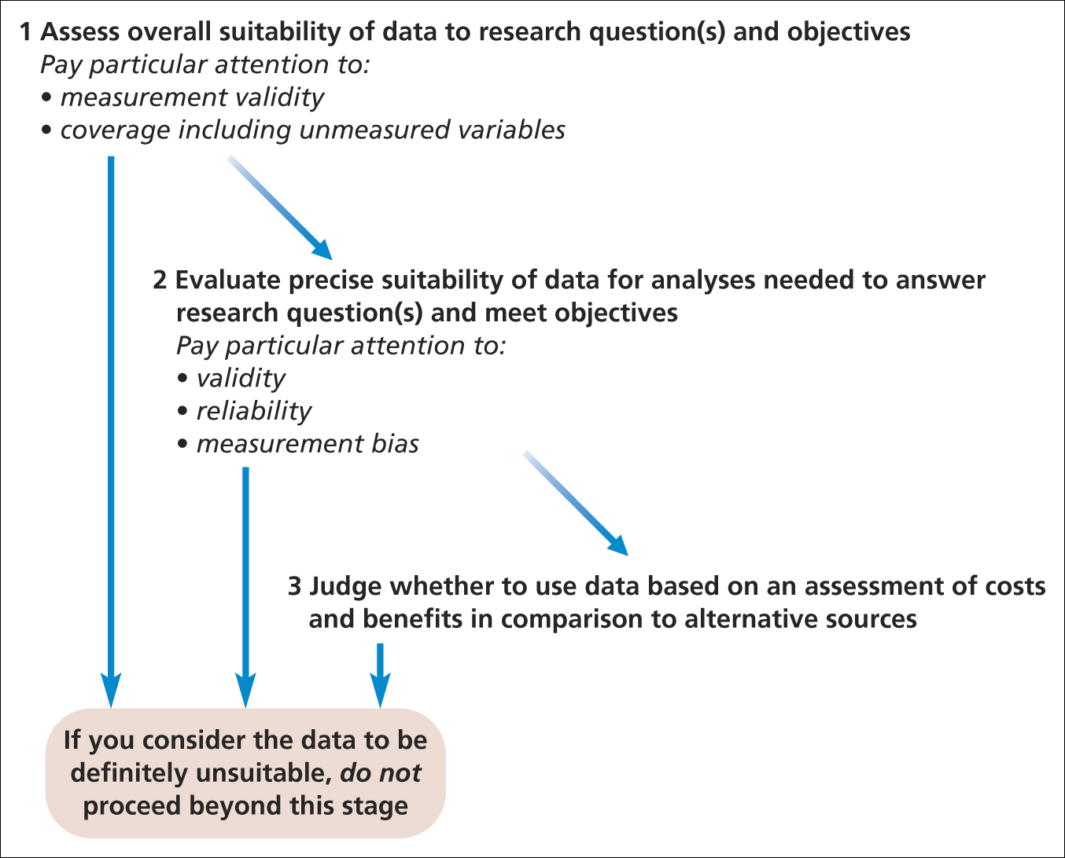
Evaluating secondary data
Evaluating potential secondary data sources
Source: Saunders et al. (2009)

Slide 16
Suitability of secondary data
Following are the important points to consider;
Precise suitability, including reliability and validity
  assessment of collection methods
  - clear explanation of collection techniques
Measurement validity
Measurement bias and deliberate distortion

Slide 17
Suitability of secondary data
Coverage and unmeasured variables
ensure exclusion of unwanted data
- ensure sufficient data remain for analysis
Costs and benefits

Slide 18
Summary
Secondary data consists of three main types - documentary, survey and multiple sources
The data can be used in a variety of ways
Secondary data may be less current and collected for a purpose that does not match your research question(s)
Secondary data needs to be located and its availability established
Data sources should be assessed for suitability, measurement validity and coverage

Slide 19
Summary
Evaluation of secondary data should include reliability and any measurement bias
Costs and benefits of using secondary data should be evaluated and compared with alternative sources
Although secondary data may contain some bias, it can help to answer your research question
Remember to check the research project assessment regulations regarding the use of secondary data

