Slide 1
Ethical Issues
Lecture 14th

Slide 2
Summary: Understanding Sampling
Choice of sampling techniques depends upon the research question(s) and their objectives
Factors affecting sample size include:
- confidence needed in the findings
- accuracy required
- likely categories for analysis

Slide 3
Summary: Understanding Sampling
Probability sampling requires a sampling frame and can be more time consuming
When a sampling frame is not possible, non- probability sampling is used
Many research projects use a combination of sampling techniques

Slide 4
Summary: Understanding Sampling
All choices depend on the ability to gain access to organisations

Slide 5
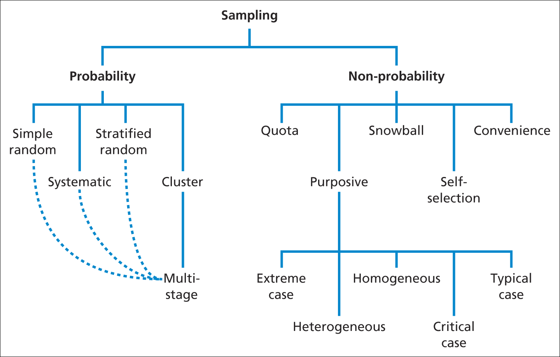
Summary: Understanding Sampling

Slide 6
Gaining access
Your ability to obtain both primary and secondary data will depend on you gaining access to an appropriate source (or sources).
Levels of access:
Physical access. Access can be difficult. There are gatekeepers or brokers who control research access and make the final decision.
Access may be denied because:
lack of perceived value,
b. potential sensitivity (confidentiality, competition, undesirable public attention).

Slide 7
Gaining access
Continuing access
First steps and then try to get further information.
2. Gatekeeper and those in direct control of the information are different.
Cognitive access
Are you allowed to have a proper sample, or set of secondary data, to answer you research question.

Slide 8
Strategies to gain access
Here we discuss a number of strategies that will help get physical and cognitive access:
you wish to get personal entry to an organization:
Become familiar with the organization before contacting it
Allowing yourself sufficient time
Using existing and new contacts (sometimes: introductory letters) and establish your credibility
Providing a clear account of purpose and type of access required

Slide 9
Strategies to gain access
Overcoming organizational concerns (such as confidentiality or data anonymity).
Highlighting possible benefits to the organization.
Using suitable language.
Facilitating replies.
Developing access incrementally.
Being open to serendipitous events.

Slide 10
Why to act ethically?
Cooper and Schindler defined Ethics as,
“norms or standards of behaviour that guide moral choices about our behaviour and our relationship with others”.
Research ethics relates to questions about how we formulate and clarify our research.
This means that the way you design your research is both methodologically sound and morally defensible to all those involved.

Slide 11
Two views on Ethics
Inevitably, what is morally defensible behaviour as researchers will be affected by broader social norms of behaviour.
Social norms: the behaviour that society (or a smaller group) expects from people.
Nonetheless, there is a bandwidth of possible ethical positions.

Slide 12
Two views on Ethics
Deontological view:
the ends of the research never justifies unethical behaviour.
It is close to Kant’s Categorical Imperative (Always act so as to treat humanity, whether in your own person or that of another, as an end in itself, never as a means only).
Do to others as you would have them do to you.
Teleological view:
the ends serves by your research justify the means (weighing benefits against costs, but for whom?).
However, if it is a matter of life and death, maybe the means become more acceptable than otherwise.

Slide 13
Ethical issues across the stages of research project
Privacy of possible and actual participants
Voluntary nature of participation and the right to withdraw
Consent and possible deception of participants
Confidentiality of data provided by individuals or identifiable participants and their anonymity
Reactions of participants to the way in which you seek to collect data, analyse and report your data including embarrassment, stress, discomfort, pain and harm.
Behaviour and objectivity of you as researcher.
The Internet brings with it new ethical challenges (Netiquette).

Slide 14
Ethical issues across the stages of research project
For each stage of research (formulating research topic, research design, access to, collecting, processing and storing data, and analysing and storing data), there are ethical issues which come down to:
Researcher’s right to absence of coercion (by sponsors, gatekeepers, participants)
Participant’s right to privacy,
confidentiality/anonymity and being informed
Sponsor’s/participant’s right to quality research

Slide 15
Consent
Gaining consent from a participant is crucial.
One can distinguishes between lack of consent (which may lead to feeling of deception), implied consent (such as returning a filled-out questionnaire) and informed consent.
In the case of oral interviews, it may be appropriate or required to let the interviewee check the transcript of the interview before using it further.
Issue: this may cause the interviewee to come back to earlier statements, esp. if the summarised interviews are published.

Slide 16
Ethical issues during data collection
Maintaining your objectivity can also be seen as an ethical principle.
This means making sure that you collect your data accurately and fully (avoiding subjective selectivity).
This also refers to the validity (accurate measurement and correct findings) and reliability (methods or techniques lead to consistent findings irrespective of the researcher) of your work.

Slide 17
Ethical issues with data processing and storage
Researchers should be familiar with data protection legislature.
Greater precaution is necessary when you are dealing with so-called sensitive personal data (such as racial or ethnic origin, political opinions, religious and other beliefs, trade union membership and the like).

Slide 18
Ethical issues related to analysis and reporting
If an individual organisation in the data can be identified, there can be a great deal of embarrassment, while following researchers can be denied any opportunity to do research.
Before publishing names etc., it stands to reason that prior permission will be asked.
Often, organisations allowing you to use their data are given a draft final report and asked to give its comments.
The same level of care is needed in making sure that the anonymity of individuals is maintained.

Slide 19
Summary of Ethical Issues

