Slide 1
Understanding Sampling
Lecture 12th

Slide 2
Why to do sampling?
What is Census?
What is sampling?
Sampling is a valid to a census because;
Entire population survey might be impracticable.
Budget and time constraints restrict data collection.
Need results from data collection quickly.

Slide 3
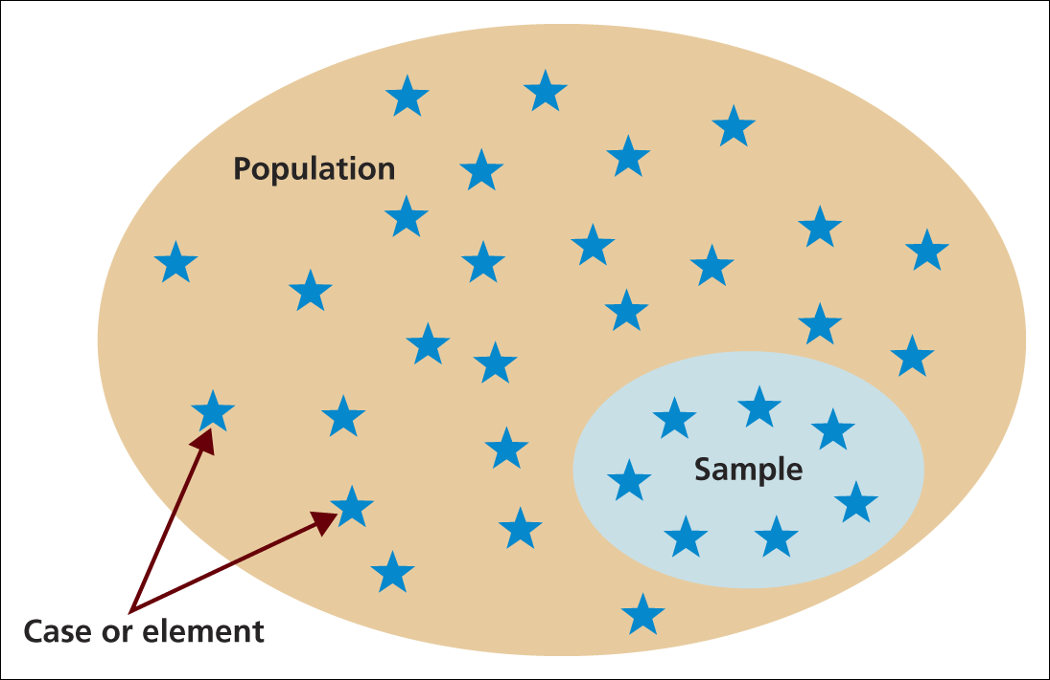
Sample selection
Source: Saunders et al. (2009)
Figure 7.1 Population, sample and individual cases

Slide 4
What is sampling frame ?
The sampling frame for any probability sample is a complete list of all the cases in the population from which your sample will be drawn.

Slide 5
Identification of sampling frame
Key points while identifying sampling frame are;
Problems of using existing databases
Extent of possible generalisation from the sample
Validity and reliability
Avoidance of bias

Slide 6
Sample size
Choice of sample size is influenced by
Confidence needed in the data
Margin of error that can be tolerated
Types of analyses to be undertaken
Size of the sample population and distribution

Slide 7
Response rate and its importance
Key considerations include;
Non- respondents and analysis of refusals
Obtaining a representative sample
Calculating the active response rate
Estimating response rate and sample size

Slide 8
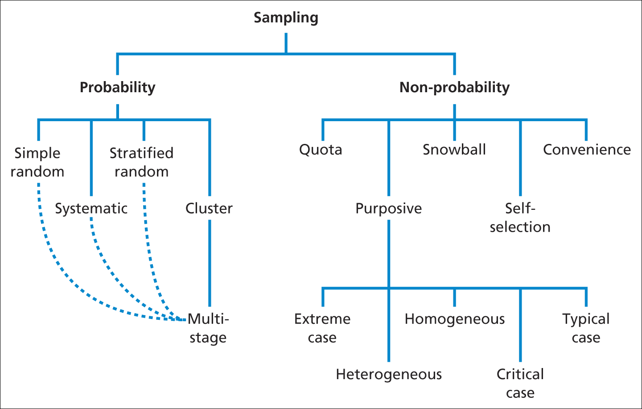
Sampling Techniques: An overview
Source: Saunders et al. (2009)

Slide 9
Probability Sampling
With probability samples the chance , or probability, of each case being selected from the population is known and usually equal to all cases.
This means that it is possible to answer research questions and to achieve objectives that require you to estimate statistically the characteristics of the population from the sample.
Consequently, probability sampling is often associated with survey and experimental research strategies.

Slide 10
Probability sampling
The probability sampling is four stage process
Identify sampling frame from research objectives
Decide on a suitable sample size
Select the appropriate technique and the sample
Check whether the sample is representative!

Slide 11
Selecting a sampling technique
Five main techniques used for a probability sample
Simple random
Systematic
Stratified random
Cluster
Multi-stage

Slide 12
Simple Random sampling
Selecting at random frame using either random number tables, a computer or an online random number generator such as Research Randomizer.
In excel you have a random number generator.

Slide 13
Systematic sampling
Systematic sampling involves you selecting the sample at regular intervals from the sampling frame.
Number each of the cases in your sampling frame with a unique number . The first is numbered 0, the second 1 and so on.
Select the first case using a random number.
Calculate the sample fraction.
Select subsequent cases systematically using the sample fraction to determine the frequency of selection

Slide 14
Stratified random sampling
Stratified random sampling is a modification of random sampling in which you divide the population into two or more relevant and significant strata based in a one or a number of attributes.
In effect, your sampling frame is divided into a number of subsets.
A random sample (simple or systematic) is then drawn from each of the strata.
Consequently stratified sampling shares many of the advantages and disadvantages of simple random or systematic sampling.

Slide 15
Cluster Sampling
Similar to stratified as you need to divide the population into discrete groups prior to sampling.
The groups are termed clusters in this form of sampling and can be based in any naturally occurring grouping.
For example, you could group your data by type of manufacturing firm or geographical area.

Slide 16
Cluster Sampling
For cluster sampling your sampling frame is the complete list of clusters rather than complete list of individual cases within population.
Select a few cluster normally using simple random sampling,.
Data then collected from every case within the selected clusters.

Slide 17
Multi-stage sampling
It is a development of cluster sampling, it is normally used to overcome problems associated with a geographically dispersed population when face to face contact is needed or where it is expensive and time consuming to construct a sampling frame for a large geographical area.
However, like cluster sampling you can use it for any discrete groups, including those that are not geographically based.
The technique involves taking a series of cluster samples, each involving some from of random sampling

