Slide 1
Research Philosophy
Lecture 11th

Slide 2
What is Research Philosophy?
The development of knowledge and the nature of that knowledge (Saunders et al, 2009).

Slide 3
Understanding Research Philosophy
What is Ontology?
Concerned with nature of reality.
This raise the questions of the assumptions researchers have about the way the world operates
and commitment held to particular views.

Slide 4
Understanding Research Philosophy
The two aspects of ontology we describe here will both have their devotees among business and management researchers.
In addition, both are likely to be accepted as producing valid knowledge by majority of researchers.

Slide 5
Ontology
Objectivism
The first aspect of ontology is objectivism.
This portrays the position that social entities exist in reality external to social actors concerned with their existence.
Subjectivism
The second aspect is subjectivism.
It holds that social phenomena are created from the perceptions and consequent actions of those social actors concerned with their existence.

Slide 6
Epistemology
What is acceptable knowledge in a particular field of study?
Concerned with the constitutes of acceptable knowledge in a field of study.

Slide 7
Aspects of Research Philosophy
There are following aspects of philosophy;
1). Positivism
This is the stance of natural scientist like Biology; Botany etc…..
2). Realism
It relates to scientific inquiry and can be
Direct and Critical Realism
3). Interpretivism
Researchers as social actors
4). Axiology
Studies judgment about values

Slide 8
Realism
Is related to scientific enquiry.
The essence of realism is that what the senses show us as reality is the truth;
That objects have an existence independent of the human mind.
In this sense, realism is opposed to idealism, the theory that only the mind and its contents exist.
Demand = Supply (Market Balance)!!!

Slide 9
Direct and Critical Realism
Direct Realism is what you see is what you get.
It is actually the experiences through senses that exposes the world.
What we experience is sensation i.e., the images of the things in the real world, not the things directly.
According to critical realism it is pointed out that how often our senses deceive us.

Slide 10
Interpretivism
Understanding differences between humans in our role as social actors is advocated by Interpretivism.
Emphasizes on the differences between conducting research among people rather than objects (such as trucks and computers).

Slide 11
Research Approaches
Research approaches can be Deductive and Inductive
Deductive:
Theory and hypotheses are developed and tested
Inductive:
Data is collected and than from data analysis theory developed

Slide 12
Deduction
There are five sequential stages of testing the theory (Robson, 2002);
1). Deducing a hypothesis
2). Expressing the hypothesis operationally
3). Testing the operational hypothesis
4). Examining the specific outcome of the enquiry
5). Modifying the theory (if necessary)

Slide 13
Characteristics of Deduction
Deduction approach helps in;
Explaining causal relationships between variables
Establishing controls for testing hypotheses
Independence of the researcher
Concepts operationalised for quantitative measurement
Generalisation

Slide 14
Induction
It is the process of building theory by;
1). Understanding the way human build their world
2). Permitting alternative explanations of what’s going on
3). Being concerned with the context of events
4). Using more qualitative data
5). Using a variety of data collection methods

Slide 15
Deductive and Inductive Research Approaches: A Comparison
Deductive Approach
Emphasizes on scientific principles
Moving from theory to data
Explain causal relationships between variables
Collection of quantitative data
Structured approach
Independence of researcher of what is being researched

Slide 17
Inductive Approach
Understanding and gaining the meanings humans attach to events.
A close understanding of the research context
Collection of qualitative data
More flexible structure to permit changes of research emphasizes during the research process
Less concerned with the need to generalize
Realization that researcher is part of the research process

Slide 18
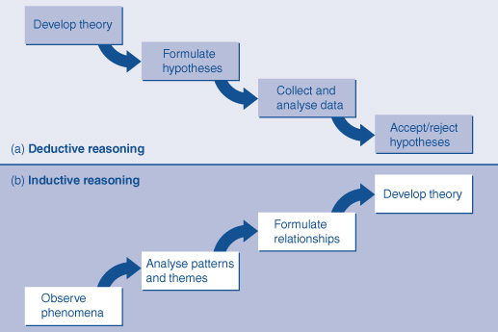
Deduction and Induction in Business Research

Slide 19
choice of Research approach
Choice of research approach helps in (Easterby-Smith et al., 2008);
Making more informed decision about the research design
Thinking which strategies will work for research topic
Adapting the research design to cater for any constraints

Slide 20
Hallmarks of Scientific Research
Purposiveness (Design)
Rigour (Validity)
Testability (method for trying or assessing)
Replicability
Accuracy
Objectivity
Generalisability
Parsimony (Cost Cutting)

