Slide 1
Research Methodology
Faisal Abbas, PhD
Lecture 1st

Slide 2
Course Outline
Realities and pitfalls of research
Approaches, strategies and methods
Techniques and procedures for data collection and analysis
Appropriate use of information technology

Slide 3
Books and Readings
Research methods for business students by Saunders et al. (2009).
Research methods: A step-by-step guide for beginners by Ranjit Kumar (2010).

Slide 4
Work Assessment
Tasks
1). When announced (5%)
2). Assignments (20%)
3). Midterm exam (25%)
4). Final exam (50%)

Slide 5
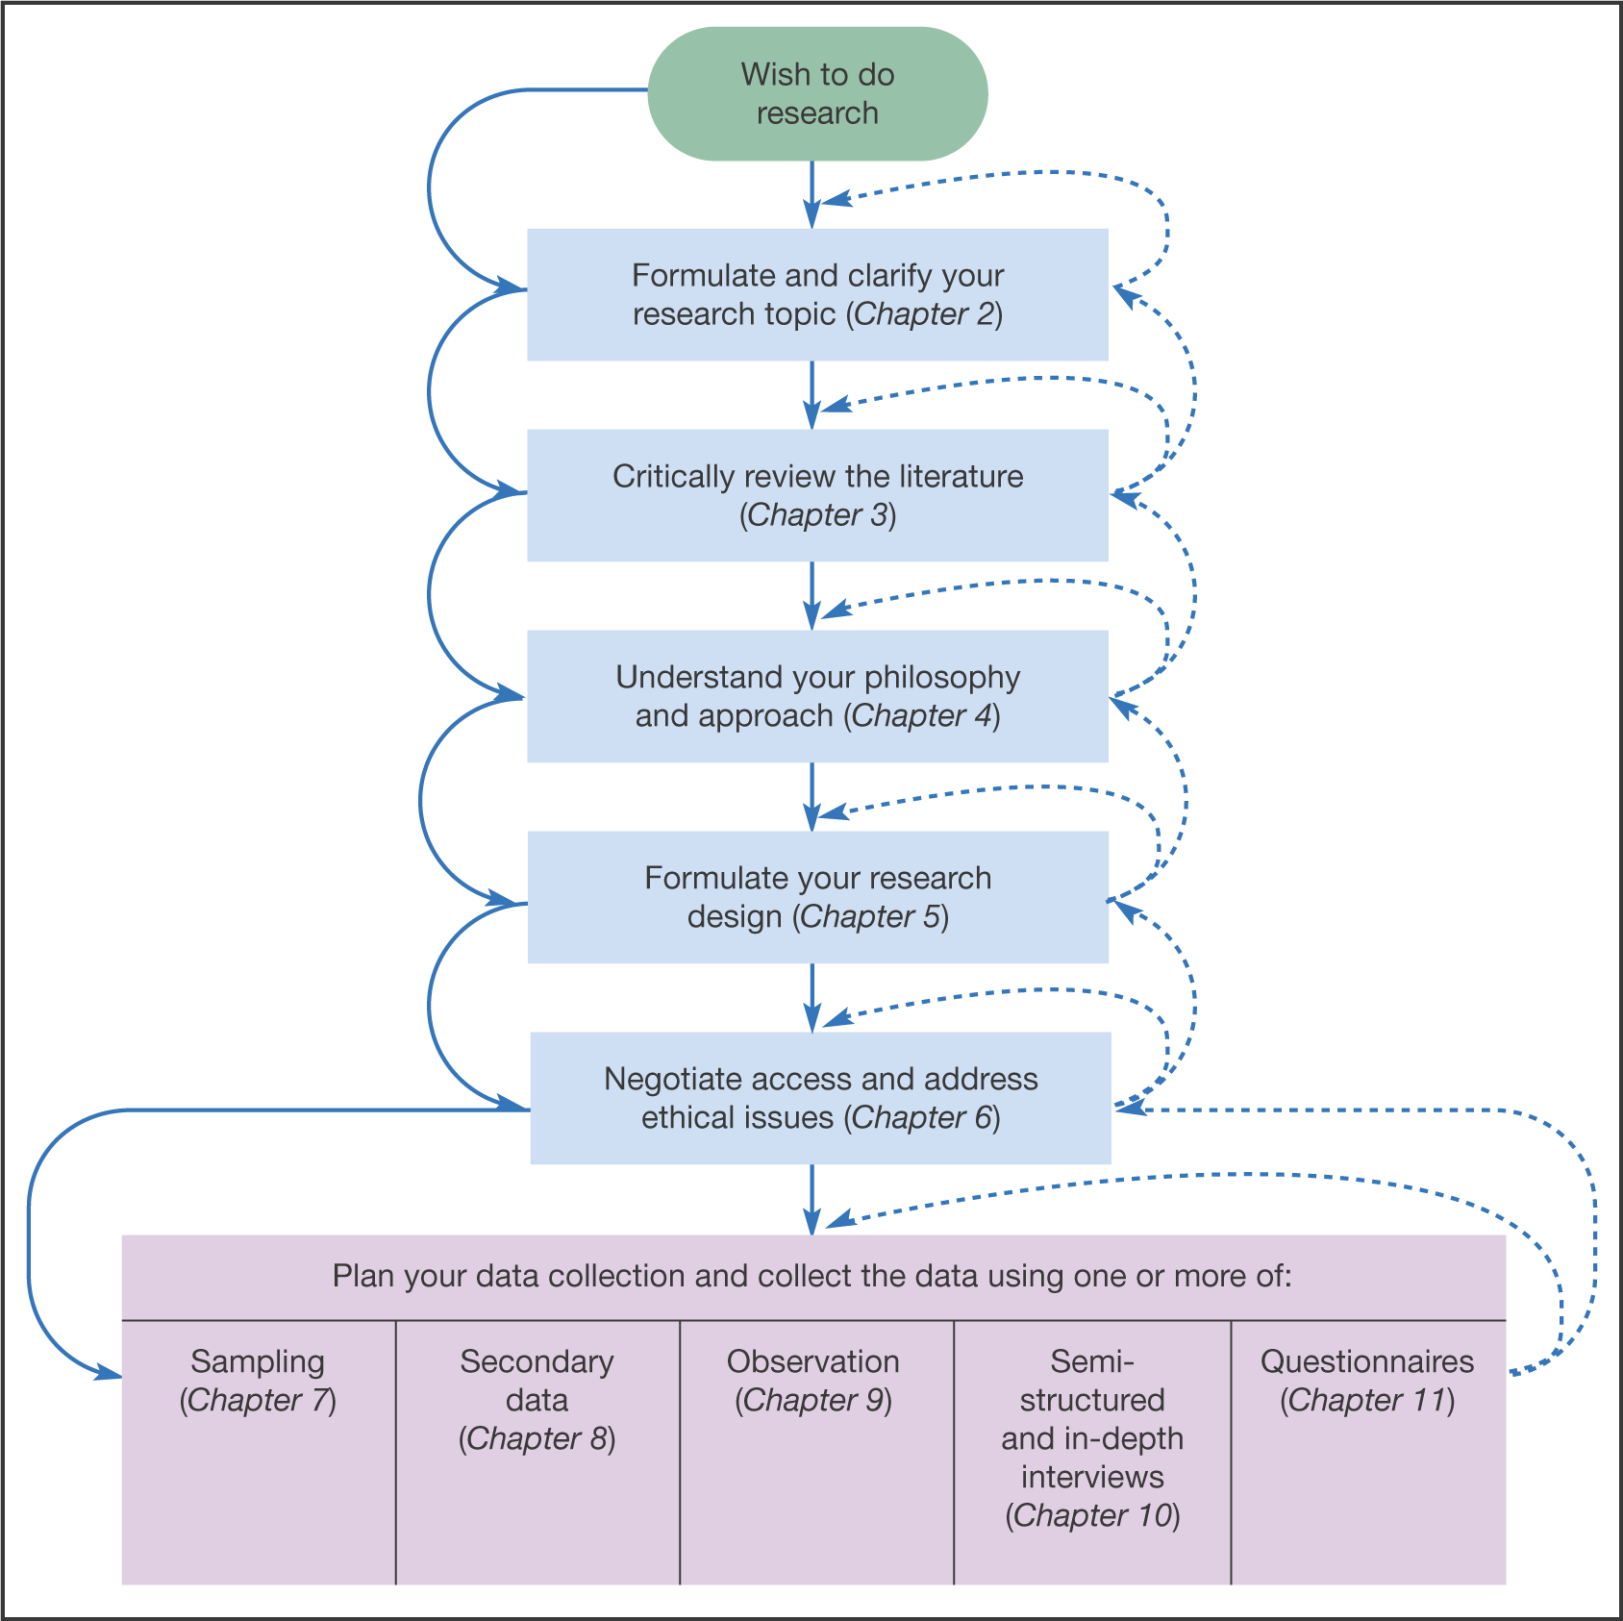
Figure 1: Process of Research Steps wise

Slide 6
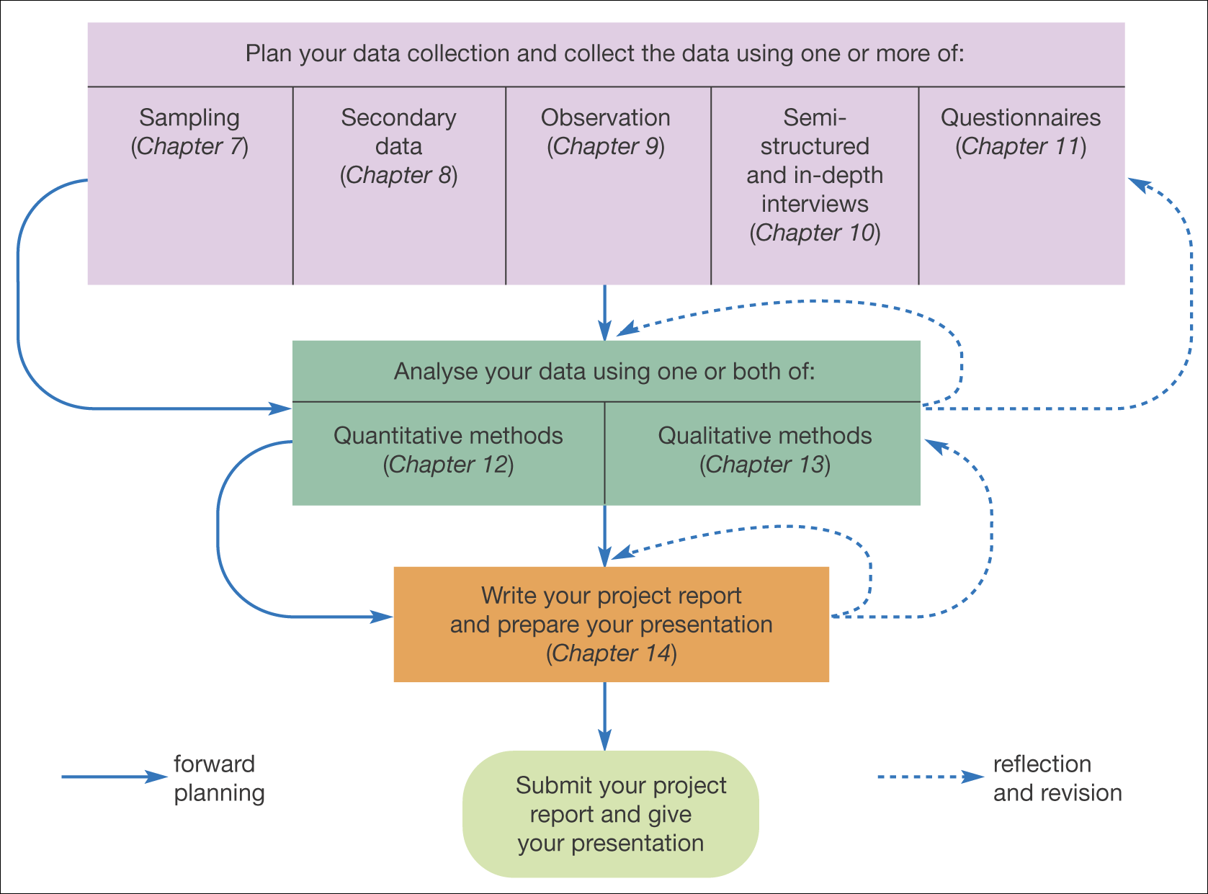
Contd……
Source: Mark Saunders, Philip Lewis and Adrian Thornhill 2006

Slide 7
Terminology
Methods
The techniques and procedures used to obtain data
Methodology
The theory of how research should be undertaken

Slide 8
Nature of Research
Bogus survey
  Statistics are hard to obtain and interpret
  Difficult to know if the situation is getting better or worse
  Program producers will not allow to talk about the complexities of methods but will use numbers to horrify viewers (Like News about floods, earthquakes etc.)
Real research
  Methodologically rigorous
  Findings are interpretable

Slide 9
What is ‘not’ Research?
Just collecting facts or information with no clear purpose.
Reassembling and reordering facts or information without interpretation.
What is Research then?
Something that people (Researchers/scientists) undertake in order to find things out in a systematic way, there by increasing their knowledge’ (Saunders et al. (2009).

Slide 10
Characteristics
There is a clear purpose to find things out
Data are collected systematically
Data are interpreted systematically

Slide 11
What does ‘systemically’ and ‘to find out ’ suggest?
Systematic suggests that research is based on logical relationships and not just beliefs. Rainfall and election win !!
To find out things suggests multiplicity of possible purposes of research e.g.
describing,
explaining,
understanding,
criticizing, and
analyzing

Slide 12
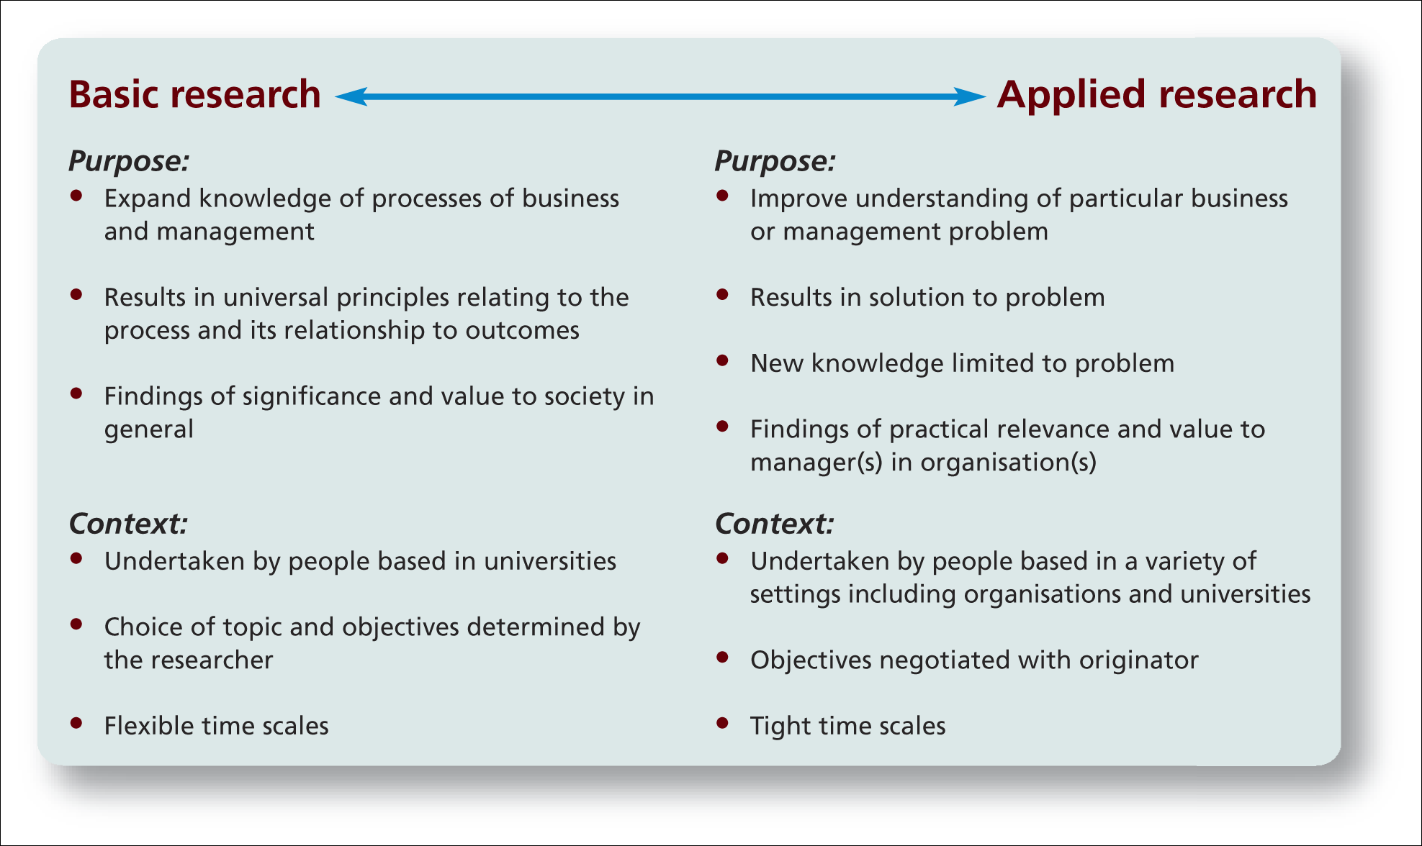
Features of Research: Basic and Applied
Sources: Easterby-Smith et al. (2008); Hedrick et al. (1993)

Slide 13
Some Key debates
Knowledge production (Modes 1 and 2)
The research-practice gap
‘Evidence based’
Basic and applied research

Slide 14
Mode One
Emphasizes research in which the questions are set and solved by the academic interests
Emphasizing a basic or fundamental research rather than applied one
Little focus on utilization of the research by practitioners.

Slide 15
Mode Two
Emphasizes research governed by the world of practice.
Highlights of collaboration both with and between practitioners.
Offers a way of bringing together the supply side of knowledge represented by universities with the demand sides represented by the business.

Slide 16
Stages of the research process
Formulating and clarifying a topic
Reviewing the literature
Designing the research
Collecting the data
Analysing the data
Writing up of the dissertation/paper/report etc.
Source: Saunders et al. (2009)

Slide 17
Things to consider
The impact of your personal feelings and beliefs
Access to data
Time and other resources
Validity and reliability of the data
Ethical issues

Slide 18
Business Research
Is trans-disciplinary
Engages with both theory and practice
Involves undertaking systematic research
Should be undertaken with rigour

Slide 19
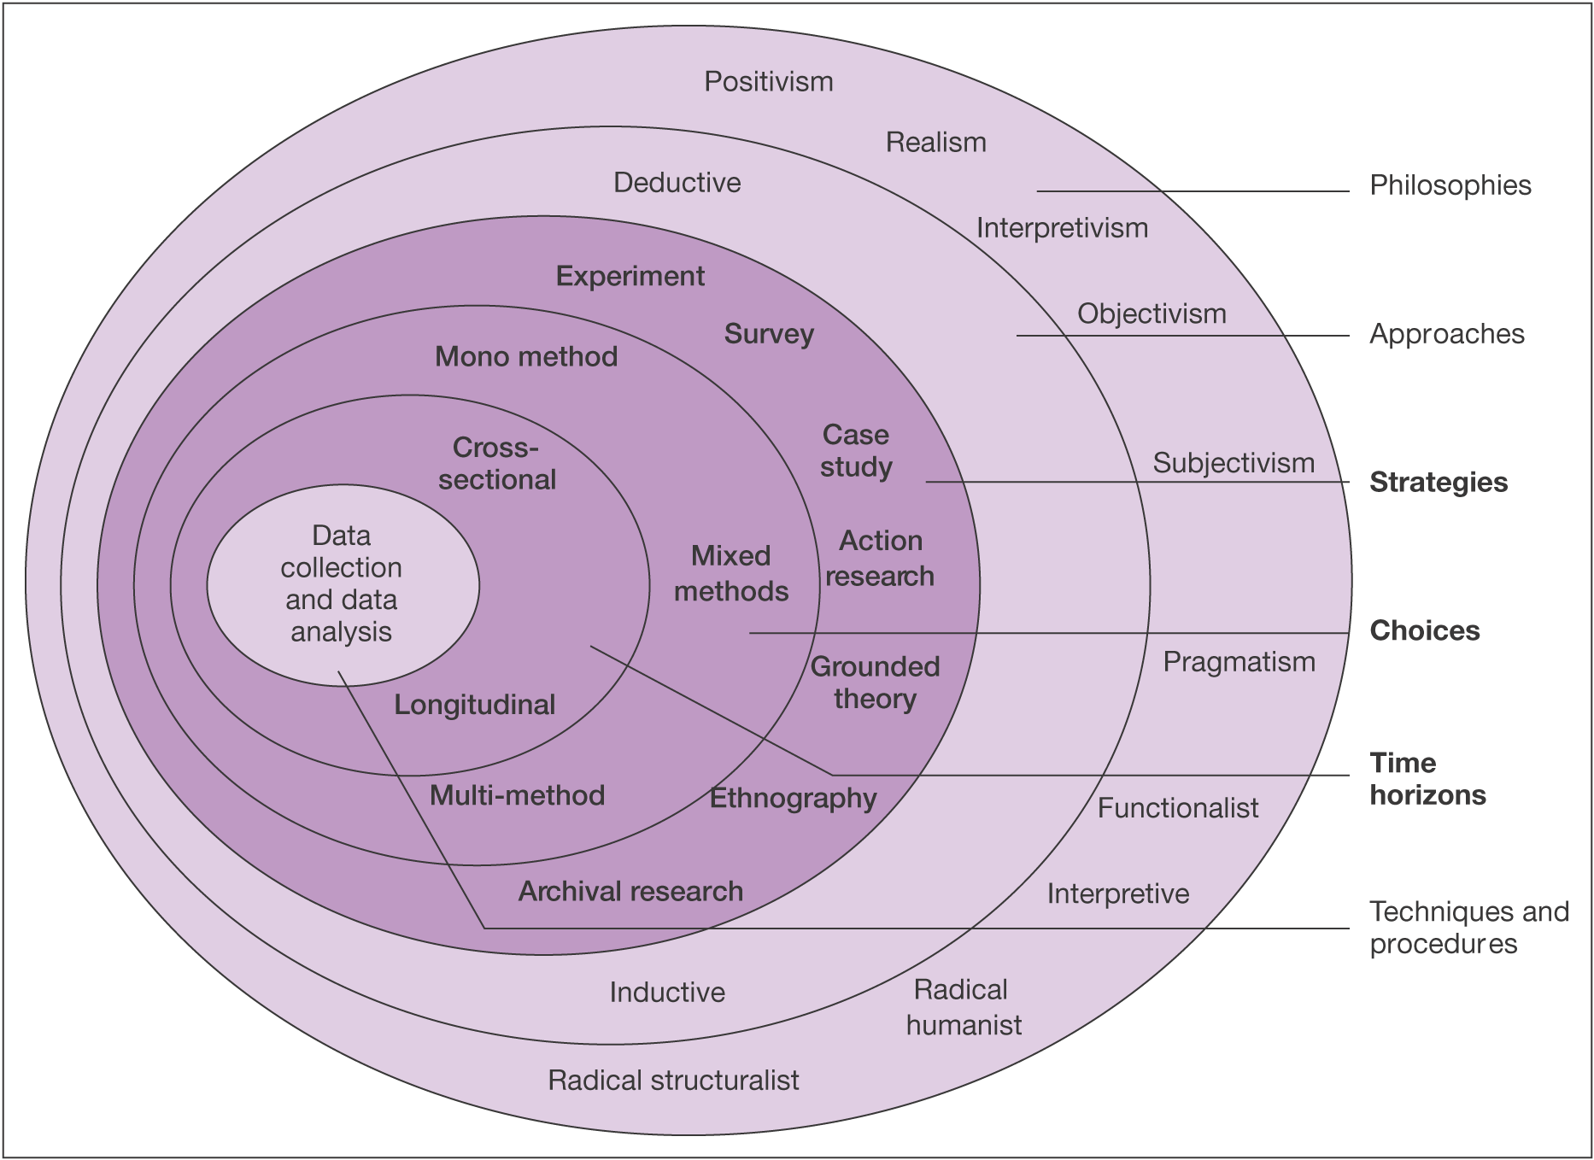
Figure 2: Research Onion

Slide 20
Research Proposal
Purpose
  Determine what the researcher wants to do?
  Why the research is important, convincing, and worth undertaking?
  How the researcher wish to undertake it?
  What benefit will result from the effort or attempt?

Slide 21
Elements of Research Proposal
  Introduction to area and questions
  Study objectives
  Proposed research design
  The setting of the study
  Instruments planned to be used

Slide 22
Elements of Research Proposal
  A sample design and a sample size
  Outline the proposed chapters for the dissertation
  Study's problems, limitations and future areas of research
  A proposed time frame

