Slide 1
Human Resource Management
Lecture 6
MGT 350

Slide 2
Last Lecture
Basic rights of employees
Honesty/Drug Tests
Whistle-blowing
Employee Monitoring and Workplace Security
    Theft
    Revealing of trade secrets to competitors
    Using the customer database for personal gain
Workplace Romance
The Employment-at-Will Doctrine

Slide 3
Last Lecture
Discipline
The most frequent violations requiring disciplinary action involve
  Attendance
  On-the-job behaviors
  Dishonesty
  Outside activities
  Make disciplinary action progressive; i.e. verbal warning, written warning, suspension, dismissal.
  Hot-stove rule; i.e. immediate response; ample warning.
  Employee Counseling.
  Why Use an Employee Handbook?
  Complaint Procedures

Slide 4
Topic
Recruiting

Slide 5
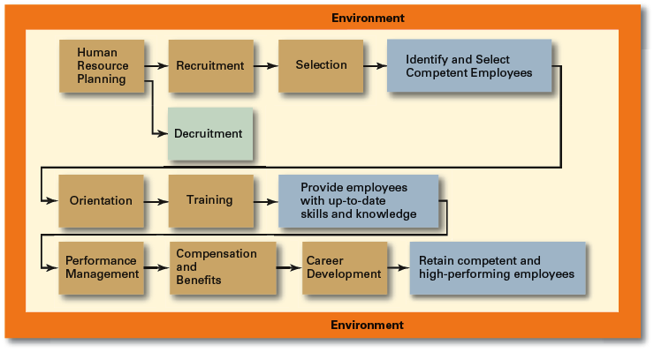
HRM Process

Slide 6
Introduction
Recruiting
Once an organization identifies its human resource needs through employment planning, it can begin the process of recruiting potential candidates for actual or anticipated organizational vacancies.

Slide 7
Recruitment
Recruitment
  The process of locating, identifying, and attracting capable applicants to an organization
Decruitment
  The process of reducing a surplus of employees in the workforce of an organization

Slide 8
Recruiting Goals
To provide information that will attract a significant pool of qualified candidates and discourage unqualified ones from applying.

Slide 9
Recruiting Goals
Factors that affect recruiting efforts
  Organizational size
  Employment conditions in the area
  Working conditions, salary and benefits offered
  Organizational growth or decline

Slide 10
Recruiting Goals
Constraints on recruiting efforts include:
  Organization image
  Internal organizational policies
  Government influence, such as discrimination laws
  Recruiting costs

Slide 11
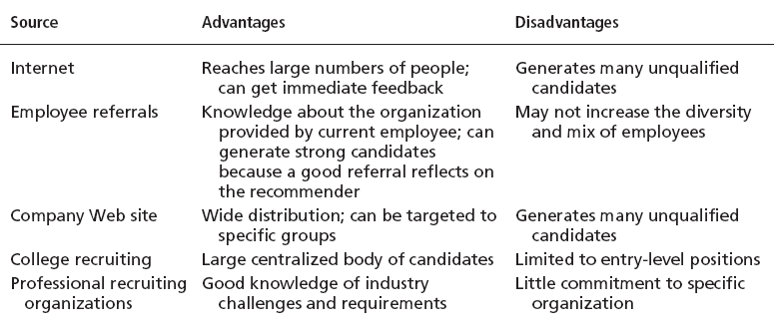
Major Sources of potential Candidates

Slide 12
Recruitment Process
1. Job Analysis
  Job description and Job Specification
2. Person Specification
  skills, knowledge, aptitudes directly related to the job
  the type of experience necessary
  the competencies necessary
  3. Compensation
  scales, grades
  negotiated agreements
  market rates and skills shortages

Slide 13
Recruitment Process
4. Attracting suitable applicants
  Internal candidates
  External candidates
  5. The advertisement
  New Papers ? Website? Agencies? Notice board?
  6. Applications
  Availability, Contact Person, Submission method

Slide 14
Internal Recruiting
Recruiting source seeking applicants for positions from among the ranks of those currently employed.
Internal Recruitment Sources
1. Replacement Charts, Skills Inventories

Slide 15
External Recruiting
Recruiting source seeking applicants for positions from outside the organization.

Slide 16
Recruiting: A Global Perspective
Who is an Expatriate?
An employee who is working and temporarily residing in a foreign country.
They are also called ‘international assignees’ by some firms.
For some positions, the whole world is a relevant labor market.
Home-country nationals are recruited when an organization is searching for someone with extensive company experience to launch a very technical product in a country where it has never sold before.

Slide 17
Recruiting: A Global Perspective
Host-country nationals (HCNs) are targeted as recruits when companies want each foreign subsidiary to have its own distinct national identity.
In some countries, laws control how many expatriates a corporation can send.
HCN’s minimize potential problems with language, family adjustment and hostile political environments.

Slide 18
Summary
What is recruitment?
Goals of recruitment.
Process of recruitment.
Recruitment in Global Village.
Expatriates
Home country nationals.
Host country nationals.

