Slide 1
Human Resource Management
Lecture 31
MGT 350

Slide 2
Topic
Revision
Lecture 10-20

Slide 3
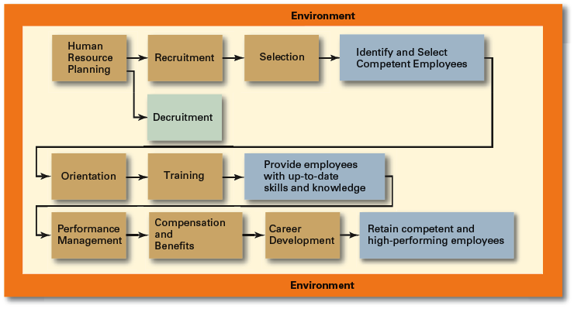
HRM Process

Slide 4
Summary
  Encouraging employees to acquire new or advanced skills, knowledge, and view points, by providing learning and training facilities, and avenues where such new ideas can be applied.
  Employee development methods
  The Learning Organization
  Post-training performance method.
  Pre-post-training performance method
  Pre-post-training performance with control group method
Cross-cultural trainings involves learning about:
  culture’s:
  History
  Politics
  Economy
  Religion
  Social climate
  Business practices

Slide 5
Summary
  Career Defined
  The sequence of positions held by a person during his or her lifetime.
  Career Responsibility
  Individual versus Organizational Perspective
  Career Stages.
  Career Development versus Employee Development
  Value for the Organization
  Value for the Individual (External vs Internal)
  Mentoring and Coaching
    disadvantages

Slide 6
Summary
Good career choice outcomes.
Holland Vocational Preferences
Three major components
  People have varying occupational preferences
  If you think your work is important, you will be a more productive employee
  You will have more in common with people who have similar interest patterns.
Model identifies six vocational themes
  Realistic
  Investigative
  Artistic
  Social
  Enterprising
  Conventional

Slide 7
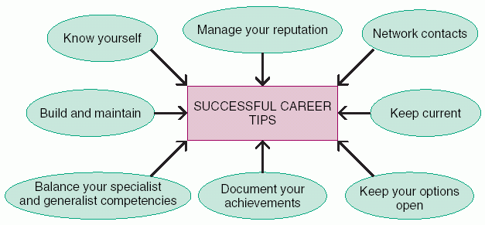
Summary
The Schein Anchors
Personal value clusters determine what is important to individuals.
  technical-functional competence
  managerial competence
  security-stability
  creativity
  autonomy-independence
Jung and the Myers-Briggs Typologies
Four personality dimensions:
  Extraversion-Introversion
  Sensing-Intuitive
  Thinking-Feeling
  Judging-Perceiving

Slide 8
Summary
Performance Management System
The performance management systems need to include:
  decisions about who should evaluate performance
  what format should be used
  how the results should be utilized
The Appraisal Process
Difficulties in Performance Management Systems
Three approaches:
Absolute standards
Relative standards
Objectives

Slide 9
Summary
Factors that can Distort Appraisals
  Leniency error
  Halo error
  Similarity error
  Low appraiser motivation
  Central tendency
  Inflationary pressures
  Inappropriate substitutes for performance
  Attribution Theory
  Impression management

Slide 10
Summary
Creating More Effective Performance Management Systems
  Use Behavior-Based Measures
  Combine Absolute and Relative Standards
  Provide Ongoing Feedback
  Use Multiple Raters
  Rate Selectively
  Train Appraisers
  International Performance Appraisal

Slide 11
Summary
Pay
Types of Reward Plans
Intrinsic versus Extrinsic Rewards Intrinsic
Financial versus Nonfinancial Rewards
Compensation Administration
The process of managing a compensation program so that the organization can attract, motivate and retain competent employees who perceive that the program is fair.
Job evaluation
Job Evaluation Methods
  Ordering method
  Classification
  Point method
Compensation surveys
Wage Curve/Wage structure

Slide 12
Summary
Individual Incentives include
  merit pay plans (annual increase, based on performance)
  piecework plans (pay based on number of units produced typically in a specified time period.)
  time-savings bonuses and commission
Group Incentives
Plant-wide Incentives:
  Scanlon Plan - supervisor and employee committees suggest labor-saving improvements
  IMPROSHARE - formula is used to determine bonuses based on labor cost savings
  Paying for Performance
  Salaries of Top Managers
  Executive Compensation Programs
  International Compensation

Slide 13
Summary
Costs of Providing Employee Benefits
Legally Required Benefits
Social Security
Unemployment Compensation
Workers’ Compensation
Traditional health insurance
Family and Medical Leave
Voluntary Benefits

Slide 14
Summary
Vesting rights – right to pension benefits even if one leaves the company.
Enables pension rights to be portable.
Sets up Pension Benefit Guaranty Corporation (PBGC)
Defined Contribution Plans
Profit-Sharing Plans
Vacation and Holiday Leave
Disability Insurance Programs
Survivor Benefits
Flexible benefits
Modular plans
Core-Plus Options Plans

Slide 15
Summary
OSHA
Inspection and the inspector
Costs of Accidents
Preventative Measures
Education
Skill training
Engineering
Protection devices
Regulation enforcement
Sick buildings are office environments that contain harmful airborne chemicals, or indoor pollution.
The Smoke-Free Environment
Repetitive Stress Injuries (Typing)
Injuries resulting from continuous, repetitive movements, such as typing.
Also referred to as musculoskeletal disorders (MSDs).
The most frequent injury is carpal tunnel syndrome, which occurs in the wrist.

Slide 16
The End

