Slide 1
Human Resource Management
Lecture 30
MGT 350

Slide 2
Topic
Summary
Lecture 1-10

Slide 3
Summary
Title and Course Code
Introduction
Text Book
Chapters (Course Topics)
What is HRM (managing people/ employees)
The importance of HRM (Important function)

Slide 4
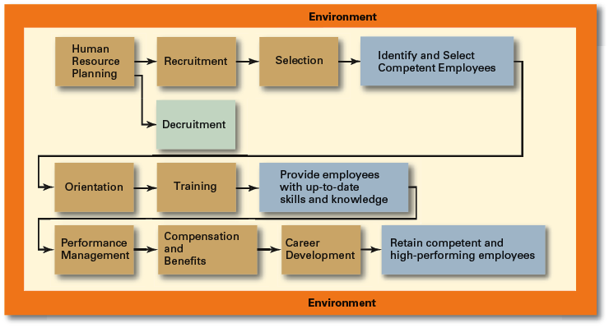
HRM Process

Slide 5
Summary
Introduction to HRM Process and functions
  Job Analysis
  Job Description
  Job specification
  Methods of Data collection for Jobs.
  Importance of Job Analysis

Slide 6
Summary
What is HRP
Supply measurement
Demand Measurement
FORECASTING HR REQUIREMENTS (DEMAND ANALYSIS)
(Trying to predict future staffing needs)
Sales Projections
Vacancy Analysis (projected turnover)
FORECASTING HR AVAILABILITY (SUPPLY ANALYSIS)
(Predicting worker flows and availabilities)
Succession or Replacement Charts
Skills Inventories (use of HRIS)
Markov Analysis (Transition Matrix)
Personnel Ratios
Regression Analysis
Trend Analysis

Slide 7
Summary
What is equal employment opportunity?
Determining Potential Discriminatory Practices
  The 4/5ths Rule
  Restricted Policy
  Geographical Comparisons
  McDonnell-Douglas Test
Three defenses:
  Business necessity
  Bona Fide occupations qualifications
  Seniority System
Comparable worth
Glass ceiling

Slide 8
Summary
Basic rights of employees
Honesty/Drug Tests
Whistle-blowing
Employee Monitoring and Workplace Security
    Theft
    Revealing of trade secrets to competitors
    Using the customer database for personal gain
Workplace Romance
The Employment-at-Will Doctrine

Slide 9
Summary
Discipline
Factors to consider when disciplining
The most frequent violations requiring disciplinary action involve
  Attendance
  On-the-job behaviors
  Dishonesty
  Outside activities
  Make disciplinary action progressive; i.e. verbal warning, written warning, suspension, dismissal.
  Hot-stove rule; i.e. immediate response; ample warning.
  Employee Counseling.
  Why Use an Employee Handbook?
  Complaint Procedures

Slide 10
Summary
What is recruitment?
Goals of recruitment.
Process of recruitment.
Recruitment in Global Village.
Expatriates
Home country nationals.
Host country nationals.

Slide 11
Summary
Recruiting Sources
  Internal Searches
  Employee Referrals/Recommendations
  External Searches
  Alternatives
  Meeting the Organization

Slide 12
Summary
The selection process
  initial screening interview
  completion of the application form
  employment tests
  comprehensive interview
  background investigation
  conditional job offer
  medical/physical exam
  permanent job offer

Slide 13
Summary
Reliability: The ability of the selection tool to measure an attribute consistently.
Validity: The relationship between scores on a selection tool and a relevant criterion, such as job performance.
Indicates how well a selection tool predicts job performance.
  Content
  Construct
  Criterion-related
Selection criteria for international assignments
Suggestions for making your interviews

Slide 14
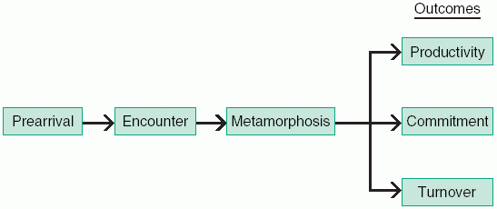
Summary
Covers such things as:
  The organization’s objectives
  History
  Philosophy
  Procedures
  Rules
  HRM policies and benefits
  Fellow employees

Slide 15
Summary
  CEO’s Role in orientation
  HRM’s Role in Orientation
Employee training
  a learning experience designed to achieve a relatively permanent change in an individual that will improve the ability to perform on the job.
Determining training needs
On-the-job training methods
  Job Rotation
  Understudy Assignments
Off-the-job training methods

Slide 16
The End

