Slide 1
Human Resource Management
Lecture 2
MGT 350

Slide 2
Last Lecture
Title and Course Code
Introduction
Text Book
Chapters (Course Topics)
What is HRM (managing people/ employees)
The importance of HRM (Important function)

Slide 3
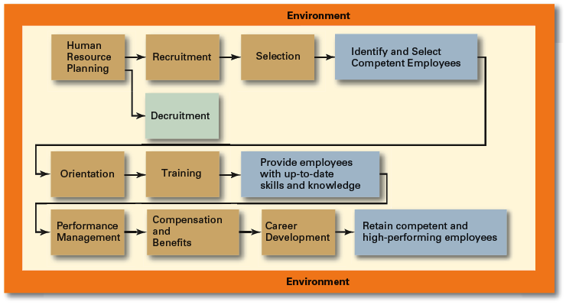
Human Resource Management Process

Slide 4
JOB ANALYSIS

Slide 5
Defining Organizational Structure
Organizational Structure
  The formal arrangement of jobs within an organization.
Organizational Design
  A process involving decisions about six key elements:
    Work specialization
    Departmentalization
    Chain of command
    Span of control
    Centralization and decentralization
    Formalization

Slide 6
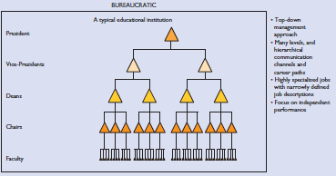
Organizational structure

Slide 7
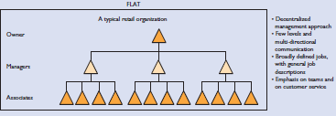
Organizational structure

Slide 8
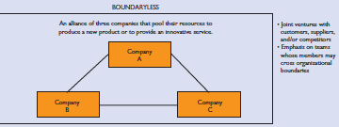
Organizational structure

Slide 9
Organization Structure (cont’d)
Centralization
  The degree to which decision-making is concentrated at a single point in the organizations.
    Organizations in which top managers make all the decisions and lower-level employees simply carry out those orders.
Decentralization
  Organizations in which decision-making is pushed down to the managers who are closest to the action.

Slide 10
Organization Structure (cont’d)
Formalization
  The degree to which jobs within the organization are standardized and the extent to which employee behavior is guided by rules and procedures.
    Highly formalized jobs offer little discretion over what is to be done.
    Low formalization means fewer constraints on how employees do their work.

Slide 11
The Learning Organization
  An organization that has developed the capacity to continuously learn, adapt, and change through the practice of knowledge management by employees.
  Characteristics of a learning organization:
    An open team-based organization design that empowers employees
    Extensive and open information sharing
    Leadership that provides a shared vision of the organization’s future, support and encouragement
    A strong culture of shared values, trust, openness, and a sense of community.

Slide 12
Job Design
job design
The process of systematically organizing work into tasks that are required to perform a specific job.
job
A group of related activities and duties held by a single employee or a number of Employees.

Slide 13
Job Design
TEAM-BASED JOB DESIGNS
Job designs that focus on giving a team, rather than an individual, a whole and meaningful piece of work to do and empowering team members to decide among themselves how to accomplish the work.
Example: Restaurant.
HUMAN ENGINEERING (ERGONOMICS)
An interdisciplinary approach that seeks to integrate and accommodate the physical needs of workers into the design of jobs. It aims to adapt the entire job system—the work, environment, machines, equipment, and processes—to match human characteristics.

Slide 14
Job Analysis
Job Analysis is a systematic exploration of the activities within a job.
It defines and documents the duties, responsibilities and accountabilities of a job and the conditions under which a job is performed.

Slide 15
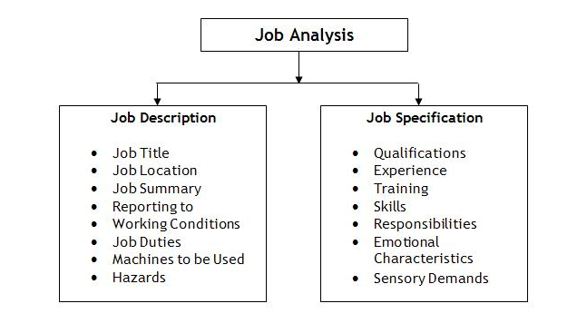
Job Analysis Parts

Slide 16
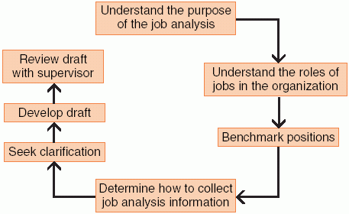
Job Analysis

Slide 17
Steps In job Analysis
Steps In job Analysis

Slide 18
Steps In job Analysis
Job Analysis Data Collection Methods
    Observation method – job analyst watches employees directly or reviews film of workers on the job.
    Individual interview method – a team of job incumbents is selected and extensively interviewed.
    Group interview method – a number of job incumbents are interviewed simultaneously.

Slide 19

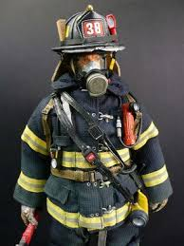
Observation Method

Slide 20
Job Analysis
Job Analysis Methods
    Structured questionnaire method – workers complete a specifically designed questionnaire.
    Technical conference method – uses supervisors with an extensive knowledge of the job.
    Diary method – job incumbents record their daily activities.
The best results are usually achieved with some combination of methods.

Slide 21
Job Analysis
Job Evaluations
  Specify relative value of each job in the organization.

Slide 22
Job Analysis
Job Analysis and the Changing World of Work
  Globalization, quality initiatives, telecommuting, and teams require adjustments to the components of a job.
  Today’s jobs often require not only technical skills but interpersonal skills and communication skills as well.

Slide 23
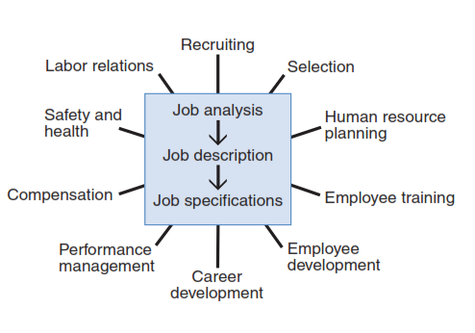
Importance of job analysis

Slide 24
Summary
Introduction to HRM Process and functions
  Job Analysis
  Job Description
  Job specification
  Methods of Data collection for Jobs.
  Importance of Job Analysis

