Slide 1
Human Resource Management
Lecture 1
MGT 350

Slide 2
Introduction
Name
Qualification
Experience
Research Work

Slide 3
Lecture outline
First part:
  Introduction to the module
Second part:
  Introduction to Human Resource Management (HRM)

Slide 4
Introduction to the module
First Part

Slide 5
MODULE OBJECTIVES
To understand and comprehend:
What is HRM?
What is the importance of HRM?
HRM Process and Functions
  Recruitment and selection
  Orientation and Training
  Performance management
  Compensation and benefits
  Career Development
  Safety and Health
  Labour Laws in Pakistan

Slide 6
Course structure
Lectures: 32 lectures
Recommended text:
    Fundamentals of Human Resource Management, By David A. DeCenzo, Stephen P. Robbins and Susan L. Verhulst.

Slide 7
Course Topics
UNDERSTANDING HRM
  The Dynamic Environment of HRM
  Fundamentals of Strategic HRM
LEGAL AND ETHICAL CONTEXT OF HRM
  Equal Employment Opportunity
  Employee Rights and Discipline
STAFFING THE ORGANIZATION
  Human Resource Planning and Job Analysis
  Recruitment
  Selection

Slide 8
Course Topics
TRAINING AND DEVELOPMENT
  Socializing, Orienting, and Developing Employees
  Managing Careers
MAINTAINING HIGH PERFORMANCE
  Establishing the Performance Management System
  Establishing Rewards and Pay Plans
  Employee Benefits
  Ensuring a Safe and Healthy Work Environment
MANAGEMENT ENVIRONMENTS
  Understanding Labor Relations and Collective Bargaining

Slide 9
Introduction to HRM
Second Part

Slide 10
Organization and HRM
Organizations have different departments.
  Finance
  Marketing
  Research and Development
  Human Resource Management

Slide 11
Human Resource Management
No universal definition
Term originated in the USA
Initially interchangeable with ‘Personnel Management’
Managing Humans (Employees)
The management of people to do the work. (Boxall and Purcell 2012)

Slide 12
Human Resource Management
Human resource management is the management of an organization's workforce, or human resources.
  The process by which managers ensure that they have the right number and kinds of people in the right places, and at the right times, who are capable of effectively and efficiently performing their tasks.

Slide 13
Managerial Concerns
  Efficiency
      Getting the most output for the least inputs
  Effectiveness
      Attaining organizational goals

Slide 14
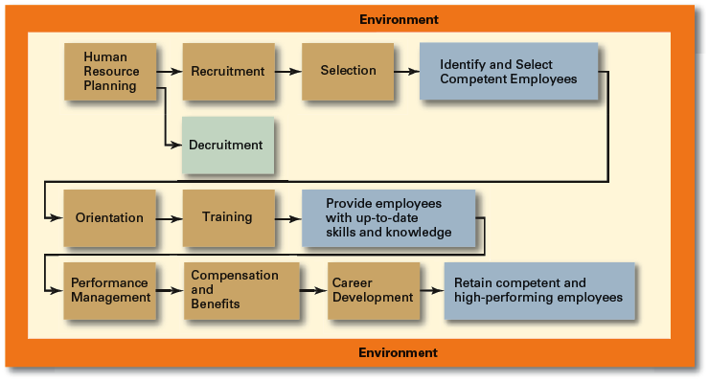
Human Resource Management Process

Slide 15
Human Resource (HR) Planning
    Assessing current human resources
    Assessing future needs for human resources
    Developing a program to meet those future needs
    Demand – supply = Gap (surplus/shortage)

Slide 16
Recruitment and Decruitment
Recruitment
  The process of locating, identifying, and attracting capable applicants to an organization.
Decruitment
  The process of reducing a surplus of employees in the workforce of an organization.

Slide 17
Selection
Selection Process
  The process of screening job applicants to ensure that the most appropriate candidates are hired.

Slide 18
Orientation
Planned introduction of new employee to his/her job, co-worker and the organization.

Slide 19
Employee Training
Employee Training is a learning experience designed to achieve a relatively permanent change in an individual that will improve the ability to perform on the job.
Up-to dated Skills.

Slide 20
Employee Performance Management
  A process of establishing performance standards and appraising employee performance in order to arrive at objective HR decisions and to provide documentation in support of those decisions.

Slide 21
Compensation and Benefits
Compensation is the total amount of the monetary and non-monetary pay provided to an employee by an employer in return for work performed as required.
Internal equity/External Equity

Slide 22
Career Development
Career Defined
  The sequence of positions held by a person during his or her lifetime is called career.

Slide 23
The Importance of Human Resource Management (HRM)
As a necessary part of the organizing function of management
  Selecting, training, and evaluating the work force
As an important strategic tool
  HRM helps establish an organization’s sustainable competitive advantage.
Adds value to the firm
  High performance work practices lead to both high individual and high organizational performance.

Slide 24
Summary
Title and Course Code
Introduction
Text Book
Chapters (Course Topics)
What is HRM (managing people/ employees)
The importance of HRM (Important function)

