Slide 1
Summary of Last Lecture
Capital Budgeting
Techniques of Capital Budgeting

Slide 2
NET PRESENT VALUE (NPV) AND INTERNAL RATE OF RETURN (IRR)

Slide 3
Learning Objective:
In this lecture, we will discuss in detail the previous lecture topics that are
Net Present value (NPV)
Internal Rate of Return (IRR)

Slide 4
Net Present value (NPV):
The most important skill in this course is to understand the NPV equation and to calculate NPV as reliably as possible. It is also the most important criteria in capital budgeting. It is very difficult to calculate because different inputs used in Net present value equation are based upon a forecast, which may or may not be accurate e.g. future cash flows and sales.

Slide 5
Net Present value (NPV):
Similarly, when we talk about the life of the project, again we are estimating the duration of the project. We also have to choose subjectively the discount rates to be used, including cost of capital, opportunity cost & required rate of return in the calculation of Net present value.

Slide 6
Net Present value (NPV):
We will discuss how to choose the interest rate when we would talk about risk. In NPV the idea is to bring back each cash flow to the present and then to add or subtract them on present time. The project or investment, which is offering the highest NPV, gets the highest rank.
Formula:
NPV = -Io + CFt / (1+i)t = -Io + CF1/(1+i) + CF2/(1+i) 2 + CF` /(1+i) 3 +..

Slide 7
Importance of NPV in terms of objectives of Financial Management:
The objective of FM is to maximize the shareholders wealth. Now, there is a direct link between shareholder wealth maximization & NPV. It is mentioned earlier that the value of an asset is determined by the future cash flows it generates.

Slide 8
Importance of NPV in terms of objectives of Financial Management:
We used these future cash flows & discount them to present and we call that the NPV. Hence, there is a direct link between NPV and future cash flows.
When the management of the company invest in the +ve NPV projects, they increase the economic value added (E.V.A) and they also increase market value added (M.V.A). It should be clear by now that when company invest in +ve NPV projects they brings in value to the company. Increase in the value of the company implies increase in shareholders’ wealth.

Slide 9
Importance of NPV in terms of objectives of Financial Management:
Example: Let us suppose that you invest Rs 100,000 in a Savings Certificate. After 1 Year you will receive a coupon payment (or profit) of Rs 12,000 and you also reclaim your initial investment (principal).

Slide 10
Importance of NPV in terms of objectives of Financial Management:
Solution:
Step 1: Identify the Variables: Io = Rs 100,000 CF1=Rs 12,000
Life = n=1year
Required Rate of Return = i =10% (assumed),
Annual compounding.
CF I1 = Rs 100,000

Slide 11
Importance of NPV in terms of objectives of Financial Management:
Here, we assume that i=10 because which is the opportunity cost as you can place that money in a bank and can earn 10%. Do not forget that you get back your principal investment after 1 Year. This is a positive cash flow and must be discounted back to the present just like any other future cash flow).

Slide 12
Importance of NPV in terms of objectives of Financial Management:
Step 2: Solve the NPV Equation
NPV = -Io + CF1 / (1+ i) + CF I1 / (1+ i)
= -100,000 + 12,000/ (1+0.10) + 100,000/ (1+0.10)
= -100,000 + 10,909 + 90,909
= + Rs 1,818 NPV positive so investment acceptable
NOTE: PV = NPV + Io = 1,818 + 100,000 = Rs 101,818

Slide 13
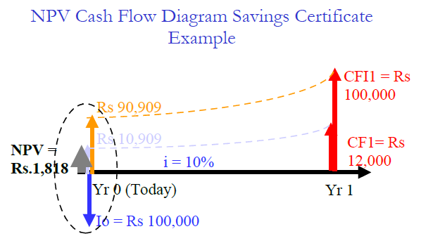
Importance of NPV in terms of objectives of Financial Management:

Slide 14
Importance of NPV in terms of objectives of Financial Management:
In diagram initial downward sloping arrow shows the cash out flow and after one year two upward pointing arrows (1. profit 2.return of initial investment) show the cash inflows. Now let us talk about the Internal Rate of Return or IRR.

Slide 15
Internal Rate of Return or IRR:
IRR is a very commonly used criterion for capital budgeting. It is popular with the managers because it gives a very simple answer in the form of annual percentage and you can compare it to the inflation rate, cost of capital or financing or to the certain financial accounting ratios. The formula uses trial & error method. We talk about the interpretation of IRR in the coming lectures.

Slide 16
Internal Rate of Return or IRR:
The formula is similar to NPV
NPV = 0 = -Io + CFt / (1+IRR)t = -Io + CF1/(1+IRR) + CF2/(1+IRR) 2 + ..
The value of i where NPV is zero is the value of IRR.

Slide 17
Internal Rate of Return or IRR:
IRR represents the Break-even Return on Investment, but the important thing to remember is the difference between IRR & NPV. When you are ranking different projects the ranking you get from NPV may be different from the ranking you get from IRR, because, there is a major difference of interpretation of i between NPV and IRR.

Slide 18
Internal Rate of Return or IRR:
The difference is that in the case of NPV; we are externally specifying the discount rate based on required rate of return. In NPV calculations, you have an idea of your opportunity cost for the capital & you use it as ‘i’.

Slide 19
Internal Rate of Return or IRR:
As mentioned earlier that rate given by the banks on account is considered as opportunity cost of your capital & you will invest in any project, which earns more than the rate offered by a bank. However, in IRR i is derived from the cash flow pattern of the project.

Slide 20
Internal Rate of Return or IRR:
Remember that in IRR project, we do not externally specify the interest rate but we calculated it from the cash flows.
Therefore, in the IRR it is what you called forecasted rate of return or an intrinsic rate of return. This is an important difference to keep in mind between NPV & IRR.

Slide 21
Internal Rate of Return or IRR:
Example:
Consider the Same Savings Certificate example for IRR calculation. The only difference is that this time, we will not assume any value for “i” as we had done in the NPV calculation.

Slide 22
Internal Rate of Return or IRR:
We set the NPV = 0 and solve the equation for “i” (or IRR).
NPV = 0 = -Io + [CF1 / (1+IRR)] + [CFI1 / (1+IRR)]
We add Rs 12,000 & Rs 10,000 as both appearing at the same time.
0 = -100,000 + [(CF1 + CFI1) / (1+IRR)]
0 = -100,000 + [(12,000+100,000) / (1+IRR)]
IRR= (112,000 / 100,000) - 1
(No need for trial & error because you have one variable & one unknown)
= 1.12 - 1.00 = 0.12 = 12 % per annum

Slide 23
Internal Rate of Return or IRR:
Is that a good IRR, a high IRR or low IRR? These things we will discuss in this & in the next lecture. Now, one very important thing, which you need to consider when you are evaluating an investment proposal, is to look at NPV & to see how it changes as you change the discount rate.

Slide 24
Internal Rate of Return or IRR:
This is known as NPV Profile (See Fig.). Logically, when you increase the discount rate, the denominator becomes larger & you net present value becomes smaller. What you find as a result is a downward sloping line. The point where the NPV is zero would be the IRR for the project.

Slide 25
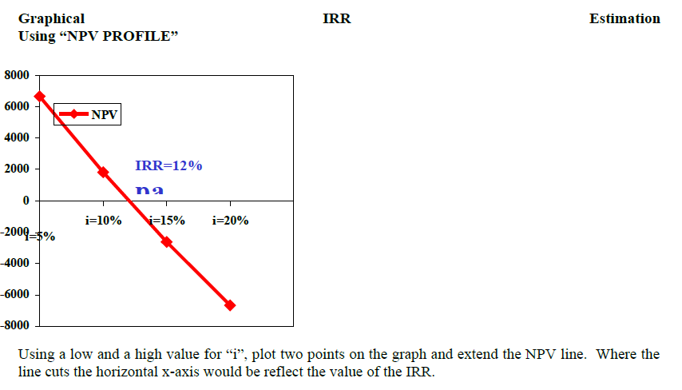
Internal Rate of Return or IRR:

Slide 26
Internal Rate of Return or IRR:
Use this Graphical Technique when:
1. The investment or project life is longer than 2 years.
2. Graphical technique very useful in IRR calculations as there are polynomial equations that are time consuming to solve algebraically in terms of “i”.
3. Comparing the NPV’s of 2 or more investments, to study how sensitive the NPV’s of the different investments are to the discount rate “i”

Slide 27
RANKING TWO DIFFERENT INVESTMENTS:
Example:
Let us consider two investment opportunities. One Investment is the Savings Certificate (which we described earlier) and the second investment is a Bank Deposit of Rs 100,000 at 10% interest compounded annually for two years.

Slide 28
NPV & IRR Numerical
Comparing the 2 Investments
Since we have calculated the NPV and IRR for the Savings Certificate, we would calculate the NPV and IRR only for the Bank deposit rate.
Bank Deposit Example
FV = PV (1+i) n = 100,000 x (1.10) ^ 2 = 121,000

Slide 29
NPV & IRR Numerical
Comparing the 2 Investments
NPV = -100,000 + 10,000/ (1.1) + 11,000/ (1.1)2 + 100,000/(1.1)2 = 100,000 + 9,090 + 91,736 = + Rs
826
IRR: NPV = 0 = -100,000 + 10,000/ (1+IRR) + 111,000/ (1+IRR)2 … by trial & error IRR = 10.5%

Slide 30
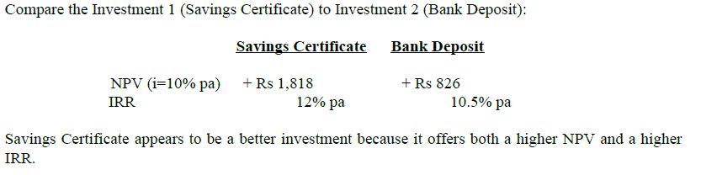
NPV & IRR Numerical
Comparing the 2 Investments

Slide 31
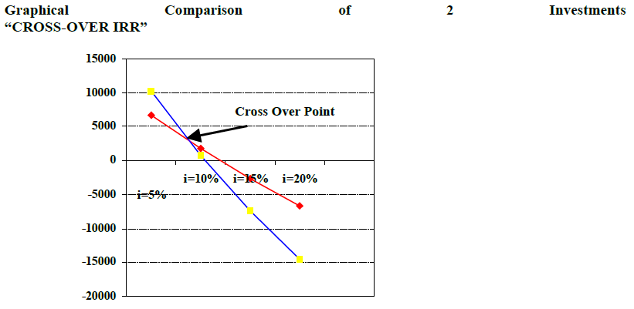
NPV & IRR Numerical
Comparing the 2 Investments

Slide 32
NPV & IRR Numerical
Comparing the 2 Investments
The above diagram shows NPV Profiles of investments intersect at the Cross Over Point. Slope of Bank Deposit investment is steeper because larger cash flows (Rs 111,000) are taking place later in time (2 years instead of 1 year for Saving Certificates). Size of the Discounting Factor grows exponentially with time so NPV graph falls much faster. The IRR at this Point is 8.8%.

Slide 33
NPV & IRR Numerical
Comparing the 2 Investments
At this point, the NPV of both the investments is equal at about +Rs 2,950 When IRR is less than 8.8% (Cross-over IRR) then the NPV of Bank Deposit is higher!

Slide 34
NPV & IRR Numerical
Comparing the 2 Investments
Investment Criteria
IRR Interpretation - How high is high.

Slide 35
Investment Criteria
IRR Interpretation - How high is high.
Macro Aspects
Inflation:
An IRR, which is considered low for a medium inflation country like Pakistan, may be considered high for a low inflation country like USA, Japan, and Singapore where inflation is below 5%.

Slide 36
Investment Criteria
IRR Interpretation - How high is high.
Macro Aspects
Risk Free Rate of Return:
Recall our discussion from earlier lecture on Interest Rates and Money Markets.
In Pakistan, we use the Government T-Bill rate, which varies from 7% to 12% per annum depending on the Money Market. Considering the risk-free rate of return the IRR on investment is not very good. We will talk more about this after we study RISK.

Slide 37
Investment Criteria
IRR Interpretation (Micro Aspects)
ROA & ROE:
If the Investor has an existing running business that generates cash flows, then any new project that matches or exceeds the returns of the existing business is worth considering.

Slide 38
Investment Criteria
IRR Interpretation (Micro Aspects)
Problem: ROA & ROE are Financial Accounting Ratios based on Net Income (not cash) & Historical Cost or Book Value (not market value) whereas IRR is based on Cash and Forecasted Market Value. The financial ratios are calculated based on the profit reported in the income statement, whereas the IRR takes into account the cash flows rather than the accounting profit in the calculations.

Slide 39
Investment Criteria
IRR Interpretation (Micro Aspects)
Weighted Average Cost of Capital (WACC) or Hurdle Rate:
If the Investors an existing operating business that runs on borrowed money (or financing) then the Investor (the borrower) bears the cost of interest, say 18% pa in Pakistan. Obviously, the rate of cash generation should exceed the rate of interest payment.

Slide 40
Investment Criteria
IRR Interpretation (Micro Aspects)
The IRR of a new project should exceed the WACC. We will discuss this in detail when we study Capital Structuring. When IRR is above the WACC, the excess return represents surplus that increases shareholders’ wealth. The details on WACC would be further discussed in Capital Structure determination.

Slide 41
Summary
Net Present value (NPV)
Internal Rate of Return (IRR)

