Slide 1
Summary of Last Lecture
Present Value and Discounting

Slide 2
DISCOUNTING CASH FLOW ANALYSIS, ANNUITIES AND PERPETUITIES

Slide 3
Learning Objectives:
After going through this lecture, you would be able to have an understanding of the following concepts.
Discounted Cash Flows (DCF Analysis)
Annuities
Perpetuity

Slide 4
DISCOUNTING CASH FLOW ANALYSIS
This lecture is continuation of the previous lecture’s topics. In the previous lecture, we had discussed the calculation of the Net Present Value (NPV) and the use of the value of interest rate or Opportunity cost in the process.
Bank Interest on the PLS Account represents the Minimum Opportunity Cost of our investment. A good investment opportunity should, however, offer a higher return than the Bank Interest rate.

Slide 5
DISCOUNTING CASH FLOW ANALYSIS
We also used the time & arrow diagram to show the cash flows forecast. In the diagram, we used upward pointing arrow to represent the cash inflows & downward pointing arrow are used to represent the cash outflows. You can simplify that diagram by arithmetically solving the upward & down ward pointing arrows at same point in time by showing it with one arrow. (see Fig next slide)

Slide 6
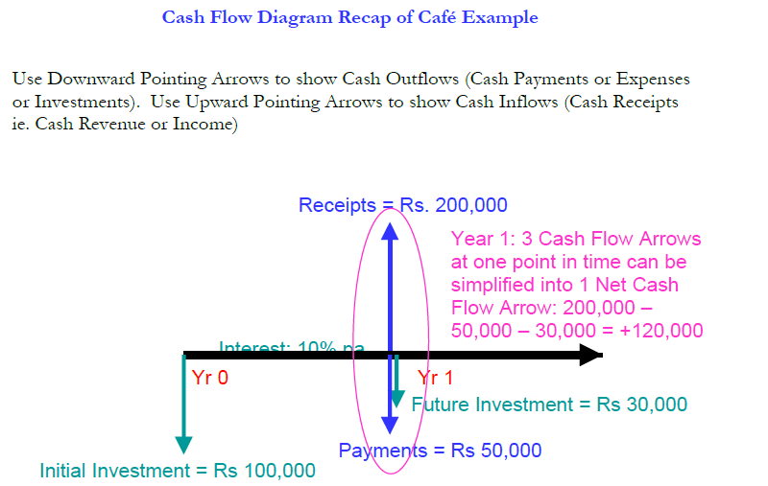
DISCOUNTING CASH FLOW ANALYSIS

Slide 7
DISCOUNTING CASH FLOW ANALYSIS
The arrows in time-and-arrow diagram can be added and subtracted when they are on same point in time but when these arrows are at the different point of time these cannot be added or subtracted. Now, let’s talk about some common cash flow patterns the most common is called annuity.

Slide 8
Annuity:
An annuity is a series of fixed payments, which might be over a fixed number of years, or over the lifetime of an individual, or both. The commonly known types of annuities we see are the monthly rent, and monthly mortgage payments, or insurance premiums.

Slide 9
Annuity:
There are two types of annuities
1. Ordinary Annuity
An ordinary annuity, also known as deferred annuity, consists of a series of equal payments at the end of each period.
2. Annuity Due
An annuity due consists of a series of equal payments at the beginning of each period.

Slide 10
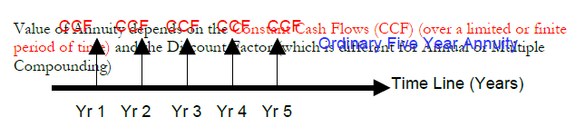
Annuity:

Slide 11
Annual Compounding (at end of every year):
FV = CCF (1 + i) ^ n - 1
For example, the payment of Rs.10,000 as monthly rental to the land lord is an annuity which gives birth to an annuity stream.
Future value of an annuity can be seen as follows:

Slide 12
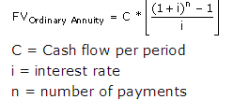
Annual Compounding (at end of every year):

Slide 13
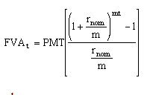
Multiple Compounding:

Slide 14
Multiple Compounding:
Once we have calculated the future value of the annuity, it is very easy to calculate the present
value using the well-known interest rate formula.
Annual Compounding (at end of every year)
PV =FV / (1 + i ) ^ n .
n = life of Annuity in number of years
Multiple Compounding:
PV =FV / [1 + (i/m)] ^ m x n
i = % interest per year

Slide 15
Multiple Compounding:
More than once per year i.e. Monthly (m =12), Quarterly (m=4), Six-monthly (m=2).
n = number of years

Slide 16
Perpetuity:
Now let’s talk about another kind of cash flow pattern called perpetuity.
The difference between Annuity and Perpetuity is that the Perpetuity is an ongoing concern, it is never ending stream of annuities, whereas an annuity is for a limited period.

Slide 17
Perpetuity:
“It is defined as an annuity with an infinite life making continual payments.”
In real life, we see the example of perpetuity in the retirement plan. For Example, you might plan to save a sufficient amount of money & invested in a particular security or investment that will give you steady & consistent rate of return on every month or quarter and this represents a constant cash flow amount that we can assume to go as long as you live.

Slide 18
Perpetuity:
Since we are not sure how far we are going to live and we make an infinite series of annuities the formula of Future value of Perpetuity is simpler than that of annuity:
Future value of perpetuity=constant cash flow/interest rate
As we assume that, it is never ending and on going so time is irrelevant and is simply dropped out of the equation.

Slide 19
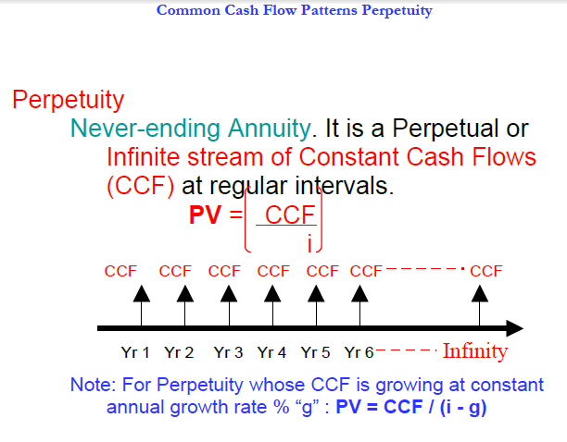
Perpetuity:

Slide 20
Examples
Let’s do a simple numerical example which will help us what an annuity calculation is like.
Example:
Assume that we need to make a basic financial decision, whether to purchase a particular asset or to get it on lease (installments).
A car has a Market Value today of Rs 150,000. If you get the car on Lease Financing, then you are required to pay a fixed regular rental at a fixed interest rate to the Leasing Company. You are allowed to use the car but the ownership of the car stays in the name of the Leasing Company until you complete all your rental payments.

Slide 21
Examples
The question is whether you should Lease the car or Buy it?
The Leasing Company quotes Rs 120,000 every year for 2 years in the form of Car Lease Rental at a Nominal rate of interest (APR interest rate) of 20% pa. Then what is the total Future Value you would have paid after 2 years? You would be paying approximately Rs 240,000 if you do not take into account the time value of money.

Slide 22
Examples
Now we calculate the present value of the investment by using Time value of money concept.
First, we need to calculate the future value by using annuity formula
FV =CCF [(1+i)^ n - 1]/ i
=120,000[(1+0.2) ^ 2 -1]/0.2
= Rs 264,000 (yearly compounding)

Slide 23
Examples
If we deposit the amount annually in a bank at the rate of 20 percent, we would be able to get Rs
264,000 at the end of the second year. Now we will calculate what the present value of this future value is going to be, and for this, we will use the old interest rate formula
PV = FV / (1+i) n
= 264,000 / (1+0.2)2
= Rs 183,333

Slide 24
Examples
The resulting amount is about Rs 33,000 more than what we would have originally paid if we had bought the car rather than lease it.
The above calculation, however, was not based on realistic assumptions because car lease rentals are generally paid monthly, rather than annual payments. In fact, you pay Rs 10,000 per month for 2 years. We use periodic interest rate (i/m). Now, what is the future value after 2 years?
Our cash flow diagram should present the monthly installments & not annual Payments.

Slide 25
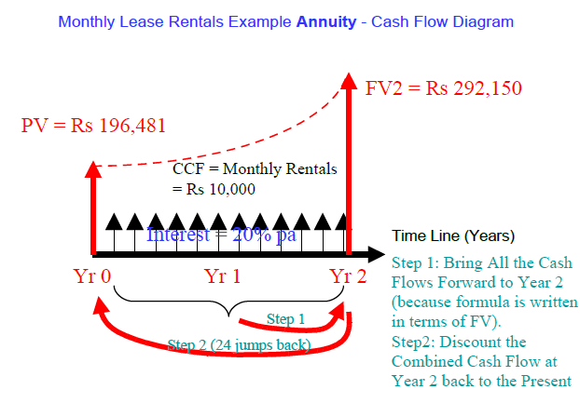
Examples

Slide 26
Examples
It can be argued that by paying a rental of 10,000 monthly, we are actually paying Rs 120,000 in a year, so there hardly any difference. But, by not realizing the difference, one is violating the time value of money because cash flows occurring at different points of time cannot be subtracted or added.
It is the cardinal principle of Time value of money.

Slide 27
Examples
If we have to calculate the future value of the annuity on a monthly basis, we would use the following formula.
=CCF X {[(1+i/m) nxm-1]/ (i/m)}
Now the m= 12 compounding cycle in a year
Putting the values in the formula, we obtain the result as under.
FV2=Rs 292,150

Slide 28
Examples
Now, we can calculate the present value of the future value of annuity
PV = FV / (1+i) ^ n
=292150/(1+.2/12)^ 2x12
=196,481
The present value of annuity can also be called the intrinsic value of the annuity.

Slide 29
Perpetuity Example - Retirement Planning
The aforementioned technique allows us to compare the amount of money we are paying to leasing company with the market value of car. It helps you to decide whether you should buy the car on market price or to get it leased. The cost of leasing at 20% p.a. tell us that you have to pay 20% interest & you have to pay more money in leasing as compare to the decision if you buy it .

Slide 30
Perpetuity Example - Retirement Planning
You would like to retire at the age of 60 and receive an income of Rs. 200,000 every year from your Bank Account for as long as you live. How much money do you need to deposit in the Bank Account offering 10% pa so that the Account will pay you Rs 200,000 of interest income every year forever (even though you will not live forever)!
• PV = CCF / i = 200,000 / 0.10 = Rs 2,000,000

Slide 31
Perpetuity Example - Retirement Planning
This also implies that you would be receiving Rs 200,000 every year for the rest of your life and
the money would neither finish nor decrease in amount. This would happen so, because what you would be receiving at the end each year would be interest accrued on the investment that you have made. The money that you are getting is not a part of the investment; instead, it is the yield on your investment.

Slide 32
Perpetuity Example - Retirement Planning
This may sound like a ‘big idea’ for making money, but in fact, it is not so. Inflation, a macroeconomic syndrome erodes the value of money constantly. If the prevailing inflation rate is 5 percent, then your real return on investment is not 10 percent. If we consider the real rate of return, which is interest rate – rate of inflation, you would see that you need to invest twice as much to guard yourself against inflation.

Slide 33
Perpetuity Example - Retirement Planning
Another example for perpetuity is Consol Bonds. Consol Bonds were issued by the British Government in 18th century to pay off the smaller bonds that were issued to fund the wars against France. Since the purpose of the bond was to consolidate the past debts, it was named as Consol. These bonds were just like other bonds issued by the government, with the difference that it had no maturity. It implies that the holder of the bond was to receive regular interest payments for an endless period.

Slide 34
Perpetuity Example - Retirement Planning
Now if we have to invest in such a bond we need to know the price or the present value of the bond. Dividing the interest payment that a Consol bondholder would receive, by the interest rate, we can find the present value of a Consol bond.
Suppose that the interest rate is at 10 percent and the promised interest payments to be received are ￡ 1,000 every year, the price of the bond can be calculated as under
PV = CCF / i = 1,000/ 0.10 = ￡ 10,000

Slide 35
Perpetuity Example - Retirement Planning
With this example, the discussion on discounted cash flows, annuities, and perpetuities is concluded. We would study the capital budgeting techniques in the next lecture.

