Slide 1
Summary of Last Lecture
Financial Forecasting and Financial Planning.
Methods of forecasting

Slide 2
PRESENT VALUE AND DISCOUNTING

Slide 3
Learning objectives:
After studying this lecture, you would be able to have a better understanding of the following.
Present Value and Discounting
The Topics of this lecture are covered in the chapter 6 of our text book called Financial Management theory and practice by Eugene F. Brigham & Louis C. Gapenski.

Slide 4
Objectives of present value:
The objective of calculating the present value is to translate the future cash flows in to present terms. The basic principle is to compare apples with apples.
For instance, if you have Rs.10 in your pocket today and then you have may as many rupees ten years after, how can you compare the two. You can do it only by comparing both amounts at the Present time.

Slide 5
Objectives of present value:
We choose the present (today) as the most convenient point in time where we could compare all the cash flows taking place at various points in time in future. We must compare everything at the SAME point in time otherwise; we would be neglecting the Time Value of money concept.

Slide 6
Discounting:
“Discounting is defined as bringing the future cash flow to the present time”.
Before answering which amount is greater in the aforementioned example, we need to have some concept of interest rates or the cost of money. An interest rate can also be understood as an opportunity cost.

Slide 7
Discounting:
One of the simple ways of estimating what opportunity cost or interest rate should be for our discounting calculations, we can use interest rate given on the PLS accounts by the banks. For example, if money is deposited in a bank and getting 10% per annum then it is interest or opportunity cost for you.

Slide 8
Discounting:
This interest on PLS account becomes minimum rate of return which any investment should be able to generate. Therefore, the investment project should offer higher rate of return than the returns on the PLS account.

Slide 9
Discounting:
Now let’s see the answer of the question that Rs.105 will be more one year later or Rs.100 today, and for this, we need interest or opportunity cost. It is important to understand why interest rate is called opportunity cost? Because, opportunity cost essentially means the cost of taking up one option while sacrificing the other.

Slide 10
Discounting:
For instance, when you deposit your money in the bank and get interest, you are sacrificing by
(1) Not consuming the money to buy something for yourself and
(2) Not investing your money elsewhere at a higher return than the bank interest.

Slide 11
Discounting:
Usually when an investment option is taken up, investors forgo the option of depositing the money in a bank account and earn interest on that. The opportunity lost in this case is the opportunity cost. Now the question is that what kind of interest rate should we use? There are many interest rates quoted in the schedules of the bank but for discounting, the most commonly used rate is the nominal interest rate, or APR.

Slide 12
Interest Rates for Discounting Calculations
Nominal (or APR) Interest Rate = i nom
It is usually published in newspapers .Annual Nominal Interest Rate is quoted for 1 year by Credit Card Companies and Leasing ompanies because it understates the actual (or Effective) interest you have to pay, these companies want to create an impression that the interest charged by them is the minimum in the market.

Slide 13
Interest Rates for Discounting Calculations
Periodic Interest Rate = i per
Periodic interest rate is used in FM for Discounting and Present Value (PV) calculations. It is defined as
iper = ( i nominal Interest rate) / m
Where m = no. of times compounding takes place in 1 year i.e. If semi-annual compounding then m = 2

Slide 14
Interest Rates for Discounting Calculations
Effective Interest Rate = i eff
It is very useful to compare securities and investments with different life or compounding cycles but not used for Discounting and PV.
i eff = [1 + ( i nom / m )] ^ m – 1
Where m = no. of times compounding takes place in 1 year, the compounding cycle. The shorter the
compounding cycle more frequently money compounded & faster the money grows.

Slide 15
Interest Rates for Discounting Calculations
Coming back to our earlier example where we were trying to figure out whether or not Rs 100 of today are worth more than Rs 105 a year after, while the periodic interest rate is 10 percent per annum. The interest rate used here would be the nominal interest rate, i.e., 10 percent.

Slide 16
Interest Rates for Discounting Calculations
When we are going to solve for the present value we are discounting from the future to the present
PV=FV/(1+i) ^ n
Where, i=interest rate
N=no. of years if we plug in the values
PV=105/(1+0.10) ^ 1=Rs.95.45

Slide 17
Interest Rates for Discounting Calculations
Now we can see that if we discount Rs.105 from future to the present that is only the worth of Rs.95.45 which is less than Rs.100. The amount offered in the future is seemingly more but when converted to present value, the worth it has today, it come out to be less than Rs 100.

Slide 18
Interest Rates for Discounting Calculations
Thus, it is clear that Rs100 today worth more to Rs. 105 one year later. This conclusion is drawn on the assumption that interest rate is 10%, but if we change the interest rate, the answer might be different.

Slide 19
Interest Rates for Discounting Calculations
With the help of the following diagram, we can observe the effect of discounting the cash flows.
Now the point to understand is that if we discount back this money from 2 years back we would have only approximate Rs.87 in other words if Rs 105 are to be received after two years, the present value of would be even lesser.

Slide 20
Interest Rates for Discounting Calculations
If you discount Rs 105 two years from now, you will have lesser amount than you have one year from today. It is clear from the slide that as more future cash flow occurs distant in time, the more its present value decreases.

Slide 21
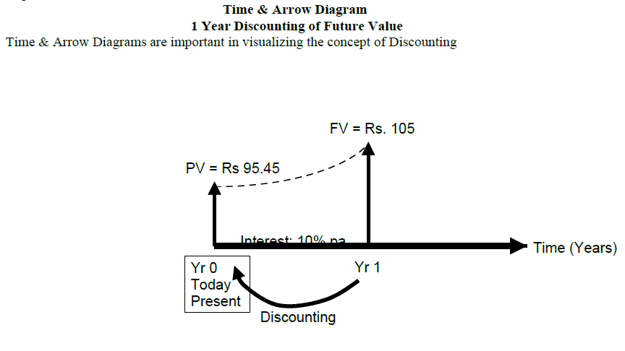
Interest Rates for Discounting Calculations

Slide 22
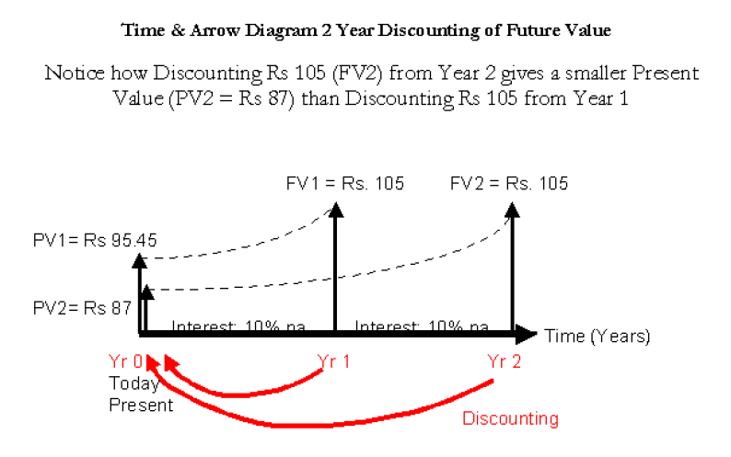
Interest Rates for Discounting Calculations

Slide 23
Discounting Cash Flows of a Business, Investment, or Project:
Let’s talk about the discounting cash flow of the business as to how we would estimate the cash flow business can generate? How can we calculate the market value and intrinsic value of a business or working asset? There are two steps involved
1) Forecast future cash flows of any business, investment, or project by using percent of sales method.
2) Discount the net cash flows back to the present time. The two-step process here can be elaborated by the following hypothetical example.

Slide 24
Discounting Cash Flows of a Business, Investment, or Project:
Cafe Case Study:
Suppose you are thinking about starting a small cafe or canteen inside a university campus. You make a simple feasibility report showing the estimated initial investment and the forecasted cash flows for the first Year (based on expected cash receipts from sales and cash payments for expenses).

Slide 25
Discounting Cash Flows of a Business, Investment, or Project:
The Key Financial Data is as follows:
• Initial Investment = Rs 100,000
• Forecasted Cash Receipts (end Year 1) = Rs 200,000
• Forecasted Cash Payments (end Year 1) = Rs 50,000
• Forecasted Future Investment (end Year 1)=Rs30,000
• Periodic Interest Rate (Opportunity Cost) = 10% p.a.
First step is to represent the phenomenon through a diagram in the form of cash out flows.

Slide 26
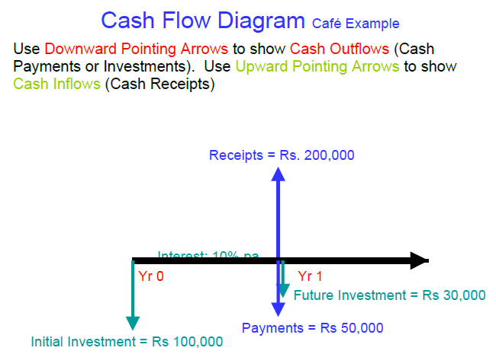
Discounting Cash Flows of a Business, Investment, or Project:

Slide 27
Discounting Cash Flows of a Business, Investment, or Project:
First of all, we can see the initial investment represented by the downward arrow. We have also forecasted the sales one year from now that is Rs.200, 000. This is a cash inflow for the business and is represented by an upward arrow; similarly, the expenses and investments (cash outflows) that we expect in future, will be shown by the downward arrows.

Slide 28
Discounting Cash Flows of a Business, Investment, or Project:
In the diagram there are three arrows, the upward one is showing forecasted sales (cash inflow) and two arrows downward show expenses of Rs.50, 000 and invest outlay of Rs.30, 000 respectively. Now the combined effect of the three arrows can be represented by a single arrow.

Slide 29
Discounting Cash Flows of a Business, Investment, or Project:
We can see that cash inflow of Rs.200,000 is having a +ve sign and expenses of Rs.50,000 and investment out lay of Rs.30,000 have –ve signs and finally, by deducting the negative signed figures from the positive one we can arrive at the net effect of the cash inflows and outflows, which is given as under
200,000-50,000-30,000 =Rs 120,000.

Slide 30
Discounting Cash Flows of a Business, Investment, or Project:
These different arrows can be added or subtracted because they are occurring at the same point of time and Rs.120, 000 can be shown by one arrow sign. In order to calculate the present value of Rs.120, 000, rate of interest as discount factor should be 10% per year.

Slide 31
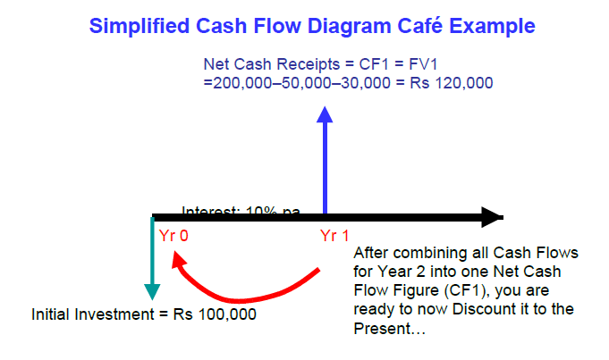
Discounting Cash Flows of a Business, Investment, or Project:

Slide 32
Discounting Cash Flows of a Business, Investment, or Project:
Calculating the NPV of the Cafe Business for 1st Year:
NPV = Net Present Value (taking Investment outflows into account)
NPV = −Initial Investment + Sum of Net Cash Flows from Each Future Year.
NPV = − Io +PV (CF1) + PV (CF2) + PV (CF3) + PV (CF4) + ...+ ∞

Slide 33
Discounting Cash Flows of a Business, Investment, or Project:
Note that PV (CF1) means the Present Value of Future Net Cash Flow (CF) taking place at the end of Year 1. CF is like the FV in our interest formulas. Our compounding cycle is 1 year so the Periodic Interest Rate is 10%.
Present Value of Net Cash Flow from Year 1 = PV (CF1) = CF1 / (1+ i) ^ n = 120,000 / (1+0.1) ^ 1 = Rs 109,000

Slide 34
Discounting Cash Flows of a Business, Investment, or Project:
The value of money has shrink from Rs.120, 000 to 109,000 as the concept of time value of the
money suggests and now we are in position to calculate the net present value of the money:
NPV = - Io + PV (CF1) = −100,000 + 109,000 = + Rs 9,000
The NPV of our Business after 1 Year is Positive Rs 9,000 which is a good sign. We will discuss this topic in more detail in capital budgeting.

