Slide 1
Summary of Last Lecture:
Main Concepts of FM.
Time Value of Money
Interest Theory and its determinants
Yield curve theory and its dynamics

Slide 2
Nominal or upward sloping yield curve:
Now, we go into the reason why the curves have either upward slope or downward slope. Following are some of the factors that determine the slope of the yield curves.

Slide 3
Expectations Theory:
Investors normally expect inflation (and interest) to rise with time thereby giving rise to a normal shaped yield curve.

Slide 4
Liquidity Preference Theory:
Investors prefer easily encashable securities with short maturities. The only problem is that short term securities are easy to encash but at maturity there is no guarantee that you can renew it . So, you can find a security today which will give you 25 %or 30% per annum they are not always renewable – hence unpredictable.

Slide 5
Market Segmentation:
The demand/supply for Short Term securities is different from that of Long Term securities. This can easily give rise to an Abnormal Yield Curve.

Slide 6
Types of Interest Rates
Now let’s talk about the practical types of interest there three kinds of interest we will talk about
1-simple interest
2-discrete compound interest
3-continuous compound interest

Slide 7
Simple Interest (or Straight Line):
Simple interest incurs only on the principal. While calculating simple interest we keep the interest and principal separately, i.e., the interest incurred in one year is not added to the principal while calculating interest of the next period. Simple interest can be calculated using the following formula.
F V = PV + (PV x i x n)

Slide 8
Simple Interest (or Straight Line):
Example: Assume that you have Rs 100 today and you want to invest the amount with a bank for five years. The bank is offering an interest rate of 7 percent. We can obtain the simple interest on the investment using the aforementioned formula
F V = PV + (PV x i x n)

Slide 9
Simple Interest (or Straight Line):
Here FV is the simple interest accrued for the term of the investment PV is the amount invested, i.e., Rs 100 in our example i stands for the interest rate offered by the bank, i.e., 7 % = 0.07, n is the term of the investment, which is assumed to be 5 years.

Slide 10
Simple Interest (or Straight Line):
Putting these values in the formula, we get
FV = 100 + (100 x 0.07 x 5)
FV = 100 + (7 x 5)
FV = 100 + (35)
FV = Rs 135
Here Rs 135 is the future value of investment after five years and Rs 35 is the interest accrued during five years on the initial investment of Rs 100.

Slide 11
Discrete Compound Interest:
Discrete compound interest is the most commonly used tool in Financial Management Discounting and NPV calculations. Unlike simple interest, compound interest takes into account the principal as well as interest accrued for a term, while calculating interest incurred during the next term., i.e., interest incurred for one year would be added to the principal to calculate the interest for the next period.

Slide 12
Discrete Compound Interest:
However, this compounding of interest takes place in a discrete manner, i.e., the compounding takes place yearly, semi-annually, quarterly, or monthly. For computing the annual compounding, we use the following formula.

Slide 13
Discrete Compound Interest:
Annual (yearly) compounding:
F V = PV x (1 + i) ^ n
However, a slight modification in the formula is need if the compounding takes place monthly.
Such a compounding would be calculated using the following formula.
F V = PV x (1 + (i / m) ^m x n
Here ‘m’ refers to the compounding intervals during the term of the investment. In order to calculate monthly compounding, the value of ‘m’ would be 12; however, for quarterly compounding calculation m would be equal to 4.

Slide 14
Discrete Compound Interest:
Example:
Assume that the investor in our previous example is offered a compound return (interest) on his same investment, at the same interest rate and term. The future value of the investment is given as under
F V = PV x (1 + i) ^ n
FV = 100 x (1+0.07) ^ 5
FV = 100 x (1.07) ^ 5
FV = 100 x (1.40255)
FV = 140.255
Here the interest accrued on the five year investment is more than what we found out in simple interest.

Slide 15
Discrete Compound Interest:
However if the compounding is done every month the future value of investment would be
F V = PV x (1 + (i / m)) ^ m x n
FV = 100 x (1 + (0.07/12)) ^ 12 x 5
FV = 100 x (1 + 0.005833)) ^ 60
FV = 100 x (1.005833) ^ 60
FV = 100 x 1.4176
FV = 141.76
With more frequent compounding, the wealth of the investor increases to a greater degree.

Slide 16
Continuous (or Exponential) Compound Interest:
The other type of compound interest is exponential compound interest. In this compound interest an infinite number of times per year at intervals of microseconds.
F V (Continuous compounding) = PV x e ^ i x n
Here e is a constant the derived value of which is 2.718

Slide 17
Continuous (or Exponential) Compound Interest:
Example:
Assume that the same investor has now the opportunity of investing at continuous compounding with the same term and interest rate. His future wealth after five years is given as under
F V = PV x e ^ i x n
FV = 100 x 2.718 ^ (0.07x5)
FV = 100 x 1.419
FV = 141.9
We can see that the wealth of the investor is the highest, when he decided to invest in a scheme which offers continuous compounding.

Slide 18
Continuous (or Exponential) Compound Interest:
The difference between simple and compound interest can increase manifold if the term of the investment is increased. As we see in the following example
Example:
Suppose you deposit Rs 10 in a bank today. The bank offers you 10% per annum (or per year) interest. How much money will you have in the bank after 15 years?
If the bank is offering simple interest:
F V = PV + (PV x i x n) = 10+ (10x0.10x15) = Rs. 25
If the bank is offering discrete compounding:
F V = PV x (1+ i) ^ n = 10 x (1+0.10)15 = Rs. 42 approx.
Banks do not offer continuous compounding but if they did:
F V = PV x e ^ ixn = 10 x (2.718) 0.10x15 = Rs. 45 approx

Slide 19
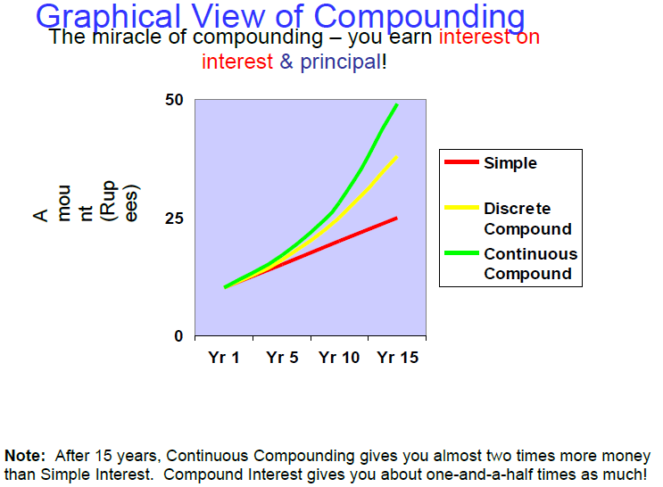
Continuous (or Exponential) Compound Interest:

Slide 20
FINANCIAL FORECASTING AND FINANCIAL PLANNING

Slide 21
Learning Objectives:
After going through this lecture, you would be able to have an understanding of the following concepts.
Financial Forecasting and Financial Planning.
Methods of forecasting

Slide 22
FINANCIAL FORECASTING AND FINANCIAL PLANNING
Before going into the detailed calculation of cash flow, it is important to know the principles behind financial forecasting and financial planning.
Although, financial planning and forecasting cannot reduce the uncertainty in our lives, the idea is simply to acknowledge and identify different points in time, here we expect some future occurrences, and to prepare plans and contingencies in the light of those forecasted happenings.

Slide 23
FINANCIAL FORECASTING AND FINANCIAL PLANNING
Of course, we cannot be certain about the future, but we can always plan and arrange for it.

Slide 24
Objectives of Financial Forecasting
Although, financial planning and forecasting cannot reduce the uncertainty in our lives, the idea is simply to acknowledge and identify different points in time, where we expect some future occurrences, and to prepare plans and contingencies in the light of those forecasted happenings.

Slide 25
Objectives of Financial Forecasting
Of course, we cannot be certain about the future, but we can always plan and arrange for it.
1) Reduce cost of responding to emergencies by anticipating the future occurrences
2) Prepare to take advantage of future opportunities
3) Prepare contingency and emergency plans
4) Prepare to deal with possible outcomes

Slide 26
Planning Documents:
There are three types of documents that are to be prepared while making a financial plan. These are
1) Cash Budget
2) Pro Forma Balance Sheet
3) Pro Forma Income Statement
Here, the term ‘pro forma’ refers to forecasting. These pro forma statements are prepared on the basis of certain estimates.

Slide 27
Methods of forecasting
In order to prepare pro forma statements, two methods are commonly practiced, which are given as under
Percentage of Sales: Simple
Cash Budget: Detailed, more complicated

Slide 28
Percentage of sales:
Step 1: Estimate year-by-year Sales Revenue and Expenses
Step 2: Estimate Levels of Investment Needs (in Assets) required meeting estimated sales (using Financial Ratios). That how the Assets of the company changes with the change in sales.
Step 3: Estimate the Financing Needs (Liabilities)

Slide 29
Percentage of sales:
Explanation:
While employing percentage of sales method, we would estimate the cash flows based on the sales revenue. The first step is to forecast the changes in the sales revenue in the successive years.
Expenses incurring in successive period would also be estimated. These expenses include cost of goods sold expense, administrative, expense, marketing expense, depreciation expense, and other expenses.
However, these revenues and expenses would be estimated on cash, rather than accrual basis.

Slide 30
Percentage of sales:
After estimating the revenues and expenses, we need to forecast the anticipated changes in assets and liabilities as a result of changes in sales. Having forecasted the assets and liabilities as a result of changes in sale, we would be able to identify how much capital the firm has to invest in assets and how much the company needs to borrow as a result of any shortfall.

Slide 31
Percentage of sales:
Here, we would examine the various heads of assets and liabilities and their relationship with sales. We can establish these relations by identifying the changes in assets and liabilities as a result of change in sales, and to do that certain assumptions need to be considered.

Slide 32
Percentage of sales:
GENERAL ASSUMPTIONS
Current Assets: Generally grow in proportion to Sales.
Fixed Assets: Do not always grow in proportion to Sales. Ask if you need to expand property, office or factory space, machinery in order to achieve your Sales target.

Slide 33
Percentage of sales:
GENERAL ASSUMPTIONS
Current Liabilities: Also called Spontaneous Financing. Generally grow in proportion to Sale
Long Term Liabilities: Also, called Discretionary Financing does not grow in proportion to Sales

Slide 34
Percentage of sales:
Explanation:
Current assets include cash, marketable securities, accounts receivable, inventory, and prepaid expenses. Out of these current assets, changes in cash, accounts receivable and inventory can be directly linked to changes in sales. However, marketable securities and prepaid expenses are independent of sales, i.e., changes in sales may not affect these two heads.

Slide 35
Percentage of sales:
It is also important to note that the current assets do not change exactly in the same proportion as the sales in real life situation, i.e., an increase of 10 percent in sales may not necessarily guarantee that the current assets would also increase by 10 percent. However, for the sake of simplicity we would assume that the current assets change proportionally as the sales change.

Slide 36
Percentage of sales:
On the other hand, fixed assets do not change directly with a change in sales. For example, if you plan to increase the sales revenue by 20% then it is not necessary to increase the fixed assets by 20%. But, if a company plans to double its sales in the next three years, the company might have to increase its fixed assets; however, small year-to-year changes in sales do not affect the fixed assets.

Slide 37
Percentage of sales:
Current liabilities include accounts payable, short term portion of long term liabilities and accrued expenses. Current liabilities like current assets are assumed to grow proportionally with any growth in sales. If the sales of a company increase by 30 percent, its current liabilities would also increase by 30 percent. Current liabilities are also called spontaneous financing since they move in direct relation with changes in sales.

Slide 38
Percentage of sales:
However, the long term liabilities, also known as discretionary financing, do not directly change in proportion to the changes in sales revenue.
In order to have a better understanding of the aforementioned concepts, let us take into consideration a numerical example.

Slide 39
Percentage of sales:
Example:
Assume that you are establishing cafeteria as a new business venture. In order to get your project funded you would be needing capital. In addition, you would also need to forecast how your business would generate revenues and incur expenses in the coming years.

Slide 40
Percentage of sales:
Suppose you expect the Sales Revenue from your Cafe (or Canteen) business to grow from Rs 200,000 to Rs 300,000 and your Expenses to grow from Rs 50,000 to Rs 70,000 after 1 year. These forecasts can be based on the business environment in which the business operates, competition faced by the business, marketing efforts and activities of the business and the target market.

Slide 41
Percentage of sales:
The first thing we need to calculate here is the sales growth rate. The increase in the sales in Rupee terms is 300,000-200,000=Rs.100, 000. The sales revenue has increased up to rupees 100,000 rate of increase is 50% as present sales were Rs.200, 000.
This means that the Sales Revenue growth rate is:
(300,000-200,000) / 200,000 = 0.5 = 50%

Slide 42
Percentage of sales:
Similarly an increase in expenses of Rs 20,000 shows that the rate of increase in expense is 40% (i.e., increase of Rs 20,000 in expenses divided by the expenses in year one).
After forecasting the growth rate in revenues and expenses, the next step is to estimate the changes in investment and financing (i.e., changes in assets and liabilities).
In order to estimate these changes, we would need to calculate a few ratios.

Slide 43
Percentage of sales:
In order to estimate the current assets for the next year, we need to calculate the ratio current asset to sales for the current year. In order to arrive at the estimate of current assets for the next year we would simply multiply the estimated sales for the next year with the ratio.
Estimated current assets for the next year = [Current assets for the current year/Current sales] x Estimated sales for the next year
If we assume the current assets/sales ratio to be 20 percent, putting in the values in the aforementioned equation, we get Current assets for the next year = 300,000 x (0.2) = 60,000

Slide 44
Percentage of sales:
This shows that with an increase in sales of Rs 100,000, the current assets of the cafeteria are likely to increase as 20 percent of the sales.
We will assume here that there is no change in the fixed assets. As mentioned earlier, fixed assets do not change with year-to-year changes in sales, however, over a period of time, the fixed assets may be increased as the business requires expansion.

Slide 45
Percentage of sales:
The next step is to forecast the retained earnings—the amount of profit which would be reinvested in the business. Retained earning forecasting is important so that any shortfall in cash could be identified and the amount of external financing necessary for the business could also be assessed.
Retained earnings can be estimated using the following formula

Slide 46
Percentage of sales:
Expected Estimated retained earnings
= estimated sales x profit margin x plowback ratio
Plow back ratio=1-pay out ratio
Pay out ratio=dividend/net income
Profit margin=net income/sales
Here, we assume that the profit margin ratio is 25 percent, whereas payout ratio of the cafeteria is 50 percent
Estimated retained earnings = 300,000 x 0.25 x (1-0.5)
=75,000*(1-0.5) =Rs.37, 500

Slide 47
Percentage of sales:
Rs 37,500/- is predicted retained earnings amount which should appear in the pro forma balance sheet. It shoes that half of the income will be distributed among the owners & the other half will be reinvested.
Now let’s forecast the external or discretionary financing (external financing), since we have estimated the revenues and expenses of the business, the changes in assets and the part of the net income that is to be reinvested in the business.

Slide 48
Percentage of sales:
The formula will be used: Estimated discretionary financing = estimated total assets – estimated total liabilities –estimated total equity
Estimated total equity can be found out by adding the retained earnings plus initial investment. The business was started with an initial investment of Rs 100,000 and then after one year of operations the earnings retained out of the profit, i.e., Rs 37,500 would be added to the equity. Hence the total equity is Rs 137,500.

Slide 49
Percentage of sales:
Now we can easily solve the above given equation
Estimated discretionary financing = estimated total assets – estimated total liabilities- estimated total equity
=160,000-0-137,500= Rs.22, 500
This is the borrowing that we need to raise in form of loan or the equity, as a result of growth in sales.

Slide 50
Percentage of sales:
After calculating the estimated revenues, expenses, assets and liabilities, we are in a position to prepare the pro forma cash flow statement. The owners like to see the company to grow at a steady rate rather then high growth & slump scenario. The shareholders prefer those companies where growth rate is steady and consistent & the mangers need to make sure that the growth rate remains steady.

Slide 51
Percentage of sales:
If you want to maintain the forecasted financial ratios that you have calculated and along with this we do not want additional personal capital to be invested in the business, then at what rate the business is growing can be calculated by the following formula
G (Desired Growth Rate) = return on equity x (1- pay out ratio)

Slide 52
Percentage of sales:
Pay out ratio as defined above equals, dividends/net income.
Return on equity is net income/ total equity.
Return on equity would be discussed in detail when we would study the rate of return & capital budgeting.

Slide 53
Drawback of Percent of Sales Method:
Despite the fact that percentage of sales method is widely used method for forecasting, it has certain disadvantages.
The first and the foremost problem with this method is that it is only a rough approximation and is not very detailed.
The other problem is that if there is a change in fixed assets during the forecasted period the percentage of sales method would not yield a very accurate answer.
The third problem is that the lumpy assets are not taken into account while using the percentage of sales method. Here, lumpy assets refer to those assets which can only be acquired in large discrete units.

Slide 54
Drawback of Percent of Sales Method:
Summarizing the above discussion, we can say that in percentage of sales method of forecasting pro forma cash flow statement most of the heads in the balance sheet are linked to the sales growth of the business. First of all, we need to know the ratios of assets and liabilities to sales for the current period. These ratios are then applied to the estimated sales for the next period to get a forecast of assets and liabilities for the next period.

Slide 55
Pro Forma Statements
After understanding the dynamics of percentage of sales method, and having prepared the pro forma income statement and pro forma balance sheet, we are in a position to discuss the forecasted or pro forma cash flow statement.

Slide 56
Pro Forma Statements
A pro forma cash flow statement is just like an ordinary cash flow statement; the only difference is that the figures in a pro forma cash flow statement are estimated figures rather than actual ones. The estimated statement is later compared to the real after-effect cash flow statement to assess the quality of the estimate.

Slide 57
Pro Forma Statements
After calculating the estimated sales revenue, we have already calculated the estimated net income of the business, multiplying the estimated figure of sales for the next year with the profit margin ratio. Forecasted net income gives the starting point for an estimated cash flow statement. If the assets are 20% of sales and depreciation is10% of the assets then the depreciation is 10% multiply 20% which is equal to 2% of sales.

Slide 58
Pro Forma Statements
After calculating depreciation at 2%, you can calculate the forecasted depreciation this will appear in our forecasted cash flow statement. Afterwards we would see the increases and decreases in current assets and current liabilities. An increases in current assets and increase in current liabilities can be calculated using constant percentage of sales approach.

Slide 59
Pro Forma Statements
We can compare the forecasted cash flow with the actual cash flow statement to know how much accurate our estimates are. If we use indirect cash flow then the first thing is our net income plus depreciation, minus increase in current assets, plus decrease in current liabilities, would provide us with cash flows from operations.

Slide 60
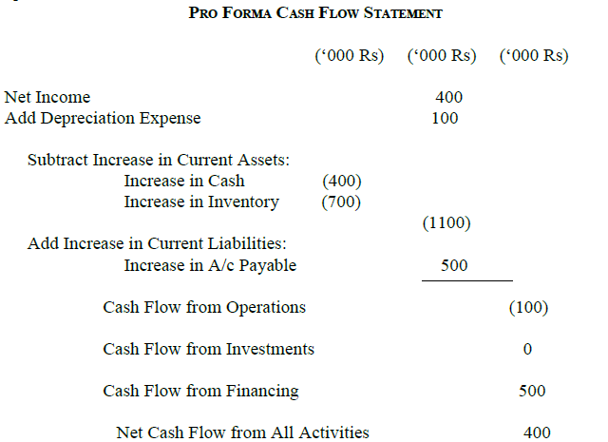
Pro Forma Statements

Slide 61
Pro Forma Statements
Note 1: Indirect Cash Flow Approach using Income Statement and two consecutive Balance Sheets
Note 2: Final Net Cash Flow from All Activities should match the difference in the difference in the closing balances in the Balance Sheets from June 30th 2001 and June 30th 2002
Note 3: Investments include all cash sale and purchases of non-current assets and marketable securities
Note 4: Financing includes all cash changes in loans, leasing, and equity etc.

Slide 62
Next Lecture
PRESENT VALUE AND DISCOUNTING

