Slide 1
Revision 2
Last lecture

Slide 2
Revision 2
BONDS VALUATION AND YIELD ON BONDS
PV= Σ CFt / (1+rD)t =CF1/(1+rD)+CFn/(1+rD)2 +..+CFn/ (1+rD) n +PAR/ (1+rD) n

Slide 3
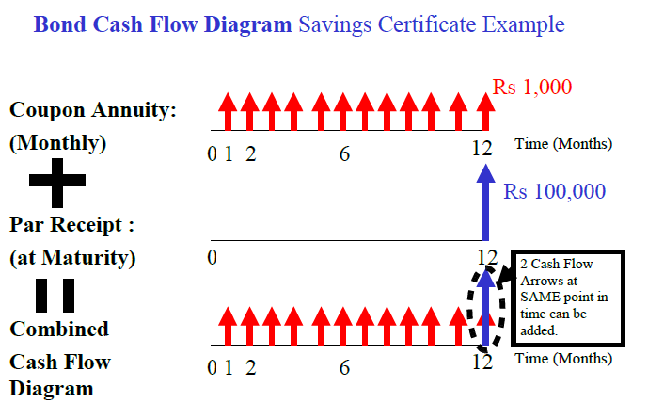
Revision 2

Slide 4
Revision 2
YTM =Total or Overall Yield = Interest Yield + Capital Gains Yield

Slide 5
Revision 2
Interest Yield or Current Yield = Coupon / Market Price
Capital Gains Yield = YTM - Interest Yield

Slide 6
Revision 2
INTRODUCTION TO STOCKS AND STOCK VALUATION

Slide 7
Revision 2
Share certificate is a piece of paper that represents some other real assets and it generates future cash flows.
1. Dividend you are received as shareholder.
2. Capital gain

Slide 8
Revision 2
Types of Equity:
There are two types of equity
1. Common Stock
2. Preferred Stock

Slide 9
Revision 2
Share Price Valuation - Preferred Stock:
Perpetual Investment with Fixed Regular Dividends:
Perpetual Investment means you are considering buying this Stock and keeping it forever!
PV = Po* = DIV 1 / r PE

Slide 10
Revision 2
Finite Investment:
Finite Investment means you plan to buy this Stock and then sell it in a few days or years (n). Formula similar to Bond.
PV = Po* = DIVt / (1+ rPE) t + Pn / (1+ rPE) n .
t=year. Sum from t = 1 to n. Pn = Final Expected Selling Price
PV (Share Price) = Dividend Value + Capital Gain /Loss.

Slide 11
Revision 2
PV (Share Price) = Dividend Value + Capital Gain /Loss.

Slide 12
Revision 2
Share Price Valuation - Common Stock
Finite (Limited Life) Investment in Common Stock
Perpetual Investment in Common Stock:
PV = DIV1/(1+rCE) +DIV2/(1+rCE)2 +..+ DIVn/(1+rCE)n + Pn/(1+rCE)n

Slide 13
Revision 2
PV = Po* = Expected or Fair Price = Present Value of Share, DIV1= Forecasted Future Dividend at end of Year 1, DIV 2 = Expected Future Dividend at end of Year 2, …, Pn = Expected Future Selling Price, rCE = Minimum Required Rate of Return for Investment in the Common Stock for you (the investor). Note that Dividends are uncertain and n = infinity
PV (Share Price) = Dividend Value + Capital Gain.

Slide 14
Revision 2
Simplified Formula (Pn term removed from the equation for large investment durations i.e. n = infinity):
PV = DIV1/ (1+rE) + DIV2/ (1+rE) 2 + … DIVn/(1+rE)n = DIVt / (1+ rE) t. t = year. Sum from t =1 to n

Slide 15
Revision 2
COMMON STOCK PRICING AND DIVIDEND GROWTH MODELS

Slide 16
Revision 2
Zero Growth Dividends Model:
PV = Po*= DIV1 / (1+ rCE) + DIV1 / (1+ rCE) 2 + DIV1 / (1+ rCE) 3 + ... +...
= DIV 1 / rCE.

Slide 17
Revision 2
Constant Growth Dividends Model:
In this, we need only to forecast the next year dividend and assume constant dividends Growth at Inflationary Growth Rate “g” which equals 5 - 10% pa (depending on country).
DIVt+1 = DIVt x (1 + g) t

Slide 18
Revision 2
PV = Po* =DIV1 (1+g) /(1+ rCE ) +DIV1 (1+g)2 / (1+ rCE )2 + DIV 1 (1+g)3 / (1+ rCE )3 + ...
= DIV 1 / (rCE - g)

Slide 19
Revision 2
INTRODUCTION TO RISK, RISK AND RETURN FOR A SINGLE STOCK INVESTMENT
Risk:
Chinese Definition of Risk:
It is defined as the combination of danger and opportunity.

Slide 20
Revision 2
In case of portfolio risk we can further made distinction between Diversifiable Risk and Market risk
Diversifiable Risk: random risk specific to one company, can be virtually eliminated.
Market Risk: It is defined as uncertainty caused by broad movement in market or economy. More significant.

Slide 21
Revision 2
Measurement of Risk:
Stand Alone Risk or Portfolio Risk?
Market Risk or Diversifiable Risk?
Stock Price Risk or Earnings Risk?
Another important thing is Time Horizon for which you are measuring the risk. Are you investing in Stocks over 1 Year or over 30 Years?
The level of risk might change as time period of the investment change.

Slide 22
Revision 2
Fundamental Rule of Risk & Return:
This rule can be summed up in saying that No Pain - No Gain. Investors will not take on additional Market Risk unless they expect to receive additional Return which is common sense and quite logical. Most investors are Risk Averse. Another important principle that one should to keep in mind is Diversification.

Slide 23
Revision 2
Diversification:
Range of Possible Outcomes, Expected Return:
Expected ROR = < r > = pi ri

Slide 24
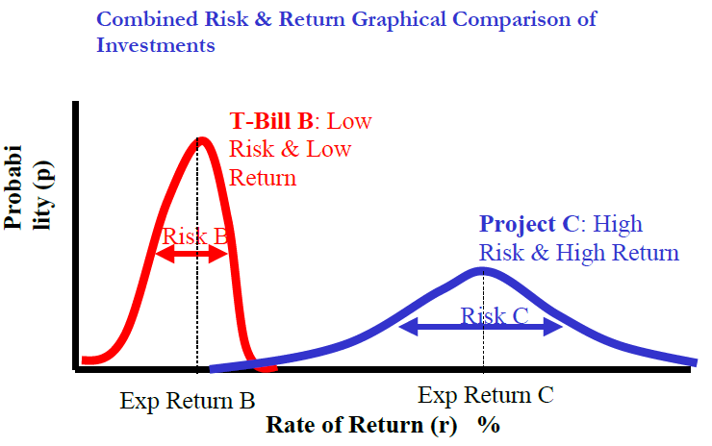
Revision 2

Slide 25
Revision 2
Coefficient of Variation:
Coefficient of Variation (Risk per unit Return)
It is defined as the CV = Standard Deviation / Expected Return.

Slide 26
Revision 2
Total Stock Risk = Diversifiable Risk + Market Risk

Slide 27
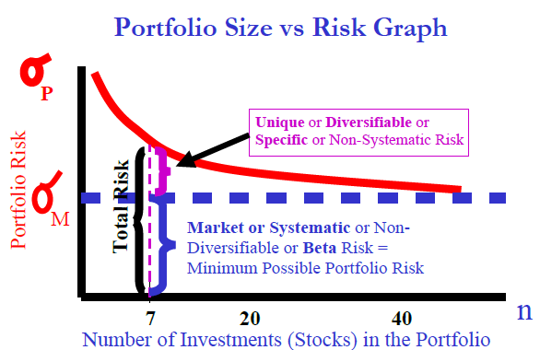
Revision 2

Slide 28
Revision 2
Portfolio’s Expected Rate of Return: ( rP ).
It is the weighted average of the expected returns of each individual investment in the portfolio.

Slide 29
Revision 2
Formula is similar to Expected Return for Individual Investment but interpretation is different:
Portfolio Expected ROR Formula:
rP * = r1 x1 + r2 x2 + r3 x3 + … + rn xn .

Slide 30

Revision 2

Slide 31
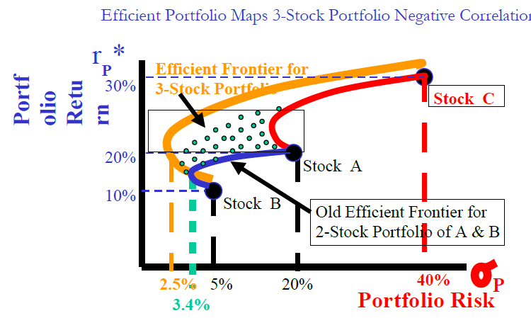
Revision 2

Slide 32
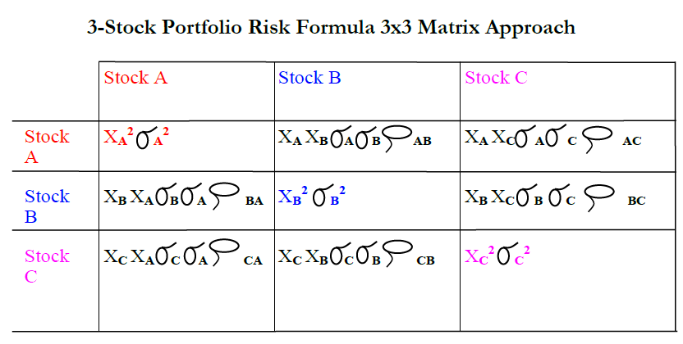
Revision 2

Slide 33
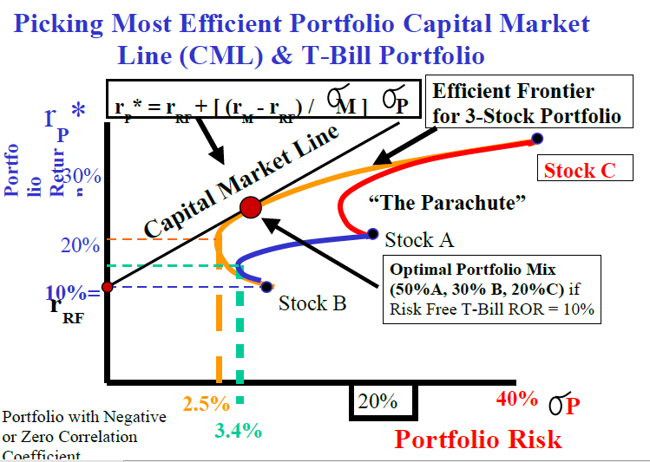
Revision 2

Slide 34
Revision 2
STOCK BETA, PORTFOLIO BETA AND INTRODUCTION TO SECURITY MARKET LINE

Slide 35
Revision 2
Beta:
It is a tendency of a Stock to move with the Market (or Portfolio of all Stocks in the Stock Market).it is the building block of CAPM.
Total Risk = Diversifiable Risk + Market Risk
Total Stock Return = Dividend Yield + Capital Gain Yield

Slide 36
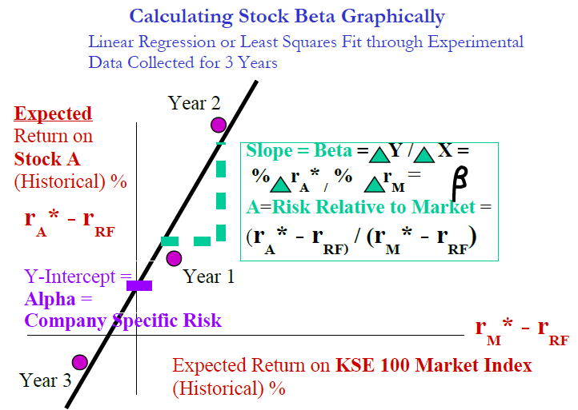
Revision 2

Slide 37
Revision 2
Slope = Beta = Δ Y / Δ X = % Δ rA* / % Δ rM*
= A =Risk Relative to Market = (rA* - rRF) / (rM* - rRF)

Slide 38
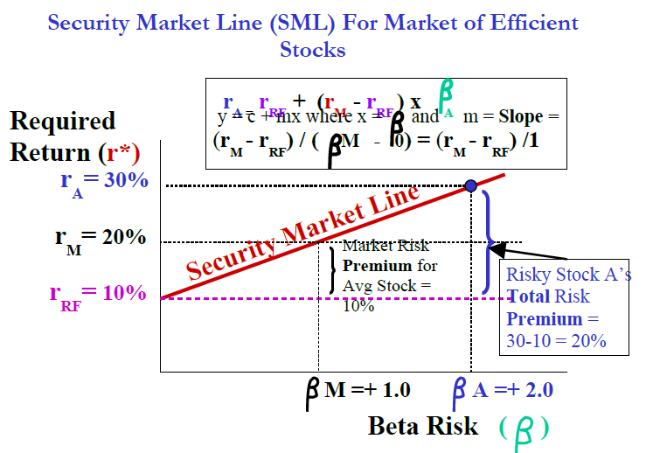
Revision 2

Slide 39
Revision 2
WEIGHTED AVERAGE COST OF CAPITAL (WACC)
WACC= rDxD+rExE+rPEp

Slide 40
Revision 2
MANAGEMENT OF CAPITAL STRUCTURE

Slide 41
Revision 2
End of Course
Welcome to the Financial World.
All the very best to all of you.

