Slide 1
Revision 1

Slide 2
Revision
What is FM?
FM is the management of financial resources – how to best find and use investments and financing opportunities in an ever-changing and increasingly complex environment.

Slide 3
Revision
Analysis of Financial Statements:
Investment Decisions & Capital Budgeting:

Slide 4
Revision
Investment Decisions & Capital Budgeting:
Interest rate formulas
Time Value of Money
Discounted Cash Flows
Net Present Value
Internal Rate of Return

Slide 5
Revision
Risk & Return:
Uncertainty
Risk
Portfolio Theory
Capital Asset Pricing Model

Slide 6
Revision
Corporate Financing & Capital Structure:
Cost of Capital
Leverage
Debt Instruments

Slide 7
Revision
Valuation:
Share
Bond

Slide 8
Revision
Objective of Financial Management (FM)
In comparison, financial management is more focused. The objective of financial management, specifically, is to maximize the shareholders wealth in the present terms.

Slide 9
Revision
Financial practitioners usually use the discounting and the net present value techniques while calculating the increase in the wealth of shareholders.

Slide 10
Revision
FINANCIAL RATIOS:
LIQUIDITY & SOLVENCY RATIOS:
Current Ratio: = Current Assets / Current Liabilities
Quick Ratio
Average Collection Period:

Slide 11
Revision
FINANCIAL RATIOS:
LIQUIDITY & SOLVENCY RATIOS:
Current Ratio: = Current Assets / Current Liabilities
Quick Ratio
Average Collection Period:

Slide 12
Revision
PROFITABILITY RATIOS:
Return on Assets
Return on Equity

Slide 13
Revision
ASSET MANAGEMENT RATIOS
Inventory Turnover:
= Sales / inventories
Total Assets Turnover:
= Sales / Total Assets

Slide 14
Revision
DEBT (OR CAPITAL STRUCTURE) RATIOS:
Debt-Assets: = Total Debt / Total Assets
Debt-Equity: Total Debt / Total Equity
Times-Interest-Earned:.
= EBIT / Interest Charges

Slide 15
Revision
TIME VALUE OF MONEY

Slide 16
Revision
Interest Theory:
– i = iRF + g + DR + MR + LP + SR
– i is the nominal interest rate generally quoted in papers. The “real” interest rate = i – g
Here i = market interest rate
g = rate of inflation

Slide 17
Revision
DR = Default risk premium
MR = Maturity risk premium
LP = Liquidity preference
SR = Sovereign Risk

Slide 18
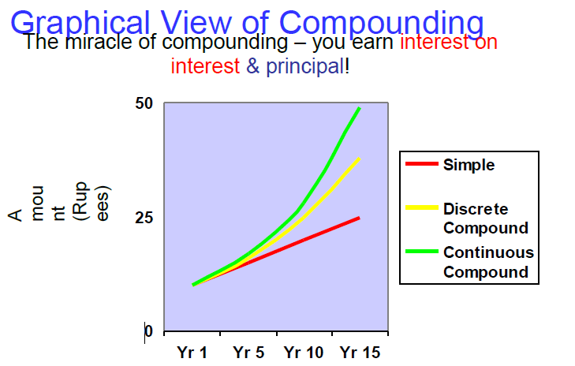
Revision

Slide 19
Revision
FINANCIAL FORECASTING AND FINANCIAL PLANNING

Slide 20
Revision
PRESENT VALUE AND DISCOUNTING
Discounting:
“Discounting is defined as bringing the future cash flow to the present time”.

Slide 21
Revision
PV=FV/(1+i)n
Where, i=interest rate
N=no. of years if we plug in the values
PV=105/(1+0.10)1=Rs.95.45

Slide 22
Revision
Annuities
Perpetuity

Slide 23
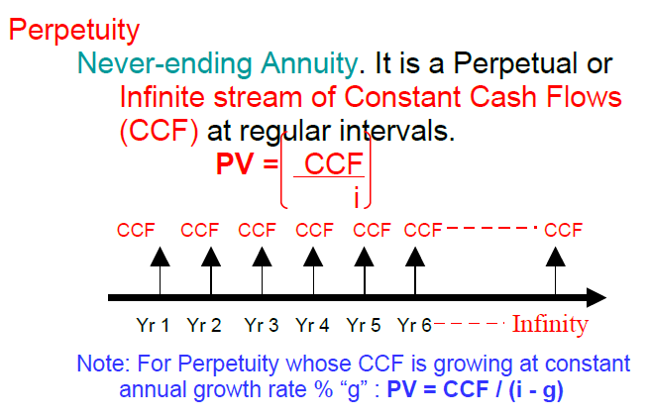
Revision

Slide 24
Revision
CAPITAL BUDGETING AND CAPITAL BUDGETING TECHNIQUES

Slide 25
Revision
1. Pay back period
2. Return on investment (ROI)
3. Net Present Value (NPV)
4. Profitability Index (PI)
5. Internal Rate of Return (IRR)

Slide 26
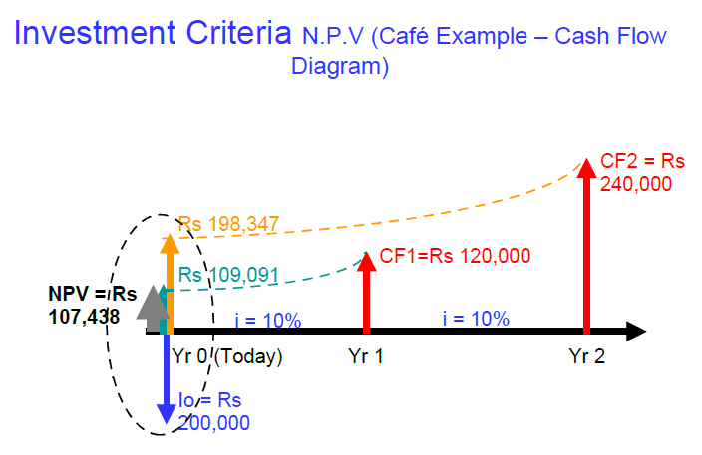
Revision

Slide 27
Revision
Capital Rationing

Slide 28
Revision
BONDS AND CLASSIFICATION OF BONDS
Maturity or Tenure or Life:
• Par Value or Face Value:
• Coupon Interest Rate:

Slide 29
Revision
BONDS AND CLASSIFICATION OF BONDS
Maturity or Tenure or Life:
• Par Value or Face Value:
• Coupon Interest Rate:
Convertible Bonds

Slide 30
Revision
BONDS’ VALUATION

Slide 31
Revision
BONDS’ VALUATION
Present Value formula for the bond:
PV= Σ CFt / (1+rD)t =CF1/(1+rD)+CFn/(1+rD)2 +..+CFn/ (1+rD) n +PAR/ (1+rD) n

Slide 32
Revision
End of First Revision Lecture

