Slide 1
Summary of Last lecture
Stock Betas and Risk
SML & Required Returns (CAPM)
Stock Prices in Efficient Markets

Slide 2
SML GRAPH AND CAPITAL ASSET PRICING MODEL

Slide 3
Learning Objectives:
After going through this lecture, you would be able to have an understanding of the following topics.
SML Graph & CAPM

Slide 4
Recap
We will continue our discussion on risk. It is very important in our daily life . We are always concerned with risky situation. There is risk that you can not watch this lecture due to the power failure.

Slide 5
Recap
We have to know that how we can measure and control the risk in every day life. We are going to see that how we can use required rate of return that we calculated by using the SML equation and use that required rate of return for the calculation we have been doing in the first two parts of this course.

Slide 6
Recap
In first part we did capital budgeting and NPV calculations and in the NPV formula the ‘r’ we are using is the required rate of return not he expected rate of return.

Slide 7
Recap
We can use the value of required return from SML equation in stock or bond pricing. We have studied that in the efficient markets the required rate of return is come from the market return.

Slide 8
Recap
There are two methods for the calculation of risk. First approach the experimental cost base in this approach we use expected rate of return and market index. Then we plot these points on the graph and we join them with a straight line called regression line and slope of this line is called beta co- efficient.

Slide 9

Recap

Slide 10
Recap
Extent to which Actual Stock Return Data lies on Regression Line
Total Risk = Market Risk + Random Company Specific Risk If the experimental data points
All lies exactly on the regression line then this particular stock has only market risk.

Slide 11
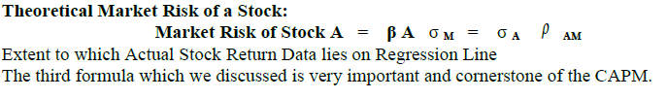
Recap

Slide 12
Security Market Line (SML) and Required Rate of Return (rA):
I t allows us that the value which we have calculated for the beta and from that calculate the required rate of return of the stock and then we use for stock pricing. So, then the required rate of return for any stock A is equal to

Slide 13
Security Market Line (SML) and Required Rate of Return (rA):
rA = rRF + (rM - rRF ) β A .

Slide 14
Security Market Line (SML) and Required Rate of Return (rA):
In Efficient Markets, Stock Price (and Value) depends on Required Return which depends on Market Risk (not the Total Risk).
The required rate of return in efficient markets depends upon the risk premium which depends only upon the market risk and not on the total risk.

Slide 15
Security Market Line (SML) and Required Rate of Return (rA):
We do not have to worry about company’s risk because we assume that investors are rational and maintain diversified portfolio. Now, let’s take a look at the security market line graphically .It is important to understand this graph and many things that it tells us.

Slide 16
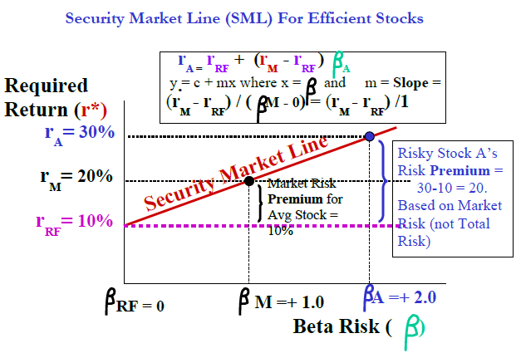
Security Market Line (SML) and Required Rate of Return (rA):

Slide 17
Security Market Line (SML) and Required Rate of Return (rA):
The graph represents the SML in the efficient stock market. On y –axis we have required rate of return r* for the stock A for and risk free rate of return and on the x- axis is beta risk which represents the market risk.

Slide 18
Security Market Line (SML) and Required Rate of Return (rA):
SML is straight line and it tells us the relationship between the market risk and the required return. it starts on the left hand side from risk free rate of return and it passes through a point on the middle which is the overall market point. This point is located at the beta of +1.0 and at the required return of 20%.

Slide 19
Security Market Line (SML) and Required Rate of Return (rA):
This means that the market offers a rate of return which is higher then the risk free rate of return. Because the market fluctuates it has a risk of 1.0 and not 0. if we extend the line it passes through the point where the beta is +2.0 and the required return is 30%.

Slide 20
Security Market Line (SML) and Required Rate of Return (rA):
because this point lies on the SML it means that stock A has no company risk & what is the risk premium ?
Risk premium=rA-rRF=30%-10%=20%.
It is directly proportion to market risk of stock.

Slide 21
Security Market Line (SML) and Required Rate of Return (rA):
Please note that slope of this line is = (rM-rRF)/ (betaM-0) = (rM-rRF)/1. This is the measure tendency of the average investors in the market to take risk.

Slide 22
Security Market Line (SML) and Required Rate of Return (rA):
If the SML line is steeper the investors will not take unnecessary risk. In other words they are risk aversive as the slope increase the avoidance for the risk also increases in the market as whole.

Slide 23
Security Market Line (SML) and Required Rate of Return (rA):
It is very important to formulate the equation for SML You should be able understand the various points that lie on the SML line including the risk free rate of return or T-BILL return as well as the market point and you should also understand that the slope of SML line is=(rM-rRF)/(betaM-0)=(rM-rRF)/1.

Slide 24
Security Market Line (SML) and Required Rate of Return (rA):
SML exist for only the efficient markets or perfect capital markets. SML tells us in detail that rational investor will eliminate the company’s specific risk and the total risk of the company will be equal to the market risk of the company.

Slide 25
Security Market Line (SML) and Required Rate of Return (rA):
Beta coefficient was the slope of the line for different graph that graph shows the stock rate of return on y-axis and market rate of return on x-axis. But over there we are not talking about the required rate of return we were talking about the expected rate of return so; do not confuse these two different graphs.

Slide 26
Security Market Line (SML) and Required Rate of Return (rA):
SML line is an ideal case and in efficient markets all the stocks lie on the SML line. If stock is not on SML then according to market equilibrium it will come back on SML. If any stock is not on SML then forces of market equilibrium will bring it on the security market line.

Slide 27
Security Market Line (SML) and Required Rate of Return (rA):
If risk and return combination of any stock is above SML it means that it is offering the higher rate of return as compare to efficient stock. The people will rush to buy such stock when the demand will increase the return will decrease.

Slide 28
Security Market Line (SML) and Required Rate of Return (rA):
If any stock is lying below the SML line the price will come down it will offer as much potential as the efficient stock offers. The supply for such stock will increase and it will offer higher return in form of capital gain.

Slide 29
Security Market Line (SML) and Required Rate of Return (rA):
So, the market forces will throw these points on the SML. Markets are not risk free .markets index fluctuate .The investors expect that market return will be more than the average expected return.

Slide 30
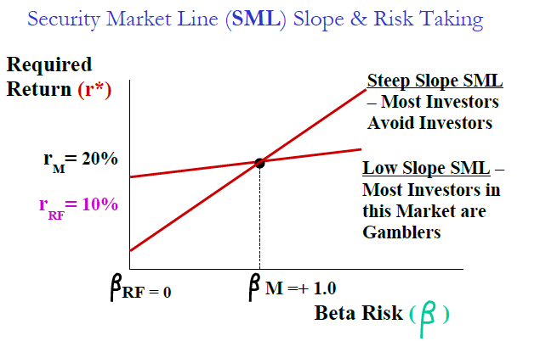
Security Market Line (SML) and Required Rate of Return (rA):

Slide 31
Security Market Line (SML) and Required Rate of Return (rA):
Even Markets and Market Returns Fluctuate because of Macro Systematic Factors. So the Fully Diversified Market Portfolio consisting of all shares is NOT Risk Free. The Market has a Risk Premium over the Risk Free ROR.

Slide 32
Security Market Line (SML) and Required Rate of Return (rA):
This Market Risk Premium represents 100% Market Risk and No Company-Specific or Diversifiable Risk. Efficient Stock combinations of Risk & Return in Efficient Market Equilibrium must lie ON the SML.

Slide 33
Security Market Line (SML) and Required Rate of Return (rA):
Any Stock whose (Risk, Return) Pair lies ABOVE THE SML is offering Excessive Return (above the Market). So, all rational investors will rush to Buy it.

Slide 34
Security Market Line (SML) and Required Rate of Return (rA):
The present Price would Rise and the Return (as measured by Capital Gain Yield = ( Pn -Po) / Po) would Fall until it comes back on SML Any Stock whose (Risk, Return) Pair lies BELOW THE SML is offering a Return that is lower than the Market. So, Rational Investors will rush to sell it. The Stock Price would Fall and the Return would Rise until it comes back on the SML.

Slide 35
Security Market Line (SML) and Required Rate of Return (rA):
Now , we will calculate the required rate of return using GORDON FORMULA . So, we need to calculate required rate of return to understand the risk so, let’s use SML formula for required rate of return by plugging it into the GORDON FORMUL A. price valuation formula by GORDON:

Slide 36
Security Market Line (SML) and Required Rate of Return (rA):
Share A is being traded in the Karachi Stock Exchange (KSE) at a Market Price of Rs 12. You need to calculate the Expected Theoretical Fair Price of a Stock A before you can decide whether to buy it or not. Given the following Data:

Slide 37
Security Market Line (SML) and Required Rate of Return (rA):
DIV1 = Rs 2 (i.e. Forecasted Dividends in the upcoming year on a share of Face Value = Rs 10)
g = 10% pa (i.e. Forecasted Constant Growth Rate in Dividends)
rRF = 10% pa (i.e. T-Bill Rate of Return or PLS Bank Account ROR)
rM = 20% pa (i.e. The Karachi Stock Exchange’s historical average ROR based on the value of the KSE 100 Index)
Beta of Stock A = 2.0 (i.e. Stock A has historically been twice as volatile or risky as the KSE 100 Index)

Slide 38
Security Market Line (SML) and Required Rate of Return (rA):
Use the Gordon-SML Equation to Estimate Fair Price of Stock A:
Po* = DIV1 / [ (rRF + (rM - rRF ) A ) - g]
= 2 / [10% + (20% - 10%) (2.0)) - 10%]
= 2 / [30% - 10%] = 2 / 20% = Rs 10

Slide 39
Security Market Line (SML) and Required Rate of Return (rA):
The Required Rate of Return for Stock A was calculated to be 30% which is higher than the Market (20%). The Market is offering a 10% extra return as a Risk Premium because Stock A (Beta = 2.0) is twice as risky as the market (Beta = 1.0).

Slide 40
Security Market Line (SML) and Required Rate of Return (rA):
The Fair Price of Stock A (Rs 10) is LESS than the Market Price (Rs 12) which means that the Market Speculators have Overvalued Stock A and you should NOT buy it.

Slide 41
Security Market Line (SML) and Required Rate of Return (rA):
So, what does our answer mean? We see that expected fair price of the share is Rs.10 which is lower than the market price which is Rs.12.keep in mind that price for the share is imperfect market depends upon the investor psychology , speculation and gambling that is taking place in the stock market .

Slide 42
Security Market Line (SML) and Required Rate of Return (rA):
so, when fair price is lower as in our example and market price is higher it means that the shares price or stock has been over valued and the rational investor will not purchase it .other thing to note is that we calculated share premium and required rate of return in our formula is 30%.it is higher than the over all market risk .because it is twice risky as the market beta A=+2.0therfore it is giving extra return to the investors for the compensation.

Slide 43
Security Market Line (SML) and Required Rate of Return (rA):
so, when fair price is lower as in our example and market price is higher it means that the shares price or stock has been over valued and the rational investor will not purchase it .other thing to note is that we calculated share premium and required rate of return in our formula is 30%.it is higher than the over all market risk .because it is twice risky as the market beta A=+2.0therfore it is giving extra return to the investors for the compensation.

Slide 44
Summary
SML Graph & CAPM

