Slide 1
Summary of Last Lecture:
Stock Beta
Portfolio Beta
Introduction to SML (CAPM)

Slide 2
STOCK BETAS & RISK, SML& RETURN AND STOCK PRICES IN EFFICIENT MARKS

Slide 3
Learning Objectives:
After going through this lecture, you would be able to have an understanding of the following topics.
Stock Betas and Risk
SML & Required Returns (CAPM)
Stock Prices in Efficient Markets

Slide 4
Recap
In the previous lecture, we have mentioned that the risk that is relevant in efficient markets where the investors are sensible and rational is the market risk. This is because rational investors maintain many stocks and they maintain diversified portfolio which contain stocks from different sectors and they manage to eliminate their diversifiable risk and the only risk they faced is the market component of the risk.

Slide 5
Recap
However, this market component can not be eliminated and it will remain because markets do fluctuate. Fluctuation in the Market Index (KSE 100 index) is a measure of Market Risk. This fluctuation is caused by macro economic and socio political factors. Rational Investors in Efficient Markets eliminate the Random Company-Specific Risk through Portfolio Diversification.

Slide 6
Recap
So, in Efficient Market the only Risk that remains is Market Risk. And so, the Price of Efficient Stocks is based on Market Risk only. But the CAPM based on the fundamental principal that the rate of return for the stock is directly proportional to the risk premium and the risk premium dependent on market risk alone and not the total risk.

Slide 7
Recap
Before going into details of SML we first go through the remaining topics related to beta and its theoretical calculation based on standard deviation and covariance.

Slide 8
Recap
We have mentioned that beta of the stocks have tendency of stock to move with the market. It is experimentally possible to calculate beta of the stock by monitoring the price or rate of return of the stock and at the same time monitoring the market index in the same period of time & comparing that how the changes in the stock market price relate to the changes in the stock market index.

Slide 9
Recap
If you plot them on the graph where you have expected return for stock on Y- axis and expected return from the stock market index slope of the line from these points represent the beta.

Slide 10
Recap
Stock Beta measures the Risk of a Stock Relative to the market.
Beta Stock A = % Δ rA* / % Δ rM* = Slope of Regression Line. Regression Line uses Experimental Data.

Slide 11
Recap
The formula that relates beta of the stock to the standard deviation is as follows
Beta Stock A = Covariance of Stock A with Market / Variance of Market

Slide 12
Recap

Slide 13
Recap
(Covariance Formula based on Probability & Statistical Portfolio Theory) Links Stock Beta (Market Portion of Risk) to Stock Standard Deviation (Total Single Stock Risk). Simplified formula:

Slide 14

Recap

Slide 15
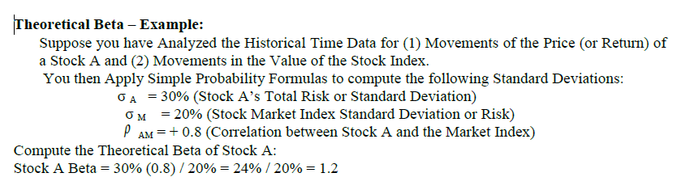
Theoretical Beta Example:

Slide 16
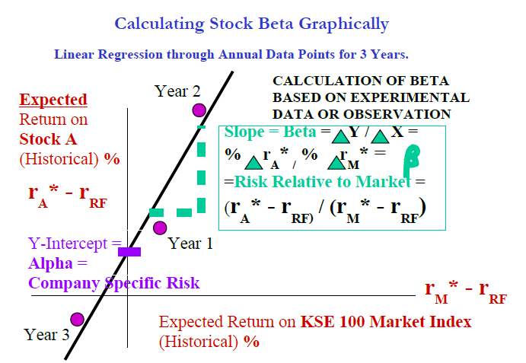
Theoretical Beta Example:

Slide 17
Theoretical Beta Example:
The beta of 1.2 shows that stock is relatively more risky then the market and if the market moves up by 10% this stock will move up by 12%.

Slide 18
Theoretical Beta Example:
If all the points of the stock lie on the straight line then stock does not have any diversifiable risk. The difference between the actual data point and the point which vertically lies above or below the point is representative of the error which is representative of the company’s risk attached to any stock.

Slide 19
Theoretical Beta Example:
Now we can put together the two concepts which we studied up till now that is company’s specific risk and the second concept of regression line and the distance between data line and actual point of the company’s risk. Now, we can come up with the total definition of total risk variances.

Slide 20
Total variance risk formula:
Total Risk of Stock A in terms of Variance (= Std Dev 2)
Total Risk = Market Risk + Random Specific Unique Risk

Slide 21
Total variance risk formula:

Slide 22
Visualizing the Variance Risk Formula on the Regression Line
If a Stock is Part of a Totally Diversified Portfolio then its Company Risk = 0. Therefore Total Risk = Market Risk. And the Stock points will lie exactly on the Regression line.

Slide 23
Visualizing the Variance Risk Formula on the Regression Line
If a Stock is a Single Investment then it carries Company Specific or Diversifiable or Random Risk.

Slide 24
Visualizing the Variance Risk Formula on the Regression Line
This means that its points will not lie on the Regression line. The extent to which the points are scattered away is a measure of the Variance Error Term (last term in the formula)

Slide 25
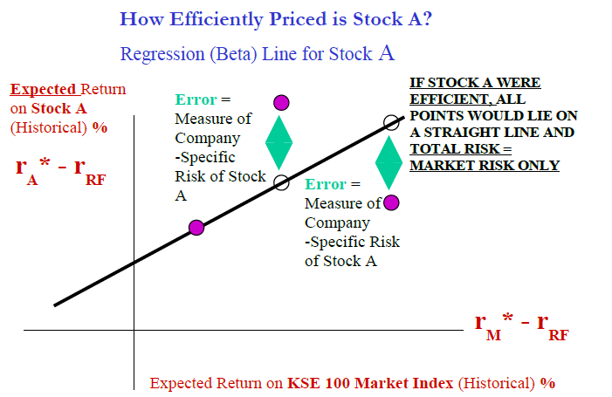
Visualizing the Variance Risk Formula on the Regression Line

Slide 26
Variance Risks – Example:
If the Market Risk = 20% and Stock A’s Beta = 1.5 then what is the Relevant Market Risk Component of Stock A?
Stock A’s Market Variance = Beta A2 x Market Variance = 1.52 x (20%) 2 = 2.25 x 400% =
900% (Variance)

Slide 27
Variance Risks – Example:
So the Stock A’s Market Risk (in Standard Deviation terms) = Square Root of Variance = 30% = Beta A σ M
Note that Total Risk of Stock A can be calculated directly by calculating the Standard Deviation of the Possible Future Returns. That was the first Risk Formula we studied in Risk Theory.

Slide 28
Variance Risks – Example:
Suppose Total Risk = 35%. Then Company Specific or Diversifiable or Random Risk of Stock A = Total Risk - Market Risk = 35% - 30% = 5%.

Slide 29
Variance Risks – Example:
So 86% (= 30/35 x 100) of Stock A’s Total Risk is Market Risk - quite likely that Stock A is Part of a well Diversified Portfolio or Mutual Fund.

Slide 30
Security Market Line (SML) :
Straight Line Model is for Beta Risk and Required Return. Similar to the Relationship for the 2- Stock Portfolio with Ro > 0 Beta Risk is Directly Proportional to Required Return.

Slide 31
Security Market Line (SML) :
The Investors require an extra Return which exactly compensates them for the extra Risk of the Stock relative to the Market.
SML Linear Equation for the Required Return of any Stock A:

Slide 32
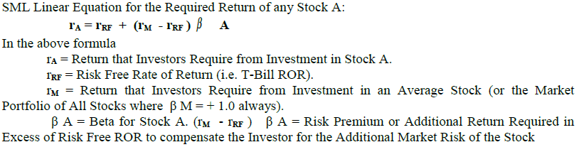
Security Market Line (SML) :

Slide 33
Required Rate of Return,
Risk Premium & Market Risk:
SML Model for Efficient Markets establishes a Straight Line relationship (or Direct Proportionality) between a Stock’s Required ROR and its Risk Premium.
rA = rRF + (rM - rRF ) A
A Stock’s Risk Premium depends on its Market Risk Portion (and not the Total Risk)

Slide 34
Required Rate of Return,
Risk Premium & Market Risk:
In Efficient Markets, Market Price of a Stock is based on Required Return which depends on Risk Premium which depends on Stock’s Market Risk Component (and not the Total Risk).

Slide 35
Stock Prices in Efficient Markets:
A Single Stock Investor who owns No Stocks and wants to buy a Share A will have to face more Risk (Market Risk + Specific Risk) than a Rational Fully Diversified Investor. The Single Stock Investor will want to buy the Stock at a lower price to compensate him for the higher risk.

Slide 36
Stock Prices in Efficient Markets:
However, Efficient Markets do not price stocks based on Single Stock Investors who want compensation for taking on Unnecessary Company-Specific Risk which they should have diversified away.

Slide 37
Stock Prices in Efficient Markets:
Efficient Markets price the Stocks based on their Market Risk Component only. So, Efficient Stock Prices are based on Rational Investors holding Diversified Portfolios of many stocks.

Slide 38
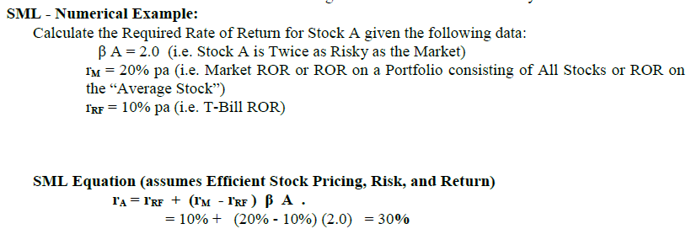
SML - Numerical Example:

Slide 39
Interpretation of Result:
Investors require a 30% pa Return from Investment in Stock A. This is higher than the Market ROR because the Stock (Beta = 2.0) is Riskier than the Market (Beta = 1.0 always).

Slide 40
Interpretation of Result:
If Required Return (30%) is higher than Expected Return (20%) it means that Stock A is Unlikely to Achieve the Investors’ Requirement and Investors will NOT invest in Stock A.

Slide 41
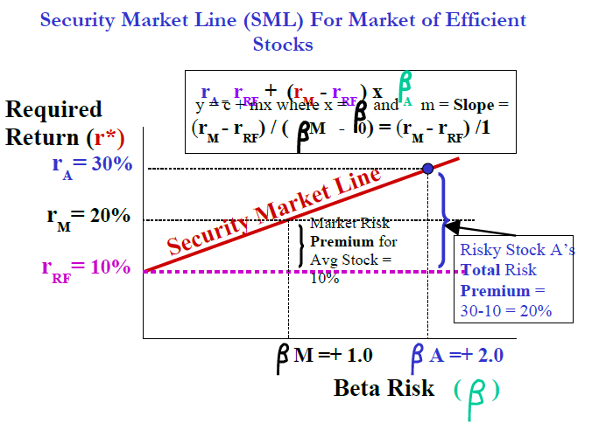
Interpretation of Result:

Slide 42
Summary
Stock Betas and Risk
SML & Required Returns (CAPM)
Stock Prices in Efficient Markets

