Slide 1
Summary of Last Lecture
Efficient Portfolios,
Market Risk & CML

Slide 2
STOCK BETA, PORTFOLIO BETA & INTRODUCTION TO SECURITY MARKET LINE
(SML)

Slide 3
Learning Objectives:
After going through this lecture, you would be able to have an understanding of the following topics.
Stock Beta
Portfolio Beta
Introduction to SML (CAPM)

Slide 4
Recap
First, we would recap some of the concepts which we have studied in the previous lectures. It is mentioned in the efficient capital markets the investors would take on extra risk only if they are compensated in the form of extra return.

Slide 5
Recap
The market only compensates the investor to the extent that he will receive extra return for extra market risk he takes on by investing in a new stock. However, the market will not pay the investor any extra return for taking on unnecessary risk in the form of company’s own risk.

Slide 6
Recap
Therefore, it is best for investors to act rationally and to maintain diversified portfolios of many stocks and in this manner they can eliminate the company’s own risk and they can make investments in stocks at a lower required rate of return.

Slide 7
Recap
Market portion of risk can be represented through the ‘Beta’ coefficient and it is the corner stone for Capital Asset Pricing Model (CAMP).

Slide 8
Beta:
It is a tendency of a Stock to move with the Market (or Portfolio of all Stocks in the Stock Market). It is the building block of CAPM.

Slide 9
Beta:
Total Risk = Diversifiable Risk + Market Risk

Slide 10
Beta:
Total Stock Return = Dividend Yield + Capital Gain Yield

Slide 11
Stock Risk Vs Stock Beta:
Stock Risk:
It is a statistical spread of possible returns (or Volatility) for that Stock.
Stock Beta:
It is a statistical spread of possible returns (or Volatility) for that Stock relative to the market spread i.e. spread (or Volatility) of the fully diversified market portfolio or index.

Slide 12
Stock Risk Vs Stock Beta:
Beta Coefficients of Individual Stocks are published in “Beta Books” by Stock Brokerages & Rating Agencies.

Slide 13
MARKET:
It is the overall Stock Market. For Example, Karachi Stock Exchange. KSE 100 Index represents Value of “Portfolio” of Highest Volume Stocks but NOT ALL stocks. Therefore it is not fully perfect diversified portfolio.

Slide 14
MARKET:
Market carries Risk. It moves up and down because of macroeconomic factors (inflation, general interest rates) and political changes. Therefore the market has some expected rate of return which changes with time because of this there is possibility of different outcomes.

Slide 15
MARKET:
There are no fully diversified portfolios in reality. The CAPM based on the promise market Beta to be Equal to + 1.0. We can then look at the different beta and compare them with the markets.

Slide 16
Meaning of Beta for Share ABC in Karachi Stock Exchange (KSE):
If Share A’s Beta = +2.0 then that Share is Twice as risky (or volatile) as the KSE Market i.e. If the KSE 100 Index moved up 10% in 1 year, then based on historical data, the Price of Share B would move up 20% in 1 year.

Slide 17
Meaning of Beta for Share ABC in Karachi Stock Exchange (KSE):
If Share B’s Beta = +1.0 then that Share is Exactly as risky (or volatile) as the KSE Market. If Share C’s Beta = +0.5 then that Share is only Half as risky (or volatile) as the KSE Market.

Slide 18
Meaning of Beta for Share ABC in Karachi Stock Exchange (KSE):
If you could find a Share D with Beta = -1.0 then that share would be exactly as volatile as the KSE Market BUT in the opposite way i.e. If the KSE 100 Index moved UP 10% then the price of the Share D would move DOWN by 10%!

Slide 19
Meaning of Beta for Share ABC in Karachi Stock Exchange (KSE):
The Beta of most Stocks ranges between + 0.5 and + 1.5
The Average Beta for All Stocks = Beta of Market = + 1.0 Always.

Slide 20
Meaning of Beta for Share ABC in Karachi Stock Exchange (KSE):
Our approach for calculating the beta will be straight forward. Let us assume that we analyze the movements in KSE index for period of three years and we also analyze the price movements for the Stock A in KSE for the same period of time of three years.

Slide 21
Meaning of Beta for Share ABC in Karachi Stock Exchange (KSE):
We look at the change in the price of the stock and compare it to the change in price in the market for each one of the three years separately.

Slide 22
Meaning of Beta for Share ABC in Karachi Stock Exchange (KSE):
And then we plot those points on a graph where the expected return on the stock on the y- axis and the expected return on the market on x-axis.

Slide 23
Meaning of Beta for Share ABC in Karachi Stock Exchange (KSE):
We are using the price of the stock and value of the index as representative measures for the expected return.

Slide 24
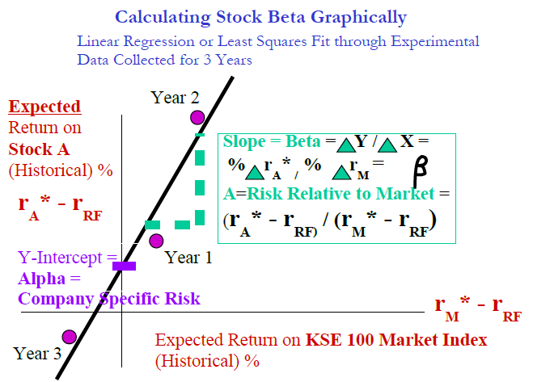
Meaning of Beta for Share ABC in Karachi Stock Exchange (KSE):

Slide 25
Meaning of Beta for Share ABC in Karachi Stock Exchange (KSE):
If you look at the graph, we have plotted three years of data for the changes in the Karachi stock exchange 100 market index and the expected return on the stock A.

Slide 26
Meaning of Beta for Share ABC in Karachi Stock Exchange (KSE):
The expected return on A is on yaxis and it is represented by rA* and the expected return on stock in KSE 100 market index is represented by rM* the ‘*’ represented the expected part of the rate of return.

Slide 27
Meaning of Beta for Share ABC in Karachi Stock Exchange (KSE):
In both cases the expected returns have been benched marked against the risk free rate of return. That is because we pick the risk free rate of return as the starting point for the changes in the expected return.

Slide 28
Meaning of Beta for Share ABC in Karachi Stock Exchange (KSE):
Three points are shown on the graph on for each year in the analysis and after plotting these points on the graph we can then do what is known as the linear regression of straight line which best fit through points. You have studied this concept in the course of “Statistics and Probability”.

Slide 29
Meaning of Beta for Share ABC in Karachi Stock Exchange (KSE):
The slope of the line represents the beta coefficient.
Slope = Beta = Δ Y / Δ X = % Δ rA* / % Δ rM*
= A =Risk Relative to Market = (rA* - rRF) / (rM* - rRF)

Slide 30
Meaning of Beta for Share ABC in Karachi Stock Exchange (KSE):
Beta represents the risk of stock relative to the return of the market and in terms of risk free rate of return we can define the Beta as the expected rate of return for stock A minus risk free rate of return divided by the expected rate of return for the market minus risk free rate of return.

Slide 31
Meaning of Beta for Share ABC in Karachi Stock Exchange (KSE):
We use historical data of expected rate of return and we graphed it against changes in the overall market index.

Slide 32
Calculating Portfolio Beta (CAPM):
There are two ways of calculating portfolio beta.
Analyze Historical Data for Portfolio Returns and Market Index Returns like in the case of Stock Beta, plot Least Squares Fit Line, and compute Portfolio Line Slope or Beta directly.

Slide 33
Calculating Portfolio Beta (CAPM):
Use the Published Data for Individual Stock Betas from the “Beta Book”

Slide 34
Calculating Portfolio Beta (CAPM):
Portfolio beta can be calculated as the sample weighted average of the stock beta’s in that portfolio.

Slide 35
Calculating Portfolio Beta (CAPM):

Slide 36
Calculating Portfolio Beta (CAPM):
In the formula βA represents the Beta (or Market Risk) of Stock A.
XA represents the Weight of Stock (fractional value of investment in A to total portfolio value).The simple formula for calculating the portfolio beta is as follows.

Slide 37
Calculating Portfolio Beta (CAPM):
Portfolio Beta (or Market Risk) Formula is a Simple Weighted Average unlike the portfolio risk formula, which is.

Slide 38

Calculating Portfolio Beta (CAPM):

Slide 39
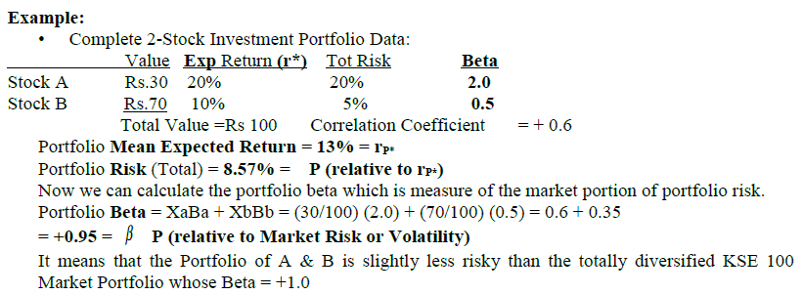
Calculating Portfolio Beta (CAPM):

Slide 40
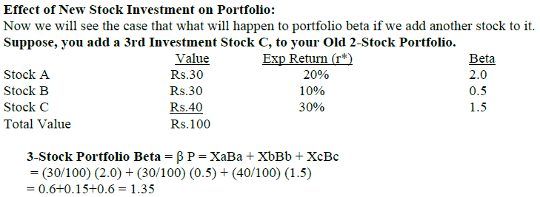
Calculating Portfolio Beta (CAPM):

Slide 41
Calculating Portfolio Beta (CAPM):
The effect of adding a stock with a Beta higher than the Portfolio’s is that it increases the Portfolio’s Beta or Risk. In this case we also increase the beta by adding new stock but the expected rate of return also increases for the portfolio. So, the increase rate of return would compensate the increase in risk.

Slide 42
Required Rate of Return (CAPM)
Required ROR vs. Expected ROR
Expected ROR (r*):
The Most Likely (or Mean) ROR expected in the future. It is calculated using Weighted Average Formula and Probabilities (what we have been calculating so far).It is basically the weighted average or mean of the expected return of the individual investments in the portfolio.

Slide 43
Required Rate of Return (CAPM)
Required ROR vs. Expected ROR
Required ROR (r):
It is the minimum return that investors require from the stock to invest in it. It varies from individual to individual. It is based on
1) Perceived Risk relative to the Market and Psychological Risk Profile of each Investor and
2) His personal Opportunity Cost of Capital preference.

Slide 44
Required Rate of Return (CAPM)
Required ROR vs. Expected ROR
We have mentioned earlier that ROR or opportunity cost varies from person to person because every individual have a different preference for risk taking.

Slide 45
Required Rate of Return (CAPM)
Required ROR vs. Expected ROR
Some people have tendency to be gamblers whereas other people put their money at national saving schemes. However, the ROR can be linked to the Beta risk because based on the portfolio theory and CAPM where we mentioned there is direct relationship between risk and return.

Slide 46
Required Rate of Return (CAPM)
Required ROR vs. Expected ROR
Average Required ROR for all rational investors in an Efficient Market can be estimated using the CAPM Theory: Beta and Risk Free Rate of Return.
Total Rate of Return (ROR) for Single Stock = Dividend Yield + Capital Gain.

Slide 47
Required Rate of Return (CAPM)
Required ROR vs. Expected ROR
GORDON’S FORMULA FOR COMMON STOCK PRICING OR VALUATION USES REQUIRED RETURN r = DIV/Po + g. In Efficient Markets, Price of Stocks is based on Market Risk (or Beta).
We can formulate the required rate of return in terms of Beta risk so how can we use beta coefficient to calculate the required rate of return for the average investor in the market.

Slide 48
Required Rate of Return (CAPM)
Required ROR vs. Expected ROR
The answer to it is the Security Market line SML.

Slide 49
Required Rate of Return (CAPM)
Required ROR vs. Expected ROR
It is the part of CAPM and it is the most critical part of CAPM. SML is straight line relationship that contains all possible combinations of efficient stocks in the market.

Slide 50
Required Rate of Return (CAPM)
Required ROR vs. Expected ROR
If the combination of risk and return for any stock does not lie on the SML then that stock is not efficiently priced. In other words, it means that for most of the investors in the market there ROR for investment in stock A is directly proportional to Beta risk for that stock A.

Slide 51
Required Rate of Return (CAPM)
Required ROR vs. Expected ROR
You will recall that we are not unfamiliar with straight line relationship between risk and return when we are talking about the portfolio when we calculate the portfolio risk with a +ve correlation coefficient we came up with a continuously increasing relationship between portfolio risk and return. So that model is similar to SML.

Slide 52
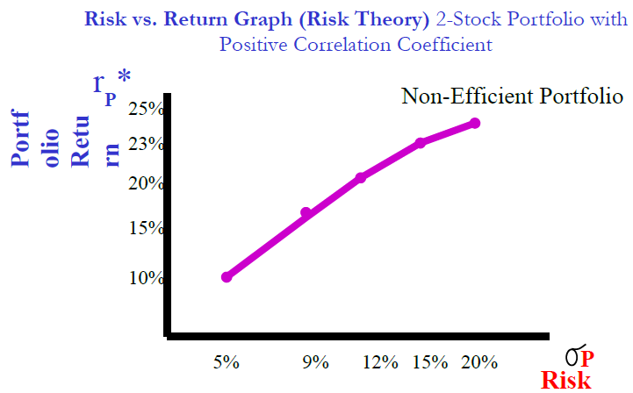
Security Market Line (SML):

Slide 53
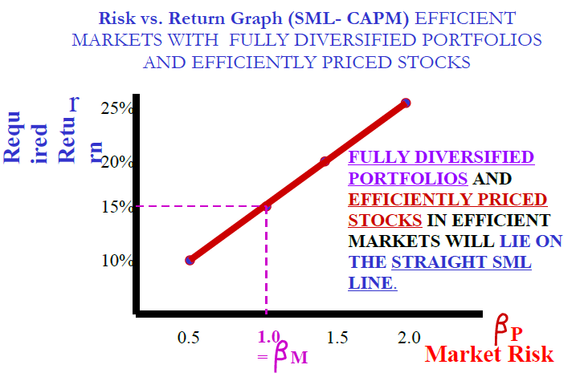
Security Market Line (SML):

Slide 54
Security Market Line (SML):
It is a Straight Line Model for Beta Risk and Required Return. It is Similar to the Relationship for the 2-Stock Portfolio with r > 0.

Slide 55
Security Market Line (SML):
Beta Risk is Directly Proportional to Required Return. The Investors require an extra Return which exactly compensates them for the extra Risk of the Stock relative to the Market.

Slide 56
Security Market Line (SML):
SML Linear Equation for the Required Return of any Stock A:
rA = rRF + (rM - rRF ) β A .

Slide 57
Security Market Line (SML):
In the above equation
rA = Return that Investors Require from Investment in Stock A.
rRF = Risk Free Rate of Return (ie. T-Bill ROR).
rM = Return that Investors Require from Investment in an Average Stock (or the Market Portfolio of All Stocks where β M = + 1.0 always).

Slide 58
Security Market Line (SML):
β A = Beta for Stock A.
(rM - rRF ) β A = Risk Premium or Additional Return in Excess of Risk Free ROR to compensate the Investor for the additional Risk.

Slide 59
Summary
Stock Beta
Portfolio Beta
Introduction to SML (CAPM)

