Slide 1
Summary of Last Lecture:
After going through this lecture, you would be able to have an understanding of the following topics.
Efficient Portfolios,
Market Risk & CML

Slide 2
Market Risk & Portfolio Theory & CAPM:

Slide 3
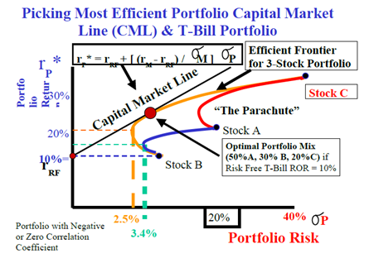
Recap:

Slide 4
Picking Most Efficient Portfolio Capital Market
Line (CML) & T-Bill Portfolio
The efficient frontier for the 3 stock portfolio is the overarching largest hook shaped curve and also remember that closed combination of the all the hook shaped curves forms a parachute like shape and any one of the points inside that parachute is a possible mix or combination of different stocks that you can have in your portfolio.

Slide 5
Picking Most Efficient Portfolio Capital Market
Line (CML) & T-Bill Portfolio
However, the most efficient combinations lie on the efficient frontier line and the next logical step we are going to take is to figure out what is the best point on the efficient frontier.

Slide 6
Picking Most Efficient Portfolio Capital Market
Line (CML) & T-Bill Portfolio
As it is mentioned that we will assume that we have access to T- bill portfolio which offers a risk free rate of return of 10% and that will be the starting point of our capital market line (CML).

Slide 7
Picking Most Efficient Portfolio Capital Market
Line (CML) & T-Bill Portfolio
Wherever this line if you extend from the 10 % point from y-axis touches the efficient frontier line and is tangent to it is the point for the “Optimal Portfolio Mix.” This point is shown as a large dot in the above figure.

Slide 8
Picking Most Efficient Portfolio Capital Market
Line (CML) & T-Bill Portfolio
If you look at the location of this large dot on the efficient frontier you can see that it lies closer to the Stock B and Stock A. Therefore, there is larger percentage of stock A and B in this optimal portfolio mix.

Slide 9
Picking Most Efficient Portfolio Capital Market
Line (CML) & T-Bill Portfolio
Approximately, the optimal portfolio mix consist of 50% Stock A, 30% Stock B, and 20% Stock C. It is important to remember that we have the option of investing in the T-bill portfolio which offers a risk free rate of return.

Slide 10
Picking Most Efficient Portfolio Capital Market
Line (CML) & T-Bill Portfolio
And the expected rate of return is 10%. Therefore, if the returns on this portfolio decrease 10% then the investor will invest in the risk free T –bills portfolio.

Slide 11
Picking Most Efficient Portfolio Capital Market
Line (CML) & T-Bill Portfolio
Whichever portfolio offers lowest coefficient of variation is the better portfolio. The CML represents different combinations that you can pick in the risk free as well as stock portfolio.

Slide 12
Picking Most Efficient Portfolio Capital Market
Line (CML) & T-Bill Portfolio
Thus CML represents combination of efficient portfolio in the capital market. It is the important point remembers that According to the Portfolio Theory, Efficient Portfolios are Fully Diversified and they must lie on the CML Line. Now, it is also possible simply come up with the equation for the CML.

Slide 13
Picking Most Efficient Portfolio Capital Market
Line (CML) & T-Bill Portfolio
CML Equation: rP* = rRF + [(rM - rRF) / σM] σP
rRF= risk free rate of return
rM = expected rate of return for the market of all possible stock
σM = risk of the market
σP = risk of stock portfolio

Slide 14
Picking Most Efficient Portfolio Capital Market
Line (CML) & T-Bill Portfolio
The Expected Return on an Investment in a Common Share is not guaranteed or certain. The Price and Dividend can vary so we can guess what the Possible future Returns (or Outcomes) might be and assign probabilities to each.

Slide 15
Picking Most Efficient Portfolio Capital Market
Line (CML) & T-Bill Portfolio
Uncertainty about Future Expected Return on Investment gives rise to Probability Distribution of Possible Outcomes. This gives rise to a Spread of Possible Future Returns which is a measure of the Risk or Uncertainty or Standard Deviation.

Slide 16
Picking Most Efficient Portfolio Capital Market
Line (CML) & T-Bill Portfolio
We can apply this concept to the single stock or a portfolio of a many stocks. When we talk about the expected return on a single stock then we are saying that it is the combination of the dividend gain yield and the capital gain yield.

Slide 17
Picking Most Efficient Portfolio Capital Market
Line (CML) & T-Bill Portfolio
When we talk about the expected return for the portfolio then we consider expected return for each stock in that portfolio and assign proportionate amount of weight age based on the fraction of the investment in a particular stock compare to the total value of the portfolio.

Slide 18
Picking Most Efficient Portfolio Capital Market
Line (CML) & T-Bill Portfolio
Furthermore, the individual risk of every investment affects the risk of every other investment in the portfolio! The Overall Portfolio Risk decreases as the number of investments increase up to the point that the Company Specific or Unique Risk has been totally eliminated.

Slide 19
Picking Most Efficient Portfolio Capital Market
Line (CML) & T-Bill Portfolio
i.e. About 40 uncorrelated stocks. In this Range it is possible to Increase Return and Reduce Risk! After that, the Portfolio is assumed to be Fully Diversified and any additional investment will only contribute to the Market Risk which can not be eliminated.

Slide 20
Market Risk & Portfolio Theory:
We can measure that how market risk varies from one stock to another based on the Beta’s. It is mentioned that when you add newly stock to the fully diversified portfolio then the only contribution this new stock is made to the risk of the existing portfolio is the market risk because we are considering that company’s unique risk has entirely wiped out by diversification.

Slide 21
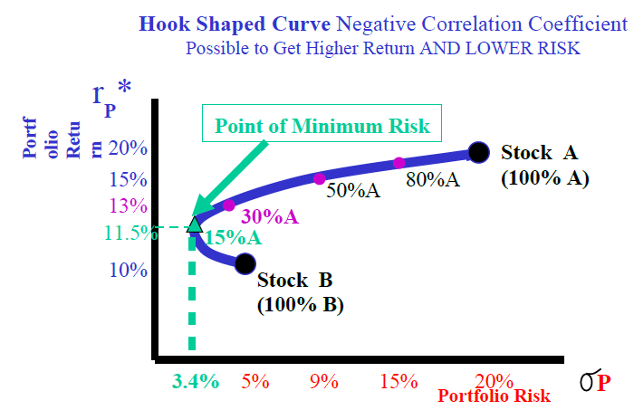
Market Risk & Portfolio Theory:

Slide 22
Market Risk & Portfolio Theory:
However, if the correlation coefficient is +ve then the risk return relationship is that of continuous function which is continuously rising as return rises the risk also rises with it. It is the fundamental concept in risk and return that the investor will not take on any additional risk unless they compensated by additional return.

Slide 23
Market Risk & Portfolio Theory:
It is important to under stand that when we are talking about efficient capital markets and talking about the capital market line we are saying that efficient portfolios in the market all lie on the capital market line.

Slide 24
Market Risk & Portfolio Theory:
It means that if one investor is only investing in the stock A and the other has a diversified portfolio of 40 stocks and now he is also investing in Stock A then the amount of risk for both investors will be different.

Slide 25
Market Risk & Portfolio Theory:
The investor who is only investing in stock A is taking on the Market risk of the stock as well as the company’s risk whereas the other investor is only taking on the market component risk for that stock.

Slide 26
Market Risk & Portfolio Theory:
Rational Investors with Diversified Portfolios expect to be compensated by extra return in exchange for taking on Extra Market Risk.

Slide 27
Market Risk & Portfolio Theory:
You can NOT expect to receive extra return (or compensation) for taking on Company-Specific Risk which Rational Investors have eliminated!

Slide 28
Market Risk & Portfolio Theory:
The Efficient Market will only offer you a Return (and a Share Price) which is the bare minimum acceptable to Rational Diversified Investors. This is the Basis of the Capital Asset Pricing Model (CAPM).

Slide 29
Beta Concept & CAPM:
Beta:
It is a tendency of a Stock to move with the Market (or Portfolio of all Stocks in the Stock Market). It is the building block of CAPM.

Slide 30
Beta Concept & CAPM:
Stock Risk vs. Stock Beta:
Stock Risk:
It is a statistical spread of possible returns (or Volatility) for that Stock

Slide 31
Beta Concept & CAPM:
Stock Beta:
It is a statistical spread of possible returns (or Volatility) for that Stock relative to the market spread i.e. spread (or Volatility) of the fully diversified market portfolio or index.

Slide 32
CAPM: Capital Asset Pricing Model.
It is developed by Professors Sharpe & Markowitz. He won Nobel Prize in 1990 Market Risk is the only risk that is relevant to a Rational Investor with a Diversified Portfolio of Investments.

Slide 33
CAPM: Capital Asset Pricing Model.
The Company Specific (or Unique) Risk is Diversified Away! Market Risk is measured in terms of the Standard Deviation (or Volatility) of the Market Portfolio or Index.

Slide 34
CAPM: Capital Asset Pricing Model.
Every Stock Market develops an Index comprising of a weighted average of the highest-volume shares in that market.

Slide 35
CAPM: Capital Asset Pricing Model.
This Index represents the relative strength of that Stock Exchange and is considered to be close to a Totally Diversified Portfolio. In reality, no such Portfolio exists anywhere in the world. For example the Karachi Stock Exchange has the KSE 100 Index.

Slide 36
Summary
Market Risk & Portfolio Theory:
CAPM: Capital Asset Pricing Model.

