Slide 1
STOCK PORTFOLIO THEORY, RISK AND EXPECTED RETURN

Slide 2
Summary of Last Lecture
Risk for Single Stock Investment
Probability Graphs and Coefficient of variation

Slide 3
Learning Objectives:
After going through this lecture, you would be able to have an understanding of the following topics
2-Stock Portfolio Theory
Risk & Expected Return

Slide 4
Learning Objectives:
In this lecture, we will continue our discussion on the risk. One of the easiest way of calculating risk using probability is by understanding the chance that are embedded in the game of cards and the fundamentals of probability are very easily understood.

Slide 5
Learning Objectives:
We discuss in this lecture calculation of risk using probability. But first we recap the previous concepts formulas etcetera.

Slide 6
Recap of Risk Basics:
Risk: It arises because of Uncertainty, Volatility, and Spread in possible out comes. There are many possible outcomes (pi) for Expected Rate of Returns (r.i).

Slide 7
Bell Curve Assumption:
In this it is assumed that the forecasted outcome of events will be distributed in the shape of a Normal Probability Distribution.

Slide 8
Bell Curve Assumption:
The advantage we gain from using this that after calculating the standard deviation for any particular investment we have an idea that what the distribution or the spread of possible outcomes is going to be like.

Slide 9
Bell Curve Assumption:
If you use normal distribution that we are sure that 68.26% of the times the Actual Future Rate of Return will lie within -1σ and +1 σ range.

Slide 10
Bell Curve Assumption:
If you use normal distribution that we are sure that 68.26% of the times the Actual Future Rate of Return will lie within -1σ and +1 σ range.

Slide 11
Coefficient of Variation
Investment Comparison Criterion used to simultaneously account for Risk & Return
CV = σ/ < r >.
Our Objective is to minimize Risk & maximize Return.
< r > = Exp or Weighted Avg ROR = pi ri

Slide 12
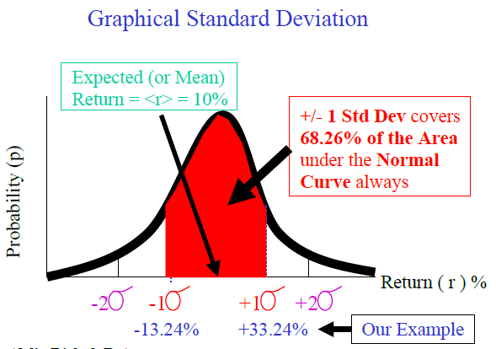
Coefficient of Variation

Slide 13
Portfolio Risk & Return:
Risk is Relative:
The RISK from investing in Stock of Company ABC usually decreases as you make more Investments in other stocks of different unrelated companies.

Slide 14
Portfolio Risk & Return:
Portfolios may have 2 or more stocks, bonds, other securities and investments or a mix of all. We will focus on Stock Portfolios.

Slide 15
Portfolio Risk & Return:
This is a logical fact because when you talk about one business which is earning you Rs 100,000 a month then you not look only on this business when you are running another business that is losing you Rs 200,000 a month,.

Slide 16
Portfolio Risk & Return:
You have to look at all the business and the overall rate of return you are generating, Similarly if you are investing in the bonds or stocks then you are need to look at the overall risk and return of the portfolio.

Slide 17
Portfolio Risk & Return:
The important thing to remember is that risk of particular share of company ABC will change if you are investing in that share after you have portfolio of many other stocks.

Slide 18
Portfolio Risk & Return:
If you already have large number of investments which you have made and then if you invest in particular share in company ABC will be different.

Slide 19
Diversification:
The important thing to remember is that risk of particular share of company ABC will change if you are investing in that share after you have portfolio of many other stocks.

Slide 20
Diversification:
If you already have large number of investments and then you invest in particular share in company ABC then the risk will be different.

Slide 21
Diversification:
Investing in many Different Shares and Bonds and Projects of Different Companies in Different Countries can reduce risk. Diversified portfolios can reduce risk. The level of risk generally reduces as the size of the portfolio increase.

Slide 22
Portfolio Risk & Return:
What matters is the Overall Risk & Return on the entire Portfolio (or Collection) of Investments. The Risk & Return of an Individual Investment in a Stock or Bond should be seen in terms of its Incremental Effect on the Overall Portfolio.

Slide 23
Investment Rule:
Investor will try to Maximize Portfolio Return and Minimize Portfolio Risk. Investor will NOT take on Additional Portfolio Risk UNLESS compensated with Additional Portfolio Return.

Slide 24
Types of Risks for a Stock:
Types of Stock-related Risks which cause Uncertainty in future possible Returns & Cash Flows:
Total Stock Risk = Diversifiable Risk + Market Risk

Slide 25
Diversifiable Risk:
It is known as Company-Specific or Unique or Non-Systematic Risk. It is associated with random events associated with Each Company whose stocks you are investing in i.e. Winning major contract, losing a court case, successful marketing campaign, losing a charismatic CEO,…Diversifiable

Slide 26
Diversifiable Risk:
Risk can be Reduced using Diversification. The bad random events affecting one stock will offset the good random events affecting another stock in your portfolio.

Slide 27
Market Risk:
It is known as Non-Diversifiable or Systematic (Country-wide) or Beta Risk. It is associated with Macroeconomic or Socio-Political or Global events that systematically affect Stock investments in every Stock Market in the country i.e. Inflation, Macro Market Interest Rates, Recession, and War.

Slide 28
Market Risk:
Market Risk can NOT be reduced by Diversification.

Slide 29
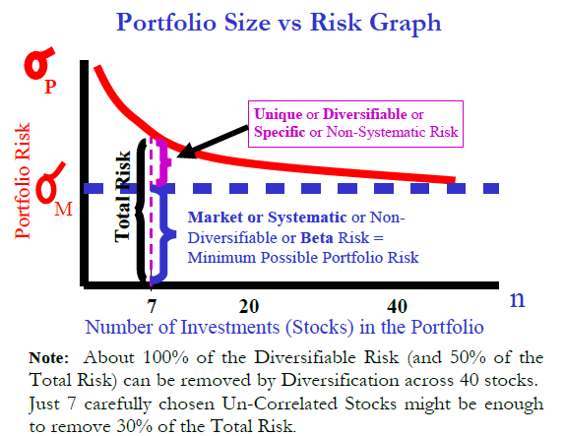
Market Risk:

Slide 30
Portfolio Rate of Return
Portfolio’s Expected Rate of Return:
It is the weighted average of the expected returns of each individual investment in the portfolio.
Formula is similar to Expected Return for Individual Investment but interpretation is different:
Portfolio Expected ROR Formula:
rP * = r1 x1 + r2 x2 + r3 x3 + … + rn xn .

Slide 31
Portfolio Rate of Return
Portfolio’s Expected Rate of Return:
Where there are “n” different investments (i.e. Stocks, Bonds, Projects,…) in your portfolio. R1 represents the expected return (in % pa) on Investment No. 1 and x1 represents the weight of Investment.
No. 1 (fraction of the Rupee value of the total portfolio that Investment No. 1 represents).

Slide 32
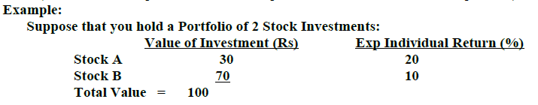
Portfolio Rate of Return
Portfolio’s Expected Rate of Return:

Slide 33
Portfolio Rate of Return
Portfolio’s Expected Rate of Return:
Expected Portfolio Return Calculation:
rP * = rA xA + rB xB
= 20% (30/100) + 10 %( 70/100)
= 6% + 7%
= 13%

Slide 34
Portfolio Rate of Return
Portfolio’s Expected Rate of Return:
2 Stock” Investment Portfolio Risk
Portfolio Risk is generally not the weighted average risk of the Individual Investments. In fact, it is usually less.

