Slide 1
Summary of Last Lecture
Introduction to Risk
Risk and Return for Single Stock Investment

Slide 2
RISK FOR A SINGLE STOCK INVESTMENT, PROBABILITY GRAPHS AND COEFFICIENT
OF VARIATION

Slide 3
Learning Objectives:
After going through this lecture, you would be able to have an understanding of the following topics
Risk for Single Stock Investment
Probability Graphs and Coefficient of variation

Slide 4
Learning Objectives:
In this lecture, we will continue our discussion on risk and return. This is very important area of financial management.

Slide 5
Learning Objectives:
In previous lecture, we have mentioned an example for the investment in share and after one year the share price has 3 possible outcomes.

Slide 6
Learning Objectives:
This uncertainty in future price of the share that leads to the certain distribution in forecasted share price and this distribution is source of the uncertainty which allow us to calculate risk.

Slide 7
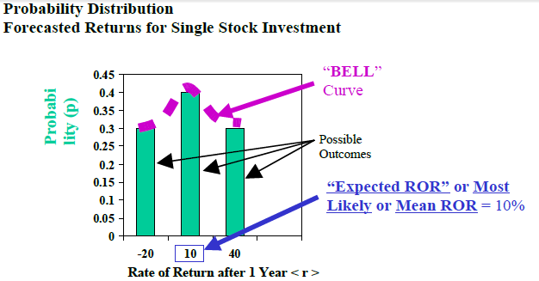
Payoff Table & Expected ROR
Payoff Table for Investment in Stock

Slide 8
Payoff Table & Expected ROR
Payoff Table for Investment in Stock
In the diagram, the probability graphed on y axis and the rate of return is graphed on x axis. All three outcomes are shown in the form of the bars. In this diagram the largest probability takes place at the value of the expected rate of return which is 10%.

Slide 9
Payoff Table & Expected ROR
Payoff Table for Investment in Stock
If the top of each vertical bar is connected then the bell curve is formed. It is easy to calculate the risk after calculating the expected rate of return. We simply use the formula of standard deviation to calculate the risk

Slide 10
Stand Alone Risk of Single Stock Investment:
The wider the range of Possible Outcomes (i.e. the greater the variability in potential returns) that can occur, the greater the Risk.
Risk Measured using Standard Deviation (Note: Variance = Standard Deviation 2)

Slide 11
Stand Alone Risk of Single Stock Investment:
Risk = Std Dev = ( r i - < r i > )2 p i . = Summed over each possible outcome “ i ” with return “r i ” and probability of occurrence “p i .” < r I > is the Expected (or weighted average) Return
This topic will be discussed in detail in the next lecture.

Slide 12
3 Possible Outcomes Example Continued:
Measuring Stand Alone Risk for Single Stock Investment.

Slide 13
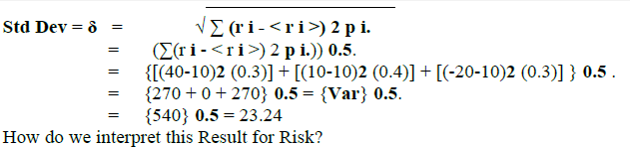
3 Possible Outcomes Example Continued:

Slide 14
Standard Deviation Interpretation
What are the units of Standard Deviation?
For our example where Return is being estimated in % terms, the units of Standard Deviation will also be %.

Slide 15
Standard Deviation Interpretation
It tells us that if we assume a Normal Probability Distribution and symmetric about expected rate of return, then we conclude that 68.26% of the time, the Actual Return will lie within -1 Standard Deviation and +1 Standard Deviation of the Expected (or Mean) Return.

Slide 16
Standard Deviation Interpretation
Expected (or Mean) Return = 10% +/- 1 Standard Deviation = 10% +/- 23.24% which means from (10% - 23.24%) to (10% + 23.24%) i.e. from -13.24% to 33.24%.

Slide 17
Standard Deviation Interpretation
There is a 68.26% chance that the Actual Return on our Stock Investment after 1 year will be somewhere between -13.24% and 33.24%. It is important thing to remember that in normal distribution the area under the curve from -1 standard deviation to +1 standard deviation is 68.28%.

Slide 18
Standard Deviation Interpretation
So, we can be sure that two thirds of the time the actual value for the return will be in between -13.68% and +33.24 %. -13.24% is not a good sign as it indicates that we are making loss but remember that required rate of return is 10%.

Slide 19
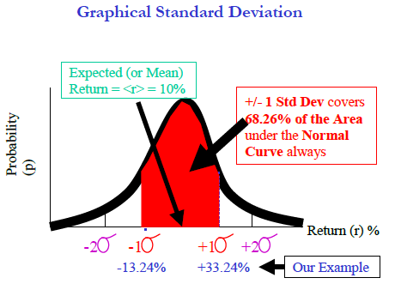
Standard Deviation Interpretation

Slide 20
Standard Deviation Interpretation
In the figure the probability is written on y-axis and the rate of return is mentioned on the x axis. It shows that higher the standard deviation the higher the risk.

Slide 21
Standard Deviation Interpretation
Now, lets take a look another example in which we raw comparing three different investments which we want to compare in terms of risk and return.

Slide 22
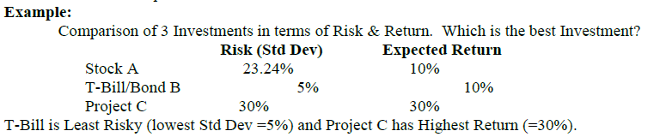
Example:

Slide 23
Example:
Given 2 Investments with Identical Expected Return, choose the Investment with the Lower Risk (or Spread or Volatility or Standard Deviation).
Given 2 Investments with Identical Risk, choose the Investment with the Higher Expected Return.

Slide 24
Example:
If you compare first two investments, both have the same rate of return but the T-bills have less risk. Clearly, T-Bill B is a better investment than Stock A because their Returns are identical (10%) but the T-Bill is less risky (10%) than the Stock (23.24%).

Slide 25
Example:
But, which is better? T-Bill B or Project C? T-Bill B is Less Risky but Project C promises Higher Return.
Now, we conceptually visualize these two types of investment.

Slide 26
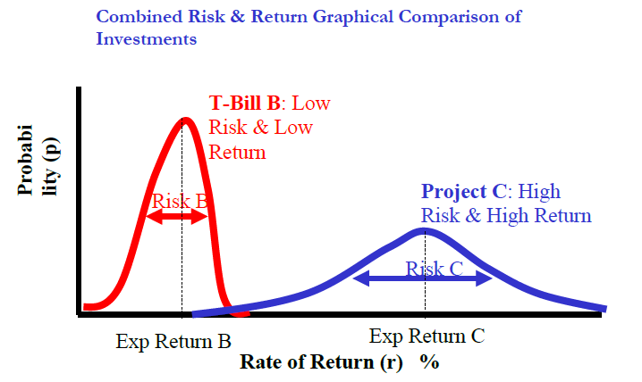
Example:

Slide 27
Example:
In the figure, we are showing both investments on the same graph. Left hand shows the probability distribution for the T- bills and on the right hand side shows the broader and shorter probability graph for project C. How to visualize which project have higher expected rate of return.

Slide 28
Example:
Project C is on right hand side and therefore it has higher return as to project B. The other thing is that project B form a probability distribution which have a sharp hill or spread of the curve is much narrower as to project C. The standard deviation for project B is much narrower then the standard deviation for project C .

Slide 29
Example:
In project B has less risk whereas Project C has a higher expected rate return. We have to look at risk and return simultaneously to answer that which option is better. We can derive the answer with the help of the coefficient of variation.

Slide 30
Comparison of Different Investments
Coefficient of Variation:
Coefficient of Variation (Risk per unit Return)
It is defined as the CV = Standard Deviation / Expected Return. Coefficient of Variation tells us about the Risk per unit Return. The project which offers lowest per unit risk is the best investment. Now we calculate the CV for both the projects.

Slide 31
Comparison of Different Investments
Coefficient of Variation:
Compare the CV’s of the Projects:
CV T-bill = 5% / 10% = 0.5
CV Project C = 30% / 30% = 1.0
Choose the Project with the Lowest CV. Choose the T-Bill because it carries the lowest Risk per unit Return.

Slide 32
Risk Aversion Assumption
Most Investors are psychologically Risk Averse. If two investments offer the same Expected Return, most Investors would choose the one with the lower Risk (or Standard Deviation or Spread or Volatility).

Slide 33
Risk Aversion Assumption
In other words, most Investors are not major gamblers. Note that gamblers would choose Project C which appeals to investor greed by offering an upside return of 30%+10% = 40% !

Slide 34
Risk Aversion Assumption
Consequences on Share Price: The Higher the Risk of a Share, the Higher its Rate of Return and the Lower its Market Price.

Slide 35
Summary
Risk for Single Stock Investment
Probability Graphs and Coefficient of variation

