Slide 1
Summary of Last Lecture
Common Stocks – Rate of Return
EPS Pricing Model

Slide 2
INTRODUCTION TO RISK, RISK AND RETURN FOR A SINGLE STOCK INVESTMENT

Slide 3
Learning Objectives:
After going through this lecture, you would be able to have an understanding of the following
topics
· Introduction to Risk
· Risk and Return for Single Stock Investment

Slide 4
What we have studied up till now?
Before discussing this important topic we should go through the area of finance which we have studied up till now.

Slide 5
What we have studied up till now?
Part I (Introduction and Capital budgeting)
FM Markets, Concepts, Definitions
Review of Accounting
Interest Rate Theory & Calculations
Investment Decisions: NPV (Valuation), IRR, Payback
Capital Budgeting: NPV & DCF
Capital Rationing (Budgeting for Real Assets)

Slide 6
What we have studied up till now?
Part II (Securities Valuation)
Valuation of Stocks & Bonds (Direct Claim Securities)
The Chapter 4 and 5 of text book cover the topics of risk and return. It is the fundamental concept to understand the topics of portfolio theory and Capital Asset pricing model (CAPM).In the previous lectures, we are ignoring the origin of required rate of return.

Slide 7
Risk:
Chinese Definition of Risk:
It is defined as the combination of danger and opportunity. Risk is the combination of both. When we talk about risk with the reference to the investment we are talking about risk in term of the uncertainty in outcome of our investment.

Slide 8
Risk:
We are talking about the variability, spread, or volatility that can take place in the expected future Value (Cash Flows) or Returns. For example, we are asking ourselves if we invest Rs 1,000 for buying a share today then what will be the price of the share one year from now.

Slide 9
Risk:
There is no guarantee about the price of the share after one year therefore there is an uncertainty or risk we are taking because we do not know the final outcome. So, the difference or variation in the possible outcomes of a particular investment also represents the riskiness of a particular investment.

Slide 10
Risk:
As we have studied earlier that there are two major categories of assets
1 Real Physical Assets
2 .Financial Assets (Stock & bonds)

Slide 11
Risk:
Risk can be understood with reference to the uncertainty of Future Cash Flows produced by Assets (Physical & Financial Securities). Businesses make forecasts based on certain assumptions which we have discussed in lecture 5 of your course.

Slide 12
Risk:
These forecasts are not 100% accurate and there is uncertainty in the possible outcome. The actual cash flows one or five years from now may be very different from the forecasted and this to represent risk.

Slide 13
Risk:
When we talk about risk in investing in direct claim securities then we need to keep in mind the distinction between Stand Alone Risk (or Single Investment Risk) as oppose to market or Portfolio Risk (or Collection of Investments Risk).which is a risk of particular investment compare to other investments you have made.

Slide 14
Risk:
In Portfolio risk we are interested in overall risk of entire collection of investments that made by the company. We will study this topic in the next lectures.

Slide 15
Risk:
In case of portfolio risk we can further made distinction between Diversifiable Risk and Market risk
Diversifiable Risk: random risk specific to one company, can be virtually eliminated.
Market Risk: It is defined as uncertainty caused by broad movement in market or economy. More significant.

Slide 16
Causes of Risk:
These can be Company-Specific or General. It may be because of Cash Losses from operations or poor financial management of the company. This is one possibility but the real question is that why these losses occurred.

Slide 17
Causes of Risk:
One of the reasons for the losses might be the company’s Debt, Inflation, Economy, Politics, War or Fate. Final analysis of risk is that it is a game of fate or chance.

Slide 18
Measurement of Risk:
It is important to attach different numbers to the risk so that we can rank different investments. Risk is measured in terms of the standard deviation or variance. You have studied these terms in the statistics.

Slide 19
Measurement of Risk:
Risk is still quite subjective even after the numbers you have calculated after standard deviation. The reason is that you have to keep in mind what kind of risk you are talking about.

Slide 20
Measurement of Risk:
Are you
Stand Alone Risk or Portfolio Risk?
Market Risk or Diversifiable Risk?
Stock Price Risk or Earnings Risk?

Slide 21
Measurement of Risk:
Another important thing is Time Horizon for which you are measuring the risk. Are you investing in Stocks over 1 Year or over 30 Years?
The level of risk might change as time period of the investment change.

Slide 22
Fundamental Rule of Risk & Return:
This rule can be summed up in saying that No Pain - No Gain. Investors will not take on additional Market Risk unless they expect to receive additional Return which is common sense and quite logical.

Slide 23
Fundamental Rule of Risk & Return:
Most investors are Risk Averse. Another important principle that one should to keep in mind is Diversification.

Slide 24
Diversification:
It states that don’t put all your eggs in one basket. Diversification can reduce risk. By spreading your money across many different Investments, Markets, Industries, Countries you can avoid the weakness of each.

Slide 25
Diversification:
Make sure that they are Uncorrelated so that they don’t suffer from the same bad news. Due to certain change in the interest rates some of the investments in your portfolio may go up and the others go downward.

Slide 26
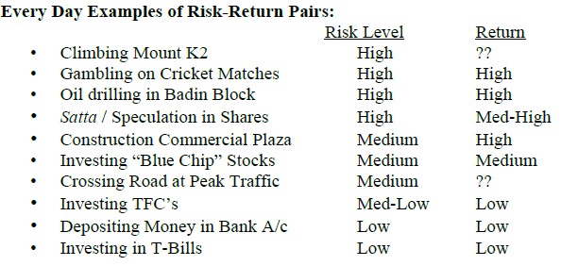
Every Day Examples of Risk-Return Pairs:

Slide 27
Every Day Examples of Risk-Return Pairs:
Before taking about the risk we first see the different possible outcomes of a particular investment by analyzing the expected return. It is mentioned earlier that once we have an idea of the variation then we can measure the risk of that investment.

Slide 28
Range of Possible Outcomes, Expected Return:
Overall Return on Stock = Dividend Yield + Capital Gains Yield (Gordon’s Formula)
Simply, Return is proportional to Capital Gain which is proportional to Selling Price.

Slide 29
Range of Possible Outcomes, Expected Return:
We can use Forecasted Selling Price as measure of Return. The wider the range of Possible Outcomes that can occur, the greater the Risk.

Slide 30
Range of Possible Outcomes, Expected Return:
The chance that a future event will actually occur is measured using Probability
Expected ROR = < r > = pi ri

Slide 31
Range of Possible Outcomes, Expected Return:
Where pi represents the Probability of Outcome “i” taking place and ri represents the Rate of Return (ROR) if Outcome “i” takes place. The Probability gives weight age to the return. The Expected or Most Likely ROR is the SUM of the weighted returns for ALL possible Outcomes.

Slide 32
Case of investing in the share of the particular company.
Suppose you are deciding whether to invest in the Stock of Company ABC. You’re not sure because the Future or Forecasted Price of the Stock after 1 year could reach any one of 3 Possible Values (or Outcomes).

Slide 33
Case of investing in the share of the particular company.
Before you can estimate the most likely or Mean or Expected Future Price, you need to guess the Probability of Each Possible Outcome.

Slide 34
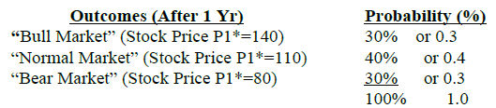
Case of investing in the share of the particular company.

Slide 35
Case of investing in the share of the particular company.
Po= Present Market Price Rs100. P1*=Forecasted Price.
The Sum of Probabilities of all Possible Outcomes MUST Add Up to 100% (or 1.0).

Slide 36
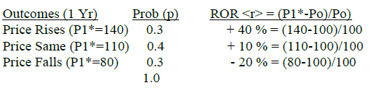
Payoff Table & Expected ROR
Payoff Table for Investment in Stock

Slide 37
Payoff Table & Expected ROR
Payoff Table for Investment in Stock
Expected ROR of Investment in Stock
Most Likely or Weighted Average or Mean ROR Rate of Return < r >
Expected ROR = < r > = pi ri.
= p1 (r1) + p2 (r2) + p3 (r3)
= 0.3(40%) + 0.4(10%) + 0.3(-20%)
= 12% + 4% - 6% = 10%

Slide 38
Summary
Introduction to Risk
Risk and Return for Single Stock Investment

