Slide 1

Competitive Dynamics

Slide 2
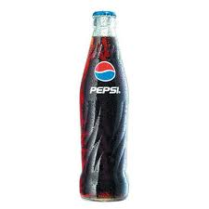
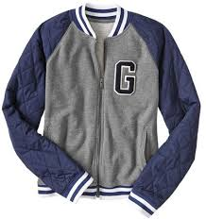
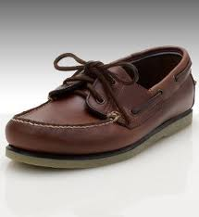
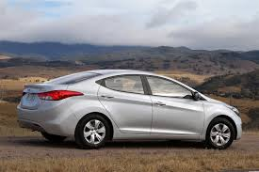
Expanding the Total Market
New customers
(Market Penetration Strategy, New-market segment strategy, Geo-graphical expansion strategy)
More usage

Slide 3
Protecting Market Share
Dominant firm in any business must defend its current business through continuous innovation.
Proactive Market
1. Responsive Marketer finds a stated need and fills it.
2. Anticipative Marketer looks ahead to needs, customer may have in future.
3. Creative Marketer discovers solutions customer did not ask for.

Slide 4
Defensive Marketing
    Position Defense – Market Leader occupy the most desirable market space in consumer’s minds
    Flank Defense – Market Leader erect outposts to protect a weak front or support a possible counter attack
    Preemptive Defense – Attack competitor (s) first, achieve broad market envelopment that signals competitors not to attack
    Counteroffensive Defense – meet attacker frontally
      Mobile defense is stretching the firm’s domain in new territories through market broadening (shifts focus from the current product to the underlying generic need e.g. petroleum company recasts itself as “energy” company) and market diversification (shift into unrelated industries).
      Contracting Defense is giving up weaker market

Slide 5
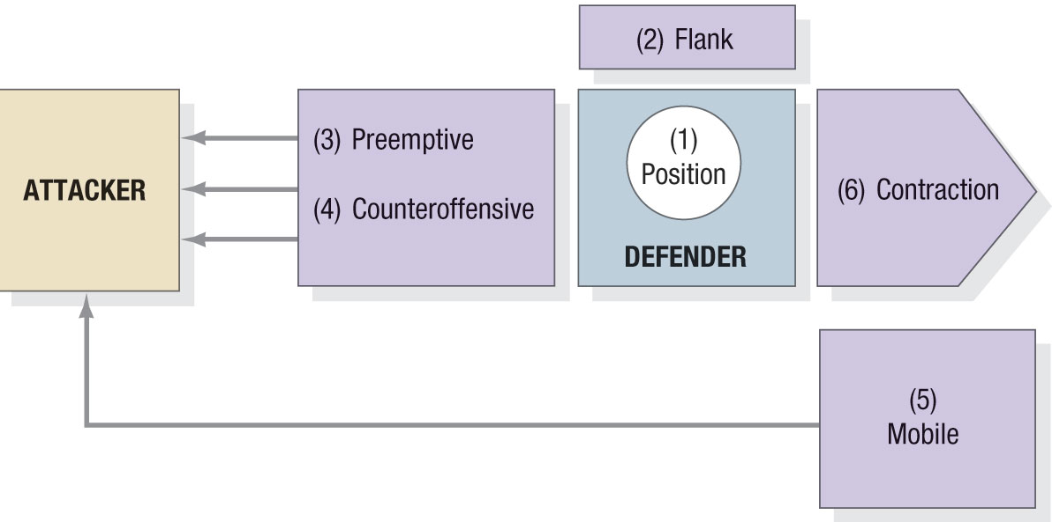
Six Types of Defense Strategies

Slide 6
Other Competitive Strategies
Market
Challengers
Market
Followers
Market
Nichers

Slide 7
Market Challenger Strategies
Define the strategic objective and opponents
  Market leader can be attacked
  Market challenger can attack firms of its own size who are not doing the job and are underfinanced.
  Market challengers can attack small local and regional firms
Choose a general attack strategy
Choose a specific attack strategy

Slide 8
General Attack Strategies
Flank Attack
Identify shifts that are causing gaps to develop,
then rushing to fill the gaps.
Frontal Attack
Match opponents marketing mix
Encirclement
Attack
Launch offensive on multiple fronts
Bypass Attack
Diversify into unrelated products
Diversify into new geographical markets\
leapfrog into new technologies
Guerrilla Warfare
Small intermittent attacks, conventional
and unconventional.

Slide 9
Market Follower Strategies
    Counterfeiter: Duplicating leader’s product and sell on black market
Cloner: Emulate leader’s solutions with slight variations
Imitator: Copy a few things from the leader but maintain differentiation
of packaging, advertising, pricing or location
    Adapter: Take leader’s products and adapt or improve them
    for different markets

Slide 10
Market Nicher Strategies
    Avoid competing with larger firms by targeting small markets of little or no interest to larger rivals
    Larger firms may use niche strategy for some business units
    Risks – niche may “dry-up” or be attacked
    Nichers must create new niches, expand existing niches and protect niches

Slide 11
Product-Life Cycle Marketing Strategies
Product has a life cycle means it has four things:
Products have a limited life.
Product sales pass through distinctive stages, each posing different challenges, opportunities and problems to the seller.
Profit rises and falls at different stages of PLC
Products require different marketing, financial, manufacturing, purchasing, and human resource strategies in each life cycle stage.

Slide 12
Product Life-Cycle Strategies
PLC Stages
Begins when the company develops a new-product idea
Sales are zero
Investment costs are high
Profits are negative
Product development
Introduction
Growth
Maturity
Decline

Slide 13
Product Life-Cycle Strategies
PLC Stages
Low sales
High cost per customer acquired
Negative profits
Innovators are targeted
Little competition
Product development
Introduction
Growth
Maturity
Decline

Slide 14
Marketing Strategies: Introduction Stage
Product – Offer a basic product
Price – Use cost-plus basis to set
Distribution – Build selective distribution
Advertising – Build awareness among early adopters and dealers/resellers
Sales Promotion – Heavy expenditures to create trial

Slide 15
Product Life-Cycle Strategies
PLC Stages
Rapidly rising sales
Average cost per customer
Rising profits
Early adopters are targeted
Growing competition
Product development
Introduction
Growth
Maturity
Decline

Slide 16
Marketing Strategies:
Growth Stage
Product – Offer product extensions, service, warranty
Price – Penetration pricing
Distribution – Build intensive distribution
Advertising – Build awareness and interest in the mass market
Sales Promotion – Reduce expenditures to take advantage of consumer demand

Slide 17
Product Life-Cycle Strategies
PLC Stages
Sales peak
Low cost per customer
High profits
Middle majority are targeted
Competition begins to decline
Product development
Introduction
Growth
Maturity
Decline

Slide 18
Marketing Strategies:
Maturity Stage
Product – Diversify brand and models
Price – Set to match or beat competition
Distribution – Build more intensive distribution
Advertising – Stress brand differences and benefits
Sales Promotion – Increase to encourage brand switching

Slide 19
Product Life-Cycle Strategies
PLC Stages
Declining sales
Low cost per customer
Declining profits
Laggards are targeted
Declining competition
Product development
Introduction
Growth
Maturity
Decline

Slide 20
Marketing Strategies: Decline Stage
Product – Phase out weak items
Price – Cut price
Distribution – Use selective distribution: phase out unprofitable outlets
Advertising – Reduce to level needed to retain hard-core loyalists
Sales Promotion – Reduce to minimal level

Slide 21
Thank You

