Slide 1
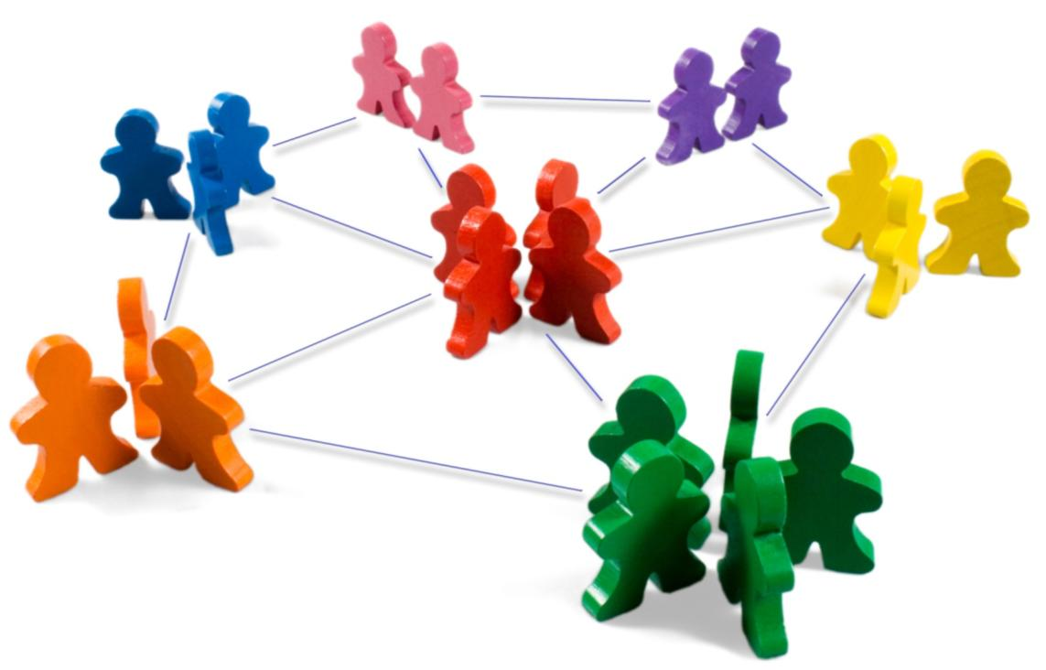
Identifying Market Segments and Targets

Slide 2
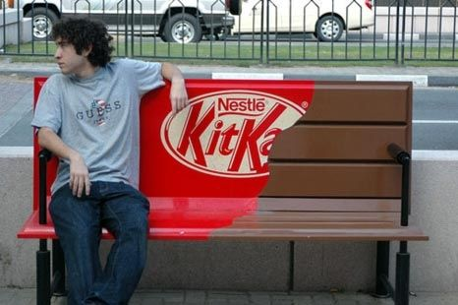
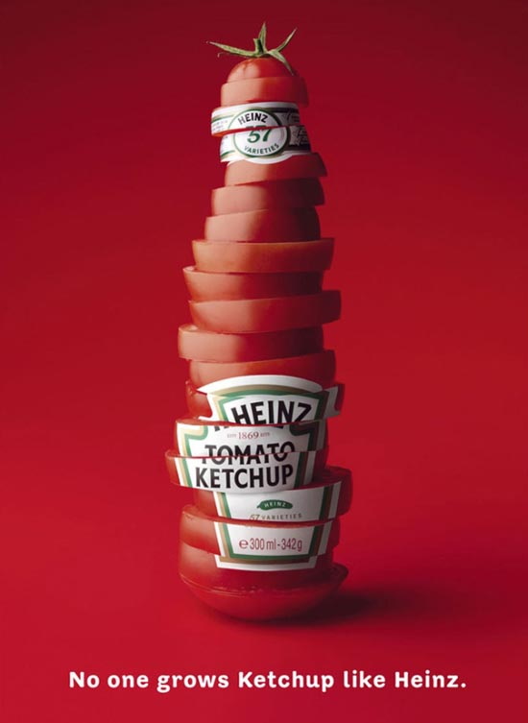
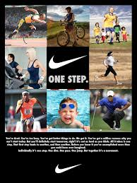

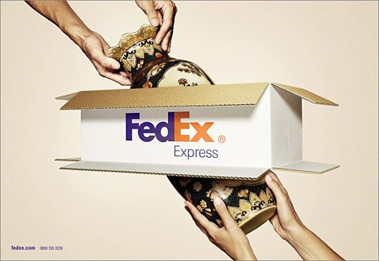
Notes:
Companies cannot connect with all customers in large, broad, or diverse markets. But they can divide such markets into groups of consumers or segments with distinct needs and wants. A company then needs to identify which market segments it can serve effectively. This decision requires a keen understanding of consumer behavior and careful strategic thinking. To develop the best marketing plans, managers need to understand what makes each segment unique and different. Identifying and satisfying the right market segments is often the key to marketing success.

Slide 3

Target Marketing Requirements
Identify and profile distinct groups of buyers who differ in their needs and wants (market segmentation).
Select one or more market segments to enter (market targeting).
For each, establish and communicate benefits of offering (market positioning).
Notes:
Market Segmentation – Identify and profile distinct groups of buyers who differ in their needs and wants.
Market Targeting – Select one or more market segments to enter.
Market Positioning – For each target segment, establish and communicate the distinctive benefit(s) of the company’s market offering.

Slide 4
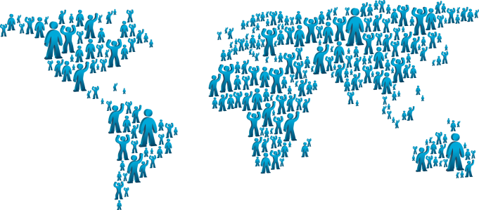


Bases for Segmenting Consumers
Geographic
Demographic
Psychographic
Behavioral
Notes:
A market segment consists of a group of customers who share a similar set of needs and wants. Major segmentation variables are:
Geographic,
Demographic
Psychographic
Behavioral

Slide 5
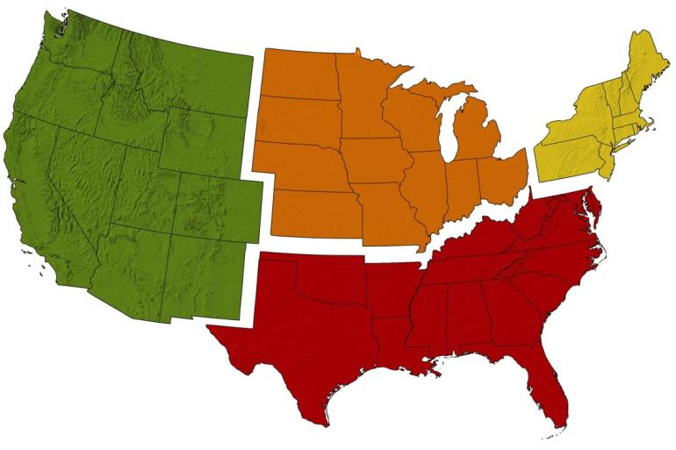
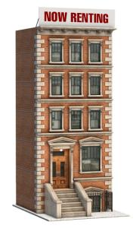


Geographic Segmentation
Market by nations, states, regions, countries, cities, or neighborhoods
Geoclustering: Approach that combines geographic data with demographic data that yields richer descriptions of consumers and neighborhoods. 39 factors considered from 5 broad categories.
Education and affluence, (2) Family life cycle, (3) Urbanization, (4) Race and ethnicity, and (5) Mobility.
Notes:
Geographic segmentation divides the market by nations, states, regions, counties, cities, or neighborhoods.
Nielsen Claritas developed PRIZM NE, a geoclustering approach that combines geographic data with demographic data that yields richer descriptions of consumers and neighborhoods. The groupings take into consideration 39 factors from 5 broad categories: (1) education and affluence, (2) family life cycle, (3) urbanization, (4) race and ethnicity, and (5) mobility.
Inhabitants in a cluster tend to lead similar lives, drive similar cars, have similar jobs, and read similar magazines.

Slide 6

Demographic Segmentation
Demographic variables are often associated with consumer needs and wants and are easy to measure.
Age and Life-cycle Stage
Life Stage
Gender
Income
Generation
Race and Culture
Religion
Occupation
Education
Notes:
Demographic segmentation divides the market on variables such as age, family size, family life cycle, gender, income, occupation, education, religion, race, generation, nationality, and social class.
Demographic variables are often associated with consumer needs and wants and are easy to measure.

Slide 7
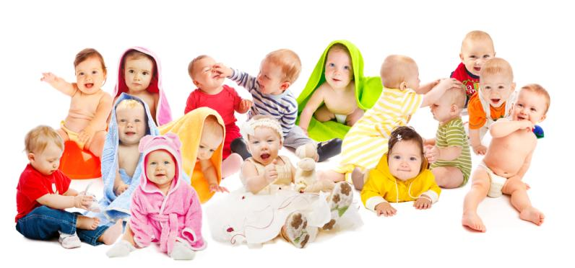


Age and Life-Cycle Stage
Wants and abilities change with age. Companies such as Crest and
Colgate offer products that target kids, adults and older consumers.
Notes:
Wants and abilities change with age. Companies such as Crest and Colgate offer products that target kids, adults and older consumers.

Slide 8
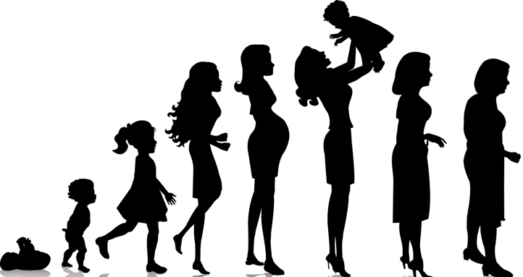

Life Stage
Life stage defines a person’s major concern, such as going through a
divorce, going into a second marriage, taking care of an older parent,
deciding to buy a new home etc. These life stages present opportunities
for marketers who can help people cope with their major concerns.
Notes:
Life stage defines a person’s major concern, such as going through a divorce, going into a second marriage, taking care of an older parent, deciding to cohabit with another person, deciding to buy a new home, and so on. These life stages present opportunities for marketers who can help people cope with their major concerns..

Slide 9


Gender
Women:
  Influence 80% of consumer purchases
  Make 75% of new home decisions
  Purchase 60% of cars
Notes:
Men and women have different attitudes and behaviors due in part to genetics and socialization. Women are more communal-minded, men more self-expressive and goal directed. A recent study found that men need to be invited to touch a product, whereas women are more likely to pick up without prompting.

Slide 10
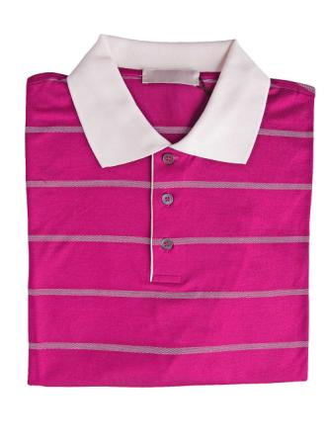
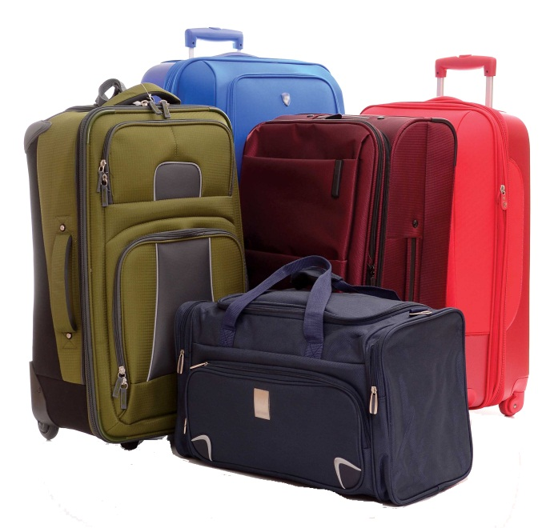

Income
Income segmentation is used in categories such as clothing, travel,
financial services, and automobiles.
Income does not always predict the best customers.
Like blue collar workers were among the first adopters of color TVs as it
offered entertainment at a lower cost than going to movies or
restaurants.
Notes:
Income segmentation is used in categories such as clothing, travel, financial services, and automobiles. Income does not always predict the best customers – blue collar workers were among the first adopters of color TVs as it offered entertainment at a lower cost than going to movies or restaurants.
Increasingly, companies are finding their markets are hourglass shaped as middle-market U.S. consumers migrate toward both discount and premium products.

Slide 11

Generation
Gen X (1964-1978)
Baby Boomers (1946-1964)
Silent Generation (1925-1945)
Millennials (Gen Y) – (1979-1994)
  -78 Million people
  -Less saving intentions
Notes:
Each generation or cohort is profoundly influenced by the times in which it grows up—the music, movies, politics, and defining events of that period. Members share the same major cultural, political, and economic experiences and have similar outlooks and values. Marketers often advertise to a cohort by using the icons and images prominent in its experiences. They also try to develop products and services that uniquely meet the particular interests or needs of a generational target.

Slide 12
U.S. Generation Cohorts
Cohort | Size | Defining Features
Millennials (1979-1994) | 78 m | Raised in affluence, tech savvy, perceived immunity from marketing
Gen X (1964-1978) | 50 m | Parents relied on day care, accepts diversity, pragmatic and individualistic
Baby Boomers (1946-1964) | 76 m | Control 3/4th of the wealth in the U.S, seek fountain of youth (hair color, hair replacement), home exercise equipment
Silent Generation (1925-1945) | 42 m | Lead vibrant lives, spend money and time on grandchildren.

Slide 13
Pakistani Population 2012

Slide 14



Race and Culture
Multicultural marketing is an approach recognizing that
different ethnic and cultural segments have sufficiently
different needs and wants to require targeted marketing
activities. Multicultural marketing can result in different
marketing messages, media, channels, and so on.
Notes:
Multicultural marketing is an approach recognizing that different ethnic and cultural segments have sufficiently different needs and wants to require targeted marketing activities, and that a mass market approach is not refined enough for the diversity of the marketplace. Multicultural marketing can result in different marketing messages, media, channels, and so on.
Hispanic Americans are the largest minority group in America and have an annual purchasing power estimated to exceed $1 trillion. By 2020, 17% of Americans are projected to be of Hispanic origin.
African Americans have had a significant economic, social, and cultural impact on the U.S. life. African Americans are the most fashion-conscious of all racial and ethnic groups, but strongly motivated by quality and selection. Children have a strong influence on product selection.
The Asian American market has been called the “invisible market” because, compared to Hispanic Americans and African Americans, it has traditionally received a relatively small portion of multicultural marketing dollars.
The next slide contains Table 8.4 that offers a profile of these three markets.

Slide 15

Psychographic Segmentation
Psychographics is the science of using psychology and
demographics to better understand consumers.
Personality traits
Lifestyle
Values
Notes:
Psychographics is the science of using psychology and demographics to better understand consumers. In psychographic segmentation, buyers are divided into different groups on the basis of psychological/personality traits, lifestyle, or values. People within the same demographic group can exhibit very different psychographic profiles.

Slide 16
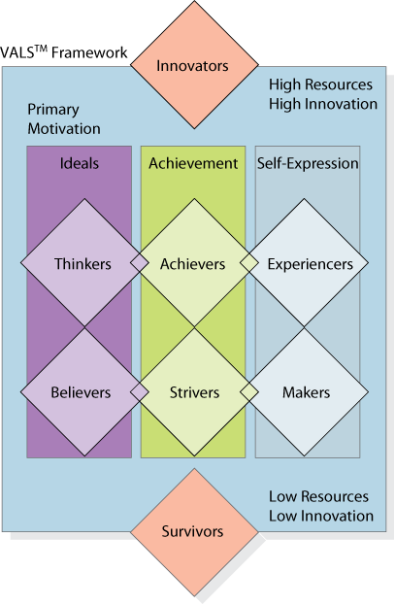
VALS Segmentation System
Notes:
VALS™ framework signifies values and lifestyles, classifies U.S. adults into eight primary groups based on responses to a questionnaire featuring 4 demographic and 35 attitudinal questions. The VALS system is continually updated with new data from more than 80,000 surveys per year.
The four groups with higher resources are:
1. Innovators—Successful, sophisticated, active, “take-charge” people with high self-esteem. Purchases often reflect cultivated tastes for relatively upscale, niche-oriented products and services.
2. Thinkers—Mature, satisfied, and reflective people motivated by ideals and who value order, knowledge, and responsibility. They seek durability, functionality, and value in products.
3. Achievers—Successful, goal-oriented people who focus on career and family. They favor premium products that demonstrate success to their peers.
4. Experiencer—Young, enthusiastic, impulsive people who seek variety and excitement. They spend a comparatively high proportion of income on fashion, entertainment, and socializing.
The four groups with lower resources are:
1. Believers—Conservative, conventional, and traditional people with concrete beliefs. They prefer familiar, U.S.-made products and are loyal to established brands.
2. Strivers—Trendy and fun-loving people who are resource-constrained. They favor stylish products that emulate the purchases of those with greater material wealth.
3. Makers—Practical, down-to-earth, self-sufficient people who like to work with their hands. They seek U.S.-made products with a practical or functional purpose.
4. Survivors—Elderly, passive people concerned about change and loyal to their favorite brands.

Slide 17
VALS Segmentation System
1. Innovators—Successful, sophisticated, active, “take-charge” people with high self-esteem. Purchases often reflect cultivated tastes for relatively upscale, niche-oriented products and services.
2. Thinkers—Mature, satisfied, and reflective people motivated by ideals and who value order, knowledge, and responsibility. They seek durability, functionality, and value in products.
3. Achievers—Successful, goal-oriented people who focus on career and family. They favor premium products that demonstrate success to their peers.
Notes:
Market Segmentation – Identify and profile distinct groups of buyers who differ in their needs and wants.
Market Targeting – Select one or more market segments to enter.
Market Positioning – For each target segment, establish and communicate the distinctive benefit(s) of the company’s market offering.

Slide 18
VALS Segmentation System
4. Experiencer—Young, enthusiastic, impulsive people who seek variety and excitement. They spend a comparatively high proportion of income on fashion, entertainment, and socializing.
The four groups with lower resources are:
1. Believers—Conservative, conventional, and traditional people with concrete beliefs. They prefer familiar, U.S.-made products and are loyal to established brands.
2. Strivers—Trendy and fun-loving people who are resource-constrained. They favor stylish products that emulate the purchases of those with greater material wealth.
Notes:
Market Segmentation – Identify and profile distinct groups of buyers who differ in their needs and wants.
Market Targeting – Select one or more market segments to enter.
Market Positioning – For each target segment, establish and communicate the distinctive benefit(s) of the company’s market offering.

Slide 19
VALS Segmentation System
3. Makers—Practical, down-to-earth, self-sufficient people who like to work with their hands. They seek U.S.-made products with a practical or functional purpose.
4. Survivors—Elderly, passive people concerned about change and loyal to their favorite brands.
Notes:
Market Segmentation – Identify and profile distinct groups of buyers who differ in their needs and wants.
Market Targeting – Select one or more market segments to enter.
Market Positioning – For each target segment, establish and communicate the distinctive benefit(s) of the company’s market offering.

Slide 20
Behavioral Segmentation
Behavioral segmentation divide buyers into groups
on the basis of their knowledge of, attitude
toward, use of, or response to a product.
Usage occasions
User status
Usage rate
Initiator
Influencer
Decider
Buyer
User
Buyer-readiness
Loyalty status
User and Usage
Decision Roles
Notes:
Behavioral segmentation divide buyers into groups on the basis of their knowledge of, attitude toward, use of, or response to a product.
Needs and Benefits: Not everyone who buys a product has the same needs or wants the same benefits from it. Needs-based or benefit-based segmentation is a widely used approach because it identifies distinct market segments with clear marketing implications.
Decision Roles: People play five roles in a buying decision: Initiator, Influencer, Decider, Buyer, and User.
User and Usage: variables related to various aspects of users or their usage—occasions, user status, usage rate, buyer-readiness stage, and loyalty status—are good starting points for constructing market segments.
Occasions: We can distinguish buyers according to the occasions when they develop a need, purchase or use a product. For example, air travel is triggered by occasions related to business, vacation, or family.
User Status: The key to attracting potential users, or even possibly nonusers, is understanding the reasons they are not using. Included in the potential-user group are consumers who will become users in connection with some life stage or life event. Mothers-to-be are potential users who will turn into heavy users.
Usage Rate Heavy users are often a small slice but account for a high percentage of total consumption.

Slide 21
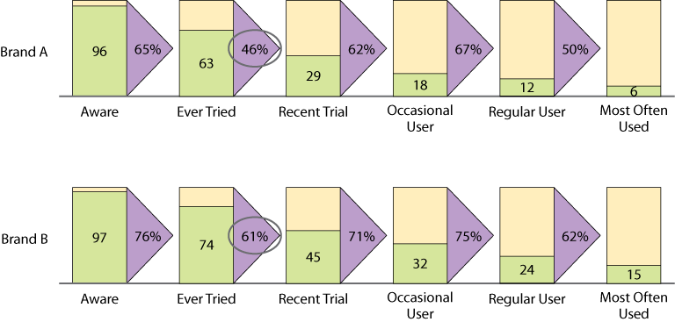
Brand Funnel
Notes:
User and Usage
Buyer-Readiness: Some people are unaware of the product, some are aware, some are informed, some are interested, some desire the product, and some intend to buy. To help characterize how many people are at different stages and how well they have converted people from one stage to another, marketers can employ a marketing funnel to break down the market into different buyer-readiness stages.
Loyalty Status: Marketers usually envision four groups based on brand loyalty status:
Hard-core loyals—Consumers who buy only one brand all the time
Split loyals—Consumers who are loyal to two or three brands
Shifting loyals—Consumers who shift loyalty from one brand to another
Switchers—Consumers who show no loyalty to any brand51
Figure 8.2 displays a funnel for two hypothetical brands. Compared to Brand B, Brand A performs poorly at converting one-time users to more recent users (only 46 percent convert for Brand A compared to 61 percent for Brand B). Depending on the reasons consumers didn’t use again, a marketing campaign could introduce more relevant products, find more accessible retail outlets, or dispel rumors or incorrect beliefs consumers hold.

Slide 22





Consumer Attitudes
Enthusiastic
Positive
Indifferent
Negative
Hostile
Notes:
Five consumer attitudes about products are: enthusiastic, positive, indifferent, negative, and hostile. Door-to-door workers in a political campaign use attitude to determine how much time to spend with each voter. They thank enthusiastic voters and remind them to vote, reinforce those who are positively disposed, try to win the votes of indifferent voters, and spend no time trying to change the attitudes of negative and hostile voters.

Slide 23
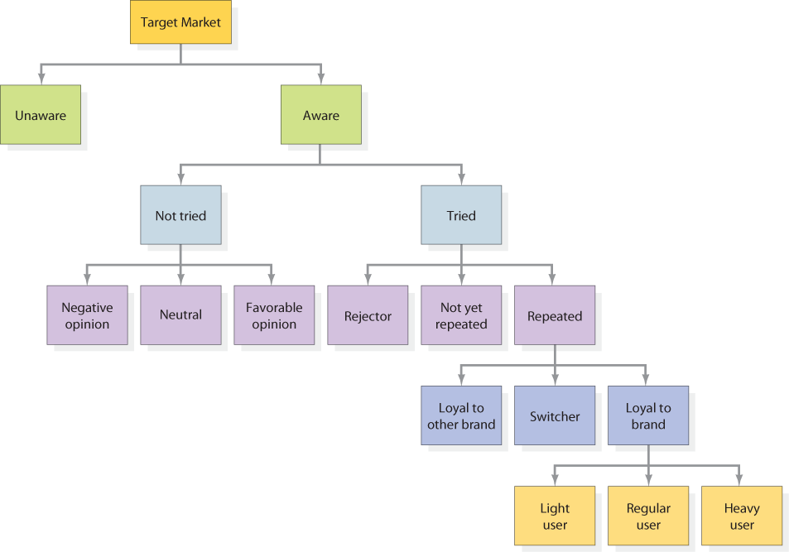
Behavioral Segmentation
Notes:
Combining different behavioral bases can provide a more comprehensive and cohesive view of a market and its segments. Figure 8.3 depicts one possible way to break down a target market by various behavioral segmentation bases.

Slide 24
Bases for Segmenting B2B Markets
Demographic
Industry, company size, location
Operating Variables
Technology, user status, customer capabilities
Purchasing Approach
Power structure, nature of existing relationship
Situational Factors
Urgency, specific application, size of order
Personal Characteristics
Buyer-seller similarity, loyalty, risk attitude
Notes:
Table 8.5 lists major questions that business marketers should ask in determining which segments and customers to serve. A rubber-tire company can sell tires to manufacturers of automobiles, trucks, farm tractors, forklift trucks, or aircraft. Within a chosen target industry, it can further segment by company size and set up separate operations for selling to large and small customers.
Business marketers generally identify segments through a sequential process. Consider an aluminum company: The company first undertook macrosegmentation. It looked at which end-use market to serve: automobile, residential, or beverage containers. It chose the residential market, and it needed to determine the most attractive product application: semifinished material, building components, or aluminum mobile homes. Deciding to focus on building components, it considered the best customer size and chose large customers. The second stage consisted of microsegmentation. The company distinguished among customers buying on price, service, or quality. Because it had a high-service profile, the firm decided to concentrate on the service-motivated segment of the market.

Slide 25
Market Targeting
Effective Segmentation Criteria
Measurable. The size, purchasing power, and characteristics of the segments can be measured.
Substantial. The segments are large and profitable enough to serve. A segment should be the largest possible homogeneous group worth going after with a tailored marketing program. It would not pay, for example, for an automobile manufacturer to develop cars for people who are less than four feet tall.
Accessible. The segments can be effectively reached and served.
Differentiable. The segments are conceptually distinguishable and respond differently to different marketing-mix elements and programs. If married and unmarried women respond similarly to a sale on perfume, they do not constitute separate segments.
Actionable. Effective programs can be formulated for attracting and serving the segments.
Notes:
Measurable. The size, purchasing power, and characteristics of the segments can be measured.
Substantial. The segments are large and profitable enough to serve. A segment should be the largest possible homogeneous group worth going after with a tailored marketing program. It would not pay, for example, for an automobile manufacturer to develop cars for people who are less than four feet tall.
Accessible. The segments can be effectively reached and served.
Differentiable. The segments are conceptually distinguishable and respond differently to different marketing-mix elements and programs. If married and unmarried women respond similarly to a sale on perfume, they do not constitute separate segments.
Actionable. Effective programs can be formulated for attracting and serving the segments.

Slide 26
Market Targeting
Porter’s Five Force has identified five forces that determine the intrinsic long-run attractiveness of a market or market segment
Rivals
New Entrants
Substitute Products
Buyer Power
Supplier Power
Notes:
Michael Porter has identified five forces that determine the intrinsic long-run attractiveness of a market or market segment:
1. Threat of intense segment rivalry—A segment is unattractive if it already contains numerous, strong, or aggressive competitors.. The cellular phone market has seen fierce competition due to segment rivalry.
2. Threat of new entrants—The most attractive segment is one in which entry barriers are high and exit barriers are low. The worst case is when entry barriers are low and exit barriers are high: Here firms enter during good times but find it hard to leave during bad times. The result is chronic overcapacity and depressed earnings for all.
3. Threat of substitute products—A segment is unattractive when there are actual or potential substitutes for the product. Substitutes place a limit on prices and on profits. Air travel has severely challenged profitability for Greyhound and Amtrak.
4. Threat of buyers’ growing bargaining power—A segment is unattractive if buyers possess strong or growing bargaining power. The rise of retail giants such as Walmart has led some analysts to conclude that the potential profitability of packaged-goods companies will become curtailed.
5. Threat of suppliers’ growing bargaining power—A segment is unattractive if the company’s suppliers are able to raise prices or reduce quantity supplied.

Slide 27
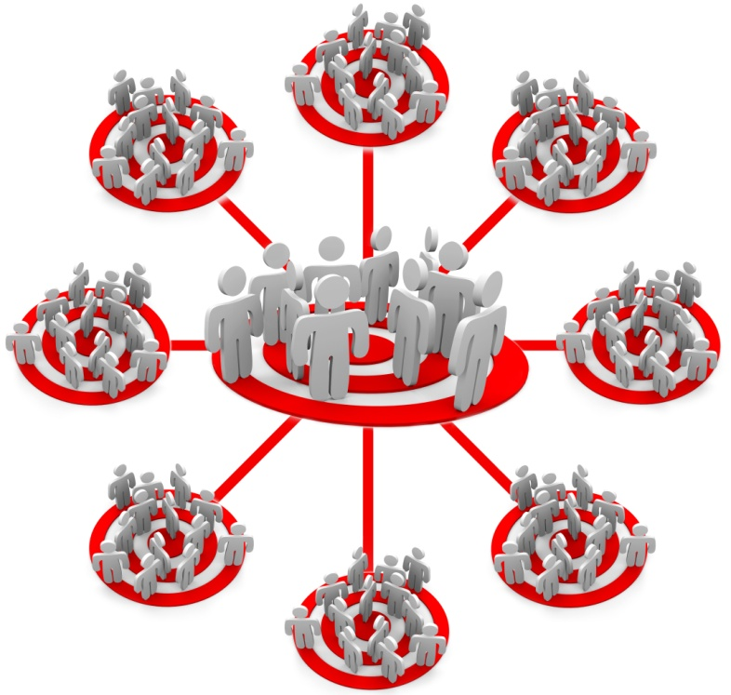


Evaluating and Selecting Segments
Multiple segment specialization
Full market coverage
Single-segment concentration
Individual marketing
Notes:
In evaluating different market segments, the firm must look at two factors: the segment’s overall attractiveness and the company’s objectives and resources.
Figure 8.4 shows that marketers have a range or continuum of possible levels of segmentation that can guide their target market decisions.

Slide 28
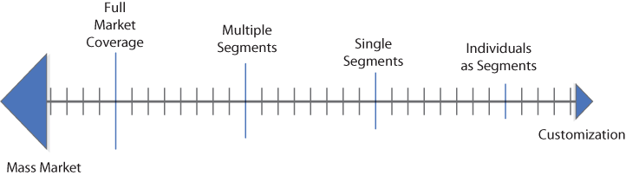
Levels of Segmentation
Full market coverage: a firm attempts to serve all customer groups with all the products they
might need.
Undifferentiated or mass marketing,
Differentiated marketing,.
Multiple Segment Specialization: With selective specialization, a firm selects a subset of all the
possible segments, each objectively attractive and appropriate. A supersegment is a set of
segments sharing some exploitable similarity.
product specialization,
market specialization,
Single-segment concentration: the firm markets to only one particular segment.
Individual Marketing: “segments of one,” “customized marketing,” or “one-to-one marketing.”
Notes:
Full market coverage: a firm attempts to serve all customer groups with all the products they might need.
Undifferentiated or mass marketing, the firm ignores segment differences and goes after the whole market with one offer.
Differentiated marketing, the firm sells different products to all the different segment of the market.
Multiple Segment Specialization: With selective specialization, a firm selects a subset of all the possible segments, each objectively attractive and appropriate. A supersegment is a set of segments sharing some exploitable similarity. A firm can also attempt to achieve some synergy with product or market specialization.
product specialization, the firm sells a certain product to several different market segments.
market specialization, the firm concentrates on serving many needs of a particular customer group, such as by selling an assortment of products only to university laboratories.
Single-segment concentration: the firm markets to only one particular segment. Porsche concentrates on the sports car market and Volkswagen on the small-car market. A niche is a more narrowly defined customer group seeking a distinctive mix of benefits within a segment.
Individual Marketing: “segments of one,” “customized marketing,” or “one-to-one marketing.” Customerization combines operationally driven mass customization with customized marketing in a way that empowers consumers to design the product and service offering of their choice.

Slide 29
Thank You

