Slide 1
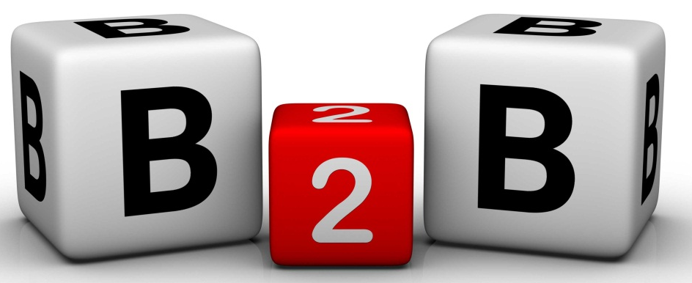
Analyzing Business Markets

Slide 2
Organizational Buying
The decision-making process by which formal organizations establish the need for purchased products and services and identify, evaluate, and choose among alternative brands and suppliers.
-- F. Webster Jr and Y. Wind

Slide 3






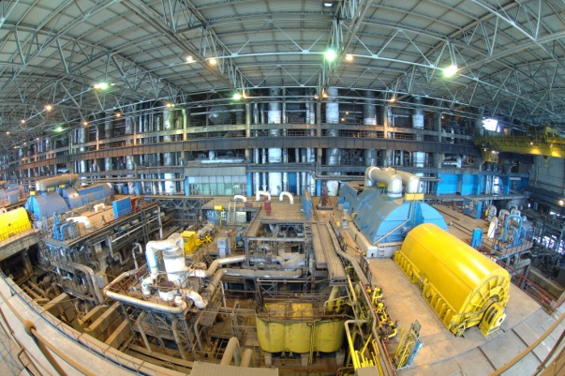
Business Markets
Transportation & Distribution
Agriculture
Construction
Forestry
Manufacturing
Communications
Banking & Finance
Notes:
The business market consists of all the organizations that acquire goods and services used in the production of other products or services that are sold, rented, or supplied to others.

Slide 4
Business Markets
Similarities to the Consumer Market
Understanding deep customer needs
Identify areas for growth
Improving value management techniques
Calculating better marketing metrics
Competing and growing in global markets
Countering product commoditization
Gain support for the marketing concept
Notes:
B2B marketers face similar challenges as do B2C marketers.

Slide 5





Business Markets
Differences to the Consumer Market
Geographically Concentrated
Fewer, Larger Buyers
Professional Buyers
Multiple Sales Calls
Personal Relationships
Notes:
Other differences include:
Multiple buying influences – Such as buying committees, which can be comprised of technical experts and senior management.
Direct purchasing – Often large volume customers purchase directly from manufacturer, rather than intermediaries

Slide 6
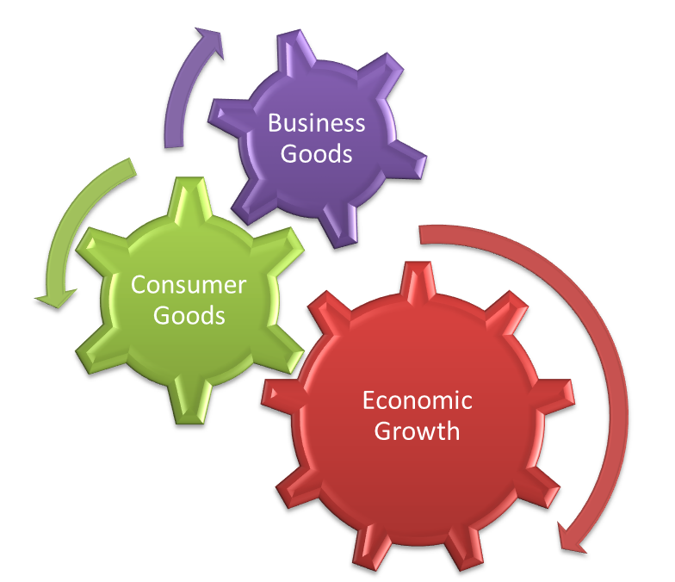
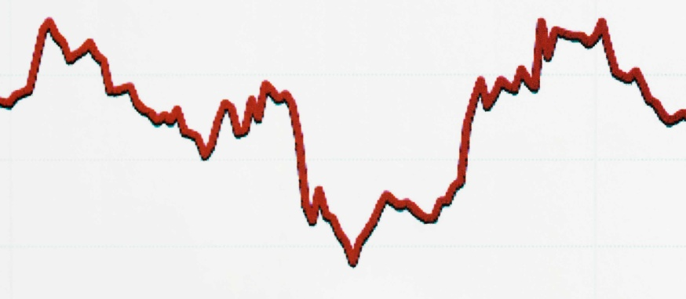
Business Markets
Differences to the Consumer Market
$$
Demand
Derived
Inelastic:
Fluctuating
Derived Demand: Demand in the business market depends on demand from the consumer market.
Inelastic Demand:
Total demand for many business goods and services is inelastic – that is, not affected too much by changes in price.
Fluctuating Demand
Notes:
B2B markets also differ from the consumer market in demand functions.
Derived Demand – Demand in the business market depends on demand from the consumer market.
Inelastic Demand – Total demand for many business goods and services is inelastic – that is, not affected too much by changes in price.
Fluctuating Demand – Demand for business goods tends to be more volatile than the demand for consumer goods. At times, a rise of 10% in consumer demand can result in a rise in business demand by as much as 200%.

Slide 7



Buying Situations
New Task: A purchaser buys the product first time like office building, machinery
Straight Rebuy: Purchasing department coordinates with suppliers whenever they need something
Modified Rebuy: When product specifications, delivery requirements, or other terms changed on the request of buyer

Slide 8
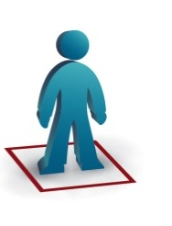

Systems Buying and Selling
Systems buying originated with the government awarding contracts for weapons and
communications systems. The firm (buyer) solicits bids from prime contractors that,
if awarded the bid, would be responsible for assembling the subcomponents of the system
from second-tier contractors.
Systems selling as a marketing tool. The contractor (seller) approaches a potential buyer and
offers to provide all of the organizations MRO (maintenance, repair, and operating) supplies.
Systems selling is a key strategy in bidding on large-scale industrial projects such as dams,
pipelines, factories, etc.
Buyer
Prime Contractor
Second-tier Contractors
Notes:
Systems buying originated with the government awarding contracts for weapons and communications systems. The firm (buyer) solicits bids from prime contractors that, if awarded the bid, would be responsible for assembling the subcomponents of the system from second-tier contractors.
Many organizations have turned the process around by adopting systems selling as a marketing tool. The contractor (seller) approaches a potential buyer and offers to provide all of the organizations MRO (maintenance, repair, and operating) supplies. Systems selling is a key strategy in bidding on large-scale industrial projects such as dams, pipelines, factories, etc.

Slide 9






Business Buying Participants
Initiator/Users
Influencer
Decider
Approver
Buyers
Gatekeeper
Notes:
Initiators
Users
Influences
Deciders
Approvers
Buyers
Gatekeepers

Slide 10




Buying Center Influences
Participants differ by:
  Interest
  Authority
  Status
  Persuasiveness
  Decision criteria
Notes:
Buying centers can have multiple participants, with a variety of backgrounds, such as finance, engineering, production staff, and/or senior managers. These differences must be taken into account as sales messages must be structure not to overly appeal to one participant, at the risk of alienating another.

Slide 11
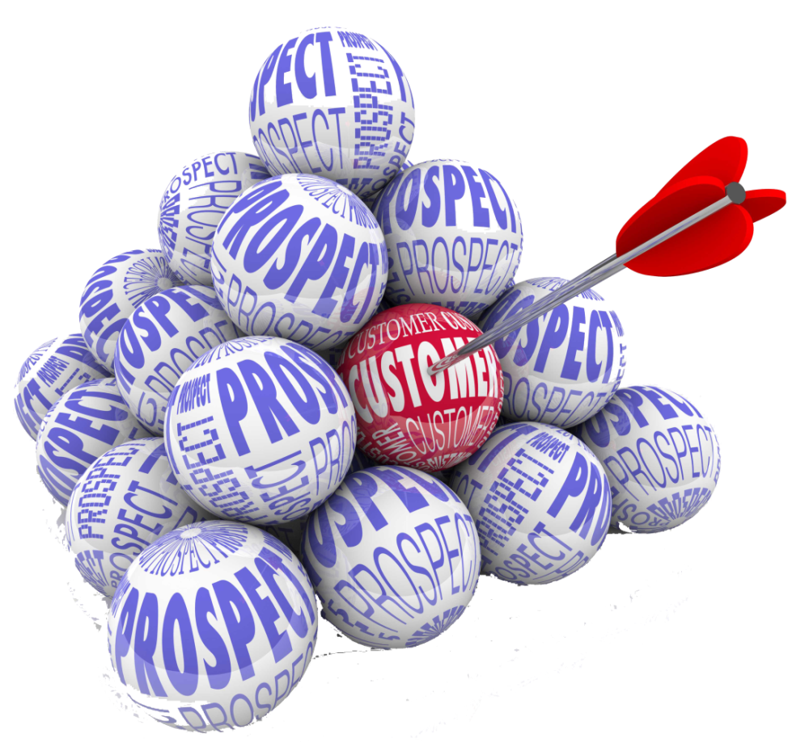

Targeting Firms and Buying Centers
Marketers must determine:
Who are the major decision makers?
What decisions do the influence?
What is their level of influence?
What evaluation criteria do they use?
Who to target?
Notes:
Firms should uncover those business sectors that have high future growth potential, most profitable customers, and the most promising opportunities. Once target firms are identified the firm must determine how best to sell to them. Marketers must determine:
Who are the major decision makers?
What decisions do the influence?
What is their level of influence?
What evaluation criteria do they use?

Slide 12



Purchasing/Procurement Process
Diverse supplier base
Benefits vs. Costs
Notes:
Buyers typically seek to obtain the highest benefit package from the products and services they purchase, in relation to the overall costs of the offering. To compare the offerings of one company to another, they will translate the costs and benefits into monetary terms. As such, the marketer must develop a profitable offering that delivers superior customer value.
Purchasing departments have been elevated in the hierarchy of many organizations.
Firms are actively seeking out women and minority owned firms in order to diversify their supplier base.

Slide 13
Stages in the Buying Process
Problem Recognition
Description and Characteristics
Supplier Search
Proposal Solicitations
Performance Review
Order Specification
Supplier Selection

Slide 14
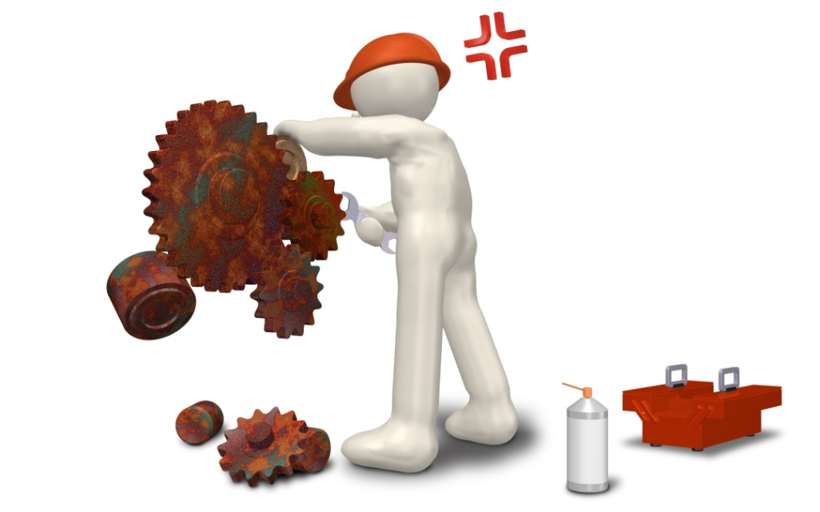
Stages in the Buying Process
Problem Recognition
Internal stimuli
New product being developed
Broken machine
Low stock level
External stimuli
Trade show visit
Advertisement
Notes:
Problems can be discovered from internal or external stimuli. A broken machine, low stock levels, or a new product being developed. External stimuli can trigger the process as well.

Slide 15

Stages in the Buying Process
Description and Characteristics
Technical specifications
  Reliability
  Durability
  Price
Product value analysis
Notes:
Product value analysis is an approach to cost reduction that studies whether components can be redesigned or standardized or made by cheaper methods of production without affecting the product performance.

Slide 16


Stages in the Buying Process
Supplier Search
Trade directories
Trade advertisements
Trade shows
E-Procurement
Lead generation
Notes:
Electronic marketplaces take numerous forms including: Catalog sites, Vertical markets, “Pure Play” auction sites, Spot markets, Private exchanges, Barter markets, and Buying alliances.
The suppliers task is to ensure that they are considered when customers are– our could be – in the market and searching for a supplier. Marketing must work together with sales to define what makes a “sales ready” prospect and cooperate to send the right messages via sales calls, trade shows, online activities, PR, events, direct mail, and referrals.

Slide 17


Stages in the Buying Process
Proposal Solicitations
Formal presentation
Written
Notes:
Buyers next invites suppliers to submit proposals. Complex or expensive items will require written and detail proposals and suppliers who make the cut may often be required to make formal presentations of their proposals.
Marketers must be skilled in researching, writing, and presenting proposals. Materials should stress the value and benefits in customer terms.

Slide 18

Stages in the Buying Process
Supplier Selection
Supplier-evaluation model
Number of suppliers
Notes:
Buyers will often specify and rank desired supplier attributes, often using a supplier-evaluation model. In some cases, companies are reducing the overall number of suppliers they deal with. They want to choose suppliers who can be responsible for large component systems.
Marketers should develop compelling value propositions and understand how buyers arrive at their valuations.

Slide 19

Stages in the Buying Process
Order Specification
Stockless purchase plan
Technical specifications
Quantity
Delivery time
Return policy
Warranties
Notes:
After selecting suppliers, the buyer negotiates the final order. Depending on the product, the buyer may end up leasing the product. Advantages of leasing include: Latest product, better service, conservation of capital, and tax advantages.
For maintenance, repair, and operating (MRO) items, buyers are beginning to use stockless purchase plans, (blanket contracts) that establish long-term relationships. Here the supplier agrees to resupply the buyer as needed, at agreed upon prices, over a specific period of time.

Slide 20

Stages in the Buying Process
Performance Review
9
7
4
End user evaluations
Weighted-score method
 | C₁ | C₂ | C₃ | C₄ | TOTAL
Alts | 0.2 | 0.15 | 0.4 | 0.25
A₁ | 25 | 20 | 15 | 30 | 21.5
A₂ | 10 | 30 | 20 | 30 | 22
A₃ | 30 | 10 | 20 | 10 | 18
Notes:
Buyers periodically review the performance of chosen suppliers using one of three methods.
Buyers contact end users and ask for their evaluations of the product/supplier
Rate the supplier on several criteria using a weighted-score method.
Aggregate the cost of poor performance to come up with adjusted costs of purchase, including price.

Slide 21

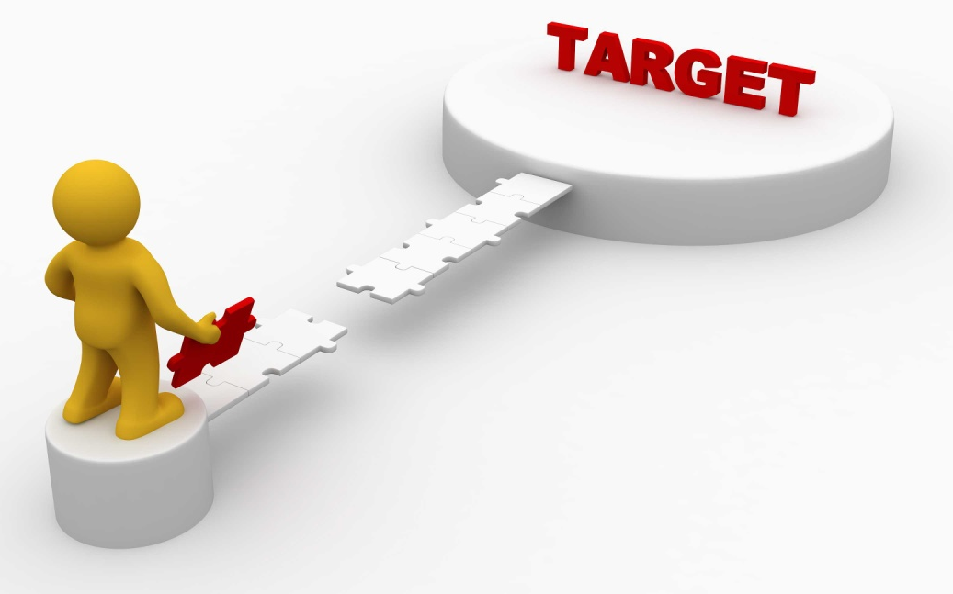
Managing B2B Relationships
Online social media
One-to-one Marketing
Notes:
Buyers and sellers are exploring different ways to manage their relationships. Closer relationships are driven in part by supply chain management, early supplier involvement, and purchasing alliances. Cultivating the right relationships is paramount for any holistic marketing program.
Marketers are focusing more on attracting and retaining the right customers, developing one-to-one marketing approaches.

Slide 22
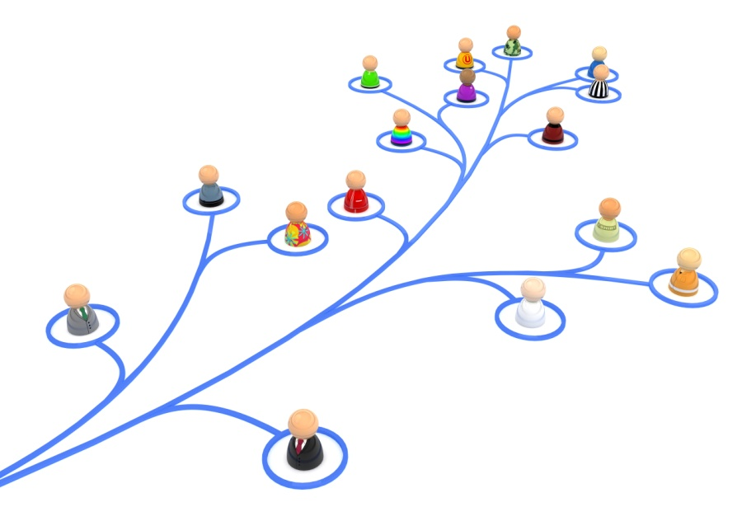
Managing B2B Relationships
Vertical Coordination
Relationship Factors
  Availability of alternatives
  Importance of supply
  Complexity of supply
  Supply market dynamism
Notes:
Companies are looking to move away from transactional relationships and instead focusing on activities that create value for both parties. One key factor in greater vertical coordination is building trust between parties.

Slide 23





Buyer-Seller Relationship Categories
Cooperative systems
Collaborative
Customer is king
Contractual transaction
Mutually adaptive
Notes:
Basic buying and selling
Bare bones
Customer supply

Slide 24




Institutional and Governments Markets
Prisons
Government agencies
Schools
Hospitals
Notes:
Many of the buying behaviors exhibited by organizations are similar to those of institutions and governments. However, there are certain special features in this part of the B2B market.
Many institutions are characterized by having low budgets and captive clients. Hospitals, for example, decide what quality of food to buy for patients. The goal is not profit, because the food is part of the total service package. But low quality food can damage the hospitals reputation.
Governments typically require that sellers submit bids and most often award the contract to the lowest bidder. The US government bought goods and services of $220 billion in 2009, making it the largest customer in the world.

Slide 25
Thank You

