Slide 1

Analyzing Consumer Markets

Slide 2
Consumer Behavior
The study of how individuals, groups, and organizations select, buy, use, and dispose of goods, services, ideas, or experiences to satisfy their needs or wants.

Slide 3



Consumer Behavior
Personal Factors
Cultural Factors
Social Factors
Notes:
Successful marketing requires that companies fully connect with their customers. Adopting a holistic marketing orientation means understanding customers— gaining a 360-degree view of both their daily lives and the changes that occur during their lifetimes so the right products are always marketed to the right customers in the right way.
Consumer behavior is the study of how individuals, groups, and organizations select, buy, use, and dispose of goods, services, ideas, or experiences to satisfy their needs and wants. Marketers must fully understand both the theory and reality of consumer behavior. A consumer’s buying behavior is influenced by cultural, social, and personal factors. Of these, cultural factors exert the broadest and deepest influence.

Slide 4


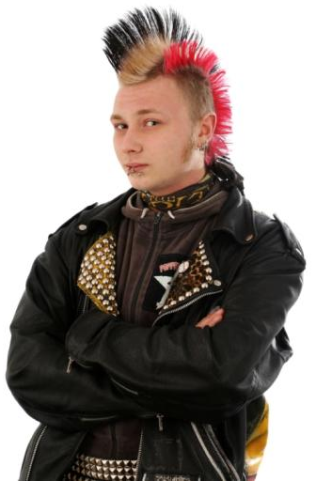
Cultural Factors
Culture is the fundamental determinant of a person’s wants and behavior.
It comprises of ideas, customs, and social behavior of particular people
or society.
Subculture a cultural group within a larger culture, often having beliefs
or interests at variance with those of the larger culture.
Social Class is division of a society based on social and economic status.
Social Class
Culture
Subculture
Notes:
Cultural Factors
Culture, subculture, and social class are particularly important influences on consumer buying behavior. Culture is the fundamental determinant of a person’s wants and behavior. Through family and other key institutions, a child growing up in the United States is exposed to values such as: achievement and success, activity, efficiency and practicality, progress, material comfort, individualism,
freedom, external comfort, humanitarianism, and youthfulness. A child growing up in another country might have a different view of self, relationship to others, and rituals. Marketers must closely attend to cultural values in every country to understand how to best market their existing products and find opportunities for new products.

Slide 5
Social Factors: Reference Groups
Social Factors
Social Factors include reference groups, family, and social roles and
statuses affect our buying behavior.
REFERENCE GROUPS
A person’s reference groups are all the groups that have a direct
(face-to-face) or indirect influence on attitudes or behavior.
Groups having a direct influence are called membership groups.
Some of these are primary groups with whom the person interacts
fairly continuously and informally, such as family, friends, neighbors,
and coworkers.
People also belong to secondary groups, such as religious, professional,
and trade-union groups, which tend to be more formal and require less
continuous interaction.
Notes:
Cultural Factors
Culture, subculture, and social class are particularly important influences on consumer buying behavior. Culture is the fundamental determinant of a person’s wants and behavior. Through family and other key institutions, a child growing up in the United States is exposed to values such as: achievement and success, activity, efficiency and practicality, progress, material comfort, individualism,
freedom, external comfort, humanitarianism, and youthfulness. A child growing up in another country might have a different view of self, relationship to others, and rituals. Marketers must closely attend to cultural values in every country to understand how to best market their existing products and find opportunities for new products.

Slide 6

Social Factors: Reference Group
Reference groups influence members in at least three ways.
They expose an individual to new behaviors and lifestyles, they influence
attitudes and self-concept, and they create pressures for conformity
that may affect product and brand choices.
People are also influenced by groups to which they do not belong.
Aspirational groups are those a person hopes to join;
Dissociative groups are those whose values or
behavior an individual rejects.
Notes:
Cultural Factors
Culture, subculture, and social class are particularly important influences on consumer buying behavior. Culture is the fundamental determinant of a person’s wants and behavior. Through family and other key institutions, a child growing up in the United States is exposed to values such as: achievement and success, activity, efficiency and practicality, progress, material comfort, individualism,
freedom, external comfort, humanitarianism, and youthfulness. A child growing up in another country might have a different view of self, relationship to others, and rituals. Marketers must closely attend to cultural values in every country to understand how to best market their existing products and find opportunities for new products.

Slide 7

Social Factor: Family
FAMILY
The family is the most important consumer buying organization in
society, and family members constitute the most influential primary
reference group.
There are two families in the buyer’s life.
The family of orientation consists of parents and siblings. From
parents a person acquires an orientation toward religion, politics,
and economics and a sense of personal ambition, self-worth, and love.
Even if the buyer no longer interacts very much with his or her parents,
parental influence on behavior can be significant.
Family of procreation is the second family in the buyer’s life
Notes:
Cultural Factors
Culture, subculture, and social class are particularly important influences on consumer buying behavior. Culture is the fundamental determinant of a person’s wants and behavior. Through family and other key institutions, a child growing up in the United States is exposed to values such as: achievement and success, activity, efficiency and practicality, progress, material comfort, individualism,
freedom, external comfort, humanitarianism, and youthfulness. A child growing up in another country might have a different view of self, relationship to others, and rituals. Marketers must closely attend to cultural values in every country to understand how to best market their existing products and find opportunities for new products.

Slide 8

Social Factor: Roles and Status
Person’s position in each group is defined in terms of role and status.
A role consists of the activities a person is expected to perform.
Each role in turn connotes a status.
People choose products that reflect and communicate their role and
their actual or desired status in society. Marketers must be aware of the
status-symbol potential of products and brands.
Notes:
Cultural Factors
Culture, subculture, and social class are particularly important influences on consumer buying behavior. Culture is the fundamental determinant of a person’s wants and behavior. Through family and other key institutions, a child growing up in the United States is exposed to values such as: achievement and success, activity, efficiency and practicality, progress, material comfort, individualism,
freedom, external comfort, humanitarianism, and youthfulness. A child growing up in another country might have a different view of self, relationship to others, and rituals. Marketers must closely attend to cultural values in every country to understand how to best market their existing products and find opportunities for new products.

Slide 9
Advertisement Clip

Slide 10
Personal Factors
Personal Factors
Personal characteristics that influence a buyer’s decision include age
and stage in the life cycle; occupation and economic circumstances;
Personality and self-concept; and lifestyle and values.
AGE AND STAGE IN THE LIFE CYCLE
Our taste in food, clothes, furniture, and recreation is often related to
our age. Consumption is also shaped by the family life cycle and the
number, age, and gender of people in the household at any point in
time. Marketers should also consider critical life events or transitions—
marriage, childbirth, illness, relocation, divorce, first job, career change,
retirement, death of a spouse—as giving rise to new needs.
Notes:
Cultural Factors
Culture, subculture, and social class are particularly important influences on consumer buying behavior. Culture is the fundamental determinant of a person’s wants and behavior. Through family and other key institutions, a child growing up in the United States is exposed to values such as: achievement and success, activity, efficiency and practicality, progress, material comfort, individualism,
freedom, external comfort, humanitarianism, and youthfulness. A child growing up in another country might have a different view of self, relationship to others, and rituals. Marketers must closely attend to cultural values in every country to understand how to best market their existing products and find opportunities for new products.

Slide 11
Personal Factors
PERSONALITY AND SELF-CONCEPT
Personality is a set of distinguishing human psychological traits that
lead to relatively consistent and enduring responses to environmental
stimuli (including buying behavior).
Personality can be defined in terms of self-confidence, dominance,
autonomy, sociability, defensiveness, and adaptability.
Personality can be a useful variable in analyzing consumer brand
choices. Brands also have personalities, and consumers are likely
to choose brands whose personalities match their own.
Brand Personality is the specific mix of human traits that can attribute
to a particular brand.
Notes:
Cultural Factors
Culture, subculture, and social class are particularly important influences on consumer buying behavior. Culture is the fundamental determinant of a person’s wants and behavior. Through family and other key institutions, a child growing up in the United States is exposed to values such as: achievement and success, activity, efficiency and practicality, progress, material comfort, individualism,
freedom, external comfort, humanitarianism, and youthfulness. A child growing up in another country might have a different view of self, relationship to others, and rituals. Marketers must closely attend to cultural values in every country to understand how to best market their existing products and find opportunities for new products.

Slide 12
Personal Factors
OCCUPATION AND ECONOMIC CIRCUMSTANCES
Occupation also influences consumption patterns. Marketers try to
identify the occupational groups that have above-average interest in
their products and services and even tailor products for certain
occupational groups.
Economic Recession greatly affect product and brand choices.
LIFESTYLE AND VALUES
A lifestyle is a person’s pattern of living in the world as expressed in
activities, interests, and opinions. It portrays the “whole person”
interacting with his or her environment. Marketers search for
relationships between their products and lifestyle groups.
Notes:
Cultural Factors
Culture, subculture, and social class are particularly important influences on consumer buying behavior. Culture is the fundamental determinant of a person’s wants and behavior. Through family and other key institutions, a child growing up in the United States is exposed to values such as: achievement and success, activity, efficiency and practicality, progress, material comfort, individualism,
freedom, external comfort, humanitarianism, and youthfulness. A child growing up in another country might have a different view of self, relationship to others, and rituals. Marketers must closely attend to cultural values in every country to understand how to best market their existing products and find opportunities for new products.

Slide 13
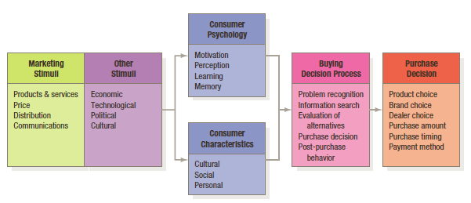
Psychological Factors
Notes:
The starting point for understanding consumer behavior is the stimulus-response model shown in Figure 6.1. Marketing and environmental stimuli enter the consumer’s consciousness, and a set of psychological processes combine with certain consumer characteristics to result in decision processes and purchase decisions. The marketer’s task is to understand what happens in the
consumer’s consciousness between the arrival of the outside marketing stimuli and the ultimate purchase decisions. Four key psychological processes—motivation, perception, learning, and memory—fundamentally influence consumer responses

Slide 14
Motivation
Freud: Psychological forces that shaped peoples behavior are unconscious.
Maslow: People are driven by different needs at different times. According to Maslow, human needs are arranged in a hierarchy from most to least pressing.
Herzberg: Developed two-factor theory that distinguishes dissatisfiers (factors that cause dissatisfaction) from satisfiers (factors that cause satisfaction).
Notes:
Freud – Psychological forces that shaped peoples behavior are unconscious.
Maslow – People are driven by different needs at different times. According to Maslow, human needs are arranged in a hierarchy from most to least pressing.
Herzberg – Developed two-factor theory that distinguishes dissatisfiers (factors that cause dissatisfaction) from satisfiers (factors that cause satisfaction).

Slide 15
Perception
Selective Attention:
It’s estimated that the average person may be exposed to over 1,500 ads or brand communications a day. But a person gives attention to very few and screen most stimuli out—a process called selective attention.
Selective Retention:
Perception is the process by which we select, organize, and interpret information inputs to create a meaningful picture of the world.
Notes:
Selective retention – People tend to remember (forget) information that supports (differs) our attitudes and beliefs.
A motivated person is ready to act—how is influenced by his or her perception of the situation. In marketing, perceptions are more important than reality, because perceptions affect consumers’ actual behavior. Perception is the process by which we select, organize, and interpret information inputs to create a meaningful picture of the world. It depends not only on physical stimuli, but also on the stimuli’s relationship to the surrounding environment and on conditions within each of us. One person might perceive a fast-talking salesperson as aggressive and insincere; another, as intelligent and helpful. Each will respond to the salesperson differently.
SELECTIVE ATTENTION
Attention is the allocation of processing capacity to some stimulus. Voluntary attention is something purposeful; involuntary attention is grabbed by someone or something. It’s estimated that the average person may be exposed to over 1,500 ads or brand communications a day. Because we cannot possibly attend to all these, we screen most stimuli out—a process called selective attention. Selective attention means that marketers must work hard to attract consumers’ notice.
SELECTIVE DISTORTION
Even noticed stimuli don’t always come across in the way the senders intended. Selective distortion is the tendency to interpret information in a way that fits our preconceptions. Consumers will often distort information to be consistent with prior brand and product beliefs and expectations. For a stark demonstration of the power of consumer brand beliefs, consider that in “blind” taste tests, one group of consumers samples a product without knowing which brand it is, while another group knows. Invariably, the groups have different opinions, despite consuming exactly the same product.
SELECTIVE RETENTION
Most of us don’t remember much of the information to which we’re exposed, but we do retain information that supports our attitudes and beliefs. Because of selective retention, we’re likely to remember good points about a product we like and forget good points
about competing products. Selective retention again works to the advantage of strong brands. It also explains why marketers need to use repetition—to make sure their message is not overlooked.
SUBLIMINAL PERCEPTION
The selective perception mechanisms require consumers’ active engagement and thought. A topic that has fascinated armchair marketers for ages is subliminal perception. They argue that marketers embed covert, subliminal messages in ads or packaging.
Consumers are not consciously aware of them, yet they affect behavior. Although it’s clear that mental processes include many subtle subconscious effects, no evidence supports the notion that marketers can systematically control consumers at that level, especially enough to change moderately important or strongly held beliefs.

Slide 16
Perception
Subliminal Perception: Marketers embed covert, subliminal messages in ads or packaging. Consumers are not consciously aware of them, yet they affect behavior. Although it’s clear that mental processes include many subtle subconscious effects, no evidence supports the notion that marketers can systematically control consumers at that level.
Selective Distortion: It is the tendency to interpret information in a way that fits our preconceptions. Consumers will often distort information to be consistent with prior brand and product beliefs and expectations.
Notes:
Selective retention – People tend to remember (forget) information that supports (differs) our attitudes and beliefs.
A motivated person is ready to act—how is influenced by his or her perception of the situation. In marketing, perceptions are more important than reality, because perceptions affect consumers’ actual behavior. Perception is the process by which we select, organize, and interpret information inputs to create a meaningful picture of the world. It depends not only on physical stimuli, but also on the stimuli’s relationship to the surrounding environment and on conditions within each of us. One person might perceive a fast-talking salesperson as aggressive and insincere; another, as intelligent and helpful. Each will respond to the salesperson differently.
SELECTIVE ATTENTION
Attention is the allocation of processing capacity to some stimulus. Voluntary attention is something purposeful; involuntary attention is grabbed by someone or something. It’s estimated that the average person may be exposed to over 1,500 ads or brand communications a day. Because we cannot possibly attend to all these, we screen most stimuli out—a process called selective attention. Selective attention means that marketers must work hard to attract consumers’ notice.
SELECTIVE DISTORTION
Even noticed stimuli don’t always come across in the way the senders intended. Selective distortion is the tendency to interpret information in a way that fits our preconceptions. Consumers will often distort information to be consistent with prior brand and product beliefs and expectations. For a stark demonstration of the power of consumer brand beliefs, consider that in “blind” taste tests, one group of consumers samples a product without knowing which brand it is, while another group knows. Invariably, the groups have different opinions, despite consuming exactly the same product.
SELECTIVE RETENTION
Most of us don’t remember much of the information to which we’re exposed, but we do retain information that supports our attitudes and beliefs. Because of selective retention, we’re likely to remember good points about a product we like and forget good points
about competing products. Selective retention again works to the advantage of strong brands. It also explains why marketers need to use repetition—to make sure their message is not overlooked.
SUBLIMINAL PERCEPTION
The selective perception mechanisms require consumers’ active engagement and thought. A topic that has fascinated armchair marketers for ages is subliminal perception. They argue that marketers embed covert, subliminal messages in ads or packaging.
Consumers are not consciously aware of them, yet they affect behavior. Although it’s clear that mental processes include many subtle subconscious effects, no evidence supports the notion that marketers can systematically control consumers at that level, especially enough to change moderately important or strongly held beliefs.

Slide 17



Advertisements

Slide 18
Learning
Learning induces changes in our behavior
arising from experience. Most human
behavior is learned, although much learning
is incidental. Learning theorists believe
learning is produced through the interplay
of drives, stimuli, cues, responses, and
reinforcement.
Notes:
When we act, we learn. Learning induces changes in our behavior arising from experience. Most human behavior is learned, although much learning is incidental. Learning theorists believe learning is produced through the interplay of drives, stimuli, cues, responses, and reinforcement. Two popular approaches to learning are classical conditioning and operant (instrumental) conditioning. A drive is a strong internal stimulus impelling action. Cues are minor stimuli that determine when, where, and how a person responds. Suppose you buy an HP computer. If your experience is rewarding, your response to computers and HP will be positively reinforced. Later, when you want to buy a printer, you may assume that because it makes good computers, HP also makes good printers. In other words, you generalize your response to similar stimuli. A countertendency to generalization is discrimination. Discrimination means we have learned to recognize differences in sets of similar stimuli and can adjust our responses accordingly.

Slide 19
Learning
Driver: A drive is a strong internal stimulus impelling action.
Cues: Cues are minor stimuli that determine when, where, and how a person responds.
Discrimination means we have learned to recognize differences in sets of similar stimuli and can adjust our responses accordingly.
Notes:
When we act, we learn. Learning induces changes in our behavior arising from experience. Most human behavior is learned, although much learning is incidental. Learning theorists believe learning is produced through the interplay of drives, stimuli, cues, responses, and reinforcement. Two popular approaches to learning are classical conditioning and operant (instrumental) conditioning. A drive is a strong internal stimulus impelling action. Cues are minor stimuli that determine when, where, and how a person responds. Suppose you buy an HP computer. If your experience is rewarding, your response to computers and HP will be positively reinforced. Later, when you want to buy a printer, you may assume that because it makes good computers, HP also makes good printers. In other words, you generalize your response to similar stimuli. A countertendency to generalization is discrimination. Discrimination means we have learned to recognize differences in sets of similar stimuli and can adjust our responses accordingly.

Slide 20


Emotions
Consumers do not always respond cognitively
and rationally. Many responses can be emotional.
Brands can make people feel proud, excited, or
confident. Ads can create feelings of amusement,
disgust, or wonder.
Notes:
Consumers do not always respond cognitively and rationally. Many responses can be emotional. Brands can make people feel proud, excited, or confident. Ads can create feelings of amusement, disgust, or wonder.

Slide 21


Memory
Memory Processes
Mental Maps
Encoding
Retreival
Association
Association
Association
Association
Association
Brand
Brand Associations
Notes:
Brand associations consist of all brand related thoughts, feelings, perceptions, images, experiences, beliefs, attitudes, and so on that become linked to the brand node in the brain.

Slide 22
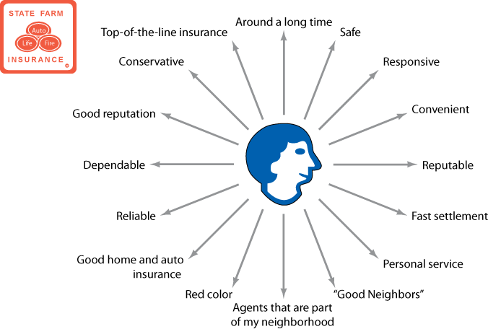
Hypothetical State Farm Mental Map

Slide 23
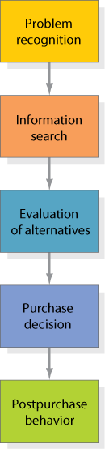
The Buying Decision Process
Notes:
Smart companies try to fully understand customers’ buying decision process—all the experiences in learning, choosing, using, and even disposing of a product. Marketing scholars have developed a “stage model” of the process. The consumer typically passes through five stages: problem recognition, information search, evaluation of alternatives, purchase decision, and postpurchase behavior. Clearly, the buying process starts long before the actual purchase and has consequences long afterward.

Slide 24

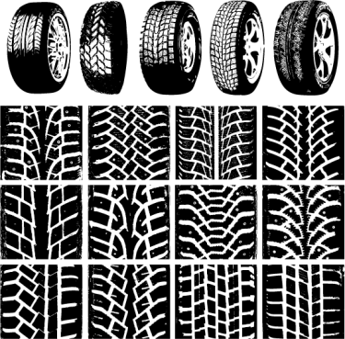



Buying Decision Process
Notes:
Consumers don’t always pass through all five stages—they may skip or reverse some. When you buy your regular brand of toothpaste, you go directly from the need to the purchase decision, skipping information search and evaluation. The model in Figure 6.4 provides a good frame of reference, however, because it captures the full range of considerations that arise when a consumer faces a highly involving new purchase

Slide 25

Problem Recognition
“I’m Hungry”
SStimulus
Internal (Hunger)
External (Advertisement)
Notes:
An internal stimulus is triggered by a person’s normal needs – hunger, thirst – when the need rises to a threshold level.
A need can also be aroused by an external stimulus, such as seeing a commercial for a vacation. A person then begins to consider the possibility of taking a vacation.

Slide 26




Information Search
Commercial
Public
Personal
Experiential
Notes:
Information Search Surprisingly, consumers often search for limited amounts of information. Surveys have shown that for durables, half of all consumers look at only one store, and only 30 percent look at more than one brand of appliances. We can distinguish between two levels of engagement in the search. The milder search state is called heightened attention. At this level a person simply becomes more receptive to information about a product. At the next level, the person may enter an active information search: looking for reading material, phoning friends, going online, and visiting stores to learn about the product.

Slide 27
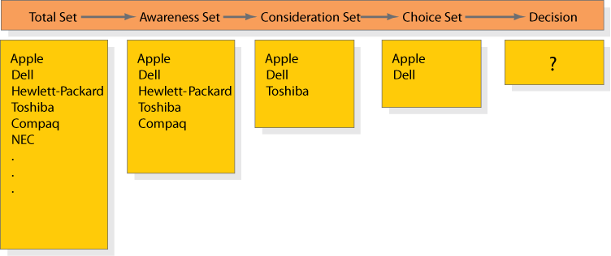
Successive Sets Involved in Consumer Decision Making
Notes:
By gathering information, the consumer learns about competing brands and their features. The first box in Figure 6.5 shows the total set of brands available. The individual consumer will come to know a subset of these, the awareness set. Only some, the consideration set, will meet initial buying criteria. As the consumer gathers more information, just a few, the choice set, will remain strong contenders. The consumer makes a final choice from these.

Slide 28



Evaluation of Alternatives
Beliefs
Attitudes
Notes:
No single process is used by all consumers, or by one consumer in all buying situations. It is important that marketers understand that:
The consumer is trying to satisfy a need.
The consumer is looking for certain benefits from the product solution.
The consumer sees each product as a bundle of attributes with varying abilities to deliver the benefits.
-- The attributes of interest will vary based on the product.
A belief is a descriptive thought that a person holds about something. Attitudes are a person’s enduring favorable, or unfavorable evaluations, emotional feelings, and action tendencies toward some object or idea.

Slide 29
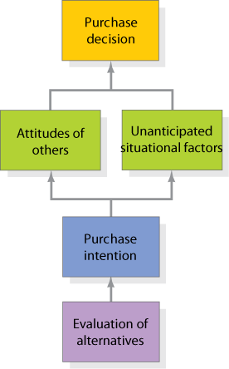
Steps between Evaluation of Alternatives and Purchase Decision
Notes:
Even if consumers form brand evaluations, two general factors can intervene between the purchase intention and the purchase decision (see Figure 6.6). The first factor is the attitudes of others. The influence of another person’s attitude depends on two things: (1) the intensity of the other person’s negative attitude toward our preferred alternative and (2) our motivation to comply with the other person’s wishes.66 The more intense the other person’s negativism and the closer he or she is to us, the more we will adjust our purchase intention. The converse is also true.
The second factor is unanticipated situational factors that may erupt to change the purchase intention. The consumer might lose her job, some other purchase might become more urgent, or a store salesperson may turn her off. Preferences and even purchase intentions are not completely reliable predictors of purchase behavior.

Slide 30

Purchase Decision
Noncompensatory Models
Choice Heuristics:
Conjective
Lexicographic
Elimination-by-aspect
A
B
Brand
Dealer
Purchase subdecisions
Quantity
Timing
Payment method
Notes:
After a consumer has reached a purchase intention, up to five subdecisions may need to be made. The brand, the dealer (where), quantity, timing (when), and payment method.
With noncompensatory models of consumer choice, positive and negative attribute considerations don’t necessarily net out. Evaluating attributes in isolation makes decision making easier for a consumer, but it also increases the likelihood that she would have made a different choice if she had deliberated in greater detail. We highlight three choice heuristics here.
1. Using the conjunctive heuristic, the consumer sets a minimum acceptable cutoff level for each attribute and chooses the first alternative that meets the minimum standard for all attributes. For example, if Linda decided all attributes had to rate at least 5, she would choose laptop computer B.
2. With the lexicographic heuristic, the consumer chooses the best brand on the basis of its perceived most important attribute. With this decision rule, Linda would choose laptop computer C.
3. Using the elimination-by-aspects heuristic, the consumer compares brands on an attribute selected probabilistically—where the probability of choosing an attribute is positively related to its importance—and eliminates brands that do not meet minimum acceptable cutoffs.

Slide 31
Non-Compensatory Models
With noncompensatory models of consumer choice, positive and negative attribute considerations don’t necessarily net out. Evaluating attributes in isolation makes decision making easier for a consumer. Three choice heuristics are
1. Using the conjunctive heuristic, the consumer sets a minimum acceptable cutoff level for each attribute and chooses the first alternative that meets the minimum standard for all attributes.
Notes:
When we act, we learn. Learning induces changes in our behavior arising from experience. Most human behavior is learned, although much learning is incidental. Learning theorists believe learning is produced through the interplay of drives, stimuli, cues, responses, and reinforcement. Two popular approaches to learning are classical conditioning and operant (instrumental) conditioning. A drive is a strong internal stimulus impelling action. Cues are minor stimuli that determine when, where, and how a person responds. Suppose you buy an HP computer. If your experience is rewarding, your response to computers and HP will be positively reinforced. Later, when you want to buy a printer, you may assume that because it makes good computers, HP also makes good printers. In other words, you generalize your response to similar stimuli. A countertendency to generalization is discrimination. Discrimination means we have learned to recognize differences in sets of similar stimuli and can adjust our responses accordingly.

Slide 32
Non-Compensatory Models
2. With the lexicographic heuristic, the consumer chooses the best brand on the basis of its perceived most important attribute.
3. Using the elimination-by-aspects heuristic, the consumer compares brands on an attribute selected probabilistically—where the probability of choosing an attribute is positively related to its importance—and eliminates brands that do not meet minimum acceptable cutoffs.
Notes:
When we act, we learn. Learning induces changes in our behavior arising from experience. Most human behavior is learned, although much learning is incidental. Learning theorists believe learning is produced through the interplay of drives, stimuli, cues, responses, and reinforcement. Two popular approaches to learning are classical conditioning and operant (instrumental) conditioning. A drive is a strong internal stimulus impelling action. Cues are minor stimuli that determine when, where, and how a person responds. Suppose you buy an HP computer. If your experience is rewarding, your response to computers and HP will be positively reinforced. Later, when you want to buy a printer, you may assume that because it makes good computers, HP also makes good printers. In other words, you generalize your response to similar stimuli. A countertendency to generalization is discrimination. Discrimination means we have learned to recognize differences in sets of similar stimuli and can adjust our responses accordingly.

Slide 33


Post purchase Behavior
Postpurchase Satisfaction
Delighted
Satisfied
Dissatisfied
Defect
Loyal
Stay or Go
Postpurchase Actions
Notes:
After the purchase, the consumer might experience dissonance from noticing certain disquieting features or hearing favorable things about other brands and will be alert to information that supports his or her decision. Marketing communications should supply beliefs and evaluations that reinforce the consumer’s choice and help him or her feel good about the brand. The marketer’s job therefore doesn’t end with the purchase. Marketers must monitor postpurchase satisfaction, postpurchase actions, and postpurchase product uses and disposal.
POSTPURCHASE SATISFACTION
Satisfaction is a function of the closeness between expectations and the product’s perceived performance. If performance falls short of expectations, the consumer is disappointed; if it meets expectations, the consumer is satisfied; if it exceeds expectations, the consumer is delighted. These feelings make a difference in whether the customer buys the product again and talks favorably or unfavorably about it to others. The larger the gap between expectations and performance, the greater the dissatisfaction. Here the consumer’s coping style comes into play. Some consumers magnify the gap when the product isn’t perfect and are highly dissatisfied; others minimize it and are less dissatisfied.
POSTPURCHASE ACTIONS
A satisfied consumer is more likely to purchase the product again and will also tend to say good things about the brand to others. Dissatisfied consumers may abandon or return the product. They may seek information that confirms its high value. They may
take public action by complaining to the company, going to a lawyer, or complaining to other groups (such as business, private, or government agencies). Private actions include deciding to stop buying the product (exit option) or warning friends (voice option).

Slide 34
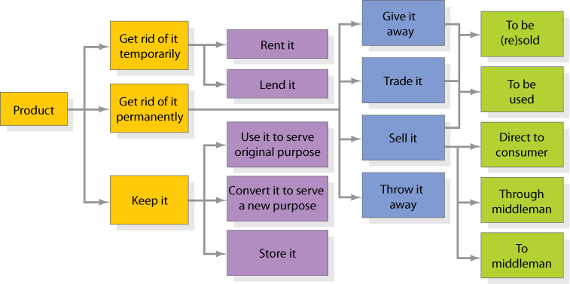
How Customers
Use or Dispose of Products
Notes:
Marketers should also monitor how buyers use and dispose of the product ( Figure 6.7). A key driver of sales frequency is product
consumption rate—the more quickly buyers consume a product, the sooner they may be back in the market to repurchase it.
Consumers may fail to replace some products soon enough because they overestimate product life. One strategy to speed replacement is to tie the act of replacing the product to a certain holiday, event, or time of year.

Slide 35




Moderating Effects
Low-involvement
Variety seeking
Notes:
The manner or path by which a consumer moves through the decision-making stages depends on several factors, including the level of involvement and extent of variety seeking, as follows. LOW-INVOLVEMENT CONSUMER DECISION MAKING The expectancy-value
model assumes a high level of consumer involvement, or engagement and active processing the consumer undertakes in responding to a marketing stimulus.
VARIETY-SEEKING BUYING BEHAVIOR
Some buying situations are characterized by low involvement but significant brand differences. Here consumers often do a lot of brand switching. Think about cookies. The consumer has some beliefs about cookies, chooses a brand without much evaluation, and evaluates the product during consumption. Next time, the consumer may reach for another brand out of a desire for a different taste. Brand switching occurs for the sake of variety, rather than dissatisfaction.

Slide 36
Thank You

