Slide 1

Collecting Information and Forecasting Demand
Chapter 3

Slide 2




Collecting Information
Customers
External Factors
Competitors
Notes:
Marketers are in position to collect information from customers, competitors, and other external factors/group that can help to identify market changes.

Slide 3


Marketing Information System
A marketing information system (MIS) consists of people, equipment,
and procedures to gather, sort, analyze, evaluate, and distribute needed,
timely, and accurate information to marketing decision makers.
Procedures
Equipment
People
Notes:
A marketing information system consists of people, equipment, and procedures to gather, sort, analyze, evaluate, and distribute information that is needed, timely and accurate.

Slide 4



Marketing Information System
Internal Records:
The heart of the internal records system is the order-to-payment cycle.
Marketing Research
Marketing research is the systematic design, collection, analysis, and reporting of data and findings relevant to a specific marketing situation facing the company.
Insight
Marketing Intelligence It is a set of procedures and sources used by managers to obtain everyday information about developments in the marketing environment.
Notes:
A marketing information system consists of people, equipment, and procedures to gather, sort, analyze, evaluate, and distribute information that is needed, timely and accurate.

Slide 5
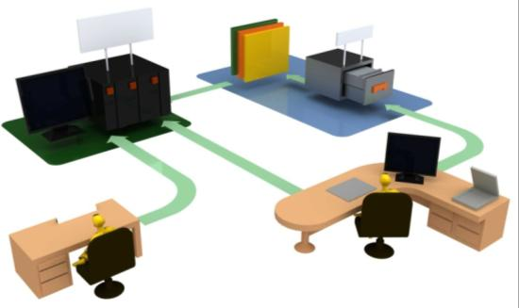


Internal Records
Order-to-Payment Cycle
Databases / Data Mining
Sales Information Systems
Notes:
The order-to-payment cycle entails the process that orders go through once they are received by the company. Includes invoices and shipping documents. Customers prefer firms that can get orders processed quickly and accurately.
Sales information systems provide managers with up-to-date information on the current sales of individual products.
Databases store and organize information that can be retrieved based on a number of criteria such as purchase history, product preferences, and can even contain demographic and psychographic information on customers.

Slide 6



Marketing Intelligence
News and Trade Publications
Meet with customers, suppliers, distributors, and other managers
Monitor social media sites
Notes:
A marketing intelligence system is a set of procedures and sources that managers use to obtain everyday information about developments in the marketing environment. This information can come from reading books and trade journals; talking to customers, distributors, suppliers, etc; monitoring social media; and talking to other managers in the company.

Slide 7




Improving Marketing Intelligence
Sales Force
Establish industry network
External Experts
Customer Advisory Panel
Notes:
Companies can improve marketing intelligence through the methods listed on the slide as well as through channel members, government data sources, and the purchase of information through secondary data sources.

Slide 8

Marketing Intelligence & the Internet
Independent Online Forums
Distributor or sales agents feedback sites
Customer review and expert opinion sites
Customer complaint sites
Notes:
Epinions.com, Bizrate.com, or ConsumerReview.com

Slide 9

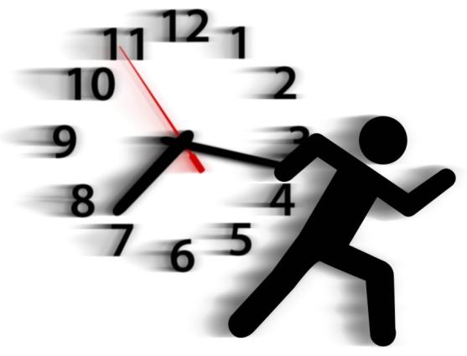
Using Marketing Intelligence
Share Information
Quickly
Notes:
Marketing intelligence should be gathered and shared with decision makers quickly in order to effectively use the information.

Slide 10

Analyzing the Macroenvironment
Notes:
Where the microenvironment refers to those elements closest to the company, customers, competitors, suppliers, etc., the macroenvrionment refers to those elements that can impact a company, but cannot be controlled. These include things such as the economy, culture, demographics, politics, technology, and the natural environment.

Slide 11



Needs and Trends
Megatrend: Its large social, economic, political and technological change. Its slow but lasts for 7 to 10 years
Fad: It is unpredictable and short-lived
Trend: More predictable and durable than a fad. It gives future insight
Notes:
Fad – Hula Hoop; Trend – Diet/exercise; Megatrend – Electric automobiles
FAD: Unpredictable, short-lived, and without social, economic, and political significance. Fads are measured in months, rather than years.
Wham-0 sold 25 million Hula Hoops in its first 4 months. Pet rocks were launched in the mid-1970’s and sold 1 million units in a matter of months. Five month’s later sales were almost non-existent.
TRENDS: Offer a view of the future due to their momentum and durability. The fitness/diet trend is an example, although there have been many fads within this trend, the overall movement toward healthier living has remained.
MEGATRENDS: Changes that are slow to form but once established last for 7 – 10 years (or more). Megatrends influence all factors of life that impact business, culture, economics, society, and personal lives.

Slide 12






Major Environmental Forces
Demographics
Economic
Technological
Natural
Political-Legal
Sociocultural

Slide 13

Demographic Environment
Worldwide population growth
Population age mix
Ethnic and other markets
Educational Groups
Household patterns
Notes:
Worldwide population growth
6.8 billion in 2010; will grow to 9 billion in 2040
Population age mix
Mexico young population; Italy old
By 2011 in the US, those 65 and older will grow faster than the entire US population.
Ethnic and other markets
25 million people in the US were born in another country
Hispanic’s accounted for 11 percent of the US population in the 2000 census. By 2020 Hispanics are expected to account for 18.9 percent of the population.
Educational Groups
Household patterns - 20% of households “Married with Children”; 27% single live-alones; Single-parent families (8%); living with nonrelatives only (5%); and other family structures (8%)

Slide 14
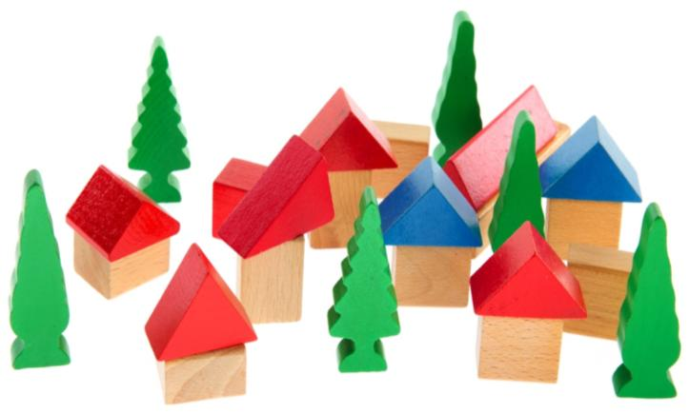
The World as a Village
If the world were a village of 100 people:
61 – Asian (20 Chinese, 17 Indian)
18 – Unable to read (33 have cell phones)
18 – Under 10 years of age (11 over 60 years old)
18 – Cars in the village
63 – Inadequate sanitation
67 – Non-Christian
30 – Unemployed or underemployed
53 – Live on less than $2 a day
26 – Smoke
14 – Obese
01 – Have AIDS
Source: David J. Smith and Shelagh Armstrong, If the World Were a Village: A Book About the World’s People, 2nd ed. (Tonawanda, NY: Kids Can Press, 2002)

Slide 15
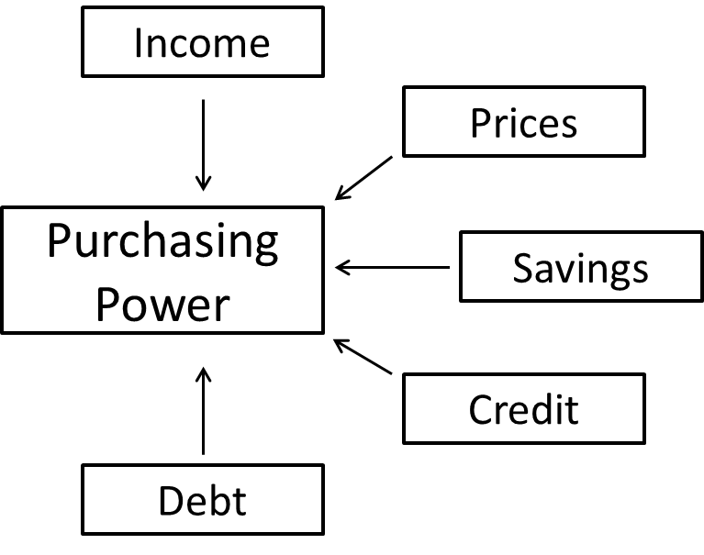



Economic Environment
Consumer Psychology
Income Distribution
Notes:
Purchasing power: is the amount of goods/services one unit of currency will purchase. Purchasing power is determined by income, prices, savings, credit availability, and debt.
The financial crisis in 2008-09 may have permanently changed consumer buying habits.
The income distribution of a country can influence the decision to enter a specific market.

Slide 16
Sociocultural Environment
Ourselves
Others
Organizations
Society
Nature
Universe
Notes:
Sociocultural: The influence that both society and culture have on the views of individuals.
A subculture is a group that shares a distinct culture different from the larger culture that they belong. Examples of subcultures include: Gothic, Metalhead, punk, Trekkies, biker, etc.

Slide 17


Natural Environment
Environmental Regulations
Notes:
Companies must be cognizant of the effects of their business on the environment and how regulations can influence its competitive position. Changes in regulations can also provide opportunities for companies, but these opportunities may only be recognized if the company includes this aspect into their strategic planning.

Slide 18

Technological Environment
Accelerated pace of change
Unlimited opportunities
R&D Spending

Slide 19



Political-Legal Environment
Government Agencies
Laws
Special Interest Groups
Notes:
Opportunities can arise due to changes in the political-legal environment. But so too can threats.

Slide 20

Forecasting and Demand Measurement
Market
  Size
  Growth
  Profit potential
Notes:
Understanding a market potential involves more than just research and analysis. Companies must also determine market size, growth, and profit potential.

Slide 21
Market Types
Potential Market
Available Market
Target Market
Penetrated Market
Notes:
Markets can be broken down in a number of ways.

Slide 22
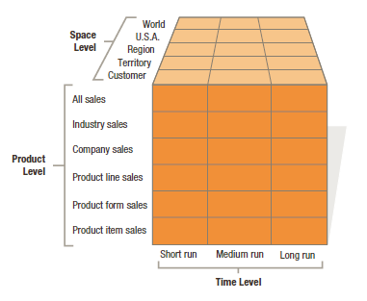
Ninety Types of Demand Measurement
Notes:
Companies can prepare as many as 90 different types of demand estimates, for six different product levels, five space levels, and three time periods. Each of these serves a different purpose. Short-run can for ordering raw materials, plan production, or borrow cash.

Slide 23
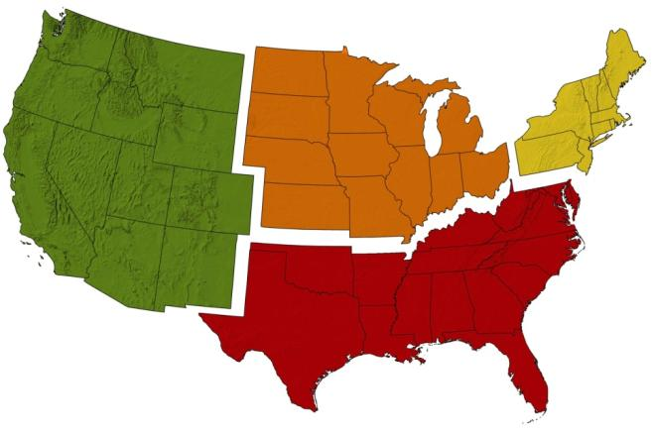
Estimating Current Demand
Total market potential
Average purchase quantity
Potential Buyers
Average price
X
X
Area market potential
Notes:
Total market potential is the maximum sales available to all firms in an industry during a given period, under a given level of industry marketing effort, and environmental conditions. Area market potential is the sales potential for a specific territory.
Market-buildup Method looks to identify all potential buyers in a market and estimating their potential purchases.
Market-factor Index Method – seeks to determine market potential based on proxy information. For example, if Virginia represents 2.55% of the US population, then the state may produce 2.55% of all US sales.
Industry Sales
Market Sales

Slide 24

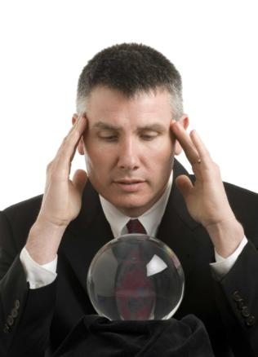



Estimating Future Demand
Sales Force Opinions
Buyer’s Intentions
Forecasting
Past Sales Analysis
Expert Opinions
Notes:
Market-test

Slide 25
Thank You

