Slide 1
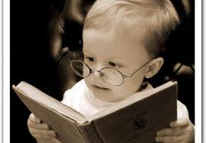
REVISION

Slide 2

Defining Marketing for the 21st Century
Chapter 1

Slide 3

Marketing is the activity, set of institutions, and processes for creating, communicating, delivering, and exchanging offers that have value for customers, clients, partners,
and society at large.

Slide 4

Marketing management is the art and science of choosing target markets and getting, keeping, and growing customers through creating, delivering, and communicating superior
customer value.

Slide 5

Developing Marketing Strategies and Plans

Slide 6

Collecting Information and Forecasting Demand
Chapter 3

Slide 7



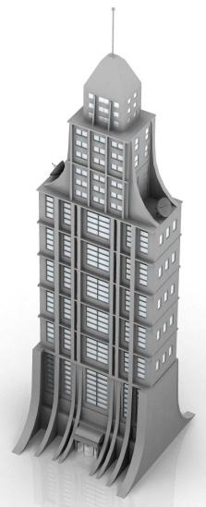
Collecting Information
Customers
External Factors
Competitors
Notes:
Marketers are in position to collect information from customers, competitors, and other external factors/group that can help to identify market changes.

Slide 8

Creating Long-term Loyalty Relationships

Slide 9

Customer Value, Satisfaction, and Loyalty
The only value a company will create is the value that comes from customer- the ones a company has now and the ones a company will have in future. Businesses succeed by getting keeping and growing customers. Customers are the only reason, company build factories, hire employees, schedule meetings, lay fiber optic lines or engage in any business activity.
Notes:
The cornerstone of a well-conceived holistic marketing orientation is strong customer relationships. Marketers must connect with
customers—informing, engaging, and maybe even energizing them in the process. Customer centered companies are adept at building customer relationships, not just products; they are skilled in market engineering, not just product engineering.
Creating loyal customers is at the heart of every business. As marketing experts Don Peppers and Martha Rogers say:
The only value your company will ever create is the value that comes from customers— the ones you have now and the ones you will have in the future. Businesses succeed by getting, keeping, and growing customers. Customers are the only reason you build factories,
hire employees, schedule meetings, lay fiber-optic lines, or engage in any business activity. Without customers, you don’t have a business.

Slide 10
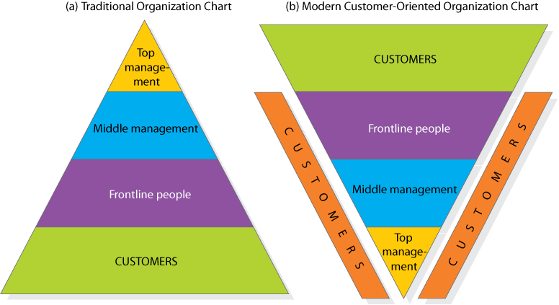
Traditional Organization vs. Customer-Oriented Organization
Notes:
Managers who believe the customer is the company’s only true “profit center” consider the traditional organization chart in Figure 5.1 (a)—a pyramid with the president at the top, management in the middle, and frontline people and customers at the bottom—obsolete.
Successful marketing companies invert the chart as in Figure 5.1 (b). At the top are customers; next in importance are frontline people who meet, serve, and satisfy customers; under them are the middle managers, whose job is to support the frontline people so they can serve customers well; and at the base is top management, whose job is to hire and support good middle managers. We have added customers along the sides of Figure 5.1 (b) to indicate that managers at every level must be personally involved in knowing,
meeting, and serving customers.

Slide 11

Analyzing Consumer Markets

Slide 12
Consumer Behavior
The study of how individuals, groups, and organizations select, buy, use, and dispose of goods, services, ideas, or experiences to satisfy their needs or wants.

Slide 13
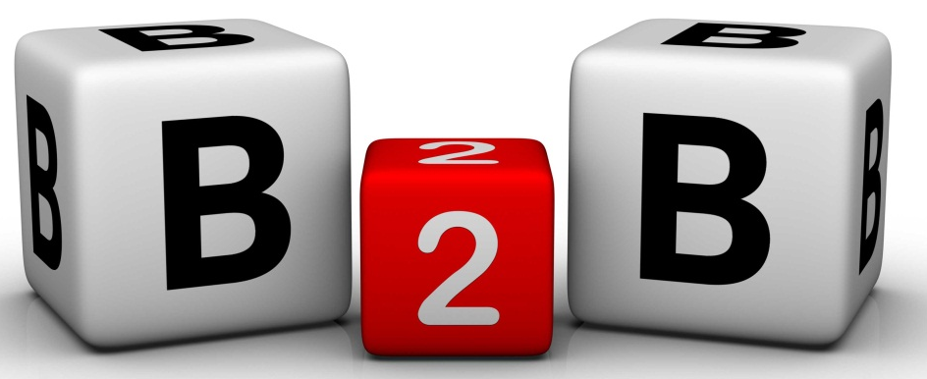
Analyzing Business Markets

Slide 14
Organizational Buying
The decision-making process by which formal organizations establish the need for purchased products and services and identify, evaluate, and choose among alternative brands and suppliers.
-- F. Webster Jr and Y. Wind

Slide 15
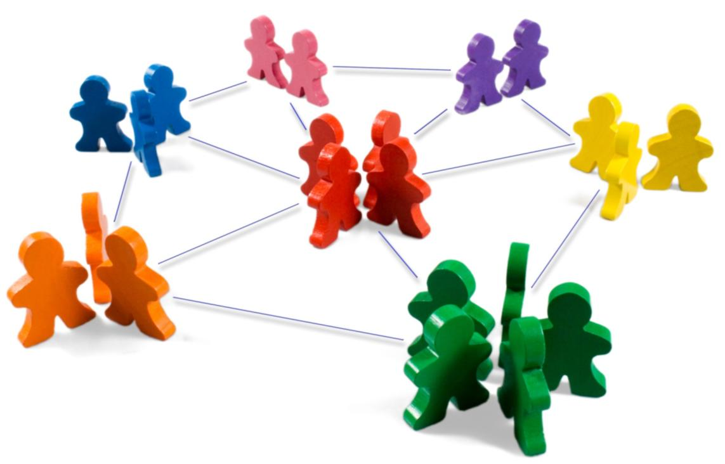
Identifying Market Segments and Targets

Slide 16
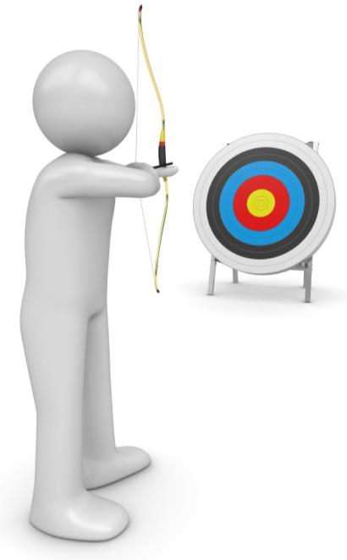
Target Marketing Requirements
Identify and profile distinct groups of buyers who differ in their needs and wants (market segmentation).
Select one or more market segments to enter (market targeting).
For each, establish and communicate benefits of offering (market positioning).
Notes:
Market Segmentation – Identify and profile distinct groups of buyers who differ in their needs and wants.
Market Targeting – Select one or more market segments to enter.
Market Positioning – For each target segment, establish and communicate the distinctive benefit(s) of the company’s market offering.

Slide 17
Competitive Dynamics

Slide 18

Crafting the Brand Position

Slide 19

Creating Brand Equity

Slide 20
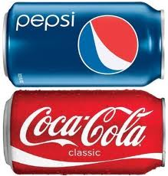

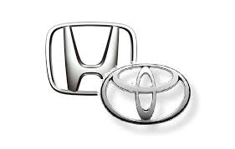


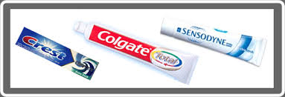
Brand Equity
American Marketing Association defines a brand as a name, term, sign, symbol, or design or a combination of them intended to identify goods or services of one seller or group of sellers and to differentiate them from those of competitors.

Slide 21
Setting Product Strategy
Kotler Koshy
Keller Jha

Slide 22
Designing and Managing Services

Slide 23
What is a Service?
A service is any act of performance that one party can offer another that is essentially intangible and does not result in the ownership of anything; its production may or may not be tied to a physical product.
Notes:
Services are an important part of the economy. The Bureau of Labor Statistics reports that the service-producing sector will continue to be the dominant employment generator in the economy, adding about 14.6 million jobs through 2018, or 96 percent of the expected increase in total employment. By 2018, the goods-producing sector is expected to account for 12.9 percent of total jobs, down from 17.3 percent in 1998 and 14.2 percent in 2008. Manufacturing lost 4.1 million jobs from 1998 through 2008 and expected to lose another 1.2 million jobs between 2008 and 2018.3 These numbers and others have led to a growing interest in the special problems of marketing services.

Slide 24
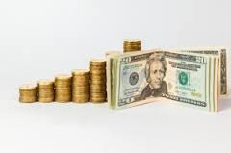
Developing Pricing Strategies and Programs

Slide 25
Synonyms for Price
Rent
Tuition
Fee
Fare
Rate
Toll
Premium
Honorarium
Special assessment
Bribe
Dues
Salary
Commission
Wage
Tax

Slide 26
Designing and Managing
Integrated Marketing Channels

Slide 27
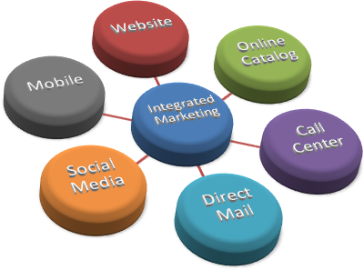
Integrated Marketing Channel

Slide 28
Managing Retailing, Wholesaling, and Logistics

Slide 29
Managing
Mass Communications

Slide 30
Mass Communication
The imparting or exchanging of information on a large scale to a wide range of people.

Slide 31
Introducing
New Market Offerings

Slide 32

Tapping into Global Markets

Slide 33
Managing a Holistic Marketing Organization for the Long Run

Slide 34
Relationship Marketing and Customer
Relationship Management (CRM)

Slide 35
Thank You

