Slide 1
Relationship Marketing and Customer
Relationship Management (CRM)

Slide 2
Introduction
Transaction-based marketing - Buyer and seller exchanges characterized by limited communications and little or no ongoing relationship between the parties
Relationship Marketing - Development, growth, and maintenance of long-term, cost-effective relationships with individual customers, suppliers, employees, and other partners for mutual benefit

Slide 3
The Shift from Transaction-Based Marketing to Relationship Marketing
Shift away from production-oriented marketing
  Emphasis on individual sales and transactions
  Limited communication
  No ongoing relationship
  Limited in some markets, such as residential real estate

Slide 4
The Shift from Transaction-Based Marketing to Relationship Marketing
Shift toward relationship marketing
  Views customers as equal partners in transactions
  Encourages long-term relationships, repeat purchases, and multiple brand purchases from the firm
  Leads to increased sales and low marketing costs

Slide 5
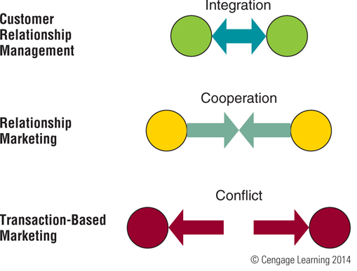
Forms of Buyer-Seller Interactions from Conflict to Integration

Slide 6
Relationship Marketing
Focuses on long term rather than short term
Emphasizes retaining customers over making a sale
Ranks customer service as a high priority
Encourages frequent customer contact
Fosters customer commitment with the
firm
Bases customer interactions on cooperation and trust

Slide 7
Elements of Relationship Marketing
Firms build long-term relationships in four ways
  Gather information about their customers
  Analyze the data and use it to modify the marketing mix
  Monitor interactions with customers
  Use customers’ preferences and knowledge

Slide 8
Internal Marketing
External customers - People or organizations that buy or use a firm’s goods or services
Internal customers - Employees or departments within the organization whose success depends on the work of other employees or departments

Slide 9
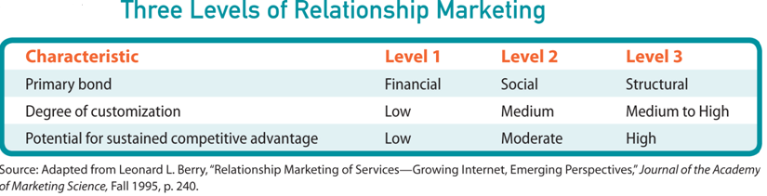
Three Levels of Relationship Marketing

Slide 10
First Level: Focus on Price
Most superficial level, least likely to lead to long-term relationships
Marketers rely on pricing to motivate customers
Competitors can easily duplicate pricing benefits

Slide 11
Second Level: Social Interactions
Customer service and communication are key factors
Example: A chocolate seller offers a chocolate tasting reception

Slide 12
Third Level: Interdependent Partnership
Relationship transformed into structural changes that ensure partnership and interdependence between buyer and seller
Example: Canadian software marketer Corel chose a cloud-based approach
  Its tech-help agents can now answer customer queries via chat, telephone, the Web, or social media

Slide 13
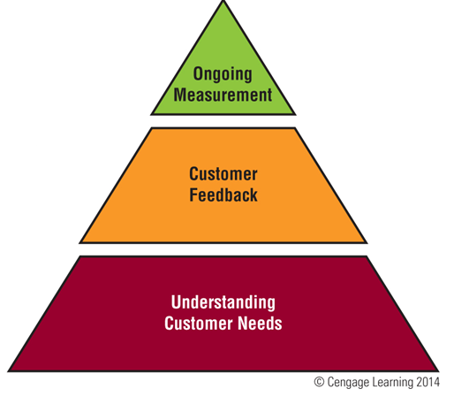
Three Steps to Measure Consumer Satisfaction

Slide 14
Understanding Customer Needs
To build long-term relationships firms must understand what customers need, want, and expect
Must measure customer satisfaction
Marketers need to keep in touch with the needs of current and potential customers

Slide 15
Obtaining Customer Feedback and Ensuring Satisfaction
Sources of information include toll free numbers or online feedback
Some firms hire mystery shoppers posing as customers to evaluate service
Complaints help firms overcome problems and demonstrate commitment to service
Some firms conduct surveys to measure satisfaction

Slide 16
Building Buyer-Seller Relationships
Consumers form relationships to:
  Reduce choices
  Simplify information gathering and the entire buying process
  Reduce the risk of dissatisfaction

Slide 17
Building Buyer-Seller Relationships
  Perceived positive value received in a long-term buyer-seller relationships is a key benefit for customers
  Customers may switch loyalties if they perceive better benefits from a competitor

Slide 18
How Marketers Keep Customers
Retaining customers is more profitable than losing them
Customer churn - Customer turnover
  Is expensive for a company
Firms generate more profits with each additional year of a relationship

Slide 19
How Marketers Keep Customers
Frequency marketing - Frequent-buyer or -user marketing programs that reward customers
Affinity marketing - Solicits responses from individuals who share common interests and activities

Slide 20
Database Marketing
Use of software to analyze data about customers
Helps firms to:
  Identify their most profitable customers
  Calculate the lifetime value of each customer’s business
  Build relationships and encourage genuine brand loyalty
  Improve customer retention and referral rates

Slide 21
Database Marketing
  Reduce marketing and promotion costs
  Boost sales volume per customer or targeted customer group
  Expand loyalty programs

Slide 22
Database Marketing
Possible sources of data
  Credit card applications
  Software registration
  Product warranties
  Point-of-sale register scanners
  Customer opinion surveys
  Websites
  Telecom companies database

Slide 23
Database Marketing
Interactive television - Television service package that includes a return path for viewers to interact with programs or commercials by clicking their remote controls
Application service providers (ASPs) - Outside companies that specialize in providing both the computers and the application support for managing information systems of business clients

Slide 24
Customers as Advocates
Grassroots marketing - Connecting directly with existing and potential customers through nonmainstream channels
Viral marketing - Satisfied customers spread the word about products to other consumers
Buzz marketing - Gathers volunteers to try products and then relies on them to talk about their experiences

Slide 25
Customer Relationship Management
Combination of strategies and tools that drive customer relationship programs
Leverages technology to manage customer relationships
Integrates all stakeholders into a company’s product design and development

Slide 26
Benefits of CRM
Software systems can make sense of huge amounts of data
Simplifies complex business processes
CRM can be used at two different levels
  On-demand
  On-premises

Slide 27
Thank YOU

