Slide 1

Developing Marketing Strategies and Plans
Chapter 2

Slide 2
Value Chain
Unlike traditional approach of making and selling, organizations in modern era focus on value creation and delivery process. Phases of value creation and delivery process are:
1. Assessing Marketing Opportunities (environmental scanning) and Customer Values (needs, wants and demands).
2. Value Selection which spotlight segmenting, targeting, positioning and branding.
3. Designing Values in relation to product strategy, new offerings and pricing.
4. Delivering values deals with distribution of products.
5. Communicating value .
Notes:
A marketing plan is used to direct and coordinate the marketing effort and is created at the strategic and tactical level.

Slide 3
The Value Chain by Michael Porter
Primary Activities
Inbound Logistics
Outbound Logistics
Operations
Marketing
Service
Margin
Procurement
Support Activities
Human Resource management
Technological Development
Infrastructure
Notes:
One way that managers can identify ways to create more value is through The Value Chain, developed by Harvard’s Michael Porter. According to this model, a company is a collection of activities that are performed to design, produce, market, deliver and support its products. The Value Chain identifies nine – five primary and 4 support – activities that create value and cost in a business.

Slide 4
Value Chain
Primary Activities
Inbound Logistics: It involves relationships with suppliers and include all the activities required to receive, store, and disseminate inputs.
Operations: It deals with all the activities required to transform inputs into outputs (products and services).
Outbound logistics: All the activities required to collect, store, and distribute the output.
Marketing: Inform buyers about products and services.
Service: All the activities required to keep the product working effectively after it is sold.
Notes:
A marketing plan is used to direct and coordinate the marketing effort and is created at the strategic and tactical level.

Slide 5
Value Chain
Secondary activities
Procurement: It is acquisition of inputs, or resources, for the firm.
Human Resource Management: All activities involved in recruiting, hiring, training, developing, compensating personnel.
Technology Development: It deals with equipment, hardware, software, procedures and technical knowledge for the transformation of inputs into outputs.
Infrastructure: serves the company's needs and ties its various parts together, it consists of functions or departments such as accounting, legal, finance, planning, public affairs, government relations, quality assurance and general management.
Notes:
A marketing plan is used to direct and coordinate the marketing effort and is created at the strategic and tactical level.

Slide 6
Holistic Marketing
Value Creation
(Creation of more promising new value offerings)
Value
Delivery
(Use of capabilities and infrastructure to deliver the new value offerings)
Value Exploration
(Identification of New Value Opportunities)
Notes:
Holistic marketers addresses three key management questions:
Value Exploration – How the firm identifies new value opportunities.
Value Creation – How efficiently a company creates more promising new value offerings
Value Delivery – How a company uses its capabilities and infrastructure to deliver the new value offering more efficiently.

Slide 7
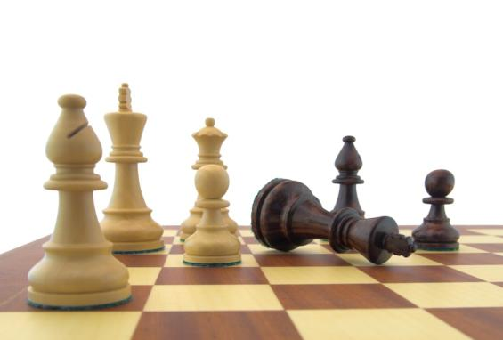
Strategic Planning
Managers give priority to strategic planning in three key areas.
Businesses as investment portfolio
Assessing each business’s strength
Establish a strategy
Notes:
Strategic planning must focus on three key areas: 1) managing a company’s businesses as an investment portfolio, 2) assessing each business’s strength by considering the market’s growth rate and the company’s position and fit in that market, and 3) establishing a strategy.

Slide 8
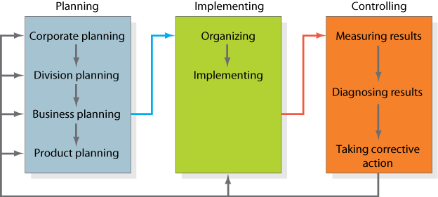
Strategic Planning, Implementation, and Control Processes
Notes:
Figure 2.1 presents the complete planning, implementation, and control cycle of strategic planning.

Slide 9
Core Organizational Levels
Corporate Planning: Corporate strategic planning deals with mission, policy, strategy, and goals to guide whole organization.
Division Planning: It caters the resources allocation.
Business Planning: It develops strategic plan to ensure profit making in future.
Product Planning: Each product level develops a marketing plan for achieving its objective.
Notes:
A marketing plan is used to direct and coordinate the marketing effort and is created at the strategic and tactical level.

Slide 10
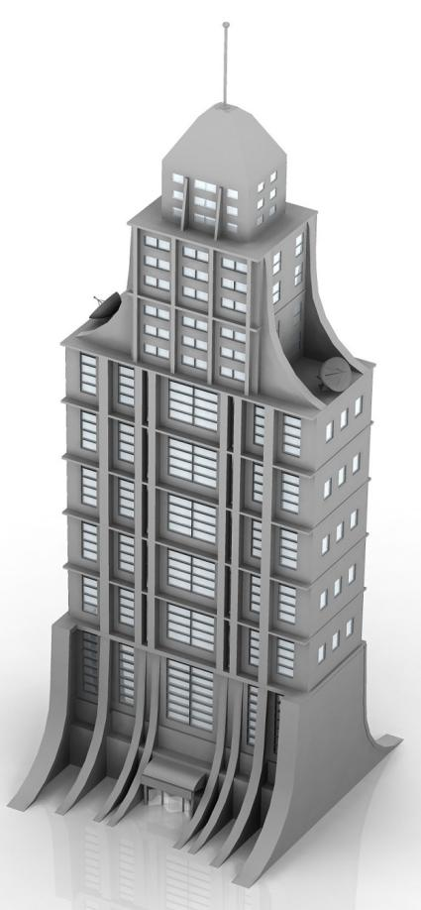
Corporate Strategic Planning
1
Define corporate mission
2
Establish SBU’s
3
Assign resources to SBU’s
4
Assess growth opportunities
Notes:
Corporate strategy focuses on these four elements.

Slide 11
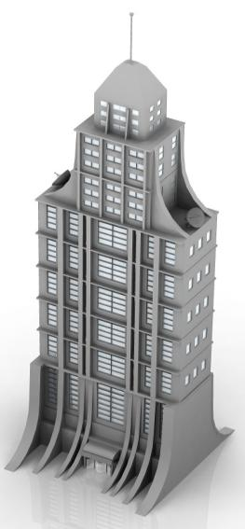
Defining the Corporate Mission
Who is the customer?
What is of value to the customer?
What is our business?
What should our business be?
What will our business be?
Notes:
In defining the corporate mission, organizations should start by answering Peter Drucker’s classic questions… from these answers the organization can develop a good mission statement.

Slide 12
Mission Statements
A formal summary of the aims and values of a company
Characteristics of good mission statements:
Focus on a limited number of goals
Stress major policies and values
Define major competitive spheres
Take a long-term view
Short, memorable, meaningful
Notes:
Good mission statements have five major characteristics:

Slide 13
GOOGLE’S Mission Statement
To organize the world’s information and make it universally accessible and useful.

Slide 14
GOOGLE’s Philosophy
Never settle for the best.
  Focus on the user and all else will follow.
  It’s best to do one thing really, really well.
  Fast is better than slow.
  Democracy on the web works.
  You don’t need to be at your desk to need an answer.
  You can make money without doing evil.
  There is always more information out there.
  The need for information crosses all borders.
  You can be serious without a suit.
  Great just isn’t good enough.

Slide 15
ENGRO Corporation
Engro Corporation’s portfolio consists of seven businesses
Engro Fertilizers Limited (Urea and NPK Fertilizer)
Engro Foods Limited (Milk and Ice Cream)
Engro Polymer & Chemicals Limited
Engro Powergen Limited
Engro EXIMP Private Limited (Fertilizer Trading)
Engro Vopak Terminal Limited (Chemical warehouse)
Elengy Terminal Pakistan Limited (LNG Handelling)

Slide 16
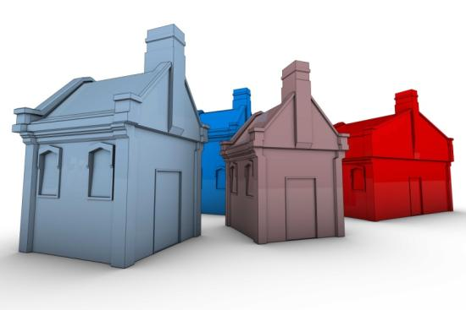

Strategic Business Units (SBU)
Three Characteristics of an SBU:
Unique competitors
A single business or collection of related businesses
Leader responsible for planning and profitability
Notes:
A strategic business unit has three characteristics: 1) It is a single business, or a collection of related businesses, that plan separately from the rest of the company; 2) It has its own set of competitors; and 3) It has a manager responsible for strategic planning and profit performance.

Slide 17
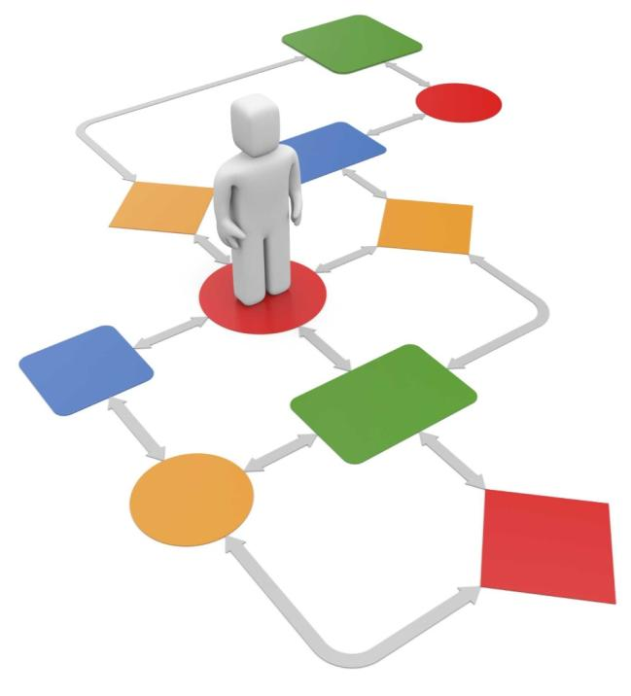
Marketing Plan
Directs and coordinates the marketing effort
Product Line or Brand Level
Strategic and Tactical levels
Notes:
A marketing plan is used to direct and coordinate the marketing effort and is created at the strategic and tactical level.

Slide 18
Levels of a Marketing Plan
Strategic
  Analysis of marketing opportunities
  Target marketing decisions
  Value proposition
Tactical
  Product features
  Promotion
  Merchandising
  Pricing
  Sales channels
  Service
Notes:
Strategic marketing plans begin with an analysis of market opportunities and based on what’s learned leads to an identification of target markets and the firm’s value propositions. Tactical marketing plans focus on specific tactics such as product features, promotion, merchandising, pricing, sales channels, and service.

Slide 19



Defining Strategic Business Units
Customer groups
Customer needs
Technology
Notes:
Companies often define themselves in terms of the products it produces. This view often limits a company. A market definition on the other hand describe the business as a customer-satisfying process. For example, if Xerox defined itself from only a product perspective (We make copying equipment) it would limit its ability to market products and services other than copiers.
SBUs can be defined by: 1) Customer needs; Customer groups; and 3) Technology

Slide 20
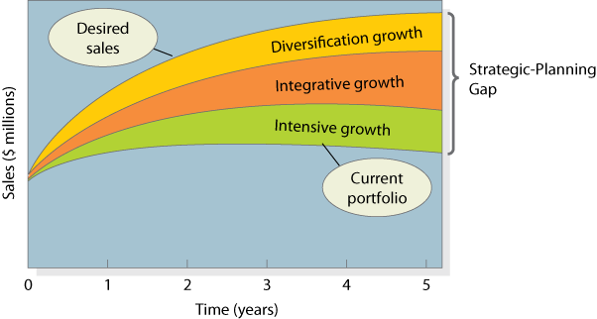
The Strategic-Planning Gap
Notes:
Figure 2.1 is based on a manufacturer (Musicale) of blank compact discs.
The lowest curve projects expected sales over the next five years from the company’s current business portfolio. The top curve is the desired sales over this period. As the company wishes to grow faster than its current businesses will allow, the company must seek new opportunities.
The firm can take three approaches toward achieving growth: Intensive; Integrative, or Diversification. Each of these will be discussed in detail in the following slides.

Slide 21
Intensive Growth
Corporate management first priority is opportunity review for improving existing businesses
Product-Market Expansion Grid
Market Development
(Current Product and New Market)
Diversification
(New Product for New Market)
Current
New
Markets
Market Penetration
(Gain More Market Share)
Product Development
(New Products for same market)
Current
New
Products
Notes:
Intensive growth looks for opportunities within current businesses. The product-market expansion grid looks at growth possibilities from the perspective of current and new products and markets.
Market Penetration – gaining market share with current products and current customers. The company can achieve growth by having current customers purchase more, attract competitors customers, or bring non-buyers into the market.
Market Development – Finding new markets for existing products. The firm can find new buyer groups (business customers rather than consumers), new distribution channels (online), or expand distribution to other regions or countries.
Product Development – Develop new products to the current market. As the firm already has a relationship with current customers, they can develop new products to meet other, related needs of it’s customers.
Diversification – Developing new products for new markets.

Slide 22
Integrative Growth
Backward
Business
Forward
Supplier
Wholesaler
Horizontal
Competitor
Notes:
A business can achieve growth through backward (buy supplier), forward (buy wholesaler), or horizontal (competitor) integration.

Slide 23
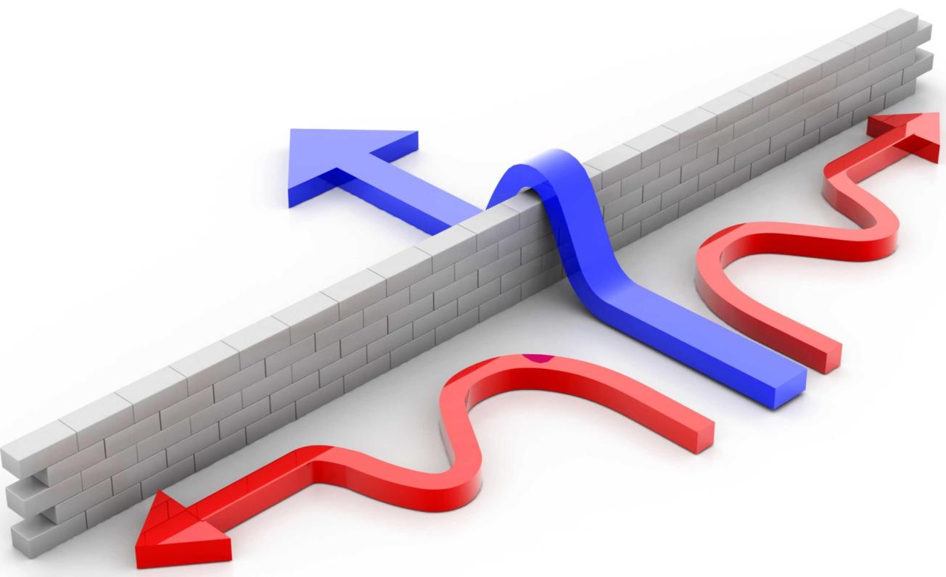
Diversification Growth
When opportunities exist outside the present businesses. And the industry is
Is highly attractive and the company has right mix of business strength.
New Opportunity
Notes:
Firms can often discover opportunities outside its present business. However, the new industry should be highly attractive (grow potential) and the company should have (or acquire) the right capabilities to succeed.

Slide 24
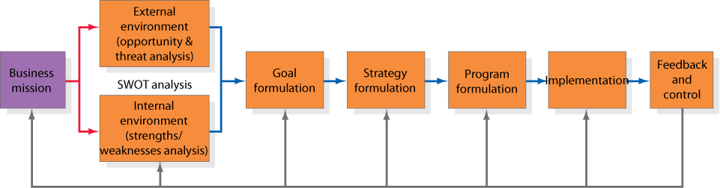
Business Unit Strategic Planning
Notes:
Figure 2.3 outlines strategic planning at the SBU level.
Each business unit must develop a specific mission that fits within the broader company mission. For example, the specific mission for YouTube must fit within the overall mission of Google.

Slide 25
SWOT Analysis
S
W
Internal
Strength
Weakness
O
T
External
Opportunity
Threat
Notes:
Strategic planning requires managers to understand the external and internal environments. A SWOT analysis allows for these environments to be monitored.
Business units must monitor key macro-environment forces as well as micro-environment factors. Monitoring the external environment can allow firms to identify growth opportunities and potential threats to its existing businesses.
To take advantage of opportunities the firm must be aware of its own internal strengths and weaknesses.

Slide 26

Goal Formulation
Ranked
Consistent
Quantified
Realistic
Notes:
After completing a SWOT analysis the firm can proceed to goal formulation whereby it develops specific goals for the planning period. Goals are objectives that are specific with respect to magnitude and time. Managing these objectives effectively requires these four criteria to be met.

Slide 27
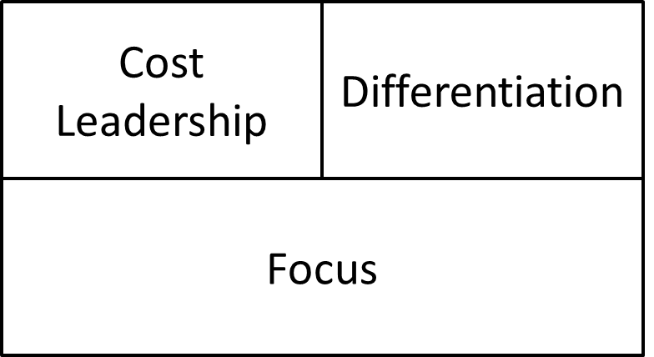

Strategy Formulation
Porter’s Generic Strategies
Strategic Alliances
Notes:
Porter outlines three generic strategies that businesses can follow. They can focus on Cost Leadership, where they are seeking to achieve the lowest production and distribution costs to underprice competitors and gain market share; the can select a Differentiation strategy, where they focus on achieving better performance on a important customer benefit (such as quality or speed); or third, businesses can take a Focus approach where they concentrate on a narrow market segment, gaining as much insight about the segment as possible, and then pursue either a cost leadership or differentiation strategy.
Oftentimes, companies cannot achieve objectives without the use of partners. Strategic Alliances can be used to compliment or leverage current capabilities and resources to the benefit of both parties. Alliances fall into four categories:
Product or service alliance.
Promotional alliances
Logistic alliances
Pricing collaborations.

Slide 28
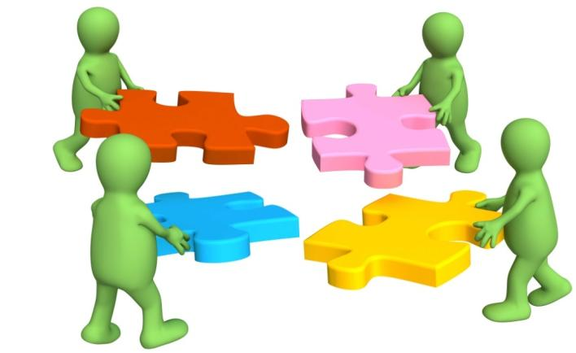
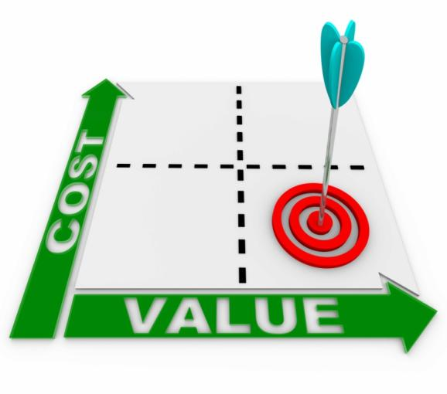
Program Formulation and Implementation
Notes:
Great strategies can lead to failure unless they are implemented properly. Proper formulation ensures that all the pieces fit together. But firms must also examine the cost of the marketing programs to ensure that the expense is justified.

Slide 29


Feedback and Control
Strong leadership
Notes:
Changes in the market are inevitable. Companies must be aware of pending changes and also have the will to change course.

Slide 30
Thank You

