Slide 1
Managing a Holistic Marketing Organization for the Long Run

Slide 2
Advertisement

Slide 3
Trends in Marketing Practices
Reengineering
Outsourcing
Benchmarking
Supplier partnering
Customer partnering
Merging
Globalizing
Flattening
Focusing
Accelerating
Empowering
Notes:
Table 22.1 explains several important shifts occurring in marketing.
Reengineering refers to appointing teams to manage customer-value-building processes and break down walls between departments. Outsourcing refers to the buying more goods and services from outside domestic or foreign vendors. Benchmarking is the studying of “best practice companies” to improve performance. Supplier partnering refers to partnering with fewer but better value-adding suppliers. Customer partnering refers to the trend of working more closely with customers to add value to their operations.
Merging is the acquiring or merging with firms in the same or complementary industries to gain economies of scale and scope. Globalizing refers to the increasing efforts to “think global” and “act local”. Flattening is the reduction in the number of organizational levels to get closer to the customer. Focusing is determining the most profitable businesses and customers and focusing on them.
Justifying means becoming more accountable by measuring, analyzing, and documenting the effects of marketing actions. Accelerating means designing the organization and setting up processes to respond more quickly to changes in the environment. Empowering is encouraging and empowering personnel to produce more ideas and take more initiative. Broadening is factoring the interests of customers, employees, shareholders, and other stakeholders into the activities of the enterprise. Monitoring is tracking what is said online and elsewhere and studying customers, competitors, and others to improve business practices.

Slide 4
Trends in Marketing Practices
Reengineering refers to appointing teams to manage customer-value-building processes and break down walls between departments.
Outsourcing refers to the buying more goods and services from outside domestic or foreign vendors.
Benchmarking is the studying of “best practice companies” to improve performance.
Supplier partnering refers to partnering with fewer but better value-adding suppliers.
Notes:
Table 22.1 explains several important shifts occurring in marketing.
Reengineering refers to appointing teams to manage customer-value-building processes and break down walls between departments. Outsourcing refers to the buying more goods and services from outside domestic or foreign vendors. Benchmarking is the studying of “best practice companies” to improve performance. Supplier partnering refers to partnering with fewer but better value-adding suppliers. Customer partnering refers to the trend of working more closely with customers to add value to their operations.
Merging is the acquiring or merging with firms in the same or complementary industries to gain economies of scale and scope. Globalizing refers to the increasing efforts to “think global” and “act local”. Flattening is the reduction in the number of organizational levels to get closer to the customer. Focusing is determining the most profitable businesses and customers and focusing on them.
Justifying means becoming more accountable by measuring, analyzing, and documenting the effects of marketing actions. Accelerating means designing the organization and setting up processes to respond more quickly to changes in the environment. Empowering is encouraging and empowering personnel to produce more ideas and take more initiative. Broadening is factoring the interests of customers, employees, shareholders, and other stakeholders into the activities of the enterprise. Monitoring is tracking what is said online and elsewhere and studying customers, competitors, and others to improve business practices.

Slide 5
Trends in Marketing Practices
Customer partnering refers to the trend of working more closely with customers to add value to their operations.
Merging is the acquiring or merging with firms in the same or complementary industries to gain economies of scale and scope.
Globalizing refers to the increasing efforts to “think global” and “act local”.
Flattening is the reduction in the number of organizational levels to get closer to the customer.
Notes:
Table 22.1 explains several important shifts occurring in marketing.
Reengineering refers to appointing teams to manage customer-value-building processes and break down walls between departments. Outsourcing refers to the buying more goods and services from outside domestic or foreign vendors. Benchmarking is the studying of “best practice companies” to improve performance. Supplier partnering refers to partnering with fewer but better value-adding suppliers. Customer partnering refers to the trend of working more closely with customers to add value to their operations.
Merging is the acquiring or merging with firms in the same or complementary industries to gain economies of scale and scope. Globalizing refers to the increasing efforts to “think global” and “act local”. Flattening is the reduction in the number of organizational levels to get closer to the customer. Focusing is determining the most profitable businesses and customers and focusing on them.
Justifying means becoming more accountable by measuring, analyzing, and documenting the effects of marketing actions. Accelerating means designing the organization and setting up processes to respond more quickly to changes in the environment. Empowering is encouraging and empowering personnel to produce more ideas and take more initiative. Broadening is factoring the interests of customers, employees, shareholders, and other stakeholders into the activities of the enterprise. Monitoring is tracking what is said online and elsewhere and studying customers, competitors, and others to improve business practices.

Slide 6
Trends in Marketing Practices
Focusing is determining the most profitable businesses and customers and focusing on them.
Justifying means becoming more accountable by measuring, analyzing, and documenting the effects of marketing actions.
Accelerating means designing the organization and setting up processes to respond more quickly to changes in the environment.
Notes:
Table 22.1 explains several important shifts occurring in marketing.
Reengineering refers to appointing teams to manage customer-value-building processes and break down walls between departments. Outsourcing refers to the buying more goods and services from outside domestic or foreign vendors. Benchmarking is the studying of “best practice companies” to improve performance. Supplier partnering refers to partnering with fewer but better value-adding suppliers. Customer partnering refers to the trend of working more closely with customers to add value to their operations.
Merging is the acquiring or merging with firms in the same or complementary industries to gain economies of scale and scope. Globalizing refers to the increasing efforts to “think global” and “act local”. Flattening is the reduction in the number of organizational levels to get closer to the customer. Focusing is determining the most profitable businesses and customers and focusing on them.
Justifying means becoming more accountable by measuring, analyzing, and documenting the effects of marketing actions. Accelerating means designing the organization and setting up processes to respond more quickly to changes in the environment. Empowering is encouraging and empowering personnel to produce more ideas and take more initiative. Broadening is factoring the interests of customers, employees, shareholders, and other stakeholders into the activities of the enterprise. Monitoring is tracking what is said online and elsewhere and studying customers, competitors, and others to improve business practices.

Slide 7
Trends in Marketing Practices
Empowering is encouraging and empowering personnel to produce more ideas and take more initiative.
Broadening is factoring the interests of customers, employees, shareholders, and other stakeholders into the activities of the enterprise.
Monitoring is tracking what is said online and elsewhere and studying customers, competitors, and others to improve business practices.
Notes:
Table 22.1 explains several important shifts occurring in marketing.
Reengineering refers to appointing teams to manage customer-value-building processes and break down walls between departments. Outsourcing refers to the buying more goods and services from outside domestic or foreign vendors. Benchmarking is the studying of “best practice companies” to improve performance. Supplier partnering refers to partnering with fewer but better value-adding suppliers. Customer partnering refers to the trend of working more closely with customers to add value to their operations.
Merging is the acquiring or merging with firms in the same or complementary industries to gain economies of scale and scope. Globalizing refers to the increasing efforts to “think global” and “act local”. Flattening is the reduction in the number of organizational levels to get closer to the customer. Focusing is determining the most profitable businesses and customers and focusing on them.
Justifying means becoming more accountable by measuring, analyzing, and documenting the effects of marketing actions. Accelerating means designing the organization and setting up processes to respond more quickly to changes in the environment. Empowering is encouraging and empowering personnel to produce more ideas and take more initiative. Broadening is factoring the interests of customers, employees, shareholders, and other stakeholders into the activities of the enterprise. Monitoring is tracking what is said online and elsewhere and studying customers, competitors, and others to improve business practices.

Slide 8
Internal Marketing
R&D
Purchasing
Manufacturing
Marketing
Sales
Logistics
Accounting
Finance
Public Relations
Other Customer-Contact Personnel
Notes:
Traditionally, marketers played the role of middleman, charged with understanding customers’ needs and transmitting their voice to various functional areas. But in a networked enterprise, every functional area can interact directly with customers. Marketing no longer has sole ownership of customer interactions; rather, it now must integrate all the customer-facing processes so customers see a single face and hear a single voice when they interact with the firm.
Internal marketing requires that everyone in the organization accept the concepts and goals of marketing and engage in choosing, providing, and communicating customer value. Only when all employees realize their job is to create, serve, and satisfy customers does the company become an effective marketer. The “Marketing Memo: Characteristics of Company Departments That Are Truly Customer Driven” presents a scoring card to evaluate which company departments are truly customer driven.

Slide 9
Organizing the
Marketing Department
Functional Organization
Geographic Organization
Product- or Brand-Management Organization
Market-Management Organization
Matrix-Management Organization
Notes:
Modern marketing departments can be organized in a number of different, sometimes overlapping ways: functionally, geographically, by product or brand, by market, or in a matrix.

Slide 10
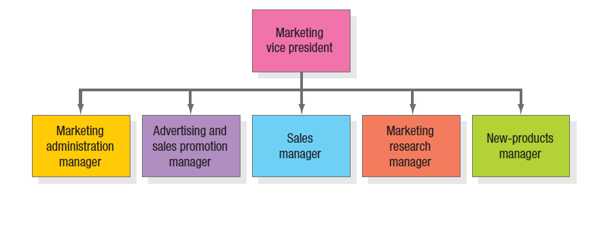
Functional Organization
In the most common form of marketing organization, functional specialists report to a
marketing vice president who coordinates their activities. Following figure shows five
specialists. a The main advantage of a functional marketing organization is its
administrative simplicity. It can be quite a challenge for the department to develop
smooth working relationships, however. This form also can result in inadequate
planning as the number of products and markets increases and each functional group
vies for budget and status.
Notes:
In the most common form of marketing organization, functional specialists report to a marketing vice president who coordinates their activities. Figure 22.1 shows five specialists. a The main advantage of a functional marketing organization is its administrative simplicity. It can be quite a challenge for the department to develop smooth working relationships, however. This form also can result in inadequate planning as the number of products and markets increases and each functional group vies for budget and status.
Other organizations organize along geographic lines.

Slide 11
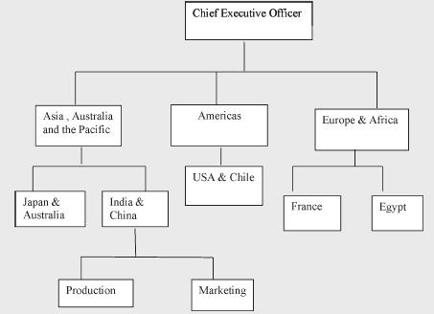
Geographical Organization
Notes:
In the most common form of marketing organization, functional specialists report to a marketing vice president who coordinates their activities. Figure 22.1 shows five specialists. a The main advantage of a functional marketing organization is its administrative simplicity. It can be quite a challenge for the department to develop smooth working relationships, however. This form also can result in inadequate planning as the number of products and markets increases and each functional group vies for budget and status.
Other organizations organize along geographic lines.

Slide 12
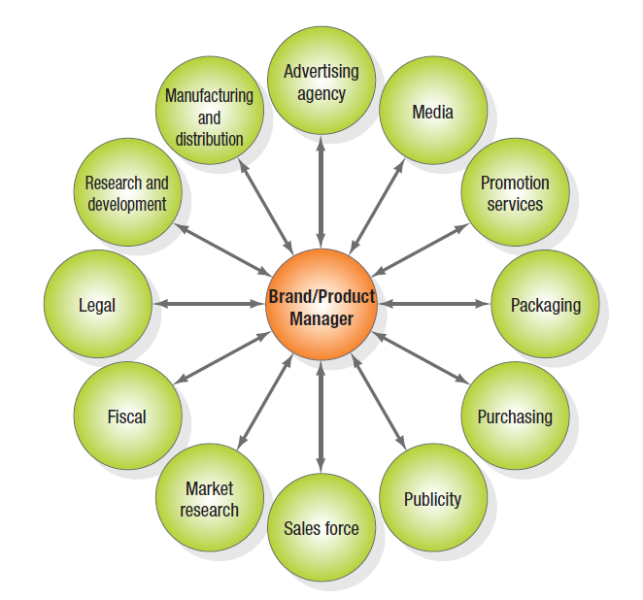
The Product-Management Organization
Companies producing a variety of products and brands often establish a product- (or brand-) management organization. This does not replace the functional organization but serves as another layer of management. A product manager supervises product category managers, who in turn supervise specific product and brand managers. A product-management organization makes sense if the company’s products are quite different or there are more than a functional organization can handle. This form is sometimes characterized as a hub-and-spoke system. The brand or product manager is figuratively at the center with spokes leading to various departments representing working relationships
Notes:
Companies producing a variety of products and brands often establish a product- (or brand-) management organization. This does not replace the functional organization but serves as another layer of management. A product manager supervises product category managers, who in turn supervise specific product and brand managers. A product-management organization makes sense if the company’s products are quite different or there are more than a functional organization can handle. This form is sometimes characterized as a hub-and-spoke system. The brand or product manager is figuratively at the center with spokes leading to various departments representing working relationships. This is shown in Figure 22.2 in the slide.

Slide 13
Tasks Performed by Brand Managers
Develop long-range and competitive strategy for each product
Prepare annual marketing plan and sales forecast
Work with advertising and merchandising agencies to develop campaigns
Increase support of the product among channel members
Gather continuous intelligence on product performance, customer attitudes
Initiate product improvements
Notes:
The manager in this type of organization performs several tasks listed in the slide. The product-management organization lets the product manager concentrate on developing a cost-effective marketing program and react more quickly to new products in the marketplace; it also gives the company’s smaller brands a product advocate. However, this system has some disadvantages too.
• They become experts in their product area but rarely achieve functional expertise.
• The system often proves costly.
• Brand managers normally manage a brand for only a short time.
• The fragmentation of markets makes it harder to develop a national strategy.
• Product and brand managers focus the company on building market share rather than customer relationships.

Slide 14
Disadvantages of The Product-Management Organization
This system has some disadvantages too.
• They become experts in their product area but rarely achieve functional expertise.
• The system often proves costly.
• Brand managers normally manage a brand for only a short time.
• The fragmentation of markets makes it harder to develop a national strategy.
• Product and brand managers focus the company on building market share rather than customer relationships.
Notes:
The manager in this type of organization performs several tasks listed in the slide. The product-management organization lets the product manager concentrate on developing a cost-effective marketing program and react more quickly to new products in the marketplace; it also gives the company’s smaller brands a product advocate. However, this system has some disadvantages too.
• They become experts in their product area but rarely achieve functional expertise.
• The system often proves costly.
• Brand managers normally manage a brand for only a short time.
• The fragmentation of markets makes it harder to develop a national strategy.
• Product and brand managers focus the company on building market share rather than customer relationships.

Slide 15
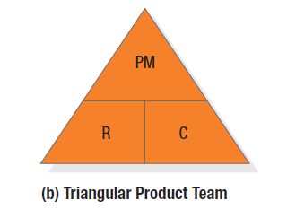
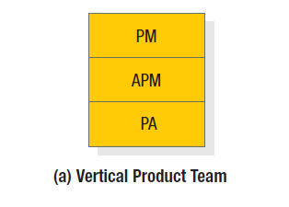
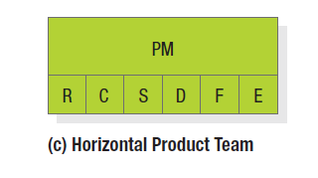
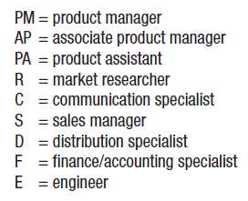
Types of Product Teams
Notes:
Figure 22.3 shown in the slide presents an alternative in a product-management organization – the use of product teams. There are three types: vertical, triangular, and horizontal. The triangular and horizontal product- team approaches let each major brand be run by a brand-asset management team (BAMT) consisting of key representatives from functions that affect the brand’s performance. The company consists of several BAMTs that periodically report to a BAMT directors committee, which itself reports to a chief branding officer. This is quite different from the way brands have traditionally been handled.

Slide 16
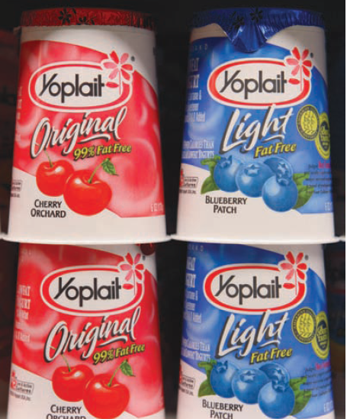
Category Management
With category management, a company focuses on product categories to manage its brands. in some packaged-goods firms, category management has evolved into aisle management and encompasses multiple related categories typically found in the same sections of supermarkets and grocery stores. Retailers and regional grocery chains such as Wal-Mart and Dominick’s embrace category management as a means to define a particular product category’s strategic role within the store and address logistics, the role of private-label products, and the trade-offs between product variety and inefficient duplication. General Mills’ Yoplait Yogurt has served as category advisor to the dairy aisle for 24 major retailers, boosting the yogurt base footprint four to eight feet at a time and increasing sales of yogurt by 9 percent and category sales in dairy by 13 percent nationwide.
Notes:
With category management, a company focuses on product categories to manage its brands. in some packaged-goods firms, category management has evolved into aisle management and encompasses multiple related categories typically found in the same sections of supermarkets and grocery stores. Retailers and regional grocery chains such as Wal-Mart and Dominick’s embrace category management as a means to define a particular product category’s strategic role within the store and address logistics, the role of private-label products, and the trade-offs between product variety and inefficient duplication. General Mills’ Yoplait Yogurt has served as category advisor to the dairy aisle for 24 major retailers, boosting the yogurt base footprint four to eight feet at a time and increasing sales of yogurt by 9 percent and category sales in dairy by 13 percent nationwide.

Slide 17
Market-Management Organization
Market managers supervise several market-development managers, market specialists, or industry specialists
Market managers are staff people with duties like those of product managers. They develop long-range and annual plans for their markets.
Companies organized this way are called market-centered organizations.
Notes:
When customers fall into different user groups with distinct buying preferences and practices, a market-management organization is desirable. Market managers supervise several market-development managers, market specialists, or industry specialists and draw on functional services as needed. Market managers of important markets might even have functional specialists reporting to them.

Slide 18
Building a Creative
Marketing Organization
Developing a company-wide passion for customers
Organizing around customer segments instead of products
Understanding customers through qualitative and quantitative research
Notes:
Many companies realize they’re not yet really market and customer driven—they are product and sales driven. Transforming into a true market-driven company requires:
1. Developing a company-wide passion for customers
2. Organizing around customer segments instead of products, and
3. Understanding customers through qualitative and quantitative research.
The task is not easy, but the payoffs can be considerable.

Slide 19
How Can CEOs Create a
Marketing-Focused Company?
Convince senior management of the need to become customer focused
Appoint a senior marketing officer and marketing task force
Get outside guidance
Change the company’s reward measurement and system
Hire strong marketing talent
Notes:
In the Marketing Insight, ten steps for a CEO to use in creating a market and customer-focused company are provided. These steps are listed on this slide and the next.

Slide 20
How Can CEOs Create a
Marketing-Focused Company?
Develop strong in-house marketing training programs
Install a modern marketing planning system
Establish an annual marketing excellence recognition program
Shift from a department focus to a process-outcome focus
Empower the employees

Slide 21
Thank you

