Slide 1

Tapping into Global Markets

Slide 2
Deciding on the Marketing Program
Global Similarities and Differences
Marketing Adaptation
Global Product Strategies
Global Communication Strategies
Global Pricing Strategies
Global Distribution Strategies

Slide 3
Standardized Marketing
Pros and Cons
Advantages
Economies of scale
Lower marketing costs
Power and scope
Brand Consistency
Leverage ideas quickly and efficiently
Uniformity of marketing practices
Disadvantages
Ignores differences in:
Consumer needs, wants, and usage patterns
Consumer response
Brand and product development
Legal environment
Marketing institutions
Administrative procedures

Slide 4



Global Similarities and Differences
Soft Drink Consumption
(8-ounce servings)
Americans 760
Mexicans 674
Brazilians 315
Russians 149
Chinese 39
Median Age
25
China, India
43
Germany, Italy, & Japan
Notes:
Global Similarities and Differences
The development of the Web, the spread of cable and satellite TV, and the global linking of telecommunications networks have led to a convergence of lifestyles. Increasingly common needs and wants have created global markets for more standardized products, particularly among the young middle class.

Slide 5
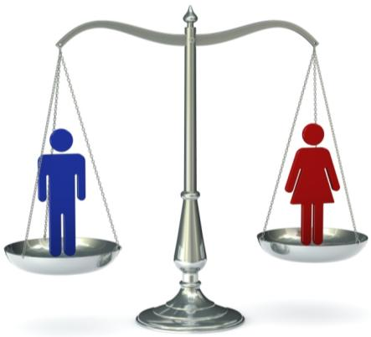



Cultural Differences
Masculine versus feminine
Collectivism
Individualism
Power distance
Uncertainty avoidance
Notes:
Consumer behavior may reflect cultural differences that can be pronounced across countries. Hofstede identifies four cultural dimensions that differentiate countries:
1. Individualism versus collectivism—In collectivist societies, the self-worth of an individual is rooted more in the social system than in individual achievement (high collectivism: Japan; low: United States).
2. High versus low power distance—High power distance cultures tend to be less egalitarian (high: Russia; low: Nordic).
3. Masculine versus feminine—This dimension measures how much the culture is dominated by assertive males versus nurturing females (highly masculine: Japan; low: Nordic countries).
4. Weak versus strong uncertainty avoidance—Uncertainty avoidance indicates how risk-aversive people are (high avoidance: Greece; low: Jamaica).

Slide 6
Cultural Differences
1. Individualism versus collectivism—In collectivist societies, the self-worth of an individual is rooted more in the social system than in individual achievement (high collectivism: Japan; low: United States).
2. High versus low power distance—High power distance cultures tend to be less egalitarian (high: Russia; low: Nordic).
3. Masculine versus feminine—This dimension measures how much the culture is dominated by assertive males versus nurturing females (highly masculine: Japan; low: Nordic countries).
4. Weak versus strong uncertainty avoidance—Uncertainty avoidance indicates how risk-aversive people are (high avoidance: Greece; low: Jamaica).

Slide 7

Consumer Behavior Differences
Honda Automobiles
Japan – Speed, youth, and energy
U.S. – Quality and reliability
Notes:
Consumer behavior differences as well as historical market factors lead marketers to position brands differently in different markets.
• Heineken beer is a high-end super-premium offering in the United States but middle-of-the road in its Dutch home market.
• Honda automobiles denote speed, youth, and energy in Japan and quality and reliability in the United States.
• The Toyota Camry is the quintessential middle-class car in the United States but is at the high end in China, though in the two markets the cars differ only in cosmetic ways.

Slide 8


Marketing Adaptation
Product
Price
Distribution
Communications
Notes:
Marketing Adaptation
Because of all these differences, most products require at least some adaptation. Even Coca-Cola is sweeter or less carbonated in certain countries. The best global brands are consistent in theme but reflect significant differences in consumer behavior, brand development, competitive forces, and the legal or political environment. Oft-heard— and sometime modified—advice to marketers of global brands is to: “Think Global, Act Local.”
Global Communication Strategies
Changing marketing communications for each local market is a process called communication adaptation. If it adapts both the product and the communications, the company engages in dual adaptation. Consider the message. The company can use one message everywhere, varying only the language, name, and perhaps colors to avoid taboos in some countries. Purple is associated with death in Burma and some Latin American nations, white is a mourning color in India, and in Malaysia green connotes disease.
The second possibility is to use the same message and creative theme globally but adapt the execution. GE’s global “Ecomagination” ad campaign substitutes creative content in Asia and the Middle East to reflect the cultural interest there. Even in the high-tech space, local adaptations may be necessary.
Global Pricing Strategies
Multinationals selling abroad must contend with price escalation and transfer prices (and dumping charges). Two particularly thorny pricing problems are gray markets and counterfeits. PRICE ESCALATION A Gucci handbag may sell for $120 in Italy and $240 in the United States. Why? Gucci must add the cost of transportation, tariffs, importer margin, wholesaler margin, and retailer margin to its factory price. Price escalation from these added costs and currency fluctuation risk might make the price two to five times as much in another country to earn the same profit for the manufacturer.
Companies have three choices for setting prices in different countries:
1. Set a uniform price everywhere. PepsiCo might want to charge 75 cents for Pepsi everywhere in the world, but then it would earn quite different profit rates in different countries. Also, this strategy would make the price too high in poor countries and not high enough in rich countries.
2. Set a market-based price in each country. PepsiCo would charge what each country could afford, but this strategy ignores differences in the actual cost from country to country. It could also motivate intermediaries in low-price countries to reship their Pepsi to high-price countries.
3. Set a cost-based price in each country. Here PepsiCo would use a standard markup of its costs everywhere, but this strategy might price it out of markets where its costs are high.

Slide 9






Global Product Strategies
Product Standardization
Product Adaptation Strategies
Brand Element Adaptation
Notes:
Global Product Strategies
Developing global product strategies requires knowing what types of products or services are easily standardized and appropriate adaptation strategies.
PRODUCT STANDARDIZATION
Some products cross borders without adaptation better than others. While mature products have separate histories or positions in different markets, consumer knowledge about new products is generally the same everywhere because perceptions have yet to be formed.
PRODUCT ADAPTATION STRATEGIES
Straight extension introduces the product in the foreign market without any change. Tempting because it requires no additional R&D expense, manufacturing retooling, or promotional modification, it’s been successful for cameras, consumer electronics, and many machine tools.
Product adaptation alters the product to meet local conditions or preferences. Flexible manufacturing makes it easier to do so on several levels.
A company can produce a regional version of its product, such as a Western European version.
A company can produce a country version.
A company can produce a city version.
A company can produce a retailer version.
BRAND ELEMENT ADAPTATION When they launch products and services globally, marketers may need to change certain brand elements. Even a brand name may require a choice between phonetic and semantic translations. When Clairol
introduced the “Mist Stick,” a curling iron, in Germany, it found that mist is slang for manure. Brand slogans or ad taglines sometimes need to be changed too:
• When Coors put its brand slogan “Turn it loose” into Spanish, some read it as “suffer from diarrhea.”
• A laundry soap ad claiming to wash “really dirty parts” was translated in French-speaking Quebec to read “a soap for washing private parts.”
• Perdue’s slogan—“It takes a tough man to make a tender chicken”—was rendered into Spanish as “It takes a sexually excited man to make a chick affectionate.”
• Electrolux’s British ad line for its vacuum cleaners—“Nothing sucks like an Electrolux”—would certainly not lure customers in the United States!

Slide 10
Global Product Strategies
  PRODUCT STANDARDIZATION
  Some products cross borders without adaptation better than others. While mature products have separate histories or positions in different markets, consumer knowledge about new products is generally the same everywhere because perceptions have yet to be formed.
  PRODUCT ADAPTATION STRATEGIES
  Straight extension introduces the product in the foreign market without any change. Tempting because it requires no additional R&D expense, manufacturing retooling, or promotional modification, it’s been successful for cameras, consumer electronics, and many machine tools.

Slide 11
Global Product Strategies
  Product adaptation alters the product to meet local conditions or preferences. Flexible manufacturing makes it easier to do so on several levels.
  A company can produce a regional version of its product, such as a Western European version.
  A company can produce a country version.
  A company can produce a city version.
  A company can produce a retailer version.
BRAND ELEMENT ADAPTATION When they launch products and services globally, marketers may need to change certain brand elements. Even a brand name may require a choice between phonetic and semantic translations. When Clairol
introduced the “Mist Stick,” a curling iron, in Germany, it found that mist is slang for manure. Brand slogans or ad taglines sometimes need to be changed too:
  • When Coors put its brand slogan “Turn it loose” into Spanish, some read it as “suffer from diarrhea.”

Slide 12
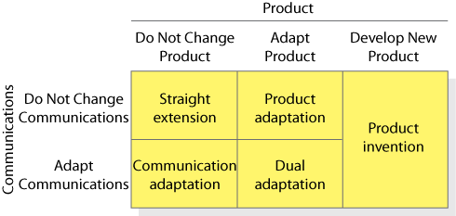
Figure 21.3
International Product and Communication Strategies

Slide 13
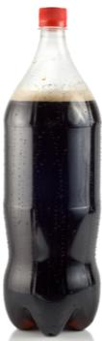





Classic Blunders in Global Marketing
Hallmark
(France)
Coca-Cola
(Spain)
Pop-Tarts
(Britain)
Phillips
(Japan)
Crest
(Mexico)
Tang
(France)
Notes:
• Hallmark cards failed in France, where consumers dislike syrupy sentiment and prefer writing their own cards.
• Philips became profitable in Japan only after reducing the size of its coffeemakers to fit smaller kitchens and its shavers to fit smaller hands.
• Coca-Cola withdrew its big two-liter bottle in Spain after discovering that few Spaniards owned refrigerators that could accommodate it.
• General Foods’ Tang initially failed in France when positioned as a substitute for orange juice at breakfast. The French drink little orange juice and almost never at breakfast.
• Kellogg’s Pop-Tarts failed in Britain because fewer homes have toasters than in the United States, and the product was too sweet for British tastes.
• The U.S. campaign for Procter & Gamble’s Crest toothpaste initially failed in Mexico. Mexicans did not care as much about the decay-prevention benefit, nor did scientifically oriented advertising appeal.
• S.C. Johnson’s wax floor polish initially failed in Japan. It made floors too slippery for a culture where people do not wear shoes at home.

Slide 14
Classic Blunders in Global Marketing
• Hallmark cards failed in France, where consumers dislike syrupy sentiment and prefer writing their own cards.
• Philips became profitable in Japan only after reducing the size of its coffeemakers to fit smaller kitchens and its shavers to fit smaller hands.
• Coca-Cola withdrew its big two-liter bottle in Spain after discovering that few Spaniards owned refrigerators that could accommodate it.
• General Foods’ Tang initially failed in France when positioned as a substitute for orange juice at breakfast. The French drink little orange juice and almost never at breakfast.

Slide 15
Classic Blunders in Global Marketing
• Kellogg’s Pop-Tarts failed in Britain because fewer homes have toasters than in the United States, and the product was too sweet for British tastes.
• The U.S. campaign for Procter & Gamble’s Crest toothpaste initially failed in Mexico. Mexicans did not care as much about the decay-prevention benefit, nor did scientifically oriented advertising appeal.
• S.C. Johnson’s wax floor polish initially failed in Japan. It made floors too slippery for a culture where people do not wear shoes at home.

Slide 16



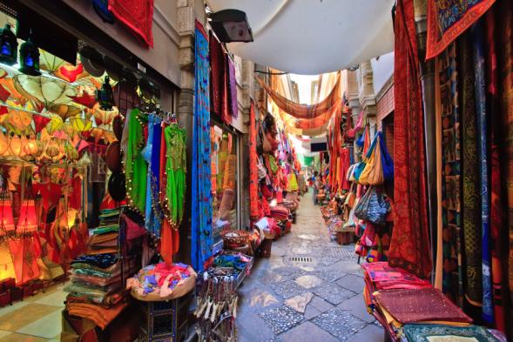
Global Distribution Strategies
Channel Entry
Channel Differences
Notes:
Global Distribution Strategies
Too many U.S. manufacturers think their job is done once the product leaves the factory. They should instead note how the product moves within the foreign country and take a whole-channel view of distributing products to final users.
Channel Entry
When multinationals first enter a country, they prefer to work with local distributors with good local knowledge, but friction often arises later. The multinational complains that the local distributor doesn’t invest in business growth, doesn’t follow company policy, and doesn’t share enough information. The local distributor complains of insufficient corporate support, impossible goals, and confusing policies. The multinational must choose the right distributors, invest in them, and
set up performance goals to which they can agree.
CHANNEL DIFFERENCES
Another difference is the size and character of retail units abroad. Large-scale retail chains dominate the U.S. scene, but much foreign retailing is in the hands of small, independent retailers. Millions of Indian retailers operate tiny shops or sell in open markets. Markups are high, but the real price comes down through haggling. Incomes are low, most homes lack storage and refrigeration, and people shop daily for whatever they can carry home on foot or bicycle. In India, people often buy one cigarette at a time. Breaking bulk remains an important function of intermediaries and helps perpetuate long channels of distribution, a major obstacle to the expansion of large-scale retailing in developing countries.

Slide 17
Global Distribution Strategies
Too many U.S. manufacturers think their job is done once the product leaves the factory. They should instead note how the product moves within the foreign country and take a whole-channel view of distributing products to final users.
Channel Entry
When multinationals first enter a country, they prefer to work with local distributors with good local knowledge, but friction often arises later. The multinational complains that the local distributor doesn’t invest in business growth, doesn’t follow company policy, and doesn’t share enough information. The local distributor complains of insufficient corporate support, impossible goals, and confusing policies. The multinational must choose the right distributors, invest in them, and
set up performance goals to which they can agree.

Slide 18
Global Distribution Strategies
CHANNEL DIFFERENCES
Another difference is the size and character of retail units abroad. Large-scale retail chains dominate the U.S. scene, but much foreign retailing is in the hands of small, independent retailers. Millions of Indian retailers operate tiny shops or sell in open markets. Markups are high, but the real price comes down through haggling. Incomes are low, most homes lack storage and refrigeration, and people shop daily for whatever they can carry home on foot or bicycle. In India, people often buy one cigarette at a time. Breaking bulk remains an important function of intermediaries and helps perpetuate long channels of distribution, a major obstacle to the expansion of large-scale retailing in developing countries.

Slide 19
Figure 21.4
Seller
Whole-Channel Concept for International Marketing
Seller’s marketing headquarters
Channels between nations
Channels within foreign nations
Final buyer

Slide 20

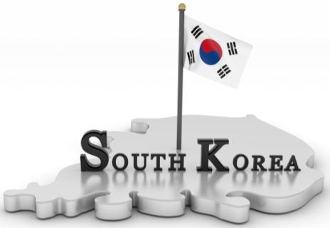

Country-of-Origin Effects
Building Country Images
Notes:
Governments market their countries just like other brands. Perceptions of a country can influence how consumers in other parts of the world react to the brands produced by the countries manufacturers. Attitudes can change over time, due to the success of a brand. Japanese products had low quality perceptions until Sony (Trinitron TVs), Honda, and Toyota changed the perceptions of American consumers by producing high quality, innovative products.

Slide 21



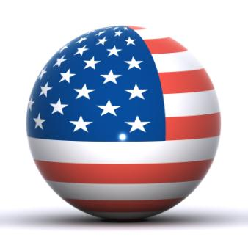
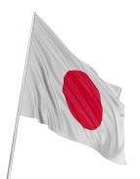

Country-of-Origin Effects
Consumer Perceptions
Ford Mustang
Toyota Sienna
Ethnocentric
Notes:
Consumer Perceptions of Country of Origin
Global marketers know that buyers hold distinct attitudes and beliefs about brands or products from different countries.83 These perceptions can be an attribute in decision making or influence other attributes in the process (“if it’s French, it must be stylish”). The mere fact that a brand is perceived as successful on a global stage— whether it sends a quality signal, taps into cultural myths, or reinforces a sense of social responsibility—may lend credibility and respect. Several studies have found the following:
• People are often ethnocentric and favorably predisposed to their own country’s products, unless they come from a less developed country.
• The more favorable a country’s image, the more prominently the “Made in...” label should be displayed.
• The impact of country of origin varies with the type of product. Consumers want to know where a car was made, but not the lubricating oil.
• Certain countries enjoy a reputation for certain goods: Japan for automobiles and consumer electronics; the United States for high-tech innovations, soft drinks, toys, cigarettes, and jeans; France for wine, perfume, and luxury goods.
• Sometimes country-of-origin perception can encompass an entire country’s products. In one study, Chinese consumers in Hong Kong perceived U.S. products as prestigious, Japanese products as innovative, and Chinese products as cheap.

Slide 22
Country-of-Origin Effects
Consumer Perceptions of Country of Origin
Global marketers know that buyers hold distinct attitudes and beliefs about brands or products from different countries. These perceptions can be an attribute in decision making or influence other attributes in the process (“if it’s French, it must be stylish”). The mere fact that a brand is perceived as successful on a global stage— whether it sends a quality signal, taps into cultural myths, or reinforces a sense of social responsibility—may lend credibility and respect. Several studies have found the following:
• People are often ethnocentric and favorably predisposed to their own country’s products, unless they come from a less developed country.

Slide 23
Country-of-Origin Effects
• The more favorable a country’s image, the more prominently the “Made in...” label should be displayed.
• The impact of country of origin varies with the type of product. Consumers want to know where a car was made, but not the lubricating oil.
• Certain countries enjoy a reputation for certain goods: Japan for automobiles and consumer electronics; the United States for high-tech innovations, soft drinks, toys, cigarettes, and jeans; France for wine, perfume, and luxury goods.
• Sometimes country-of-origin perception can encompass an entire country’s products. In one study, Chinese consumers in Hong Kong perceived U.S. products as prestigious, Japanese products as innovative, and Chinese products as cheap.

Slide 24


Which is More American?
Ford Mustang
Toyota Sienna
Notes:
With outsourcing and foreign manufacturing, it’s hard to know what the country of origin really is anyway. Only 65 percent of the content of a Ford Mustang comes from the United States or Canada, whereas the Toyota Sienna is assembled in Indiana with 90 percent local components. Foreign automakers are pouring money into North America, investing in plants, suppliers, and dealerships as well as design, testing, and research centers. But what makes a product more “American”—having a higher percentage of North American components or creating more jobs in North America?

Slide 25



Marketing Organization
Export Department
International Division
Global Organization
Notes:
Export Department
A firm normally gets into international marketing by simply shipping out its goods. If its international sales expand, it organizes an export department consisting of a sales manager and a few assistants. As sales increase, the export department expands to include various marketing services so the company can go after business more aggressively. If the firm moves into joint ventures or direct investment, the export department will no longer be adequate to manage international operations.
International Division
Sooner or later, companies that engage in several international markets and ventures create an international division to handle all this activity. The unit is headed by a division president who sets goals and budgets and is responsible for the company’s international growth.
Global Organization
Several firms have become truly global organizations. Their top corporate management and staff plan worldwide manufacturing facilities, marketing policies, financial flows, and logistical systems. The global operating units report directly to the chief executive or executive committee, not to the head of an international division. The firm trains its executives in worldwide operations, recruits management from many countries, purchases components and supplies where it can obtain them at least cost, and makes investments where anticipated returns are greatest.

Slide 26
Marketing Organization
Export Department
A firm normally gets into international marketing by simply shipping out its goods. If its international sales expand, it organizes an export department consisting of a sales manager and a few assistants. As sales increase, the export department expands to include various marketing services so the company can go after business more aggressively. If the firm moves into joint ventures or direct investment, the export department will no longer be adequate to manage international operations.
International Division
Sooner or later, companies that engage in several international markets and ventures create an international division to handle all this activity. The unit is headed by a division president who sets goals and budgets and is responsible for the company’s international growth.

Slide 27
Marketing Organization
Global Organization
Several firms have become truly global organizations. Their top corporate management and staff plan worldwide manufacturing facilities, marketing policies, financial flows, and logistical systems. The global operating units report directly to the chief executive or executive committee, not to the head of an international division. The firm trains its executives in worldwide operations, recruits management from many countries, purchases components and supplies where it can obtain them at least cost, and makes investments where anticipated returns are greatest.

Slide 28
Thank You

