Slide 1
Introducing
New Market Offerings

Slide 2
Johnson & Johnson Emphasizes
New Product Development
New Product Options
A company can add new product through
    Acquisition: Company can buy other company, patents from other company or a license or franchise from other company.
    Development: Constant stream of new models

Slide 3
Categories of New Products
New-to-the-world
New product lines
Additions
Improvements
Repositionings
Cost reductions

Slide 4
Categories of New Products
New-to-the-world: A company creates an entirely new market to minor improvements or revisions of existing products.
New Product Lines: Brand Extensions like different variants of tooth paste brand, mouth wash, tooth brushes and other oral hygiene products from Colgate-Palmolive.
Additions: Many successful new products have been extensions of well-established brands.

Slide 5
Johnson & Johnson Emphasizes
New Product Development
Categories of New Products
Improvements: Continuous innovations in products. Once a running shoe manufacturer, Nike now competes with makers of all type of athletic shoes.
Repositioning: Improving existing products with the support of a strong branding strategy.
Cost-Reduction: Fewer than 10 percent of all new products are truly innovative and new to the world. These products carry greater cost and risk.

Slide 6
The World’s
Most Innovative Companies
Apple
Google
Toyota
General Electric
Microsoft
Procter & Gamble
3M
Walt Disney
IBM
Sony
Wal-Mart
Honda
Starbucks
Target
BMW
Samsung

Slide 7
Seven Notions of Innovation
See the future through the eyes of your customer
Intellectual property and brand power are key assets
Use digital technology to create tools for customers
Build a championship team
Innovation is a state of mind
Speed is critical, so push your organization
Partner up if you’re not the best

Slide 8
Factors That Limit
New Product Development
Shortage of ideas
Fragmented markets
Social and governmental constraints
Cost of development
Capital shortages
Faster required development time
Shorter product life cycles

Slide 9
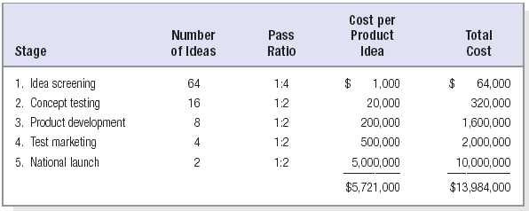
Finding One Successful New Product

Slide 10
What is a Venture Team?
A venture team is a cross-functional group charged with developing a specific product or business; intrapreneurs are relieved of other duties and provided a budget and time frame.

Slide 11

Criteria for Staffing Venture Teams
Desired team leadership style
Desired level of leader expertise
Team member skills and expertise
Level of interest in concept
Potential for personal reward
Diversity of team members

Slide 12
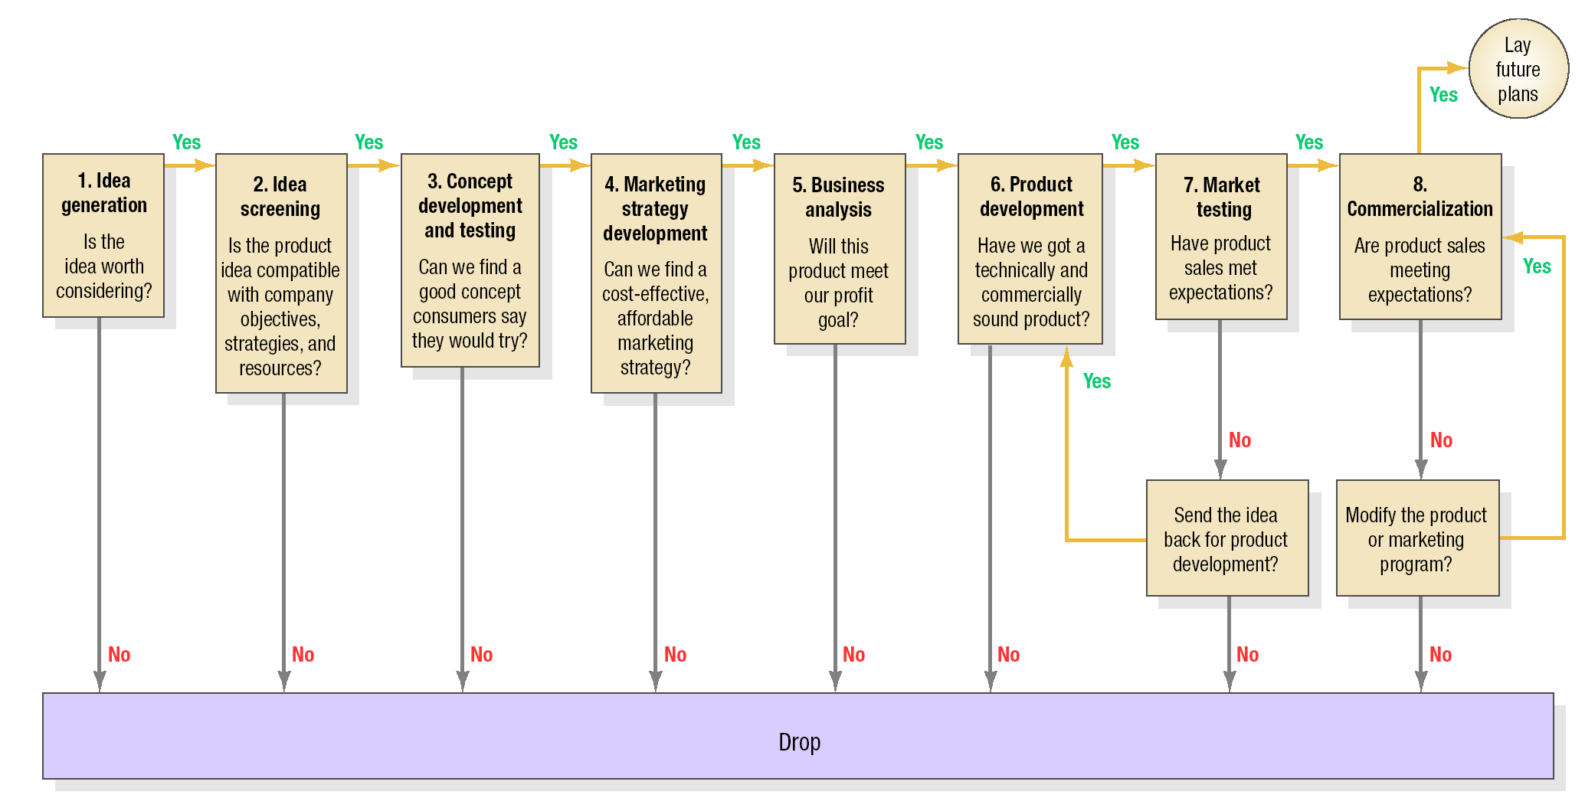
The New Product Development Decision Process

Slide 13
Ways to Find Great New Ideas
Run informal sessions with customers
Allow time off for technical people to put on pet projects
Make customer brainstorming a part of plant tours
Survey your customers
Undertake “fly on the wall” research to customers

Slide 14
More Ways to Find Great Ideas
Use iterative rounds with customers
Set up a keyword search to scan trade publications
Treat trade shows as intelligence missions
Have employees visit supplier labs
Set up an idea vault

Slide 15
Drawing Ideas from Customers
Observe customers using product
Ask customers about problems with products
Ask customers about their dream products
Use a customer advisory board or a brand community of enthusiasts to discuss product

Slide 16
Thank You

