Slide 1
Managing
Mass Communications

Slide 2
What is Sales Promotion?
Sales promotion consists of a collection of incentive tools, mostly short term, designed to stimulate quicker or greater purchase of particular products or services by consumers or the trade.

Slide 3
Sales Promotion
Advertising offers reason to buy while promotion offers incentive to buy.
  Sales Promotion Objectives
    Attract new customers
    Reward loyal customers
    Attempt to persuade existing customers to increase purchase frequency
  Advertising versus Promotion
    Promotion expenditures have increased because:
      Growing confidence in sales promotion as an effective sales tool
      Number of brands increased
      Competitors used promotions frequently
      Many brands were seen as similar
      Consumers became more price orientated
      Trade demanded more deals
      Advertising efficiency declined

Slide 4
Sales Promotion
    Risks include – devaluation of product in consumers’ minds, may not build permanent total-category volume as loyal customers may buy anyway but transaction buyers, or switchers, are attracted to promotions
    Small share competitors use as a way to leverage against large ad budgets of larger competitors

Slide 5

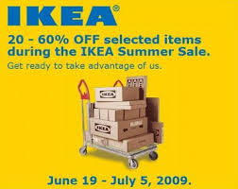
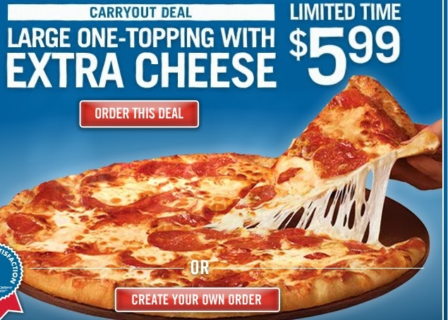
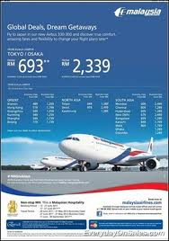

Slide 6
Sales Promotion Tactics
Consumer-directed
Samples
Coupons
Cash refund offers
Price offs
Premiums
Prizes
Patronage rewards
Free trials
Tie-in promotions
Trade-directed
Price offs
Allowances
Free goods
Sales contests
Trade shows
Specialty advertising

Slide 7
Using Sales Promotions
    Establishing Objectives - larger sized units, trial, attract switchers, etc.
    Selecting consumer promotion tools - consumer-promotion, trade-promotion, and/or business and sales force promotion tools
    Selecting Consumer Promotion Tools - Selecting Trade Promotion Tools to persuade intermediary to carry product or units, induce retailers to promote the brand and stimulate their sales force to push the brand.
    Selecting Business and Sales Force Promotion Tools

Slide 8
Using Sales Promotions
    Developing the Program - make decisions on the size of the incentive, conditions for participation, duration of the promotion, distribution vehicle, timing, and the total sales-promotion budget
    Implementing and Evaluating the Program
      Pre-tests can determine whether the tools are appropriate, the incentive size is optimal, and the presentation method efficient.
      Implementation must cover ‘lead time’ and ‘sell-in time’
      Capturing and analyzing consumer transaction data and survey data combined with experimentation can help the evaluation effort.
      Overall, sales promotions work best when attract competitors’ customers to try a superior product and get a switch
      Consumer surveys, experiments, and scanner data indicate results

Slide 9
Why Sponsor Events?
To identify with a particular target market or life style
To increase brand awareness
To create or reinforce consumer perceptions of key brand image associations
To enhance corporate image
To create experiences and evoke feelings
To express commitment to community
To entertain key clients or reward employees
To permit merchandising or promotional opportunities

Slide 10
Using Sponsored Events
  Major Sponsorship Decisions
    Choosing event opportunities
    Designing sponsorship programs (Event creation is a particularly important skill in publicizing fund-raising drives for non-profit organizations.)
    Measuring sponsorship opportunities
      Supply side – focuses on potential exposure to the brand by assessing the extent of media coverage
      Demand side – focuses on reported exposure from consumers as well as resulting attitudes and intentions toward the sponsor
  Creating Experiences - Experiential marketing:
    Communicate features and benefits
    Connects a product or service with a unique and interesting experience

Slide 11
Ideal Events
Audience closely matches target audience
Event generates media attention
Event is unique with few sponsors
Event lends itself to ancillary activities
Event enhances brand image of sponsor

Slide 12
Customer Experience Management: Experience Providers
Communications
Identity
Product presence
Co-branding
Environments
Internet
Electronic media
People

Slide 13
Steps in the CEM Framework
Analyze the customer’s experiential world
Build the experiential platform
Design the brand experience
Structure the customer interface
Engage in continuous innovation

Slide 14
Tasks Aided by Public Relations
Launching new products
Repositioning a mature product
Building interest in a product category
Influencing specific target groups
Defending products that have encountered public problems
Building the corporate image in a way that reflects favorable on products

Slide 15
Public Relations Functions
Press relations
Product publicity
Corporate communications
Lobbying
Counseling

Slide 16
Major Tools in Marketing PR
Publications
Events
Sponsorships
News
Speeches
Public Service Activities
Identity Media

Slide 17
Decisions in Marketing PR
Establish objectives
Choose message
Choose vehicles
Implement
Evaluate results

Slide 18
Thank you

