Slide 1

Defining Marketing for the 21st Century

Slide 2
The New Marketing Realities
Globalization
Communicate w/Customer
Information Technology
Collect Information
Major Societal Forces
New Company Capabilities
Consumer Information
Differentiate Goods
Increased Competition
Notes:
Major societal forces, such as information technologies, globalization, increased competition, and a more informed consumer have altered the marketplace has changed significantly. While these have created challenges, organizations have responded with new capabilities

Slide 3
Major Societal Forces
Information Technology: Accurate level of production, more targeted communications, frequent interaction with stakeholders.
Globalization: Easy for companies to trade in any country of the world. Consumer has more choices.
Deregulation: Countries have deregulated industries to create greater competition.
Heightened Competition: intense competition among domestic and foreign brand.

Slide 4
Cont…
Retailing Transformation: Retailing in South Asia is undergoing a major transformations. New supermarket chains and department stores started their operations in market.
Consumer Buying Power: Consumer started using online means to overcome the issue of limited local offerings.
Consumer Information: Consumers has access to lot of information regarding product development in different areas.
Consumer Participation: Consumer has more freedom and companies welcome their suggestions for improvement in their products

Slide 5
New Company Capabilities
Marketers can use the Internet as a powerful information and sales channel
Marketers can collect fuller and richer information about markets, customers, prospects and competitors.
Marketers can tap into social media to amplify their brand message.
Marketers can send ads, coupons, samples and information to customers.
Mass customization is now becoming increasingly feasible and popular.
Companies have tremendously improved their internal communications.

Slide 6

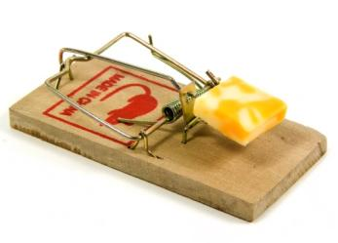
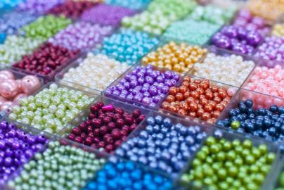

Marketing Concepts
Quality
Innovation
Create, deliver, and communicate value
Production
Product
Selling
Marketing
Holistic
Mass production
Mass distribution
Unsought goods
Overcapacity
Notes:
The five distinct marketing concepts are: Production, Product, Selling, Marketing, and Holistic. These philosophies have evolved over time and began with the production concept. The evolution of a new marketing concept does not mean that all companies are changing. Many companies continue to operate under the production concept.
Under a production philosophy the company will seek to mass produce products and to distribute them on a wide scale. The belief is that consumers prefer products that are widely available and inexpensive.
The product concept proposes that consumers prefer products that have higher quality, performance, or are more innovative. Often, managers focus too much on the product (a better mousetrap) but this does not always equal success.
The selling concept argues that members of a market will not purchase enough product on their own so companies use the “hard-sell” to increase demand. Typically used with unsought goods such as insurance or cemetery plots, or when companies face overcapacity.
The marketing concept first emerged in the 1950’s and focuses more on the customer with a “sense-and-respond” attitude. Companies that have embraced the marketing concept have been shown to achieve superior performance than competitors.
The holistic concept takes a philosophy that everything matters in marketing. Figure 1.3 (next slide) outlines the Holistic Marketing Concept.

Slide 7
Company Orientation toward the Marketplace
The production concept, one of the oldest in business, holds that consumers prefer products that are widely available and inexpensive. Managers of production-oriented businesses concentrate on achieving high production efficiency, low costs, and mass distribution.
Product concept proposes that consumers favor those products that offer the most quality, performance, or innovative features. Managers in these organizations focus on making superior products and improving them over time, assuming that buyers can appraise quality and performance.

Slide 8
Cont…
The selling concept recommends that consumers and businesses, if left alone, will ordinarily not buy enough of the organization’s products. The organization must, therefore, undertake an aggressive selling and promotion effort.
The marketing concept holds that the key to achieving organizational goals consists of the company being more effective than its competitors in creating, delivering, and communicating customer value to its chosen target markets. The marketing concept rests on four pillars: target market, customer needs, integrated marketing, and profitability

Slide 9
Cont…
The Holistic Marketing Concept is based on the development, design and implementation of marketing programs, processes and activities that recognize their breadth interdependencies.
Holistic marketing acknowledges that everything matters in marketing

Slide 10
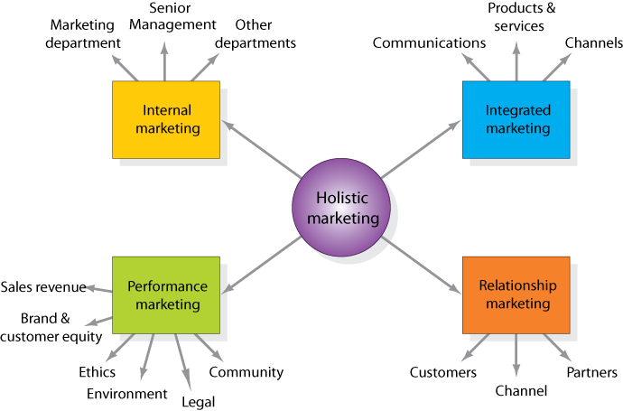
Holistic Marketing Dimensions

Slide 11
Holistic Marketing Dimensions
When all of the company’s departments work together to serve the customers’ interests, the result is integrated marketing. Integrated marketing takes place on two levels. First, the various marketing functions—sales force, advertising, customer service,
product management, marketing research—must work together. All of these functions must be coordinated from the customer’s point of view.

Slide 12
Cont…
Relationship marketing: From focusing on transactions to building long-term, profitable customer relationships. Companies focus on their most profitable customers, products, and channels. The ultimate outcome of relationship marketing is a unique company asset called a marketing network, consisting of the company and its supporting stakeholders – customers, employees, suppliers, distributors, retailers and others – with whom it has built mutually profitable business relationships.

Slide 13
Cont….
Internal Marketing an element of holistic marketing deals with hiring, training and motivating able employees who want to serve customers well. Marketing is no longer the responsibility of a single department but it is a company wide activity.
Performance Marketing requires understanding the financial and nonfinancial returns to business and society from marketing activities and program.

Slide 14
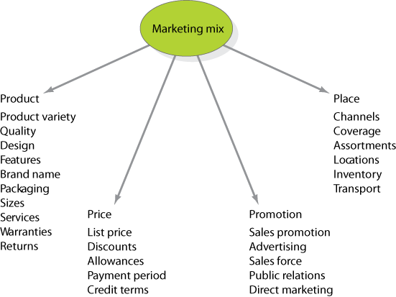
The Four P’s of the Marketing Mix

Slide 15
Modern Marketing Management Four Ps
People are critical to marketing success. The people who represent organizations must be fully trained and has passion to satisfy customers.
Processes reflect all the creativity, discipline and structure. Implementing right processes lead towards satisfying internal and external customers.
Programs reflect all the firm’s consumer directed activities.
Performance requires understanding the financial and nonfinancial returns to business and society from marketing activities and program

Slide 16
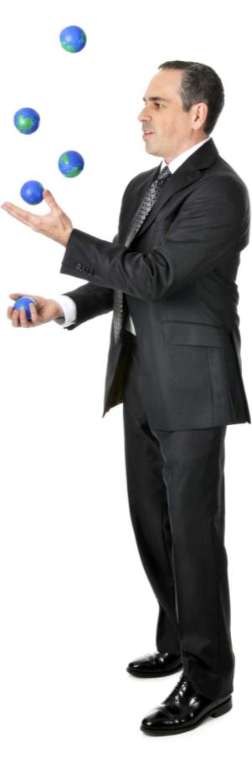
Marketing Management Tasks
Developing market strategies and plans
Capturing marketing insights
Connecting with customers
Building strong brands
Shaping market offerings
Delivering value
Communicating value
Creating long-term growth

Slide 17
Thank You

