Slide 1
Managing
Mass Communications

Slide 2
Mass Communication
The imparting or exchanging of information on a large scale to a wide range of people.

Slide 3
What is Advertising?
Advertising is any paid form of nonpersonal presentation and promotion of ideas, goods, or services by an identified sponsor.

Slide 4
Google Advertisement

Slide 5
The Five M’s of Advertising
Mission-what are the advertising objectives?
Money-How much and where is money spent?,
Message- What should be sent?
Media- what should be used?
Measurement – How to evaluate results?

Slide 6
Advertising Objectives
    Informative advertising aims to create brand awareness and knowledge of new products or new features of existing products.
    Persuasive advertising attempts to create liking, preference, conviction and purchase of a product or service. Can also be comparative advertising. .
    Reminder advertising tries to stimulate repeat purchase of products or services.
    Reinforcement advertising seeks to minimize or eliminate buyer’s remorse.

Slide 7
Factors to Consider in Setting an Advertising Budget
    Product life-cycle stages – larger budget for new product awareness building and trials, lower budgets for established products.
    Market share and consumer base- high market share products usually require less advertising as a percentage of sales versus low market share products requiring larger advertising expenditures
    Competition & clutter- the more intense the competition the more advertising required in order to be heard
    Advertising frequency – the repetitions needed the higher the advertising expenditure
    Product substitutability – commodity products require higher advertising expenditures to support differentiation efforts.

Slide 8
Developing the
Advertising Campaign
    Message generation and evaluation - focus on one core selling proposition and aim for desirability, exclusiveness, and believability
    Creative development and execution - impact depends not only on what is said but how it is said (positioning). Creative people must also find a style, tone, and format for executing the message
    Legal and Social Issues - make sure the creative advertising does not overstep social and legal norms

Slide 9
Creative Brief
Positioning statement
Key message
Target market
Objectives
Key brand benefits
Brand promise
Evidence of promise
Media
Background
Creative considerations

Slide 10
Television
Advantages
Reaches broad spectrum of consumers
Low cost per exposure
Ability to demonstrate product use
Ability to portray image and brand personality
Disadvantages
Brief
Clutter
High cost of production
High cost of placement
Lack of attention by viewers

Slide 11
Honda Advertisement

Slide 12
Print Ads
Advantages
Detailed product information
Ability to communicate user imagery
Flexibility
Ability to segment
Disadvantages
Passive medium
Clutter
Unable to demonstrate product use

Slide 13
Print Ad Evaluation Criteria
Is the message clear at a glance?
Is the benefit in the headline?
Does the illustration support the headline?
Does the first line of the copy support or explain the headline and illustration?
Is the ad easy to read and follow?
Is the product easily identified?
Is the brand or sponsor clearly identified?

Slide 14

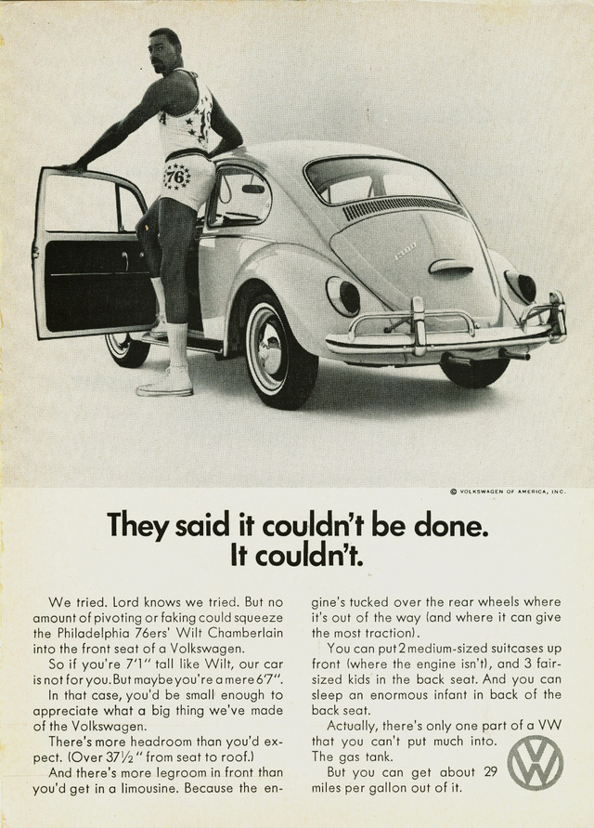
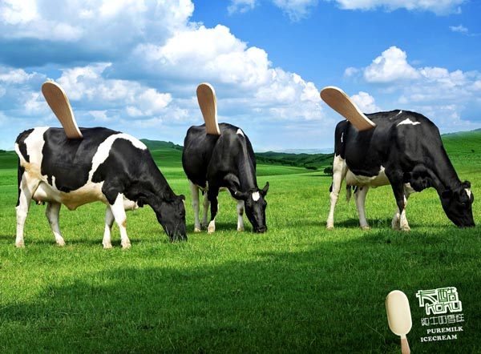

Slide 15


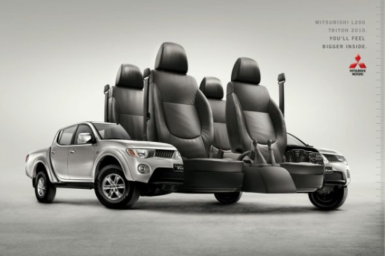

Slide 16
Media Selection
Reach (# of unique exposures) - most important when launching new products, flanker brands, brand extensions or when going after undefined target market
Frequency (# of exposures in a specific time-frame) - most important when there are strong competitors, a complex product solution, high consumer resistance or a frequent-purchase cycle.
Impact – qualitative value of an exposure through a given medium

Slide 17
Choosing Among Major Media Types
Target audience and media habits
Product characteristics
Message characteristics
Cost

Slide 18
Major Media Types
Newspapers
Television
Direct mail
Radio
Magazines
Outdoor
Yellow Pages
Newsletters
Brochures
Telephone
Internet

Slide 19
Place Advertising
Billboards
Public spaces
Product placement
Point-of-purchase

Slide 20
Measures of Audience Size
Circulation
Audience
Effective audience
Effective ad-exposed audience

Slide 21
Factors Affecting Timing Patterns
Buyer turnover
Purchase frequency
Forgetting rate

Slide 22
Media Schedule Patterns
Macro scheduling - according to seasonal or business trends
Micro scheduling - allocating advertising expenditures within a short period to obtain the maximum impact
Media timing decisions -
a. Continuity - schedule promotions evenly in a given period
b. Concentration - spend all advertising dollars in one period
c. Flighting - advertise in a period; skip a period, etc. Useful when funding is limited, the purchase cycle is relatively infrequent, or with seasonal items.
d. Pulsing - continuous advertising at low-weight levels reinforced by periods of heavier activity to help the audience learn the message more thoroughly

Slide 23
Evaluating Advertising Effectiveness
Communication Effect Research
  Consumer feedback method
  Portfolio tests
  Laboratory tests
Sales-Effect Research

Slide 24
Thank You

