Slide 1
Designing and Managing
Integrated Marketing Channels

Slide 2
Channel Power
Coercive
Reward
Legitimate
Expert
Referent

Slide 3
Channel Integration and Systems
Producer, wholesaler and retailer act as a unified system. (one member emerges
as dominant in channel, can be called the channel captain).
Three types of VMS: Corporate, Administered, and Contractual.
    Corporate VMS – combines successive stages of production and distribution under one owner.
    Administered VMS – Coordinates successive stages of production and distribution through one member’s size and power, i.e. big brand secures strong reseller cooperation and support.

Slide 4
Channel Integration and Systems
    Contractual VMS – Independent firms at different levels of production, distribution and selling, integrate their programs on a contractual basis to obtain more economies or sales impact than they could achieve alone.
      Wholesaler-sponsored voluntary chains
      Retailer cooperatives
      Franchise organizations
          Manufacturer-sponsored retailer franchise (Ford dealers) or
          Manufacturer-sponsored wholesaler franchise (Coca-Cola and its bottlers)
          Service-firm-sponsored retailer franchise (McDonald’s and its franchises)
    The new competition in retailing - between systems, not individuals

Slide 5
Channel Integration and Systems
  Horizontal Marketing Systems
    Two or more unrelated firms put together resources or programs to exploit an emerging market opportunity
    Each firm lacks the capital, technology, marketing resources or other variables to take on the venture alone.
    Can be temporary or permanent

Slide 6
Channel Integration and Systems
  Integrated Multi-Channel Marketing Systems
    Single firm uses two or more marketing channels to reach one or more customer segments. Tactics and strategies of selling through one affect the strategies and tactics of selling through one or more other channels.
    Benefits include:
      Increased market coverage
      Lower channel cost
      More customized selling
    Must decide on appropriate marketing mix for each channel

Slide 7
Causes of Channel Conflict
Goal incompatibility
Unclear roles and rights
Differences in perception
Intermediaries’ dependence on manufacturer

Slide 8
E-Commerce and M-Commerce
E-Commerce and M-Commerce Marketing Practices
  Online retailers leverage the savings from not having to support a brick and mortar environment, to profitably sell low-margin products to niche markets
    Online retailers compete in three key aspects of a transaction:
      Customer interaction with the web site
      Delivery
      Ability to address problems when they occur

Slide 9
E-Commerce and M-Commerce
  E-Commerce and Pure-click companies
    Types of Pure-click companies
      Search engines (e.g., Google)
      Internet service providers (ISPs) (e.g., cable companies, telecommunication companies, individual employers, stand-alones such as Earthlink and NetZero)
      Commerce sites (e.g., Amazon, eBay, Expedia, buy.com)
      Transaction sites
      Content sites (e.g, news, blogs)
      Enabler sites

Slide 10
E-Commerce and M-Commerce
    B2B web sites – make markets more efficient by giving buyers easy access to a great deal of information from:
      Supplier Web sites
      Infomediaries -3rd parties that add value
      Market makers - 3rd parties that link buyers and sellers
      Customer communities - (e.g., blogs, organization-sponsored chat rooms)

Slide 11
E-Commerce and M-Commerce
  E-Commerce and Brick-and-Click Companies
    Original brick entity incorporating click
      Offer different brands
      Offer online partners higher commissions to cushion the negative impact on sales
      Take order on Web but have retailer deliver and collect payment
    Original click entity incorporating brick
      Provide consumer with channel option
      Facilitate building and growth of brand awareness

Slide 12
E-Commerce and M-Commerce
  M-Commerce Marketing (m for mobile)
    Phone or PDA allow for virtual commerce allowing companies to keep consumers connected to brands throughout their day
    By 2015 more people will be accessing the Internet from their phones than from their PCs
    Mobile marketing taking new forms:
      Target people who need to book travel while on the move
      Use text messaging to alert consumers to special promotions
    Mobile marketing, with its GPS capability, is raining privacy concerns

Slide 13
Practical Example

Slide 14
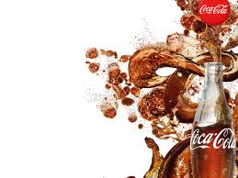
The Promotional Mix:Tools Of IMC
Advertising
Direct Marketing
Interactive/
Internet Marketing
Sales Promotion
Publicity/Public
Relations
Personal Selling

Slide 15
Advertising
Advertising is defined as any paid form of non personal communication about an organization, product, service, or idea by an identified sponsor.
Coca-Cola uses the concept of aggressive advertising to promote its products. Thus advertising is the most important marketing tool for the company as it has to cater mass consumer markets. They mainly does national advertising.
Company introduces different themes and concepts to sell their product and advertises mainly in electronic media and out of home advertising. These advertisements build brand image and create awareness.
Big names of Indian film industry mainly become the brand ambassadors of the Company.
Throughout the years, the slogans of the Coca-Cola have been memorable. For E.g.
Thanda Matlab Cola-Cola
Jo chaho ho jae Cola-Cola enjoy
Coca-Cola-Piyo sir utha ke
Brrrrrrr!!!

Slide 16
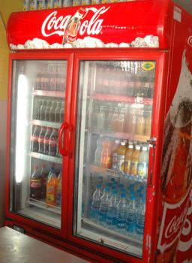
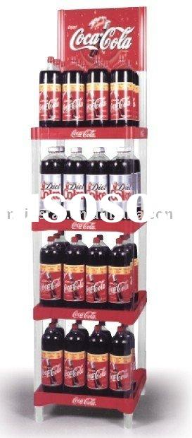
Mediums Of Advertising
The mediums of advertising used by Coca-Cola are:
Print media:
They print media for advertisement. Although very rare, they have a separate department for print media.
Point Of Sale Materials:
Point of sale material this includes: Posters and Stickers display in the stores and in different areas. It also includes:
Vizi cooler
Freezers
Display racks

Slide 17
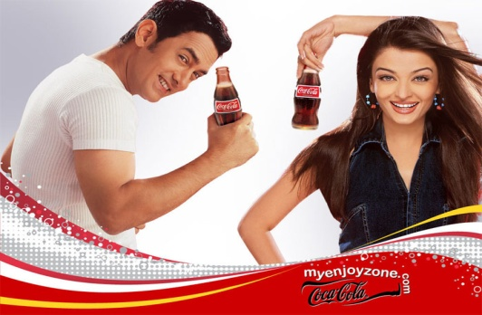
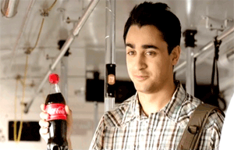
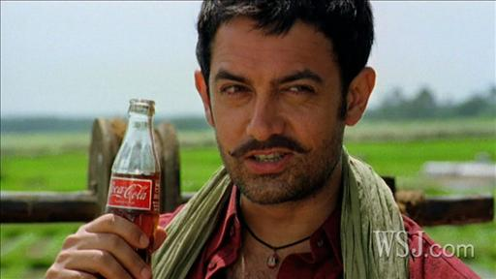
T.V Commercials
As everybody know that TV is a most common entertaining medium so TV commercials is one of the most attractive way of doing advertisement. So Coca Cola Company does regular TV commercials on different channels.
It focuses on both the urban as well as the rural India with its advertisements.
In the summer of 2011, Coca-Cola introduced the new Brrrrr!! Ad and featured Imran Khan as the brand ambassador.

Slide 18
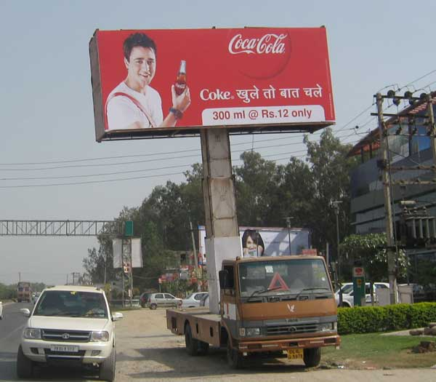
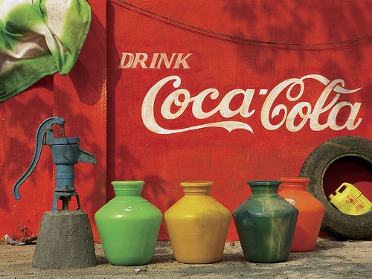
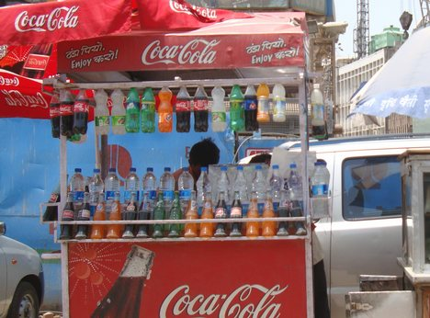
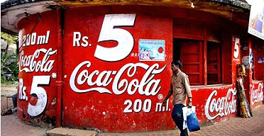
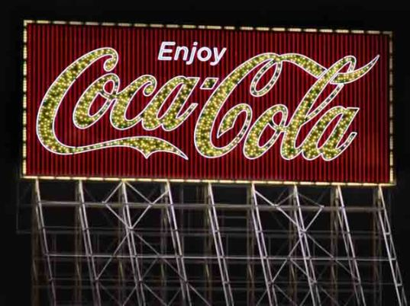
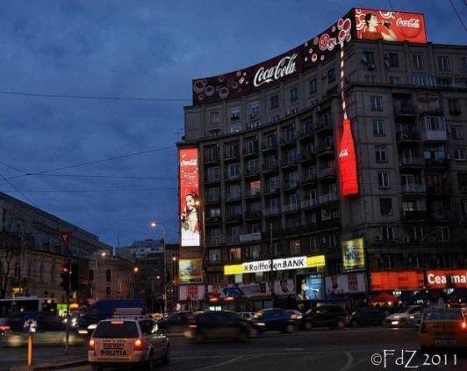
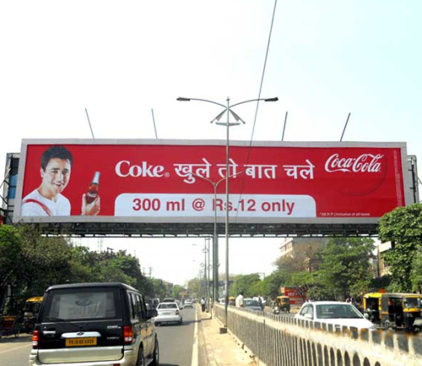
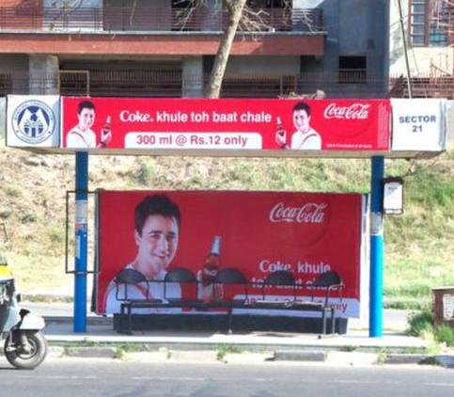
Outdoor Advertising
Coca cola is very much conscious about their billboards and hoardings. They have so many sites in different locations for their billboards.
Billboards are usually found at cross roads, buildings, shops.
Also in India the Coca-cola can be seen painted on walls, bus stands, dhabas etc focusing in rural areas if India.

Slide 19
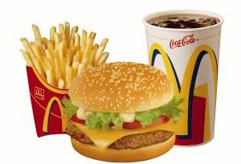

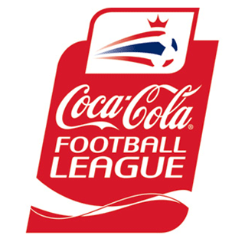
Direct Marketing
Coca-Cola uses direct marketing in many ways. First, the company partners with various restaurants, movie theaters, etc. to carry its product.
This way, when a customer orders a drink, the only brand they are offered is Coca-Cola, which forces them to buy a drink from that brand. By doing this, Coke forces out other competition, and keeps the restaurants, or other businesses, purchasing their product over and over again. Eg. Mc Donalds.
According to mobilemarketingmagazine.com, Coke uses mobile graphics and texts to appeal to markets on a more personal level.
Coca Cola also sponsors various sporting events in India and around the world in events like Cricket, Football, and Motor Racing etc.

Slide 20
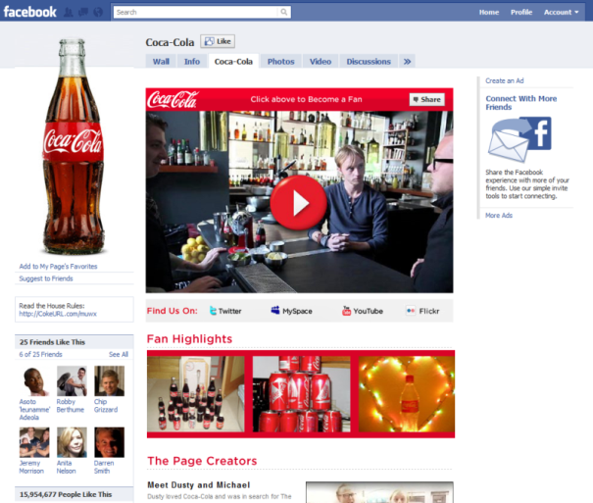
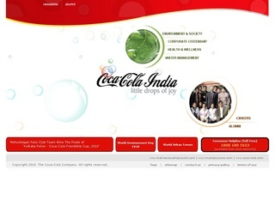
Interactive/Internet Marketing
Coca-Cola uses the internet to promote its products. The company has its own website, which is quite simple to navigate through. The website allows customers to become interactive through various games, contests, shopping, and through a special section of the website that enables consumers to find out how they can help their community.
Also in the modern era of communication and networking, the company uses various social networking sites like Facebook, YouTube, Twitter to connect with the consumers.
The internet marketing thus helps to reach to those consumers who cant afford to spend time on T.V and are always online.

Slide 21
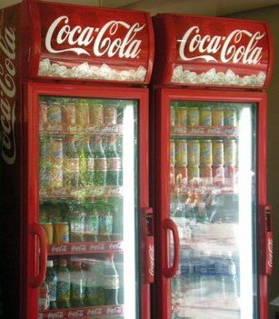
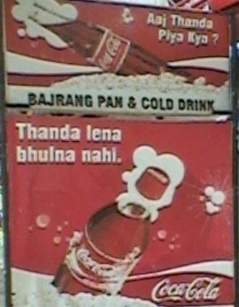
Sales Promotion
A sales promotion is an activity that is implemented to boost the sales of a product or service temporarily. Coca-Cola does sales promotion in two ways to quickly increase sales.
1. Consumer - Oriented sales promotion:
Getting Shelves
Eye Catching Position
Under The Crown Scheme
2. Trade - Oriented sales promotion:
Discounts to retailers and stores
Return back allowances
Merchandising assets
Free goods or free tours

Slide 22
Publicity/Public Relations
Publicity refers to non personal communications regarding an organization, product, service or idea not directly paid or run under identified sponsorship.
Today, the company can still use word of mouth advantage. For instance, when Coke produces a new product, and someone on their lunch break purchases that new product, and enjoys it, they will tell others in the office about how great the new product is. This will cause others to purchase the product, and in-turn increase sales.
Public relations is defined as “the management function which evaluates public attitudes, identifies the policies and procedures of an individual and organization with public interest, and executes a program of action to earn public understanding and acceptance”.
Coca-Cola can address law suits, rumors, stories, new products, and activities. There is also a section of the website devoted to investors. Here, current, or future, investors can access financial statements and up-to-the-minute stock information.

Slide 23
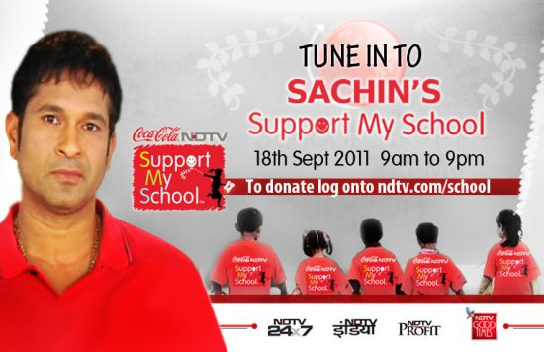
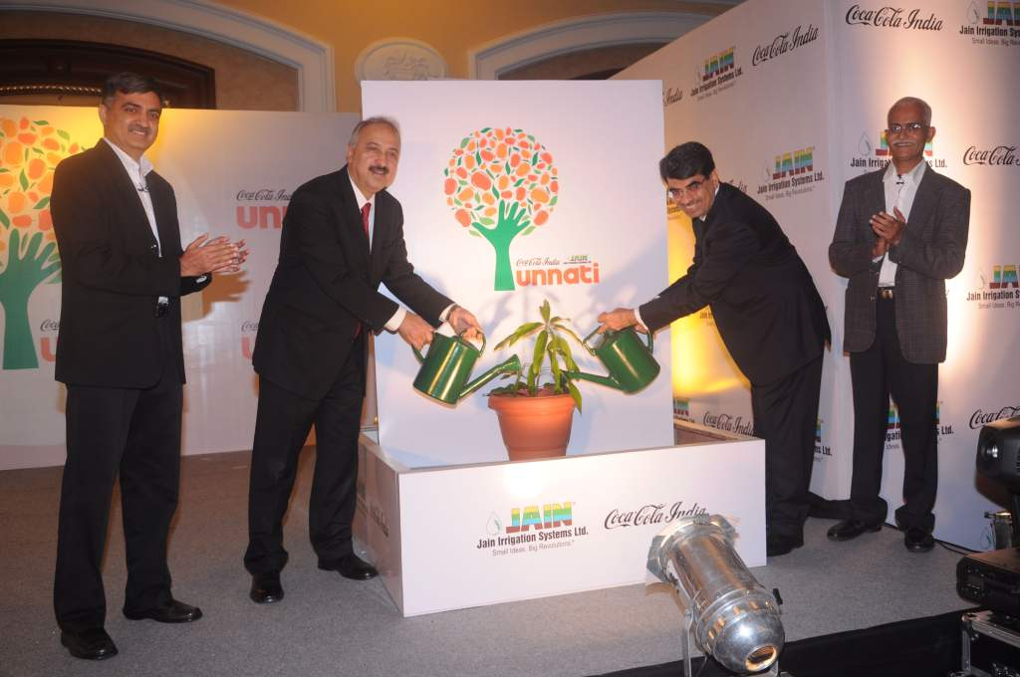
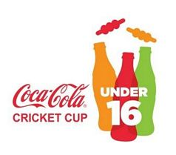
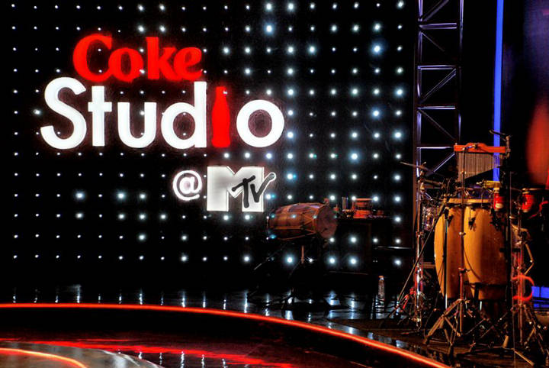
Publicity/Public Relations
The Coca-Cola India is also undertaking some projects as a part of their social cause and part of the corporate social responsibility.
The support my school campaign along with NDTV has Sachin Tendulkar as the brand ambassador.
The project Unnati focuses on more yield of mangoes to farmers.
Coca Cola also Sponsors events in cricket and music.

Slide 24
Personal Selling
Coca-Cola has many salespeople, who are individuals representing the company to communicate, sell, service, and build relationships with customers.
These salespeople promote their product to different customers within their regions, and once they sustain a customer, they sell their products to them and service them many times per week.
These individuals form close relationships with the customers in order to continue business with them.
Thus though minimum, the company also thus have many sales people for personal selling.

Slide 25
THANK YOU

