Slide 1
Designing and Managing
Integrated Marketing Channels

Slide 2
What is a Marketing Channel?
A marketing channel system is the particular set of interdependent organizations involved in the process of making a product or service available for use or consumption.

Slide 3
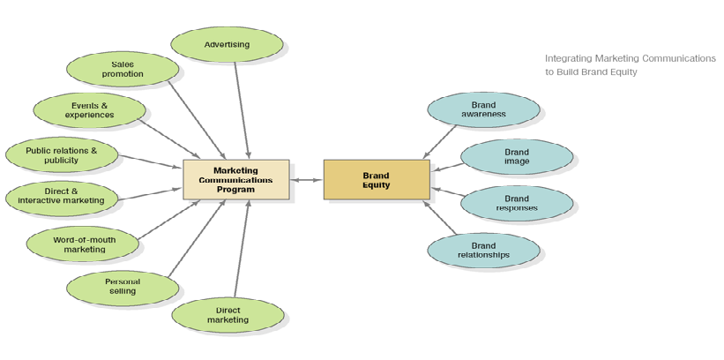
IMC Builds Brands

Slide 4
Communication Platforms
Advertising
Print and broadcast ads
Packaging inserts
Motion pictures
Brochures and booklets
Posters
Billboards
POP displays
Logos
Videotapes
Sales Promotion
Contests, games, sweepstakes
Premiums
Sampling
Trade shows, exhibits
Coupons
Rebates
Entertainment
Continuity programs

Slide 5
Communication Platforms
Events/ Experiences
Sports
Entertainment
Festivals
Arts
Causes
Factory tours
Company museums
Street activities
Public Relations
Press kits
Speeches
Seminars
Annual reports
Charitable donations
Publications
Community relations
Lobbying
Identity media
Company magazine

Slide 6
Communication Platforms
Personal Selling
Sales presentations
Sales meetings
Incentive programs
Samples
Fairs and trade shows
Direct Marketing
Catalogs
Mailings
Telemarketing
Electronic shopping
TV shopping
Fax mail
E-mail
Voice mail
Blogs
Websites

Slide 7
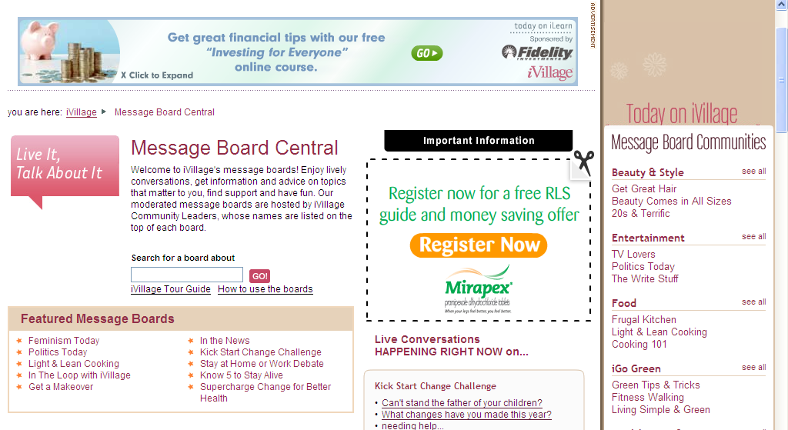
Word-of-Mouth Marketing
Person-to-person
Chat rooms
Blogs

Slide 8
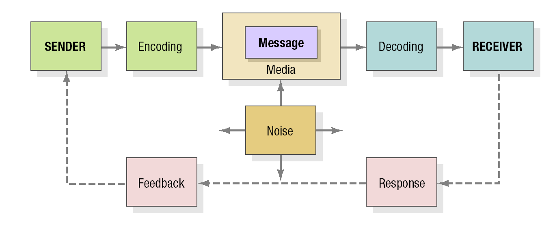
Elements in the Communications Process

Slide 9
Channels and
Marketing Decisions
A push strategy uses the manufacturer’s sales force, trade promotion money, and other means to induce intermediaries to carry, promote, and sell the product to end users
A pull strategy uses advertising, promotion, and other forms of communication to persuade consumers to demand the product from intermediaries

Slide 10
Buyer Expectations for
Channel Integration
Ability to order a product online and pick it up at a convenient retail location
Ability to return an online-ordered product to a nearby store
Right to receive discounts based on total online and offline purchases

Slide 11
Channel Member Functions
Gather information
Develop and disseminate persuasive communications
Reach agreements on price and terms
Acquire funds to finance inventories
Assume risks
Provide for storage
Provide for buyers’ payment of their bills
Oversee actual transfer of ownership

Slide 12
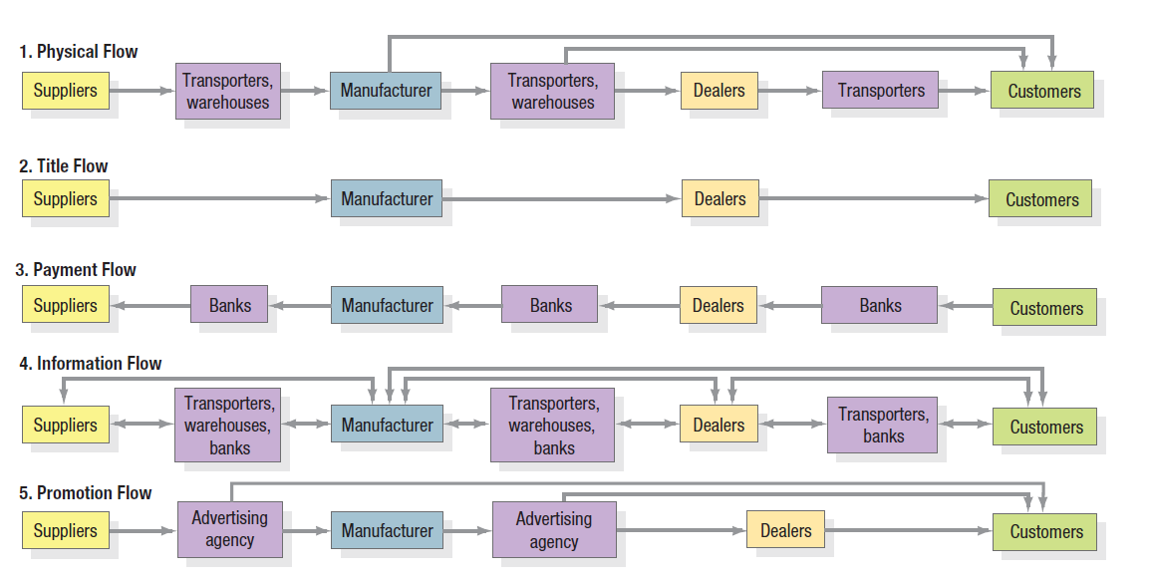
Marketing Flows in the Marketing Channel for Forklift Trucks

Slide 13
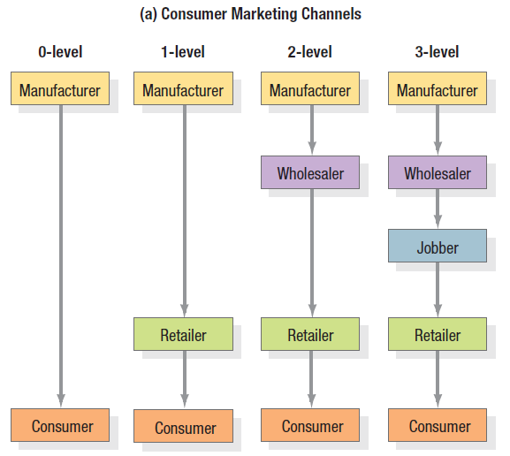
Consumer Markets

Slide 14
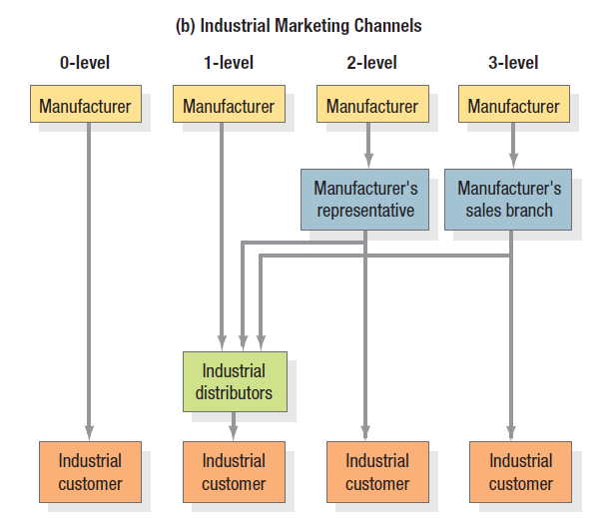
Industrial Markets

Slide 15
Designing a Marketing Channel System
1. Analyze customer needs
  Channels produce five service outputs:
    Lot size - number of units channel allows customer to purchase at one time
    Waiting and delivery time - average time customers wait for delivery of goods in respective channel
    Spatial convenience - ease of purchase
    Product variety - large variety increases chances of consumer filling need
    Service backup - the greater the number of ancillary services surrounding the purchase of a product, the more effort required of the channel

Slide 16
Designing a Marketing Channel System
  2. Establishing Objectives and Constraints based on:
    Targeted service output levels
    Markets chosen to serve
    Product characteristics as service levels will vary, for example perishable goods require expedient delivery, bulk products require minimal handling, non-standard products require informative selling
    Strengths and weaknesses of intermediaries
    Competition’s channels
    Environmental changes
    Legal regulations and restrictions

Slide 17
Designing a Marketing Channel System
3. Identify major channel alternatives
    Types of intermediaries – some examples:
      Merchants – wholesalers and retailers
      Agents – brokers, manufacturer representatives, sales agents for customers
      Facilitators – transportation companies, independent warehouses, banks, ad agencies.
    Number of intermediaries
      Exclusive distribution - one or a select few. Appropriate when producer wants to control resellers’ service level and outputs.

Slide 18
Designing a Marketing Channel System
Selective distribution - more than a few, less than all. Gains adequate market coverage with more control and less cost than intensive distribution
      Intensive distribution - as many outlets as possible. Appropriate for frequently purchased items ( usually convenience goods) that consumers will buy in a variety of locations..
      Terms and Responsibilities of Channel Members - trade relations mix
      Price policies - must be equitable and efficient
      Conditions of sale - terms and guarantees
      Territorial rights of distributors
      Mutual services and responsibilities

Slide 19
Designing a Marketing Channel System
4. Evaluate major channel alternatives
    Economic criteria - sales versus costs
    Control – especially important for channels that are not direct. (e.g. sales agents may concentrate on customers who buy the most and not necessarily those who buy the manufacturer’s goods)
    Adaptive criteria - degree of intermediary commitment

Slide 20
Identifying Channel Alternatives
Types of intermediaries
Number of intermediaries
Terms and responsibilities

Slide 21
Identifying Channel Alternatives
Types of intermediaries: Carefully work on intermediaries that can offer the manufacturer’s products easily.

Slide 22
Number of Intermediaries
Exclusive: Limiting the number of alternatives
Selective: Relies on only few intermediaries willing to carry a particular product.
Intensive: Places the goods in as many outlets as possible.

Slide 23
Terms and Responsibilities of Channel Members
Price policy: Calls for the producers to establish a price list and schedule of discounts and allowances that intermediaries see as equitable and sufficient.
Condition of sale: Payment terms and producer guarantees.
Distributors’ territorial rights: it deals with distributor’s territories.
Mutual services and responsibilities: Must be carefully spelled out.

Slide 24
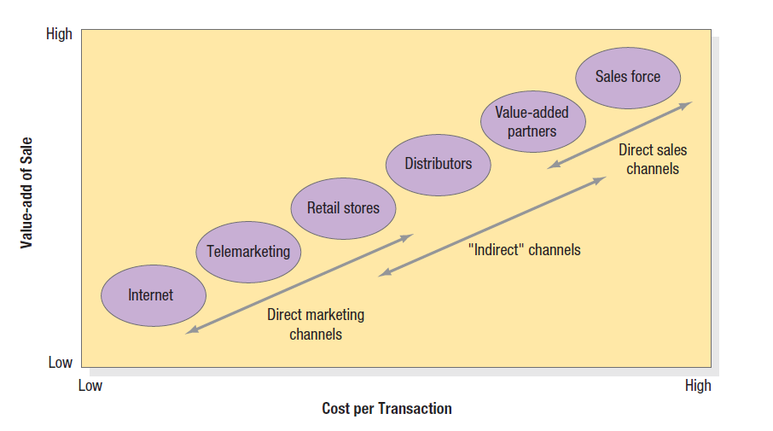
The Value-Adds versus
Costs of Different Channels

Slide 25
Thank You

